Slide 1
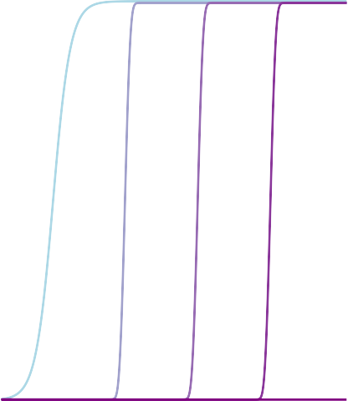
Delithiation High Voltage
Delithiation Low Voltage
1.0
1.0
Increasing Time
c(x)
0.5
c(x)
0.5
0.0
0.0
0.0
0.5
x
1.0
0.0
0.5
x
1.0
Time
t = t0
tf

