Slide 1
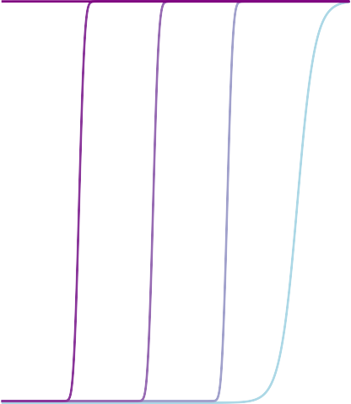
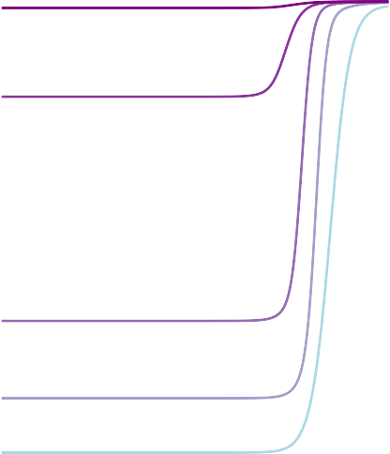
Lithiation High Voltage
Lithiation Low Voltage
1.0
1.0
Increasing Time
c(x)
0.5
c(x)
0.5
0.0
0.0
0.0
0.5
x
1.0
0.0
0.5
x
1.0
Time
t = t0
tf

