Slide 1
B-Line Security System
Vehicle Security http://b-linesecurity.com/
University of Utah
Electrical Engineering Students
Travis Jeppson
Clinton Mullins
Hwan-June Cho

Slide 2
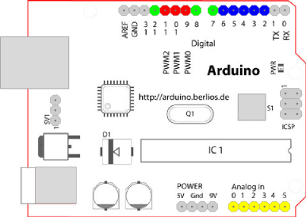
Car Controller Module
1. Arduino Pin
Pin #2 : Unlock Switch for door
(Input) (5V-->5V)
Pin #3 : Lock Switch for door
(Input) (5V-->5V)
Pin #4 : Ignition_check
(Input) (12V-->5V)
Pin #5 : Door_Statue
(Input) (12V-->5V)
Pin #6 : Alarm Trigger
(Input) (5V-->5V)
Pin #7 : Ignition_check
(Output) (5V-->5V)
Pin #8 : Door_Statue
(Output) (5V-->5V)
Pin #10: Horn
(Output) (5V-->12V)
Pin #11: Light
(Output) (5V-->12V)
Pin #12: Door Lock
(Output) (5V-->12V)
Pin #13: Door Unlock
(Output) (5V-->12V)
Figure 1. Arduino Duemilanove

Slide 3
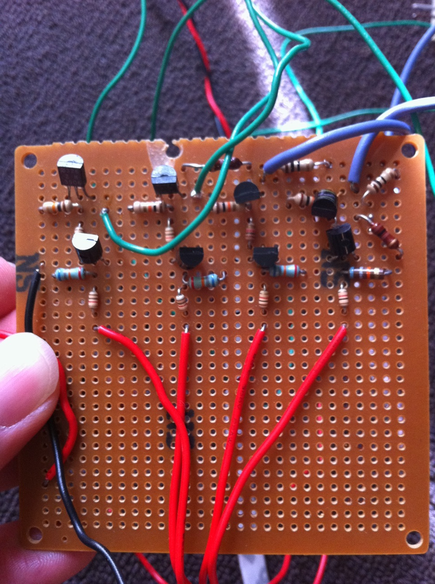
Car Controller Module
2. 5V to 12V NPN & PNP Amplifier
Figure 2. BJT AMP Module

Slide 4

Car Controller Module
3. Door Lock/Unlcok Demonstration
Figure 3. Door Lock/Unlock Module

Slide 5
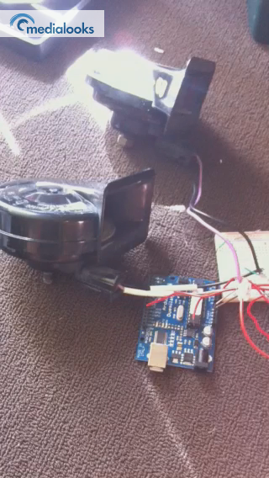
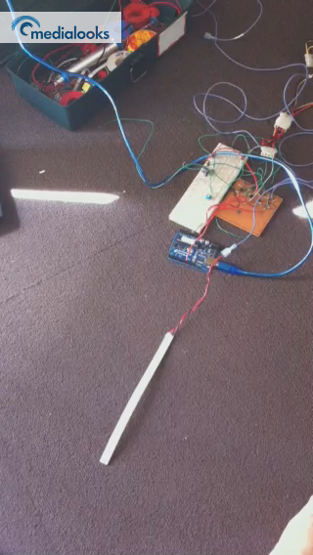
Car Controller Module
4. LED, and Horn Demonstration
Figure 4. LED Demonstration
Figure 5. Horn Demonstration

Slide 6
Car Controller Module
5. To do
Horn controller
Door Statue Module
X-bee

Slide 7
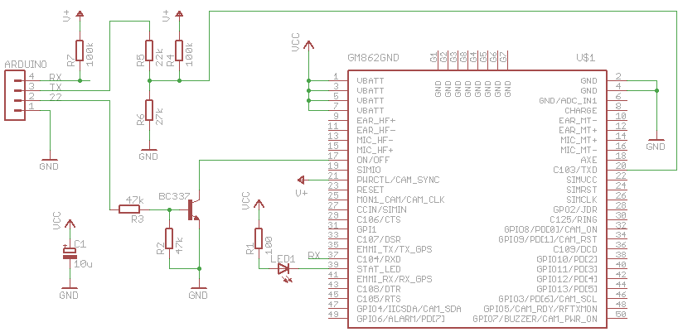
GSM Module
6. Schematic (GM862 to Arduino)

Slide 8
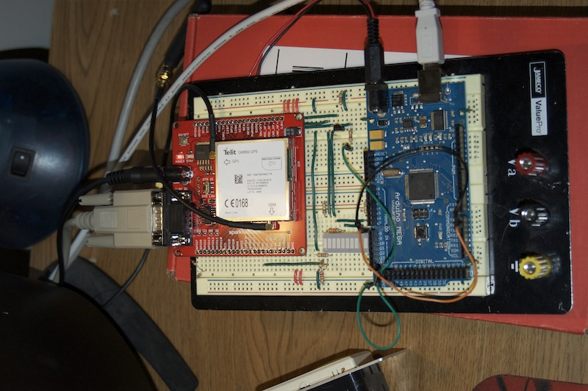
GSM Module
7. Hardware

Slide 9
GSM Module
8. Hardware
Serial over USB
5V Power
UART
Serial
5V Power
GM862
Arduino
Mega
RS232

Slide 10
GSM Module
9. Software (Current capabilities)
Connect and communicate with GM862 using RS232 connection
Receive and send SMS text messages
Query web addresses
Identify own IP address and port communication
Send data via TCP/IP connection

Slide 11
GSM Module
10. To do
Server Communication over TCP/IP
  Authorization
  Watchdog
Website Interface
  Google Maps Integration
  Control Commands
  Status updates
SMS Text Message Parsing

Slide 12
State Machine Module
Car Control Module
Arduino microcontroller state machine code under development.
Enumeration of states
Required input/outputs
*Arduino is the name of our selected Micro Controller

Slide 13
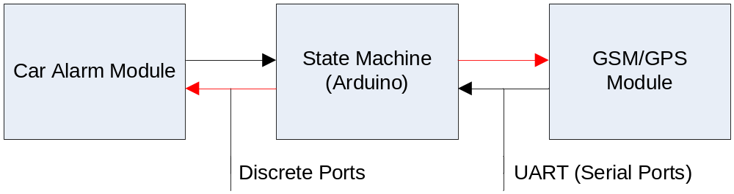
High Level Block Diagram
Monitor from Car Module: Input/Output:
Doors Locked/Unlocked I/O
Doors Open/Closed I
Ignition Status I
System Health I
Alarm Set I/O
Alarm Triggered I
Alarm Clear O

Slide 14
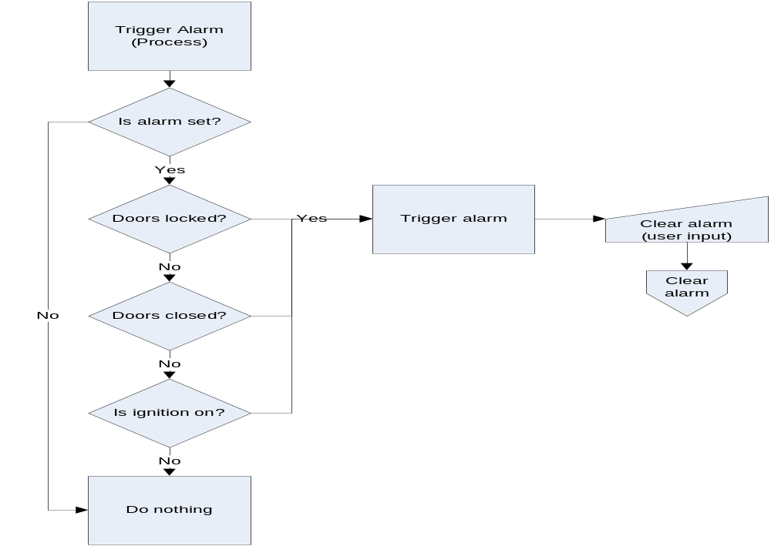
Alarm Trigger Process

