Slide 1
B-Line Security System
Vehicle Security http://b-linesecurity.com/
University of Utah
Electrical Engineering Students
Travis Jeppson
Clinton Mullins
Hwan-June Cho

Slide 2
Car Controller Module
Arduino microcontroller state machine code under development.
Enumeration of states
Required input/outputs
*Arduino is the name of our selected Micro Controller

Slide 3
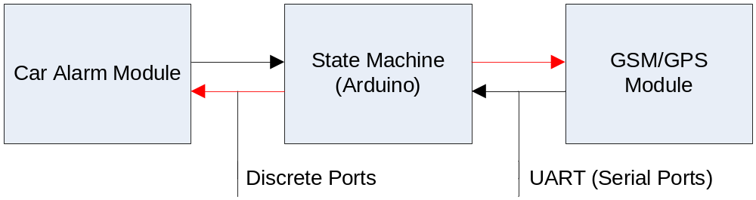
High Level Block Diagram
Monitor from Car Module: Input/Output:
Doors Locked/Unlocked I/O
Doors Open/Closed I
Ignition Status I
System Health I
Alarm Set I/O
Alarm Triggered I
Alarm Clear O

Slide 4
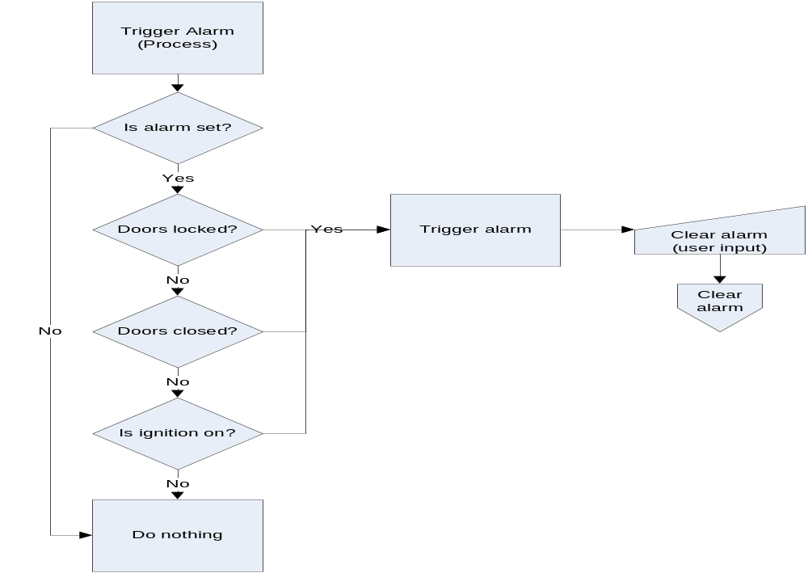
Alarm Trigger Process

