Slide 1
Simple Perl 6 Fractals and Concurrency
Steve Mynott
https://github.com/stmuk/contalk

Slide 2
Why?
Fractals are nice and easy to calculate and look pretty
But time consuming to run
Supposed to run well in parallel
Perl 6 has great support for concurrency
Use those extra core(s)

Slide 3
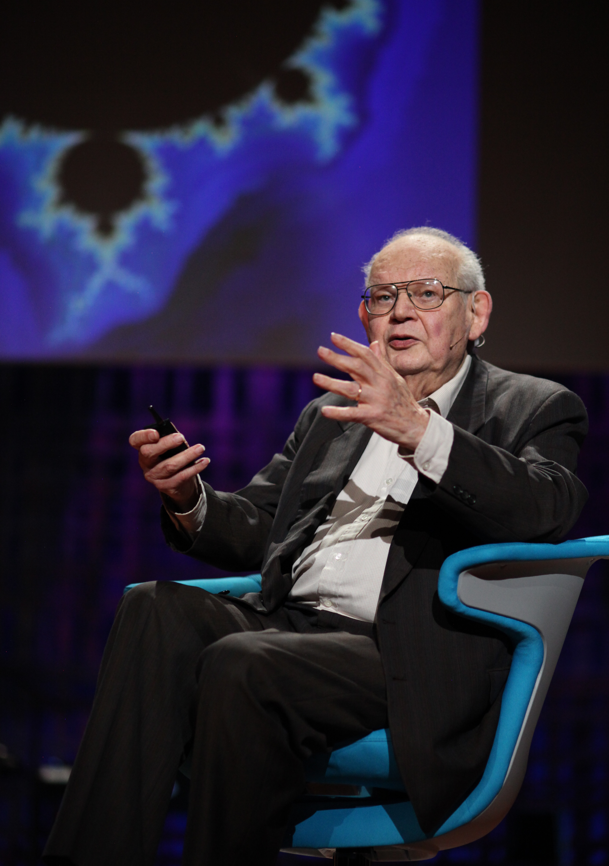
Which Fractal?
The Obvious One!
Benoit B. Mandelbrot (20 November 1924 – 14 October 2010)

Slide 4
How?
Perl 6 in “performance enhancement phase”
So very small size 320x240 (80s retro!)
On Celeron N2840 (~2.16GHz) took 100 secs
Plot with SDL (Simple DirectMedia Layer)
Code tested on Linux and Mac

Slide 5
Code Overview 1 of 2
loop (my $y = 1; $y >= -1; $y -= 0.01) { # rows
loop (my $x = -2; $x <= 1; $x += 0.01) { # cols
my ($res, $i) = mandelbrot($x + $y * i);
my $color=128;
$color=10*$i if $i;
if !$res.defined {
$color=0;
SDL_SetRenderDrawColor($render, $color, $color, $color, 0);
SDL_RenderDrawPoint($render, ($x*($width/4)).Int+200, ($y*($height/4)).Int+120);
} else {
if $i < 5 {
SDL_SetRenderDrawColor($render, 0, 0,128, 0);
} elsif $i > 5 and $i < 7 {
SDL_SetRenderDrawColor($render, 0, 0, $color, 0);
}
...
SDL_RenderDrawPoint($render, ($x*($width/4)).Int+200, ($y*($height/4)).Int+120);
SDL_RenderPresent($render);
}
}
}

Slide 6
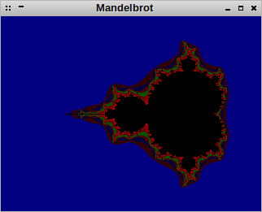
Code Overview 2 of 2
sub mandelbrot(Complex $c) {
my $z = $c;
for (1 .. 20) -> $i {
$z = $z * $z + $c;
return ($z,$i) if $z.abs> 2;
}
}

Slide 7
Perl 6 Promises
my $p = start { say "hi" }
await $p;

Slide 8
Simple Loop
for ('a'..'c') -> $l {
print "$l";
for (1..3) -> $i {
print $i
}
}
a123b123c123

Slide 9
Async Loop
await do for ('a'..'c') -> $l {
print "$l";
start do for (1..3) -> $i {
print $i
}
}
ab123c123123

Slide 10
mbrot2.p6
await do for ( 0..$width) -> int $xcoord {
start {
for ( 0..$height-1) -> int $ycoord {

Slide 11

Oh dear
Took 80% of time (better) but

Slide 12
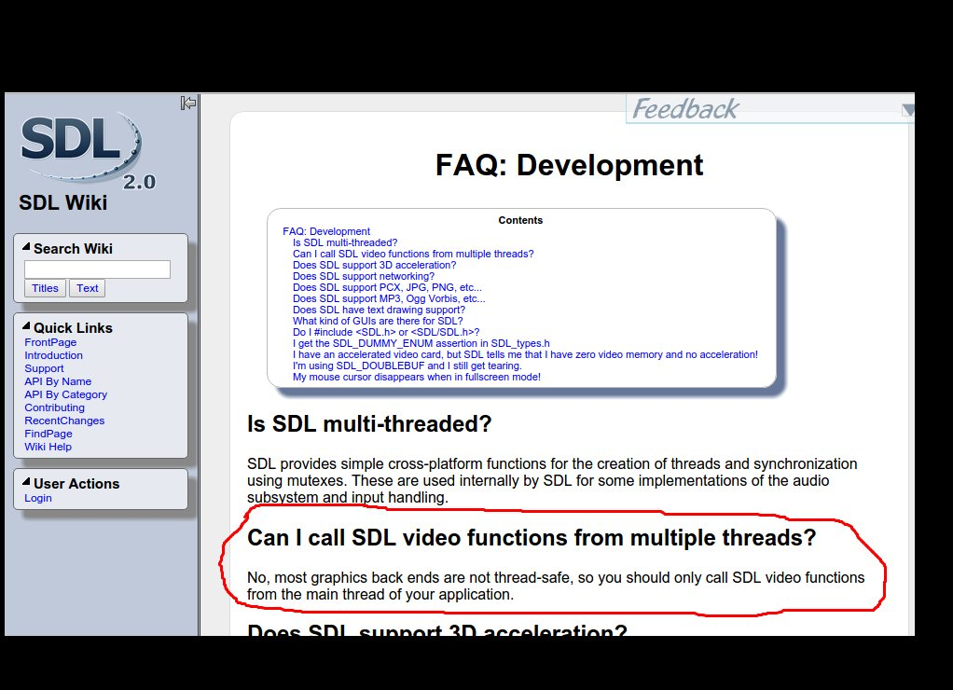
SDL2 didn't work with threads

Slide 13
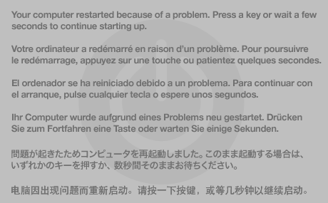
Mac didn't like it
Reproducible Kernel panic
Apple's problem not the Perl 6 Team!

Slide 14
What's A Solution?
http://doc.perl6.org/language/concurrency
Locking!

Slide 15
mbrot3.p6
my $l = Lock.new;
await do for ( 0..$width) -> int $xcoord {
  start {
for ( 0..$height-1) -> int $ycoord {
…
$l.protect(sub{plot($render, $xcoord, $ycoord $color)});

Slide 16
Visible Threading

Slide 17
Locking Works But...
Image looks fine and its only costs a little more time than not locking
Not really supposed to use lock due to risk of deadlocks
Better, more high level solutions in Perl6
“Channel” – thread safe queue (multiple writers to single reader)

Slide 18
mbrot4.p6 (reader)
my $c = Channel.new;
my $plotting = start {
my $closed = $c.closed;
loop {
if $c.poll -> $item {
my ($xcoord, $ycoord, $color) = $item;
plot($render, $xcoord, $ycoord, $color);
}
elsif $closed {
last;
}
}
}

Slide 19
mbrot4.p6 (writers)
await do for ( 0..$width) -> int $xcoord {
start {
...
my $item = ($xcoord, $ycoord, $color);
$c.send($item);
}
}
}
$c.close;
await $plotting;

Slide 20
Cheating a little
Messing with thread scheduler
$PROCESS::SCHEDULER=ThreadPoolScheduler.new(initial_threads => 0, max_threads => 2, uncaught_handler => Callable);

Slide 21
Benchmarks
benchmarking will run 3 iteration(s)
mbrot1.p6 – non-concurrent 100s
mbrot2.p6 - broken concurrent 74s
mbrot3.p6 - concurrent with lock 80s
mbrot4.p6 - concurrent with channel 112s

Slide 22
Threading is slower!
What to do?
Freenode/#perl6
“Threading has a lot of overheads only improves performance with 1000-10,000s of calculation / promise” – moritz
Increase number of pixels and wait longer

Slide 23
Bigger Mandelbrot!
1024x768 (90s retro)
Use faster computer (2nd Gen i5 2.5Ghz)
Wait longer

Slide 24
Results
Standard Mandelbrot – 67 minutes
Mandelbrot with channel – 62 minutes
Not hugely different but at least faster!
Research continuing – watch this space!

Slide 25
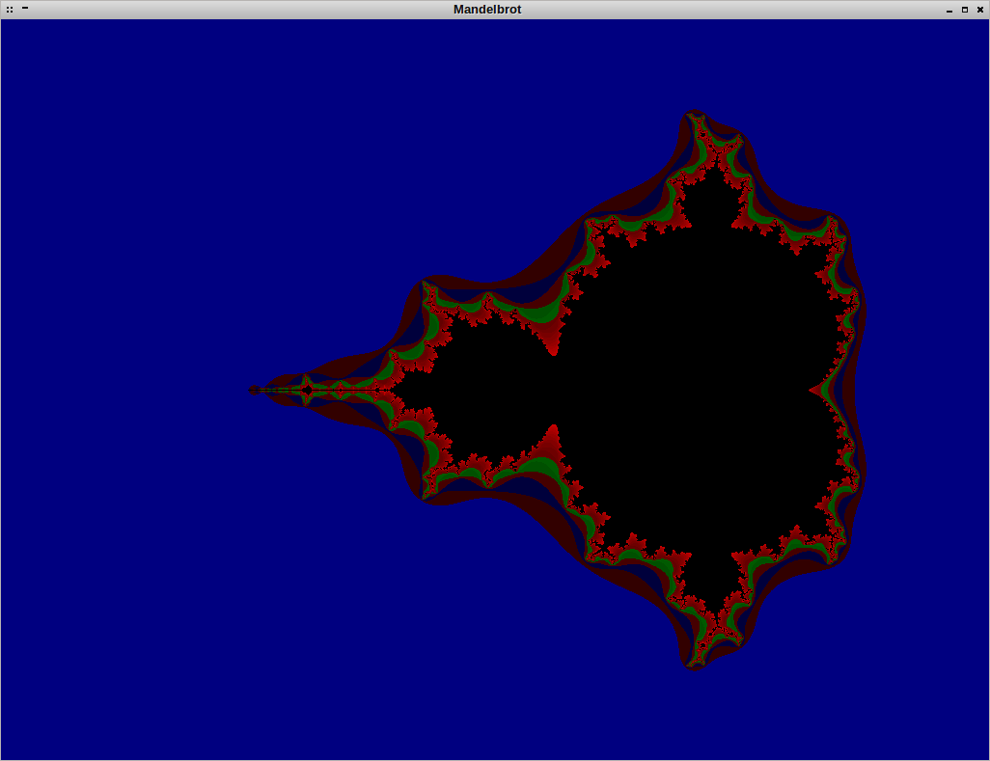

Slide 26
Conclusions
Concurrency in Perl 6 is fairly easy
It is a good selling point
Not a “silver bullet”
Releases this year set to improve performance
https://github.com/stmuk/contalk

