Slide 1

Internet of Things – Final Project
Fausto Alessandro Gatti – 356264
LM Ingegneria Informatica
Prof. Gianluigi Ferrari
Dr. Luca Davoli
Dr. Laura Belli

Slide 2
Context
Simulation of a smart wellness village as an Internet of Things environment
Message passing communication using CoAP Protocol
Java 1.7
Californium Framework

Slide 3
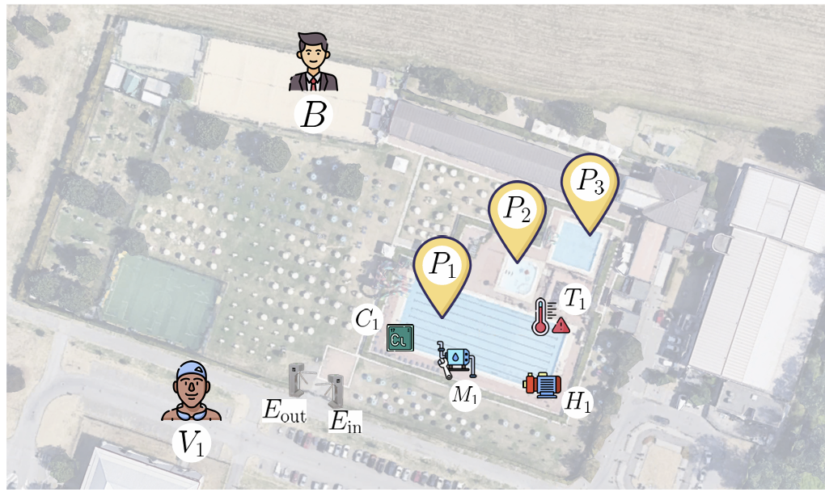
Assignment
Three pools for each wellness village
Each pool has two parameters that have to be monitored: temperature and chlorine concentration
Every parameter is measured by a sensor and increased by an actuator if it’s too low
Temperature is regulated by an heating pump, while chlorine by a chlorine mixer.
The turnstile must accept the visitors if they insert their personal ID
The turnstile has the entry and the exit.
Every visitor is described as a CoapClient and can read the number of entries.
A manager (Boss) can look at the status of the village

Slide 4
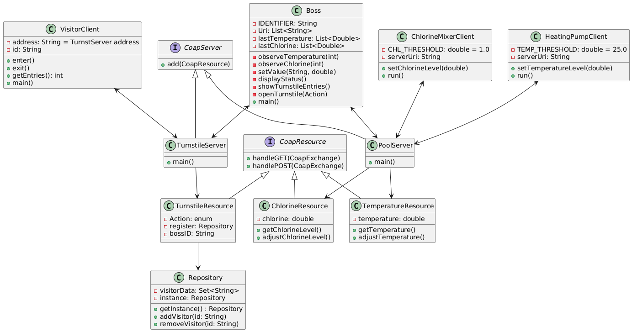
Project architecture

Slide 5
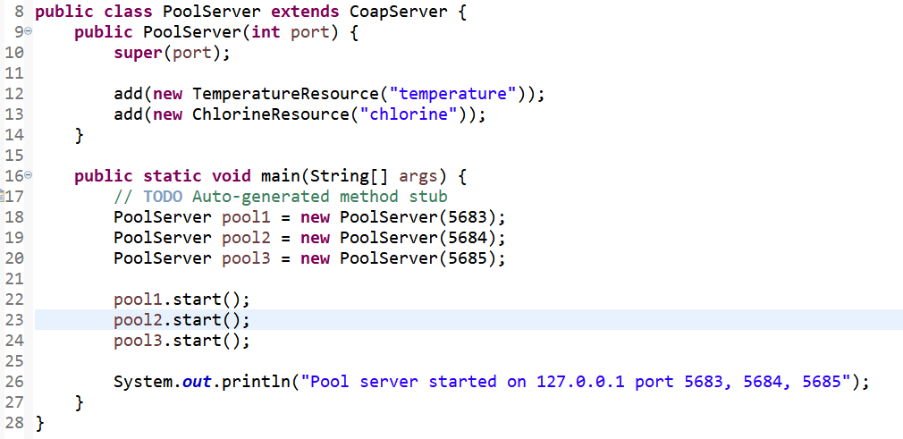
Coap Server
The project runs locally (127.0.0.1)
Each pool Server listens on a different port
Each pool adds two Coap Resources (Temperature & Chlorine)

Slide 6
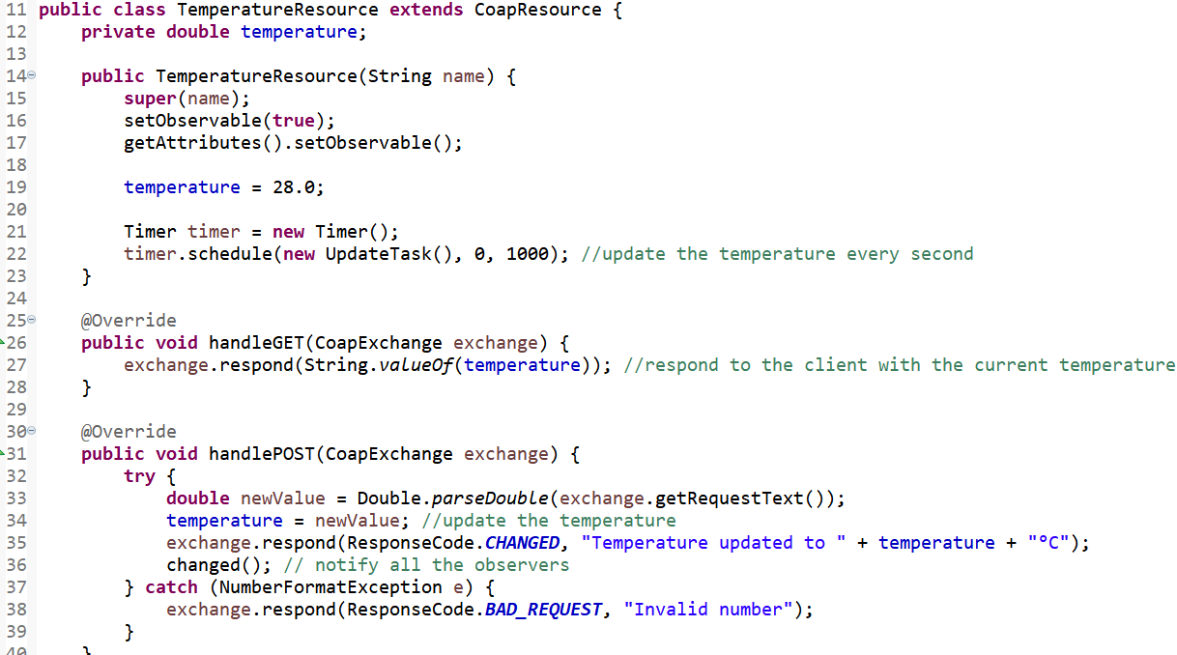
Coap Resource
TemperatureResource and ChlorineResource have similar structure
They simulate the functioning of a sensor
Double variable to be stored and shared
handleGET returns the variable
handlePOST updates the variable
updateTask simulates the decreasing of the pool temperature

Slide 7
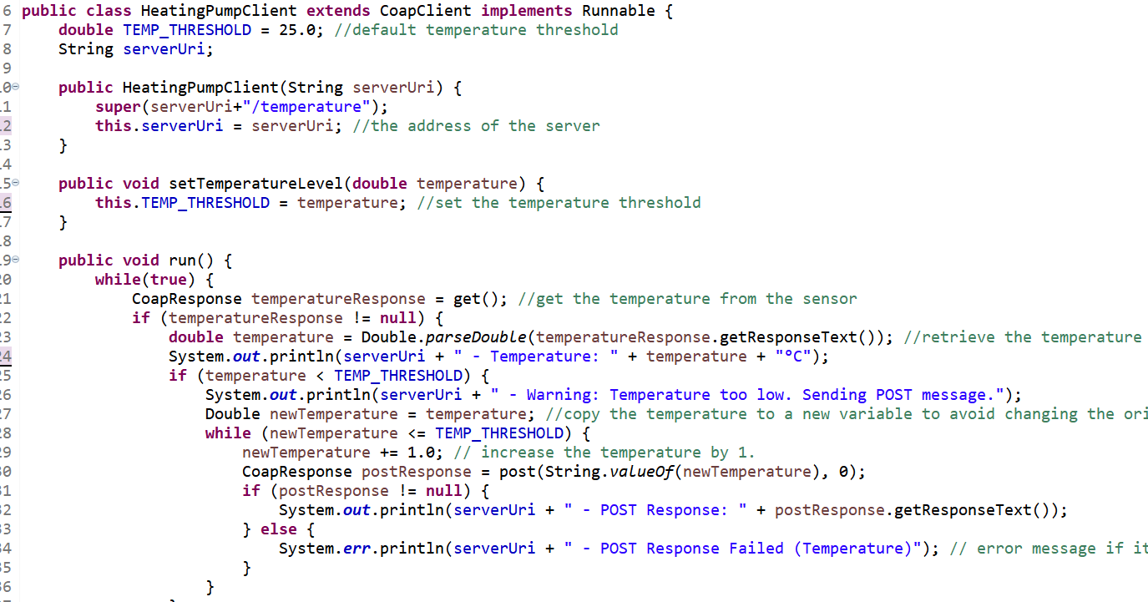
Coap Client
Simulates the working of an actuator
The run() consists in a while cycle that costantly checks the temperature from the sensor with a GET request
Asynchronuos message passing
If the temperature is below the desired temperature, send a number of POST messages that allows to fix the temperature
Sleep time after can be modified

Slide 8
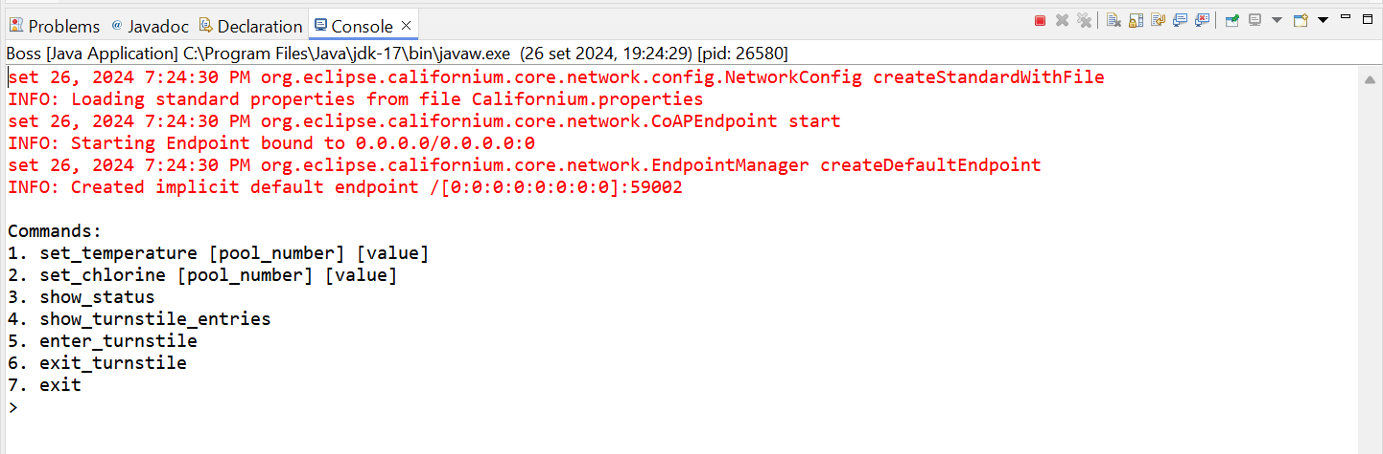
Boss class
The manager of the village
Can do multiple operations
Implemented an interface to select the next operation to solve
Communicates with the servers (not with other clients)

Slide 9
How to test?
Open in Eclipse
Run the servers (PoolServer.java & TurnstileServer.java)
Run the clients/actuators (HeatingPumpClient.java & ChlorineMixer.java)
The project contains the class ‘Client.java’ with the main that launches all the threads of the actuators for test purposes
Eventually run the VisitorClient to test the user interface of the customers

Slide 10
Challenges and Constraint
In this simulation we assume the communication works properly
Pool Client has to check a resource that constantly changes
The client waits for the server response (asynchronous)
The Clients have to store the server IP address in a local variable
Sventually we could use a shared file to save it

