Slide 1
Flight information management
professor Michael Zijlstra
Group 3: bon nguyen
Phuong le
son nguyen

Slide 2
contents
Introduction
Use Cases
Static Model
Technologies Used
Future Extension
Demo

Slide 3
introduction
Flight Information System is to manage and present all flight info and related info: airplane, airline and airport.
The team decided to selected a type of project that we could practice the studied topics as many as possible.
Ability to extend business domain and technologies.

Slide 4
Use cases
 | Use Case | Description | Onwer
1 | Airport | Add/modify/delete an Airport | Ba Bon
2 | Airline | Add/modify/delete an Airline | Hoang Phuong
3 | Airplane | Add/modify/delete an Airplane | Hoang Phuong
4 | Flight | Add/modify a flight | Truong Son
5 | Logging and search | AOP logging and search | Ba Bon

Slide 5
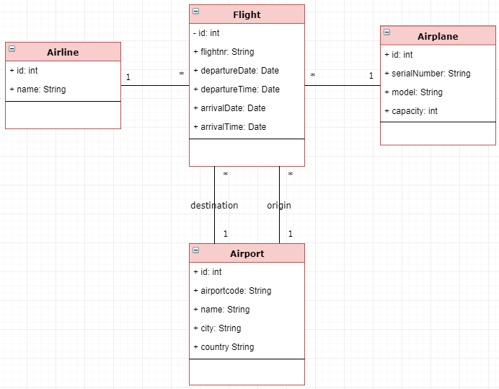
Static model

Slide 6
Technologies used
Spring Boot
Spring Web/MVC and Thymeleaf
Spring AOP,
Transaction and Validation
Spring JPA
DB: MySQL/Mac and Postgre/Windows

Slide 7
Extension
Business Domain:
Customer
Ticket
Technologies:
Advanced Search, Security, Error Handling, Mobile app
Spring Cloud and Microservices: distributed config, service discovery, routing & load balancing, etc

Slide 8
SCI
“Do less and accomplish more”
What we studied in this course is the same as the above quote.

Slide 9
Demo
Q&A

