Slide 1



Camera
Computer
Actuated lights
Drawing tablet

Slide 2
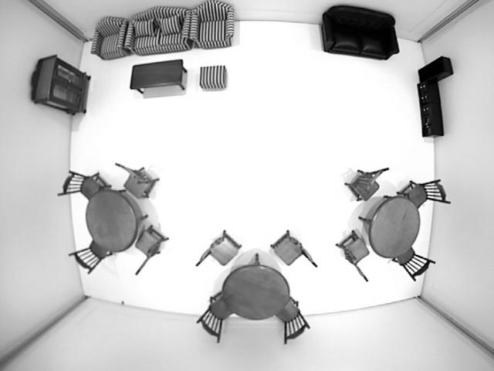
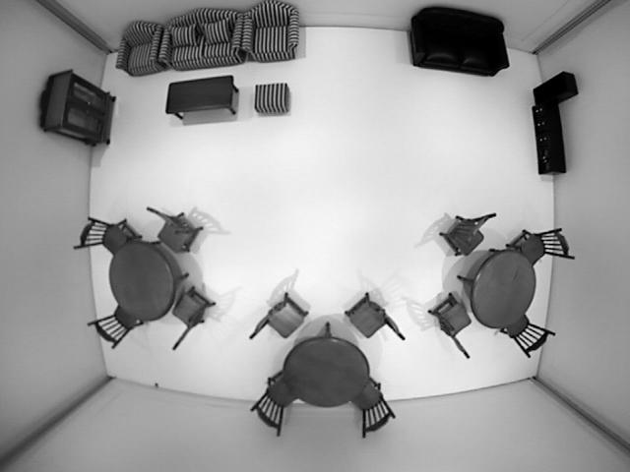
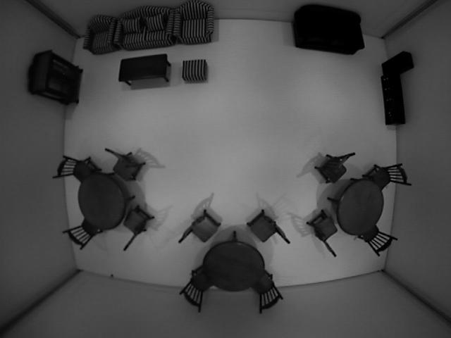
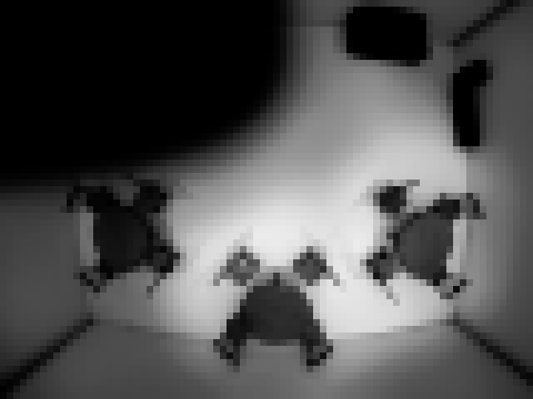
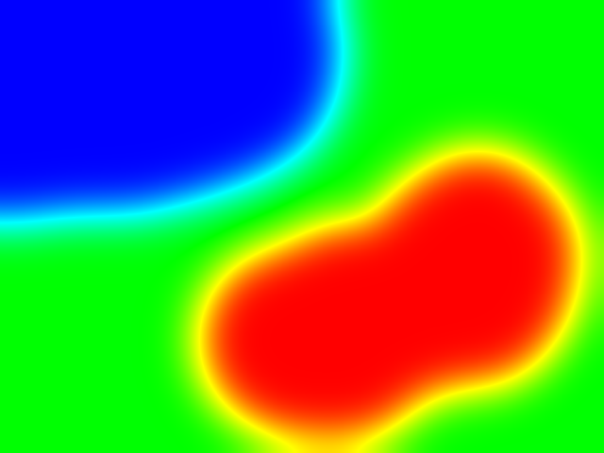
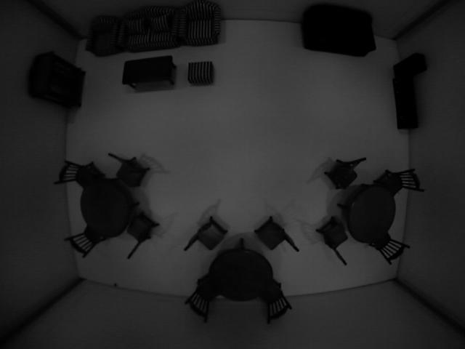
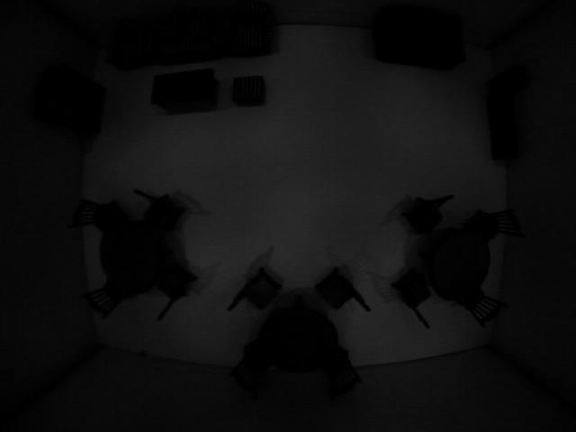
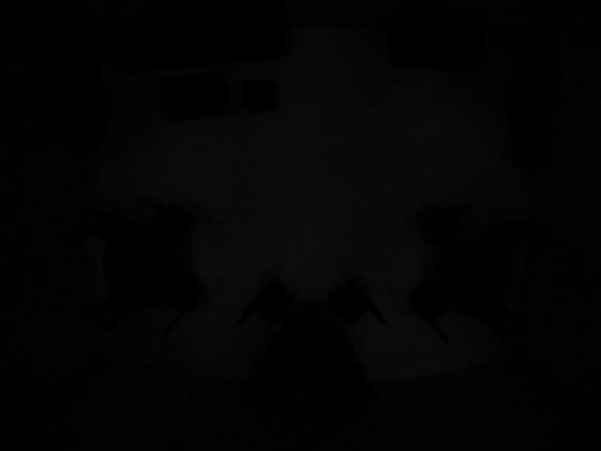
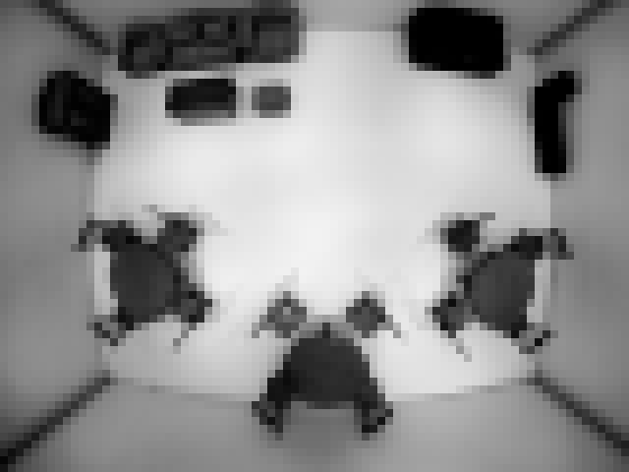
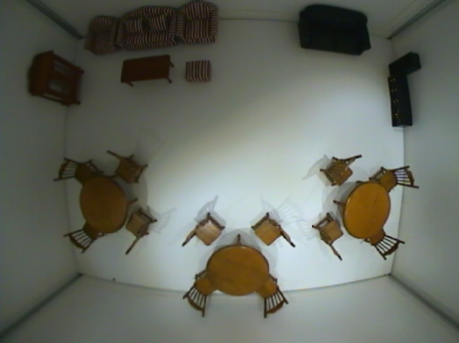
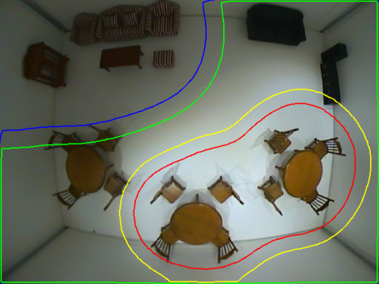
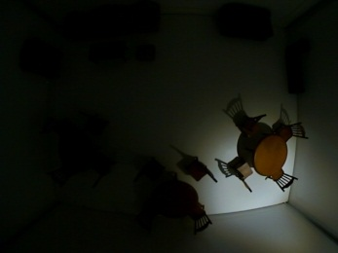
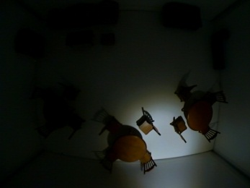
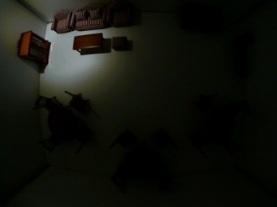


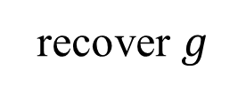
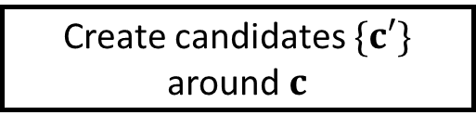








Calibration
Optimization
Manipulation
Target radiance
User painting area
$c←0$ (darkroom)
0.0
1.0
Compute $𝒪\left[c\right]$
Iteration
Create candidates $\{c′\}$
around $c$
recover $g$
Compute $\{𝒪\left[c′\right]\}$ in parallel
Base radiance
$${c′}_{1}$$
$${c′}_{2}$$
$${c′}_{3}$$
$${c′}_{72}$$
$$c←{c′}_{min}$$
Calibration
data
Live view
$${c′}_{min}←arg min 𝒪\left[c′\right]$$
Camera
NO
$$𝒪\left[c\right]≤𝒪\left[{c′}_{min}\right]$$
Assign c
YES
Real-world environment
User feedback

Slide 3
**
*
*
*
**
*
* p < 0.05
** p < 0.01
Painting
Direct

Slide 4
* p < 0.05
** p < 0.01
**
*
*

