Slide 1



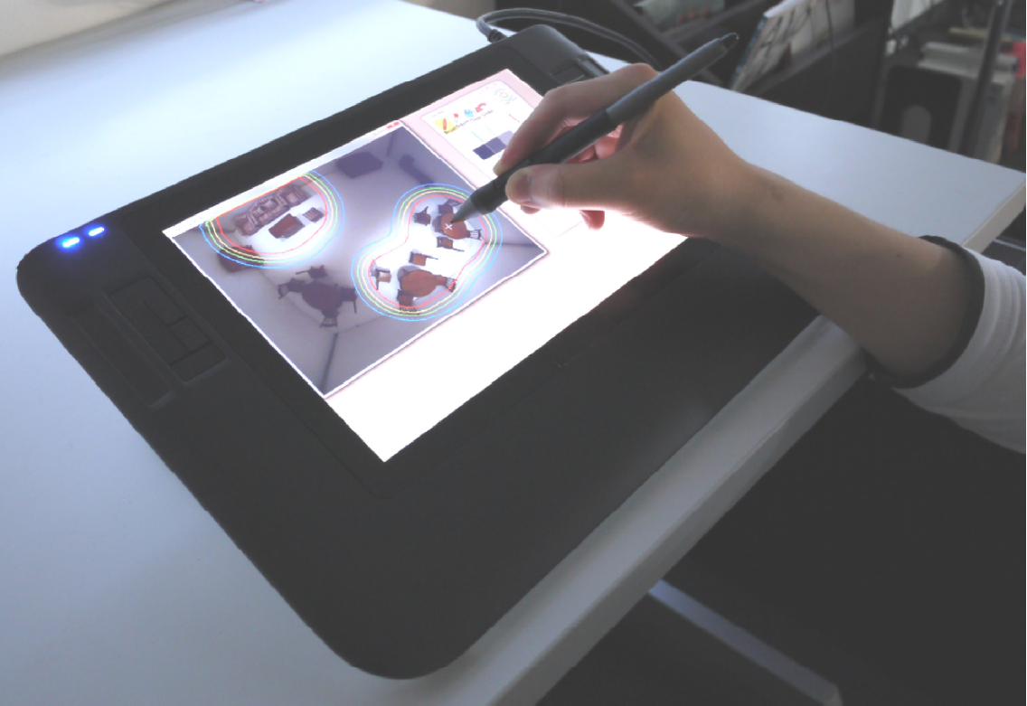
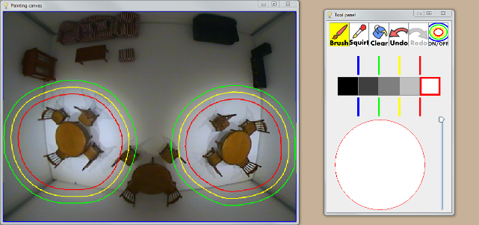
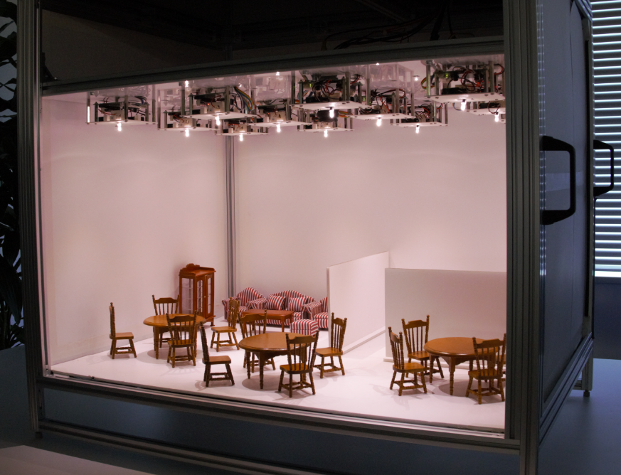
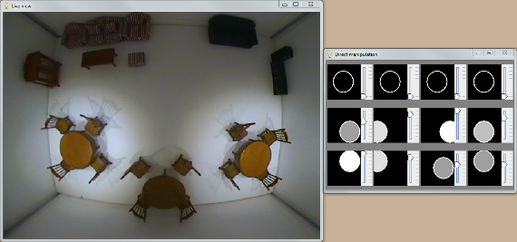
Lighty: A Painting Interface for Room Illumination by Robotic Light Array
Seung-Tak Noh^{1,2}, Sunao Hashimoto², Daiki Yamanaka^{1,2}, Youichi Kamiyama², Masahiko Inami^{2,3}, and Takeo Igarashi^{1,2}
¹ The University of Tokyo ² JST ERATO Igarashi Design Interface Project ³ Keio University .
Introduction
Lighty is a painting interface that enables users to easily design an illumination distribution for a real room using an array of computer-controlled lights [1,2].
Users specify which area of the room is to be well-lit and which is to be dark by painting an illumination distribution on a tablet device displaying an image obtained by a camera mounted in the room.
System Overview
Camera
Painting interface
It allows the users to design the illumination distribution of the room by painting the desired illumination directly onto the camera image.
Computer
Robotic lights
Optimization module
It interactively calculates the parameters of the lights that will satisfy the desired illumination distribution request.
Table for painting
Light control module
It sends the calculated parameters to the lights.
User Interface
The user specifies the desired intensity on the live view by painting.
Previous painting interfaces for lighting design showed the painting canvas (target image) and illumination result separately.
In our system, both views are merged into one screen and the painting result is visualized as contour lines of the target illumination intensity overlaid on the live view.
Contour lines
Live view
Painting tools
Evaluation
We built a miniature-scale experimental environment and ran a user study to compare our method with a standard direct manipulation method using widgets.
The results showed that the users preferred our method for informal light control.
Trial 1 | Make the left and right circular tables brighter while keeping the remaining area the same brightness.
Trial 2 | Make the center and right circular tables illuminated well. The upper left area where the sofas and cupboard exist should be darker.
Trial 3 | Make the entire room brighter. However, the areas around the left circular table and upper right sofa should be dark.
Trial 4 | Make the left side of the room bright and the right side dark, gradually changing the brightness in the middle.
Trial 5 | Make the upper right sofa bright and radially decrease the brightness around the sofa.
Miniature-scale prototype
Direct manipulation method
Task instruction and results
[1] “Lighty: A painting interface for room illumination by robotic light array.” IEEE ISMAR ’12 Poster
[2] “Design and enhancement of painting interface for room lights.”, The Visual Computer, 2013

