Slide 1
Arduino + ROS rosserial_ws
1.簡介
2.安裝
3.程式
編輯 : 曾國森
日期 : 2020/05/05_V01
更新 :
更新 :
更新 :
更新 :
更新 :

Slide 2
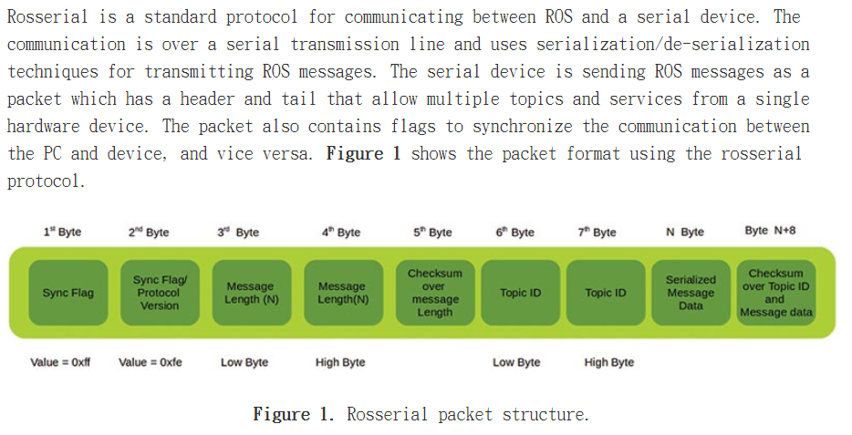
1.簡介
自從 ROS 有了 rosserial_arduino 支援 Arduino 以後，
你可以在Arduino IDE中直接使用ROS 。
rosserial_arduino 提供了 ros 的通信協議，它可以在 Arduino 的 UART 上工作。
它可以使 Arduino 成為一個完整的ROS節點，直接發佈和訂閱ROS消息，
發佈 TF 轉換，並獲得 ROS 系統時間

Slide 3
THE ROSSERIAL_CLIENT LIBRARIES
The rosserial_client libraries (http://wiki.ros.org/rosserial_client)
have a client side implementation of the rosserial protocol. The client can be an embedded microcontroller platform such as
with an Arduino, ARM, or another serial device such as Xbee.
It can run on any processor which has an ANSI C++ compiler and serial interfacing to a computer running ROS.
There are several rosserial_client library packages out there for specific platforms. Here are some of those rosserial_client libraries:
rosserial_arduino: This package helps you build an Arduino library called ros_lib which can work as a rosserial_client library for
Arduino. We can include this library for writing Arduino-ROS client nodes. This package helps us create a rosserial client on
most of the Arduino platforms – especially the Uno, Mega, and Leonardo.
rosserial_embeddedlinux: This package enables us to run rosserial_client on embedded Linux systems (like routers, etc.).
rosserial_windows: ROS is not completely ported to Windows. If we have to communicate with any Windows application,
we can use this package to communicate from the Windows client to ROS.
rosserial_mbed: Most of the ARM controller based boards support mbed (hardware abstraction layer) programming, which is
similar to Arduino programming. We can either program mbed boards using an online compiler, or offline using a
gcc4embed (https://github.com/adamgreen/gcc4mbed) project.
The offline compiler can only work with a limited number of boards, but the online compiler can use new boards which support mbed.
rosserial_tivac: The Tiva C Launchpad is another controller board from Texas Instruments which runs
on 80 to 120 MHz. The latest boards are 123GXL and 129XL, and support the Arduino-like IDE (integrated development environment)
called Energia (http://energia.nu). We can program Tiva C using the Arduino programming language called Wiring (http://wiring.org.co).
After writing the rosserial node into a serial device, we have to run another node on the PC side to encode/decode the serial data.
There are some packages for doing this process. Those are:
rosserial_python: This package is commonly used for rosserial communication. You have a Python node which can connect to the
serial device and receive serial values from the device. It will decode serial packets and generate ROS topics and services which will be
available on the PC side. This package is stable and recommended for PC applications.
rosserial_server: This is actually a C++ implementation of a rosserial receiver and can be used for high performance applications.
The features of this node are less compared to rosserial_python.
rosserial_java: If you want to interface ROS with an Android, this is the best choice.
We are going to use rosserial_python on the PC side.

Slide 4
2.安裝
2.1.Arduino IDE 安裝到 Ubuntu
2.1.1.This IDE can be downloaded from
https://www.arduino.cc/en/Main/Software.
2.1.2.Install it via the Ubuntu software package manager.
>> sudo apt-get install arduino
2.2.安裝 ROSSERIAL INTERFACE PACKAGE 到 UBUNTU
2.2.1 download https://github.com/ros-drivers/rosserial
2.2.2 copy to rosserial_ws/src
2.2.3 >> catkin_make
2.2.4 >> echo source ~/rosserial_ws/devel/setup.bash >>~/.bashrc
2.2.5 >> source ~/.bashrc
裝完後可在 sketchbook 看到 libraries.
2.2.6 /home/YOUR-NAME/Arduino/libraries
2.3 產生 ros_lib library
2.3.1. 在 terminal 中 run:
>> roscore
2.3.2. Generate the ros_lib library
>> rosrun rosserial_arduino make_libraries.py .

Slide 5
2.4.Run examples of ros_lib
2.4.1. Open Arduino IDE
選File -> Examples -> ros_lib
2.5.權限設定
2.5.1. 將 current user 加入 dialout group
讓它有對 serial port 無需再認證
>> sudo usermod -a -G dialout <username>
2.5.2. set the read/write permission
>> sudo chmod 777 /dev/ttyACM0
2.6. 整合測試
2.6.1. Arduino IDE 燒 ServoControl.ino 到 Mega2560
2.6.2. Terminal and run:
>> roscore
2.6.3. Run the rosserial node
>> rosrun rosserial_python serial_node.py /dev/ttyACM0
2.6.4. Use rostopic pub to control your servo
>> rostopic pub servo std_msgs/UInt16 <angle>

Slide 6
3.程式
//==============================================================
//rosserial Servo Control Example
//
//Running :
// 1.Set the read/write permission
// sudo chmod 777 /dev/ttyACM0
// 2.Active ROS
// roscore
// 3.Run the rosserial node on the PC side
// rosrun rosserial_python serial_node.py /dev/ttyACM0
// 4.Use rostopic pub to control your servo
// rostopic pub servo std_msgs/UInt16 <angle>
//==============================================================
#if defined(ARDUINO) && ARDUINO >= 100
#include "Arduino.h"
#else
#include <WProgram.h>
#endif
#include <Servo.h>
#include <ros.h>
#include <std_msgs/UInt16.h>
ros::NodeHandle nh;
Servo servo;
void servo_cb( const std_msgs::UInt16& cmd_msg)
{
servo.write(cmd_msg.data); //set servo angle, should be from 0-180
digitalWrite(13, HIGH-digitalRead(13)); //toggle led
}
ros::Subscriber<std_msgs::UInt16> sub("servo", servo_cb);
void setup()
{
pinMode(13, OUTPUT);
nh.initNode();
nh.subscribe(sub);
servo.attach(10); //attach it to pin 9
}
void loop()
{
nh.spinOnce();
delay(100);
}
3.1.rosserial Servo Control
Example :
ServoControl.ino

Slide 7
3.2 custom message 的使用
3.2.1 用此命令建立 msg for Arduino compatible
>> rosrun rosserial_client make_libraries
example :
rosrun rosserial_client make_libraries /home/steven/catkin_sc/devel/include/sc_control/
3.2.2 在 .ino 裏 include 進來
example :
//Self Define Message
#include "/home/steven/Arduino/libraries/ros_lib/sc_control/headservor.h"

