Slide 1

STOCHASTIC PROCESSES · WEEK 01
Review of Probability
& Introduction to Stochastic Processes
Hamid R. Rabiee
Sharif University of Technology
Fall 2026 · version 1.5
This presentation has been formatted by Claude Opus5.5.

Slide 2
Outline of Week 01
1
2
3
4
History & Philosophy
Random Variables
Density & Distribution Functions
Joint & Conditional Distributions
From gamblers' disputes to Kolmogorov's axioms
σ-fields, probability spaces, RVs as mappings
PMF, CDF, PDF, common families, expectation
Marginals, Bayes' rule, independence, Jacobians
5
6
7
Linear Correlation
Important Theorems
Introduction to Stochastic Processes
Covariance, correlation coefficient, moments
CLT, laws of large numbers, classic inequalities
Random functions of time and first examples
Stochastic Processes · Week 01 · H. R. Rabiee
2 / 62

Slide 3
01
History & Philosophy
Where probability came from, and the two ways of thinking about it.
1
2
3
4
5
6
7
3 / 62

Slide 4
01 HISTORY & PHILOSOPHY
Born from a Gamblers' Dispute
Probability started as a tool for analyzing games of chance
1654: the Chevalier de Méré brings a gambling puzzle to Blaise Pascal; Pascal and Pierre de Fermat solve it in their letters
The “double six” problem: is it a good bet that at least one double six appears in 24 throws of two dice?
1657: the first book, by Christiaan Huygens, De Ratiociniis in Ludo Aleae (“On Reasoning in Games of Chance”), in Latin
SOLVING DE MÉRÉ'S PROBLEM
24 throws is slightly unfavorable; 25 is the break-even point.
Stochastic Processes · Week 01 · H. R. Rabiee
4 / 62
Notes:
The event 'no double six in one throw of two dice' has probability 35/36; throws are independent, so the complement over n throws gives 1 - (35/36)^n.

Slide 5
01 HISTORY & PHILOSOPHY
From Games of Chance to a Science
1654
1657
1713
1718
1812
1933
Pascal & Fermat
C. Huygens
J. Bernoulli
A. De Moivre
P. Laplace
A. Kolmogorov
Letters on games of chance
First book on probability
Ars Conjectandi: first law of large numbers
The Doctrine of Chances; normal approximation (1733)
Théorie Analytique des Probabilités
Axiomatic foundations
A RENAISSANCE
Laplace (1749–1827) carried the mathematics of games over to scientific and practical problems. Bernoulli (1654–1705) and De Moivre (1667–1754) drove the rapid development of the 18th century.
Stochastic Processes · Week 01 · H. R. Rabiee
5 / 62

Slide 6
01 HISTORY & PHILOSOPHY
The 19th and 20th Centuries
19TH CENTURY
20TH CENTURY
TODAY
Theory of errors (Gauss: least squares)
Actuarial mathematics
Statistical mechanics (Maxwell, Boltzmann)
Kolmogorov's axiomatic approach
A. N. Kolmogorov, Grundbegriffe der Wahrscheinlichkeitsrechnung, 1933
English: Foundations of the Theory of Probability, Chelsea, New York, 1950
Probability theory is part of measure theory
Russian school: Chebyshev, Markov, Lyapunov, Kolmogorov
Stochastic Processes · Week 01 · H. R. Rabiee
6 / 62

Slide 7
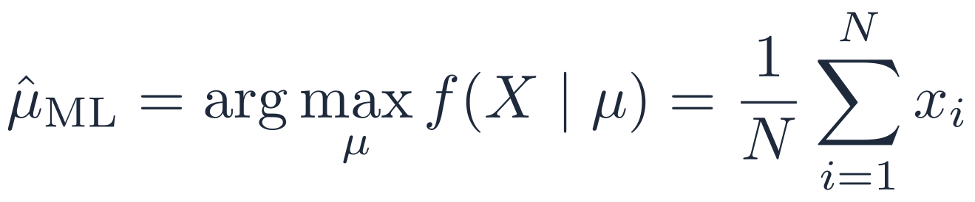
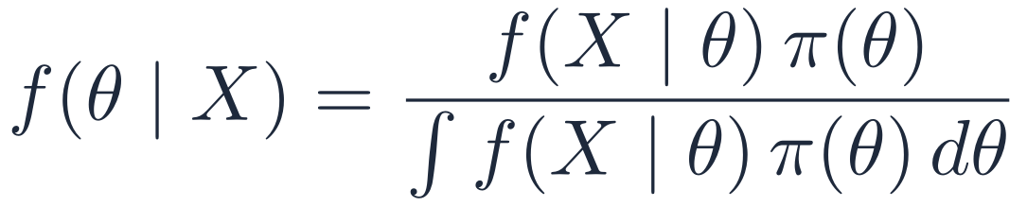
01 HISTORY & PHILOSOPHY
Two Philosophies: Frequentist vs. Bayesian
FREQUENTIST
BAYESIAN
Parameter θ is fixed but unknown
Observations X come from an underlying distribution f(X|θ) and are sufficient to learn it
All inference uses the likelihood f(X|θ)
For a Gaussian likelihood, the most likely mean is the sample average:
Parameter θ is random but unknown
Observations are necessary but not sufficient: prior knowledge π(θ) is essential
Combine prior and likelihood into the posterior f(θ|X)
The posterior mean E[θ|X] is a natural point estimate
Stochastic Processes · Week 01 · H. R. Rabiee
7 / 62
Notes:
Unlike frequentists, Bayesians allow the parameters to be random, which is fundamentally different.
Frequentists treat the parameters as fixed constants that shape the distribution. To find them (most commonly the mean) they maximize the likelihood function; for a Gaussian, the maximizer is the sample average.
Bayesians often arrive at a similar estimate, but by a different route: the prior expresses what you believe before seeing the data, and its spread reflects your confidence. Little faith in previous estimates means a wide prior. In a discrete case (e.g. will it rain today?) the prior probability itself measures your certainty.
Frequentists have no formal mechanism for prior knowledge, although they use it informally, e.g. when a tiny p-value contradicts everything we know, we do not believe the result. In the Bayesian view, the experimenter sets the prior.

Slide 8
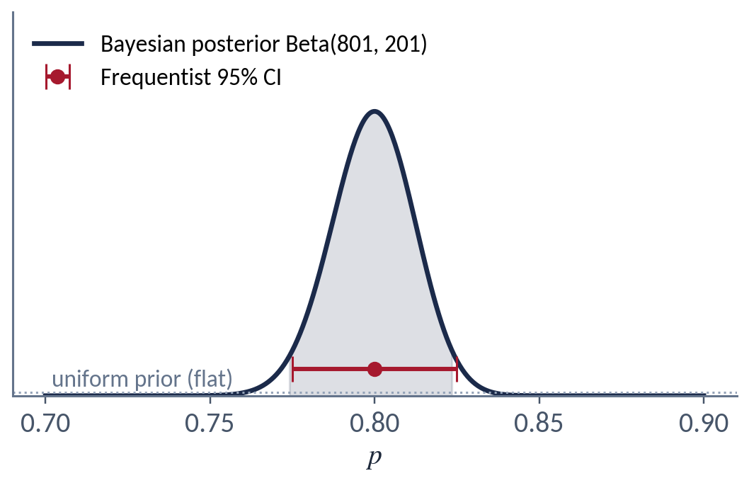
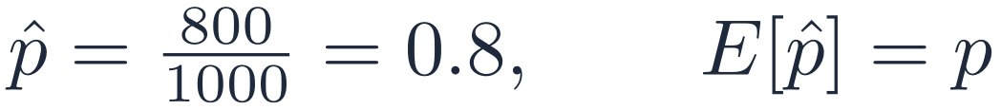
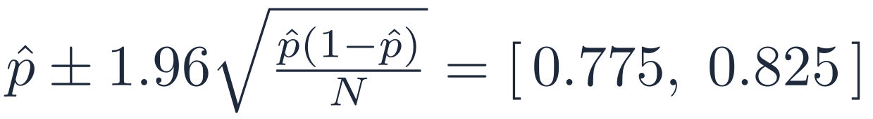
01 HISTORY & PHILOSOPHY
Example: Is the Coin Biased?
A coin is tossed 1000 times: 800 heads, 200 tails. Let p = P(heads). What is p?
BAYESIAN ANALYSIS
FREQUENTIST ANALYSIS
95% of intervals built this way cover the true p.
Stochastic Processes · Week 01 · H. R. Rabiee
8 / 62
Notes:
With a uniform prior, the posterior is Beta(801, 201). Its mean 801/1002 ≈ 0.799 and 95% credible interval [0.774, 0.824] are almost identical to the frequentist estimate 0.8 and its 95% confidence interval [0.775, 0.825]: with this much data the prior hardly matters. The interpretations differ: the credible interval is a probability statement about p; the confidence interval is a statement about the procedure.

Slide 9
01 HISTORY & PHILOSOPHY
Further Reading
TEXTBOOKS
HISTORY OF PROBABILITY
A. Papoulis, S. U. Pillai, Probability, Random Variables and Stochastic Processes, 4th ed., McGraw-Hill, 2002
A. Leon-Garcia, Probability, Statistics, and Random Processes for Electrical Engineering, 3rd ed., Pearson, 2008
http://www.leidenuniv.nl/fsw/verduin/stathist/stathist.htm
http://www.mrs.umn.edu/~sungurea/introstat/history/indexhistory.shtml
https://www.cs.ucl.ac.uk/staff/D.Wischik/Talks/histprob.pdf
Stochastic Processes · Week 01 · H. R. Rabiee
9 / 62

Slide 10
02
Random Variables
Sets, σ-fields and probability spaces: the ground a random variable stands on.
1
2
3
4
5
6
7
10 / 62

Slide 11
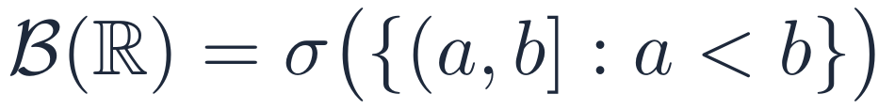
02 RANDOM VARIABLES
Sets and σ-Fields
Sets give probability its structure: outcomes are points, events are sets, and probabilities are assigned to sets
σ-FIELD (σ-ALGEBRA)
A collection 𝓕 of subsets of Ω is a σ-field if:
BOREL FIELD
The smallest σ-field on ℝ that contains all open sets (equivalently, all intervals)
Closed under countable unions, countable intersections and complements
Stochastic Processes · Week 01 · H. R. Rabiee
11 / 62
Notes:
A Borel field (Borel σ-field) contains all open sets of the space and is closed under countable unions, countable intersections and complements. Combining or modifying Borel sets in these ways always yields another Borel set, so every set we meet in practice (intervals, single points, countable unions of them) is Borel.

Slide 12

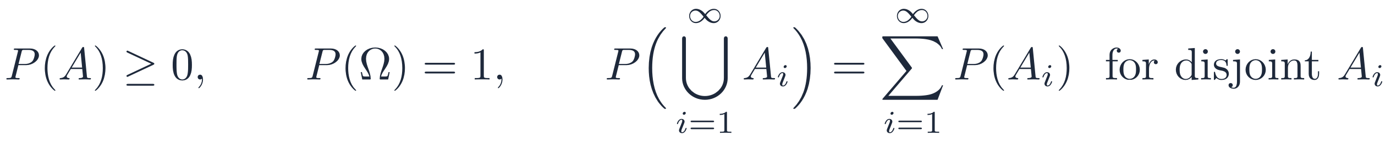
02 RANDOM VARIABLES
Probability Space
Ω
Sample space: nonempty set of outcomes (“states of nature”)
𝓕
Events: subsets of Ω forming a σ-field (Borel field)
P
Probability measure P: 𝓕 → [0, 1]
KOLMOGOROV'S AXIOMS AND CONSEQUENCES
Stochastic Processes · Week 01 · H. R. Rabiee
12 / 62
Notes:
The events F must form a Borel field (σ-field) so that complements and countable unions of events are again events, and P is defined on all of them. Fact: P(Ω) = 1.

Slide 13
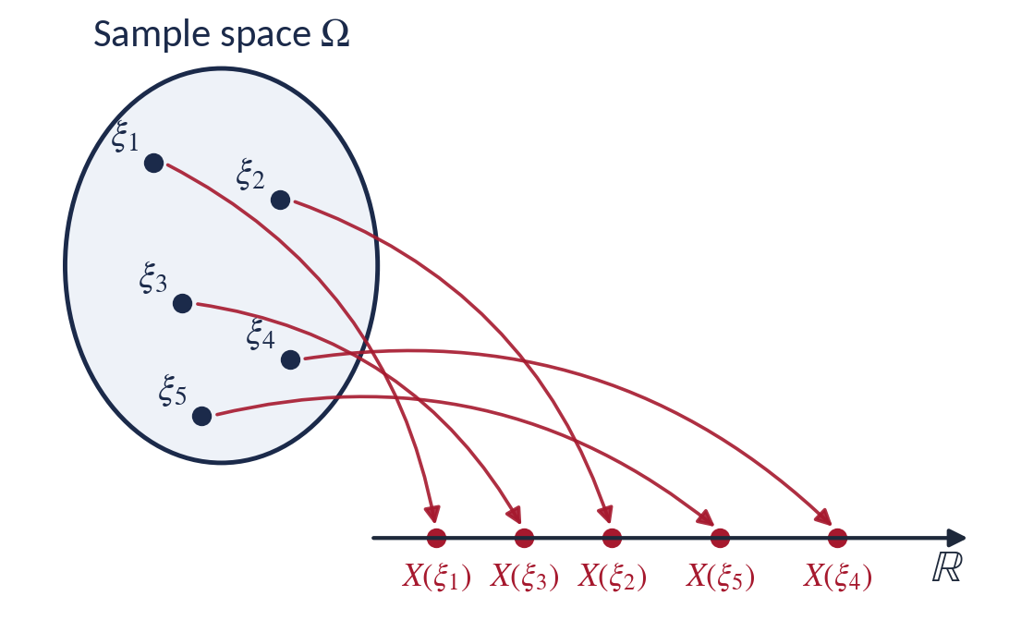
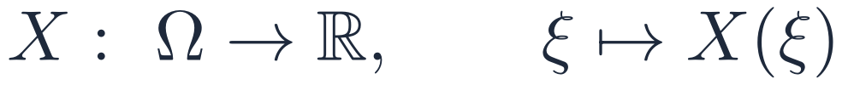
02 RANDOM VARIABLES
Random Variables
DEFINITION
A random variable (RV) is a function (mapping) from the outcomes of an experiment to the real (or complex) numbers
Requirement (measurability), so that P(X ≤ x) is always defined:
Stochastic Processes · Week 01 · H. R. Rabiee
13 / 62

Slide 14



02 RANDOM VARIABLES
Examples of Random Variables
EXAMPLE I
EXAMPLE II
EXAMPLE III
Faces of a die
Height of a person
Exam grade
Map each face to the first six natural numbers {1, …, 6}
Map a person's height to the real interval (0, 3] meters
Map exam performance to {0, 0.1, 0.2, …, 20}: steps of 0.1
Discrete
Continuous
Discrete
Stochastic Processes · Week 01 · H. R. Rabiee
14 / 62

Slide 15
02 RANDOM VARIABLES
Types of Random Variables
By range of values
By value field
Discrete
Continuous
Mixed
Real
Complex
Die, coin, course grade
Temperature, humidity, length
Waiting time with a chance of no wait
X(ξ) ∈ ℝ
Z = X + jY, e.g. phasors and baseband signals
NOTE
A complex RV is a pair of real RVs (X, Y); everything we say about real RVs extends to it through their joint distribution.
Stochastic Processes · Week 01 · H. R. Rabiee
15 / 62

Slide 16
03
Density & Distribution Functions
PMF, CDF and PDF; the families you will use all term; expectation.
1
2
3
4
5
6
7
16 / 62

Slide 17
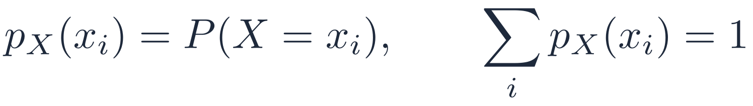
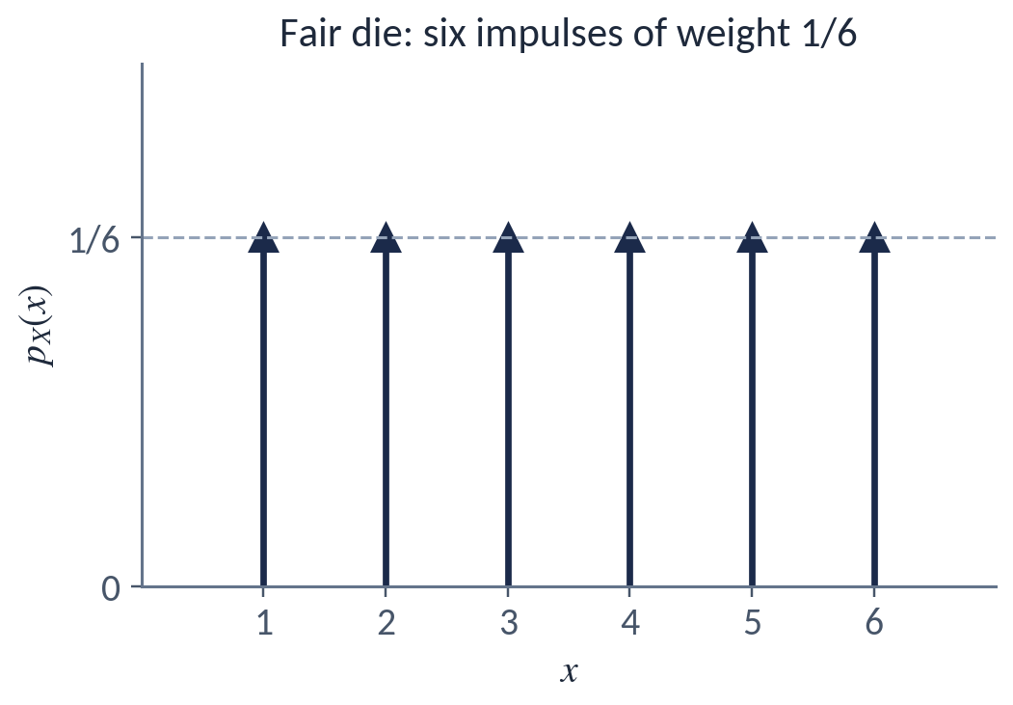
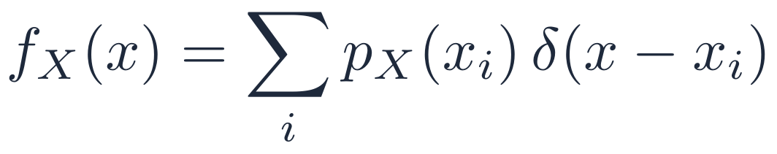
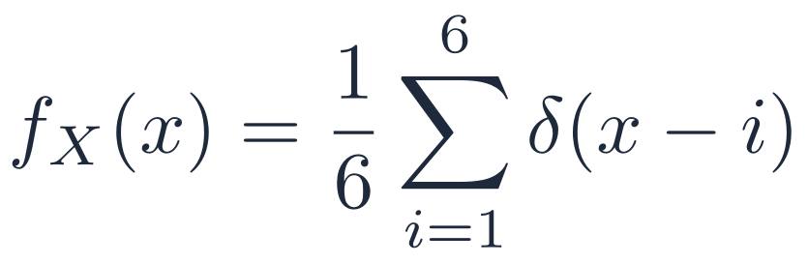
03 DENSITY & DISTRIBUTION FUNCTIONS
Probability Mass Function (PMF)
Used for discrete random variables
As a density: a sum of impulses; each impulse's magnitude is the probability of that outcome
EXAMPLE: ROLLING A FAIR DIE
Stochastic Processes · Week 01 · H. R. Rabiee
17 / 62

Slide 18
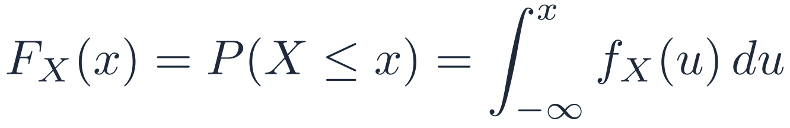
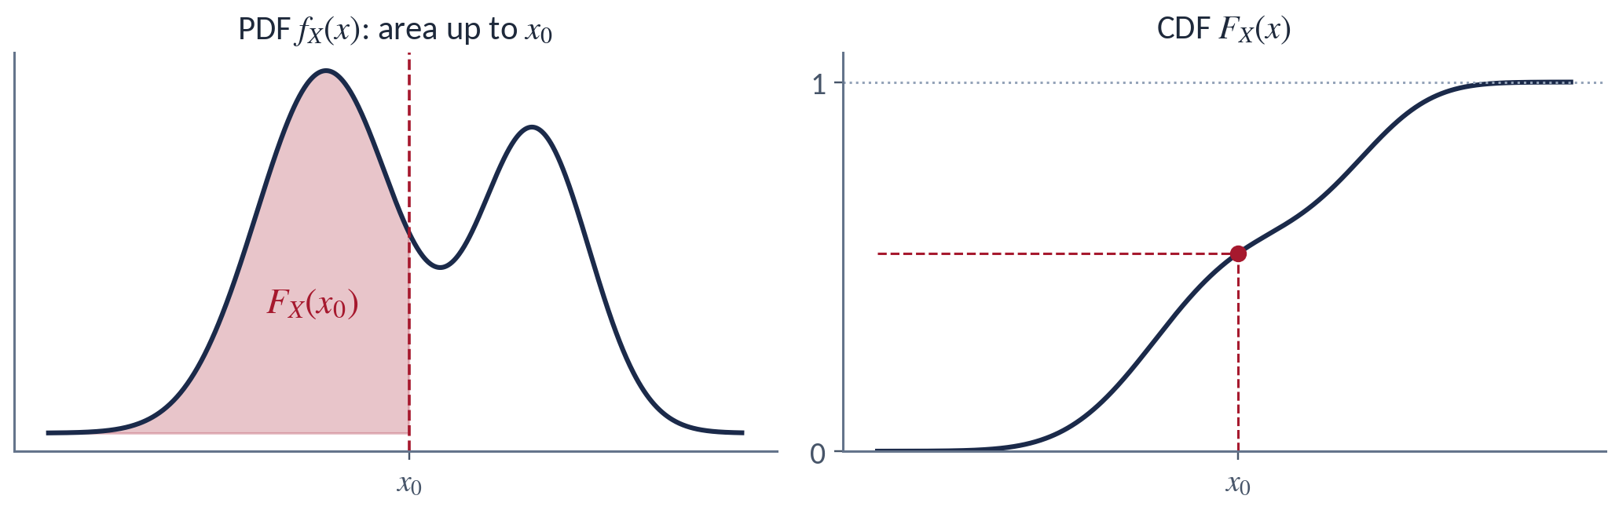
03 DENSITY & DISTRIBUTION FUNCTIONS
Cumulative Distribution Function (CDF)
DEFINITION
Defined for both continuous and discrete RVs
The integral of the PDF: the area to the left of x
Stochastic Processes · Week 01 · H. R. Rabiee
18 / 62

Slide 19
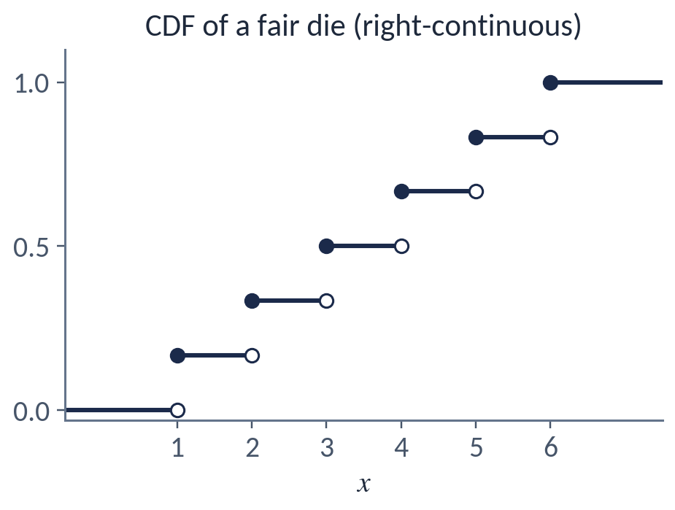
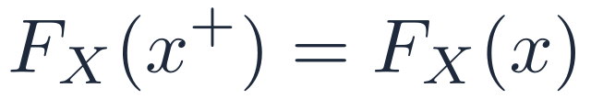
03 DENSITY & DISTRIBUTION FUNCTIONS
Properties of the CDF
1
Non-decreasing
2
Right-continuous
3
Limits
4
Interval probability
5
Jumps = point masses
Stochastic Processes · Week 01 · H. R. Rabiee
19 / 62

Slide 20
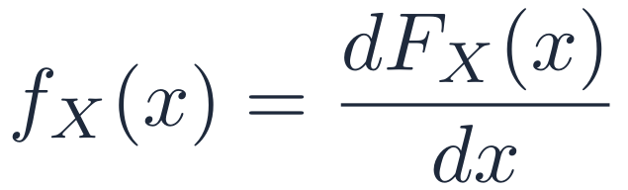
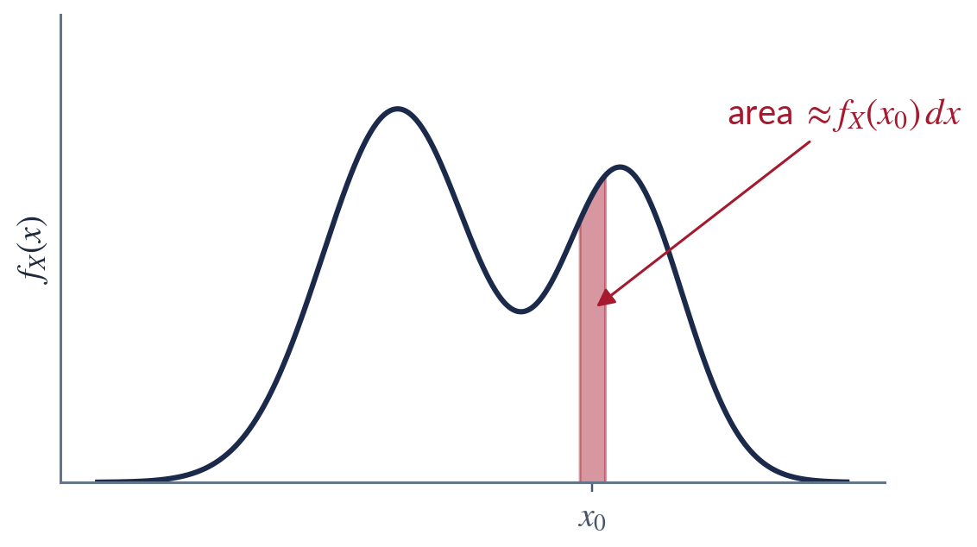
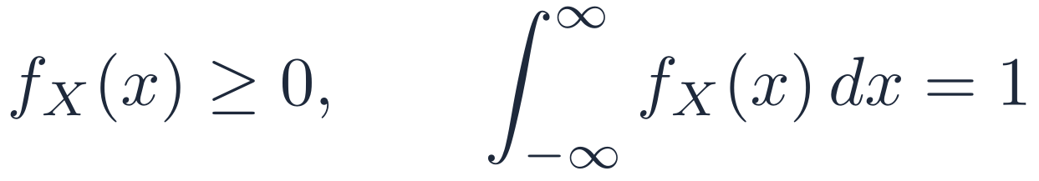
03 DENSITY & DISTRIBUTION FUNCTIONS
Probability Density Function (PDF)
Used for continuous random variables
Probability of X falling in a small interval around x₀:
NOTE
f_{X}(x) is a density, not a probability: it can exceed 1.
Stochastic Processes · Week 01 · H. R. Rabiee
20 / 62

Slide 21
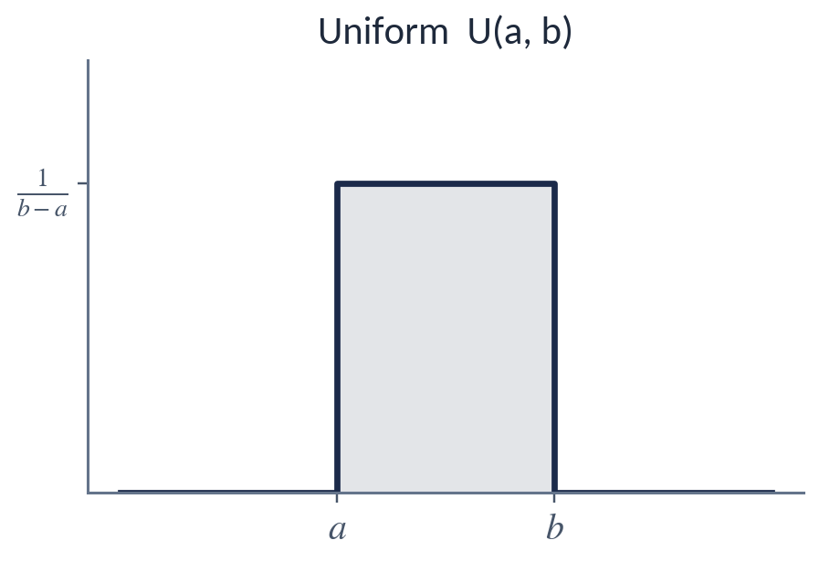
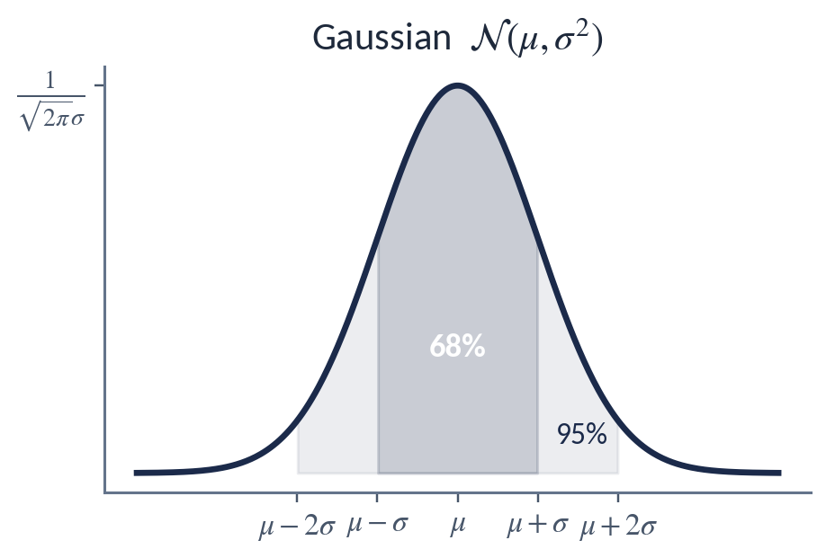
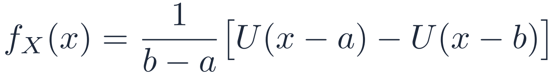
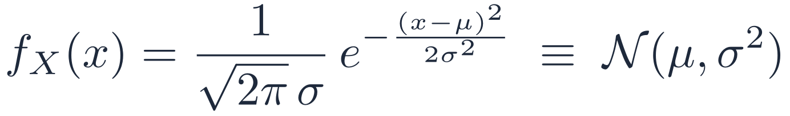
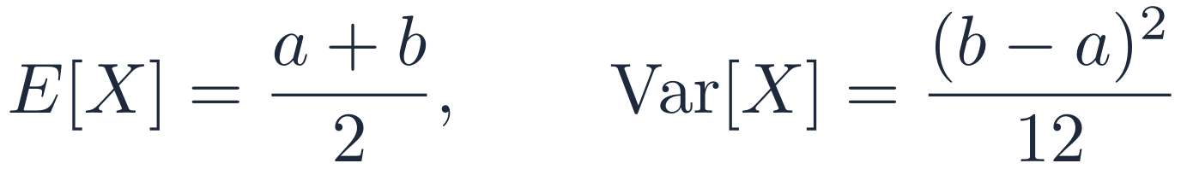
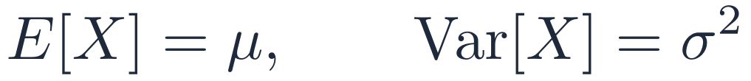
03 DENSITY & DISTRIBUTION FUNCTIONS
Common Densities: Uniform and Gaussian
UNIFORM U(a, b)
GAUSSIAN (NORMAL)
Stochastic Processes · Week 01 · H. R. Rabiee
21 / 62
Notes:
The Gaussian is written N(μ, σ²): the second parameter is the variance, not the standard deviation.

Slide 22
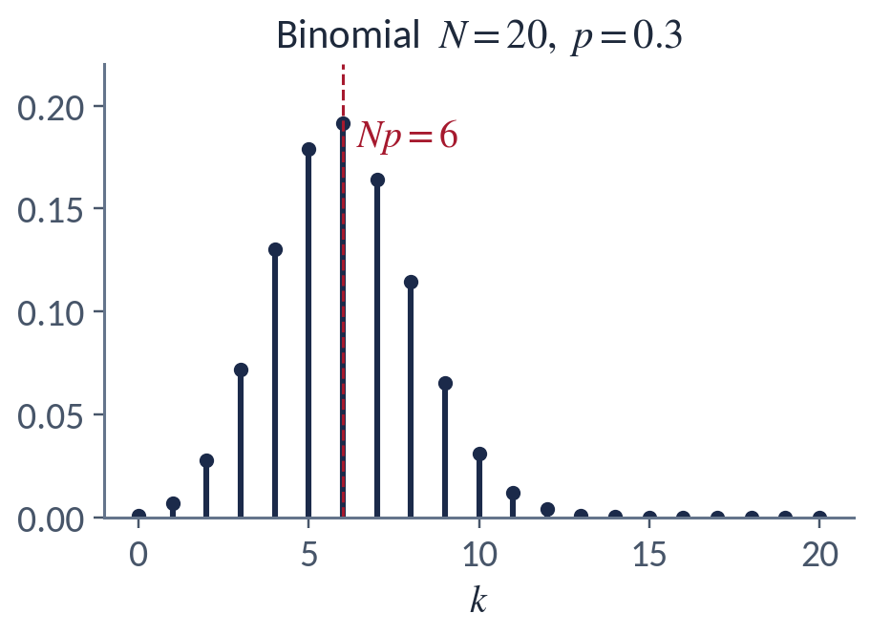
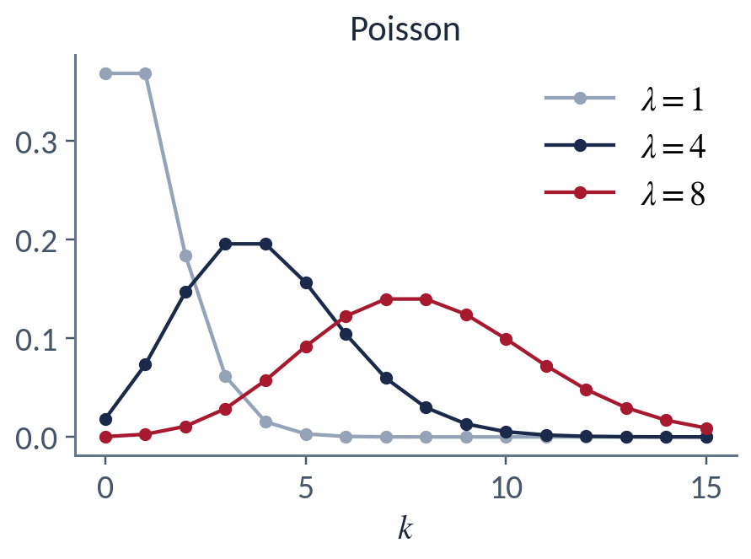
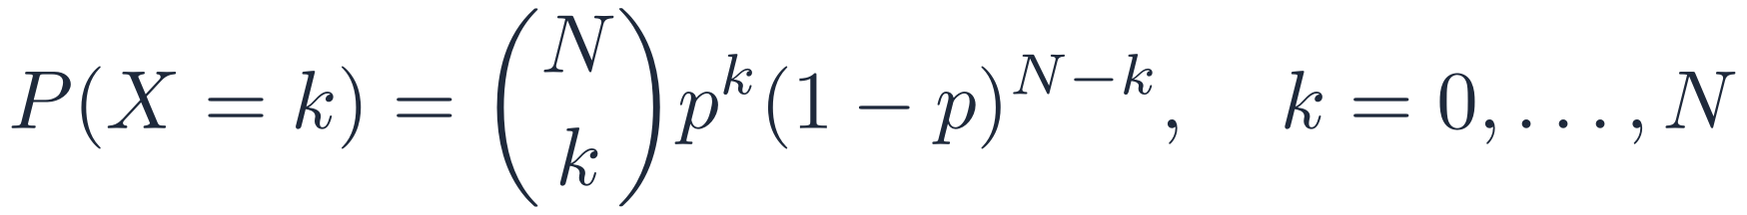
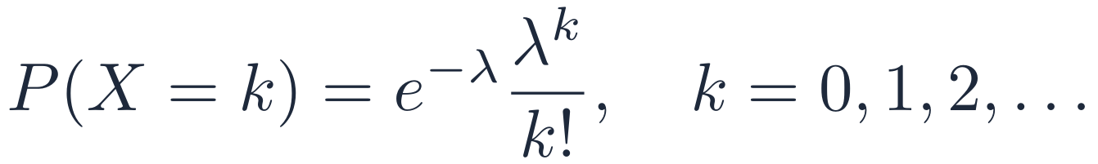
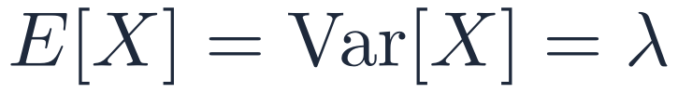
03 DENSITY & DISTRIBUTION FUNCTIONS
Discrete Families: Binomial and Poisson
BINOMIAL
POISSON
Stochastic Processes · Week 01 · H. R. Rabiee
22 / 62
Notes:
Binomial: number of successes in N independent trials with success probability p. Poisson: number of events in a fixed interval when events occur independently at a constant rate λ.

Slide 23
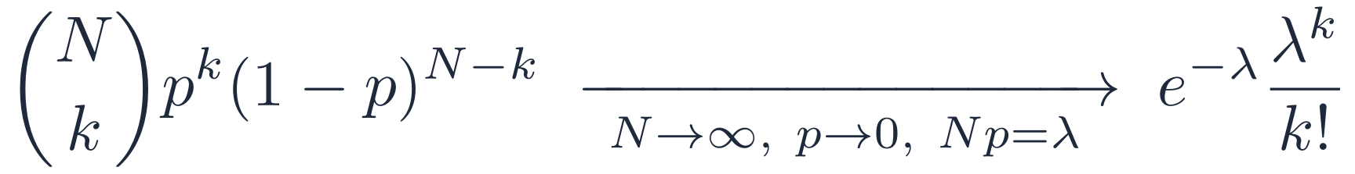
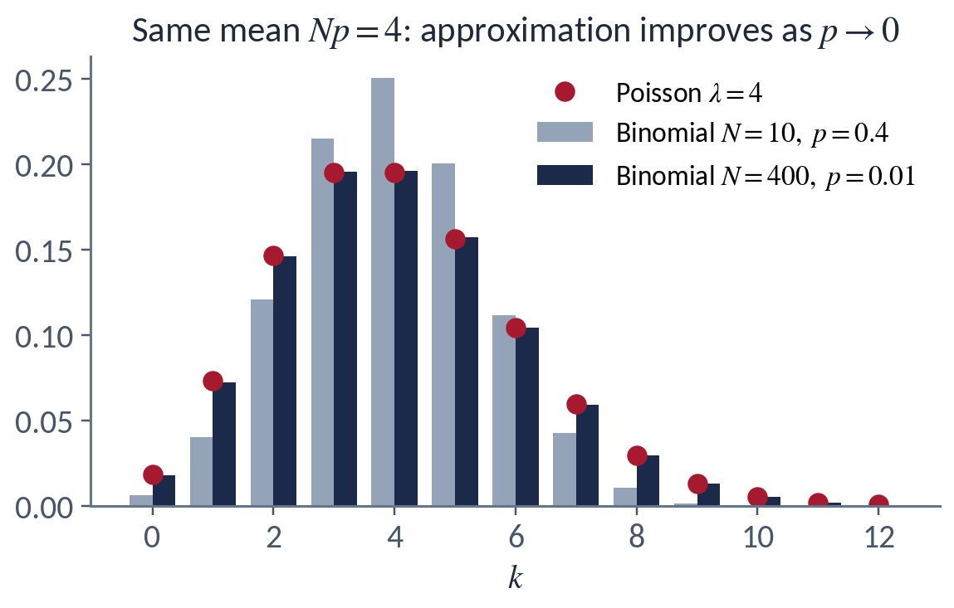
03 DENSITY & DISTRIBUTION FUNCTIONS
Poisson Approximation to the Binomial
IMPORTANT FACT
Rare events in many trials: replace Binomial(N, p) by Poisson(λ = Np)
Needs N large and p small; large N alone is not enough (compare the grey bars)
Stochastic Processes · Week 01 · H. R. Rabiee
23 / 62

Slide 24
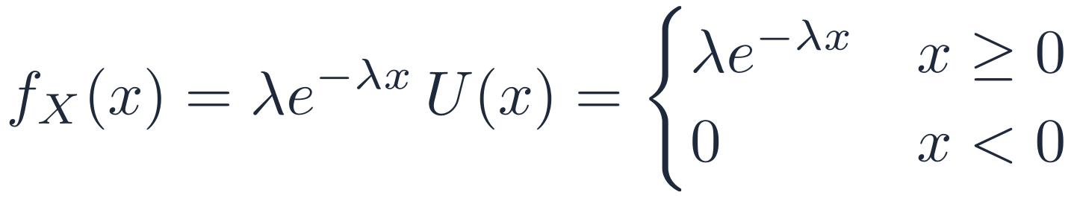
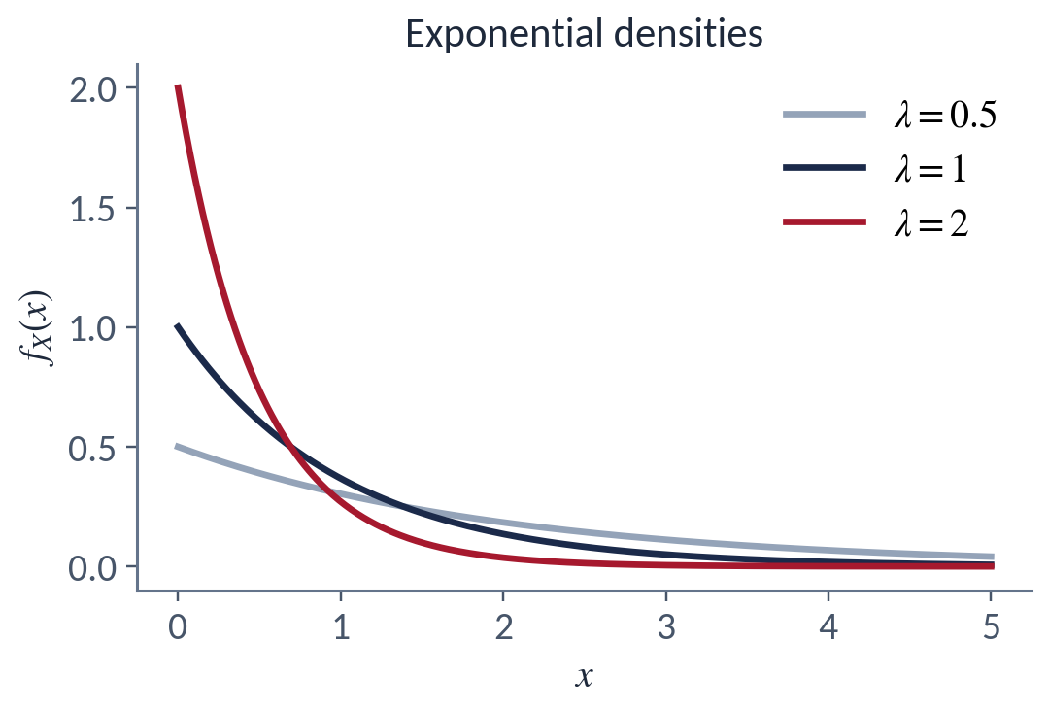
03 DENSITY & DISTRIBUTION FUNCTIONS
Exponential Density
MEMORYLESS PROPERTY
The only continuous memoryless distribution; it models waiting times between Poisson arrivals
Stochastic Processes · Week 01 · H. R. Rabiee
24 / 62

Slide 25
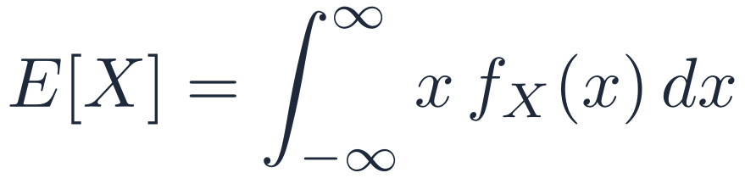
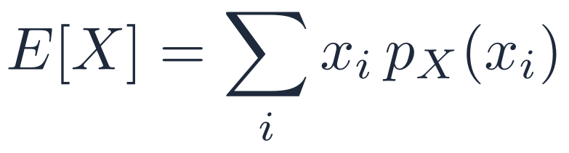
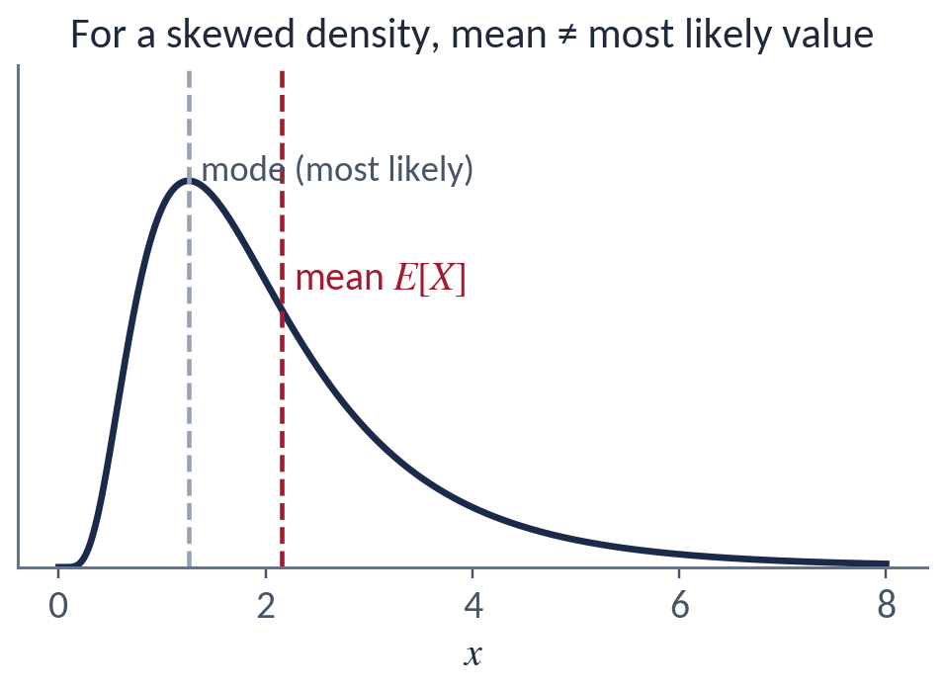
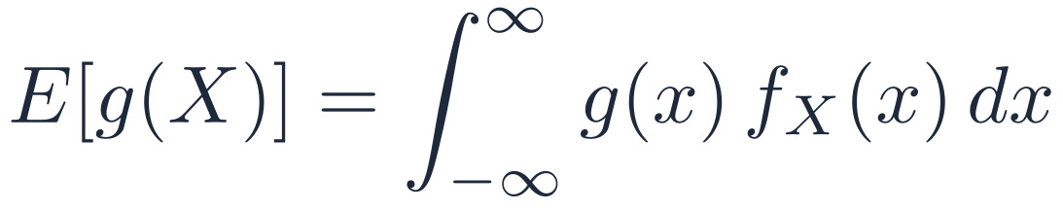
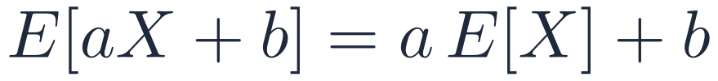
03 DENSITY & DISTRIBUTION FUNCTIONS
Expected Value
MEAN (EXPECTED VALUE)
The center of mass of the density: not necessarily the most likely value (the mode)
LINEAR OPERATOR
FUNCTION OF AN RV
Stochastic Processes · Week 01 · H. R. Rabiee
25 / 62
Notes:
Correction to v1.5: the expected value is not 'the most likely value'. The most likely value is the mode; for a skewed density the two differ.

Slide 26
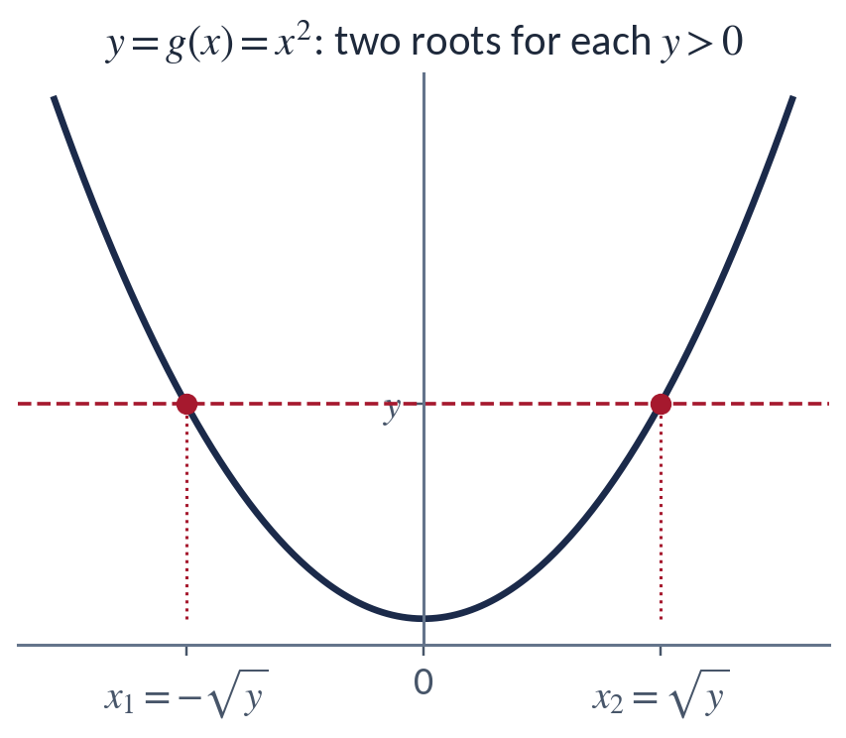
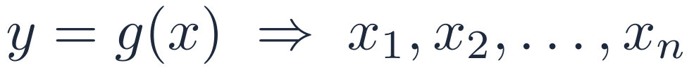
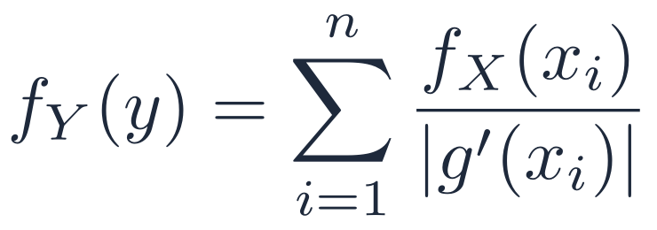
03 DENSITY & DISTRIBUTION FUNCTIONS
PDF of a Function of a Random Variable
THEOREM
Let Y = g(X), and suppose y = g(x) has the real roots x₁, …, x_{n}:
Then the PDF of Y follows from the PDF of X:
Sum over all real roots; if y = g(x) has no root, f_{Y}(y) = 0
Stochastic Processes · Week 01 · H. R. Rabiee
26 / 62

Slide 27
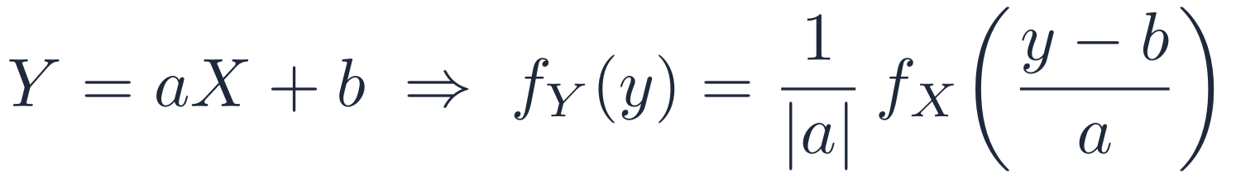
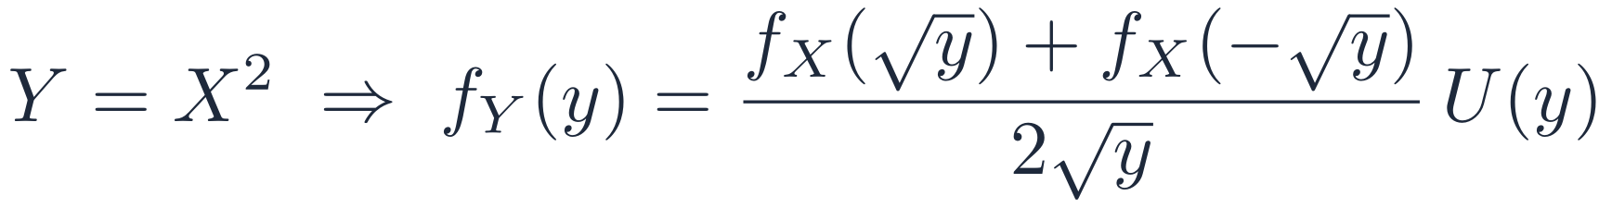
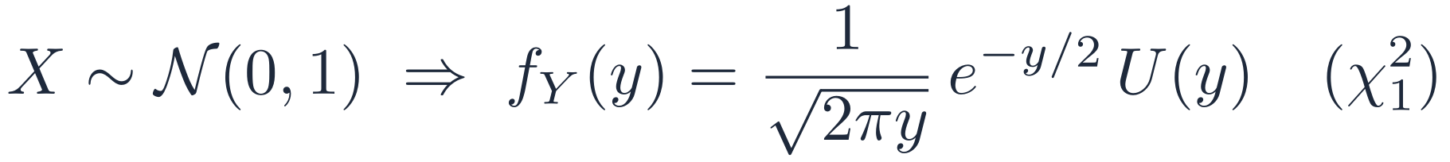
03 DENSITY & DISTRIBUTION FUNCTIONS
Worked Examples
LINEAR TRANSFORMATION
SQUARE LAW (TWO ROOTS)
GAUSSIAN SQUARED: CHI-SQUARE, 1 DEGREE OF FREEDOM
Stochastic Processes · Week 01 · H. R. Rabiee
27 / 62

Slide 28
04
Joint & Conditional Distributions
Two or more random variables at once: joint, marginal and conditional descriptions.
1
2
3
4
5
6
7
28 / 62

Slide 29
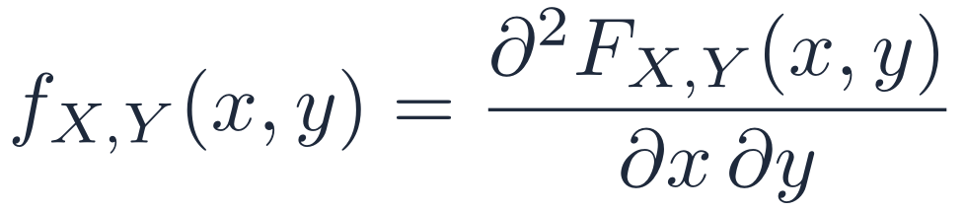
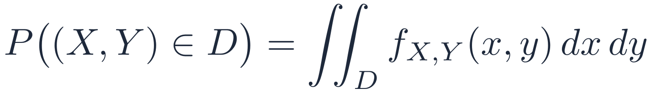
04 JOINT & CONDITIONAL DISTRIBUTIONS
Joint Distribution and Density
JOINT DISTRIBUTION FUNCTION
JOINT DENSITY FUNCTION
PROBABILITY OF A REGION
f_{X,Y}(x, y) ≥ 0 and it integrates to 1 over the whole plane
Everything about the pair (X, Y) is contained in F_{X,Y} (or f_{X,Y})
Stochastic Processes · Week 01 · H. R. Rabiee
29 / 62

Slide 30
04 JOINT & CONDITIONAL DISTRIBUTIONS
Example: A Die as a 3-Bit Number
Roll a fair die and write the outcome as a 3-bit number “xyz”. Let X and Y be the first two bits.
Outcome | x y z
1 | 0 0 1
2 | 0 1 0
3 | 0 1 1
4 | 1 0 0
5 | 1 0 1
6 | 1 1 0
Joint PMF p_{X,Y}(x, y)
 | y = 0 | y = 1
x = 0 | 1/6 {1} | 1/3 {2, 3}
x = 1 | 1/3 {4, 5} | 1/6 {6}
ARE X AND Y INDEPENDENT?
P(X = 0) = P(Y = 0) = 1/2, but P(X = 0, Y = 0) = 1/6 ≠ 1/4. No: the joint PMF does not factor.
Stochastic Processes · Week 01 · H. R. Rabiee
30 / 62

Slide 31
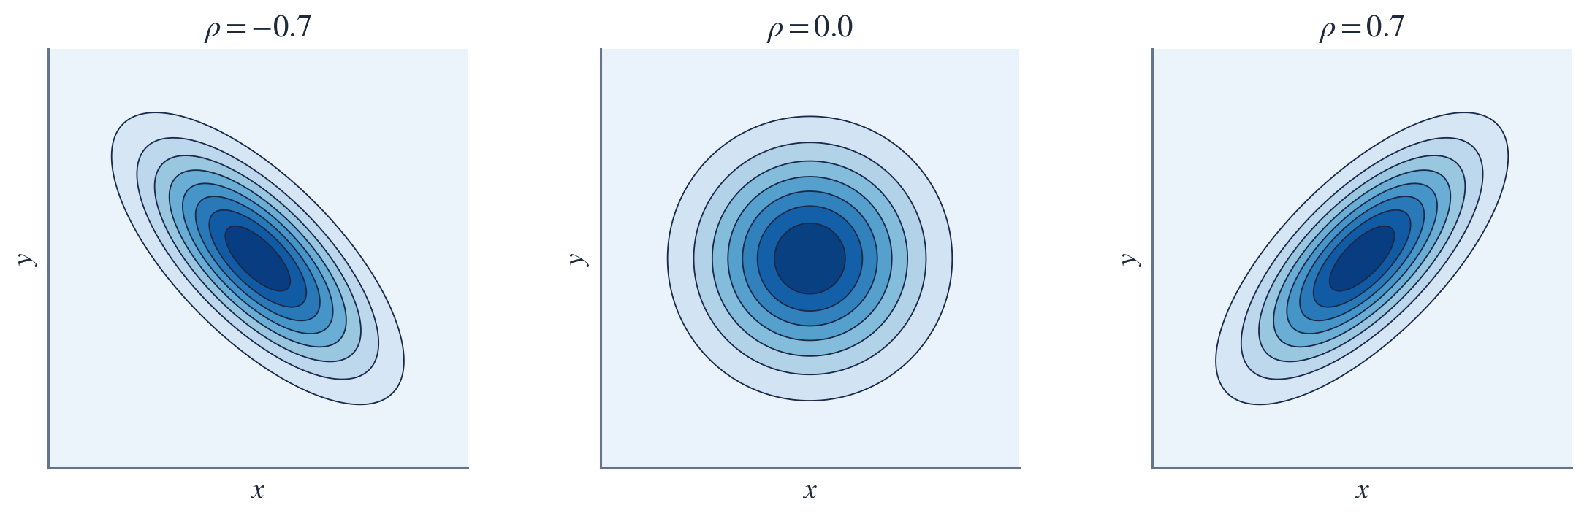
04 JOINT & CONDITIONAL DISTRIBUTIONS
Jointly Gaussian Random Variables
WHAT IS ρ?
ρ is the correlation coefficient of X and Y (Section 5): the strength and direction of their linear relationship
If ρ = 0, the density factors into f_{X}(x) f_{Y}(y)
Stochastic Processes · Week 01 · H. R. Rabiee
31 / 62
Notes:
ρ (called r in version 1.5) is the correlation coefficient between X and Y, which measures the strength and direction of their linear relationship. For jointly Gaussian RVs, uncorrelated (ρ = 0) implies independent.

Slide 32
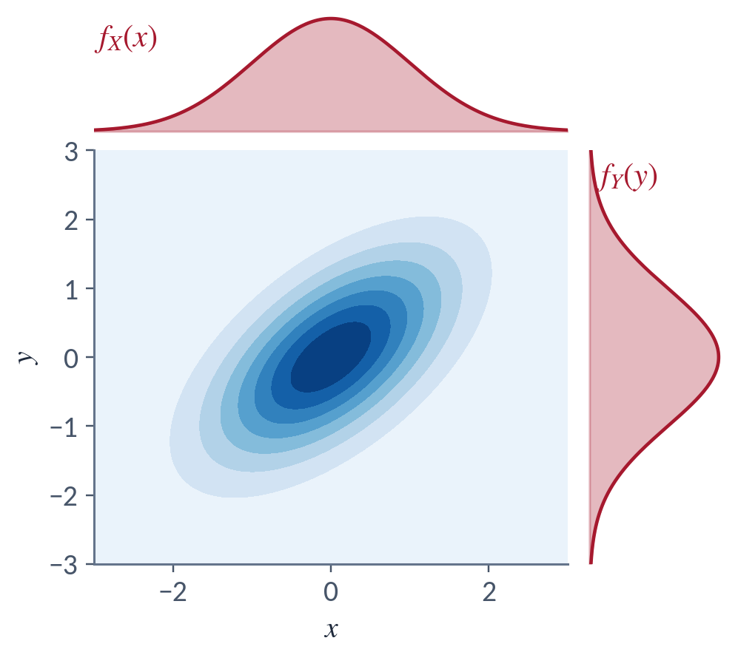



04 JOINT & CONDITIONAL DISTRIBUTIONS
Marginal Densities
Get the density of one variable by integrating out the other:
HOW DO WE GET THE DISTRIBUTION FUNCTIONS?
Integrate the marginal density, or let the other variable go to infinity:
Stochastic Processes · Week 01 · H. R. Rabiee
32 / 62

Slide 33


04 JOINT & CONDITIONAL DISTRIBUTIONS
Conditional Density and Bayes' Rule
CONDITIONAL DENSITY
Density of X once we have observed Y = y:
BAYES' RULE
Prior f_{X}(x) × likelihood f_{Y|X}(y|x) → posterior f_{X|Y}(x|y)
Stochastic Processes · Week 01 · H. R. Rabiee
33 / 62

Slide 34



04 JOINT & CONDITIONAL DISTRIBUTIONS
Examples of Conditioning
EXAMPLE I: ROLLING A FAIR DIE
X: the outcome is even {2, 4, 6}
Y: the outcome is prime {2, 3, 5}
EXAMPLE II: JOINTLY GAUSSIAN X, Y
Given Y = y, X is still Gaussian, with a shifted mean and a smaller variance:
Stochastic Processes · Week 01 · H. R. Rabiee
34 / 62
Notes:
Full conditional density for the jointly Gaussian case:
f(x|y) = 1/(√(2π) σX √(1−ρ²)) · exp{ −[x − μX − ρ(σX/σY)(y − μY)]² / (2σX²(1−ρ²)) }.

Slide 35
04 JOINT & CONDITIONAL DISTRIBUTIONS
Conditional Distribution Function
DEFINITION
Note that y is a constant during the integration
The denominator is just f_{Y}(y): it normalizes the slice of the joint density at Y = y (see the previous figure)
Stochastic Processes · Week 01 · H. R. Rabiee
35 / 62

Slide 36

04 JOINT & CONDITIONAL DISTRIBUTIONS
Independent Random Variables
DEFINITION
CONSEQUENCE: OBSERVING Y TELLS US NOTHING ABOUT X
FUNCTIONS OF INDEPENDENT RVs
Stochastic Processes · Week 01 · H. R. Rabiee
36 / 62

Slide 37


04 JOINT & CONDITIONAL DISTRIBUTIONS
Functions of Two Random Variables
Assume
The inverse system has solutions
Define the Jacobian matrix
THE JOINT PDF
Stochastic Processes · Week 01 · H. R. Rabiee
37 / 62
Notes:
Use the absolute value of the determinant of the Jacobian, evaluated at each root (x_i, y_i). This generalizes the one-variable rule f_Y(y) = Σ f_X(x_i)/|g'(x_i)|.

Slide 38




04 JOINT & CONDITIONAL DISTRIBUTIONS
Example: Cartesian to Polar Coordinates
RESULT: R AND Θ ARE INDEPENDENT
Stochastic Processes · Week 01 · H. R. Rabiee
38 / 62
Notes:
New example. The joint density factors into a function of r times a constant in θ, so R and Θ are independent: R is Rayleigh and Θ is uniform on (0, 2π]. This is the basis of the Box–Muller method and of Rayleigh fading models.

Slide 39
05
Linear Correlation
How much does knowing X tell us about Y, linearly?
1
2
3
4
5
6
7
39 / 62

Slide 40


05 LINEAR CORRELATION
Covariance and Correlation Coefficient
Knowing X, how much do we learn about Y? Covariance measures how two variables change together (linear similarity).
ρ is dimensionless; |ρ| = 1 exactly when Y = aX + b.
Stochastic Processes · Week 01 · H. R. Rabiee
40 / 62

Slide 41

05 LINEAR CORRELATION
Uncorrelated Is Not the Same as Independent
Zero covariance does not imply independence
Independence is stronger: no relationship of any kind, not just linear
Independent ⇒ uncorrelated (the converse fails, except for jointly Gaussian RVs)
COUNTEREXAMPLE
Stochastic Processes · Week 01 · H. R. Rabiee
41 / 62

Slide 42

05 LINEAR CORRELATION
Variance, Correlation and Standard Deviation
VARIANCE: COVARIANCE OF X WITH ITSELF
CORRELATION VS. COVARIANCE
σ_{X} = √Var(X): same units as X
STANDARD DEVIATION
Stochastic Processes · Week 01 · H. R. Rabiee
42 / 62
Notes:
In signal processing and in this course, 'correlation' R_XY = E[XY] and 'covariance' are different objects. This distinction becomes autocorrelation vs. autocovariance for stochastic processes.

Slide 43


05 LINEAR CORRELATION
Moments
n-TH MOMENT
n-TH CENTRAL MOMENT
MEAN AND VARIANCE
The mean is the first moment; the variance is the second moment minus the squared mean
NORMALIZED (STANDARDIZED) MOMENTS
Stochastic Processes · Week 01 · H. R. Rabiee
43 / 62
Notes:
Correction to v1.5: the variance is the second moment MINUS the square of the mean (E[X²] = σ² + μ²).

Slide 44
06
Important Theorems
Limit theorems and inequalities that make averages trustworthy.
1
2
3
4
5
6
7
44 / 62

Slide 45



06 IMPORTANT THEOREMS
Central Limit Theorem (CLT)
THEOREM
EXCEPTION: CAUCHY. WHY?
X₁, X₂, … i.i.d. with mean μ and finite variance σ²:
Cauchy RVs have no mean and infinite variance, so the hypothesis fails; the average of n Cauchy RVs is again Cauchy
The normalized sum approaches N(0, 1) whatever the distribution of X_{k}:
Stochastic Processes · Week 01 · H. R. Rabiee
45 / 62
Notes:
v1.5 wrote S_n = Σ a_n X_n and said the PDF converges. The standard statement uses the plain sum, normalized, and the convergence is of the distribution (CDF); convergence of densities needs extra conditions (a discrete X has no density at all).

Slide 46


06 IMPORTANT THEOREMS
Weak Law of Large Numbers
For i.i.d. RVs X_{k} with mean μ_{X}, the sample mean
CONVERGES IN PROBABILITY
PROOF (WHEN σ² IS FINITE), VIA CHEBYSHEV
Stochastic Processes · Week 01 · H. R. Rabiee
46 / 62

Slide 47


06 IMPORTANT THEOREMS
Strong Law of Large Numbers
CONVERGES ALMOST SURELY
WHY IS THIS STRONGER THAN THE WEAK LAW?
Almost-sure convergence implies convergence in probability, not the other way round
Weak: for each large n, a big deviation is unlikely, but individual sequences may still stray again and again
Strong: almost every sequence of running averages eventually stays close to μ_{X} for good
Stochastic Processes · Week 01 · H. R. Rabiee
47 / 62

Slide 48





06 IMPORTANT THEOREMS
Markov and Chebyshev Inequalities
MARKOV'S INEQUALITY (“CHEBYSHEV'S FIRST INEQUALITY”)
CHEBYSHEV'S INEQUALITY
Apply Markov to (X − μ_{X})² with c = ε². With ε = kσ:
Stochastic Processes · Week 01 · H. R. Rabiee
48 / 62
Notes:
The name 'Chebyshev's inequality' is sometimes used for Markov's inequality, especially in analysis; the two are closely related and some authors call Markov's inequality 'Chebyshev's first inequality'. The bound is distribution-free and therefore loose: for a Gaussian, P(|X−μ| ≥ 2σ) ≈ 0.046, while Chebyshev guarantees only ≤ 0.25.

Slide 49

06 IMPORTANT THEOREMS
Cauchy–Schwarz Inequality
FOR RVs X, Y WITH FINITE SECOND MOMENTS
Equality holds iff X = aY with probability 1 (linear dependence)
PROOF
A quadratic in a that is never negative has a non-positive discriminant.
CONSEQUENCE
Stochastic Processes · Week 01 · H. R. Rabiee
49 / 62

Slide 50
07
Introduction to Stochastic Processes
A random variable for every instant of time: random functions.
1
2
3
4
5
6
7
50 / 62

Slide 51

07 INTRODUCTION TO STOCHASTIC PROCESSES
What Is a Stochastic Process?
Let ξ denote the random outcome of an experiment
To every outcome, assign a function of time X(t, ξ)
The collection of such functions is a stochastic process
Both ξ and the time index t can be continuous or discrete (countably infinite or finite)
For a fixed ξ_{i} ∈ Ω (the set of all outcomes), X(t, ξ_{i}) is a specific time function
Stochastic Processes · Week 01 · H. R. Rabiee
51 / 62

Slide 52
07 INTRODUCTION TO STOCHASTIC PROCESSES
Four Ways to Read X(t, ξ)
T FIXED, Ξ FIXED
T VARIES, Ξ FIXED
X(t₁, ξ₁)
X(t, ξ₁)
A number
A time function (sample path, realization)
T FIXED, Ξ VARIES
T VARIES, Ξ VARIES
X₁ = X(t₁, ξ)
X(t) = X(t, ξ)
A random variable
The stochastic process (the ensemble)
Stochastic Processes · Week 01 · H. R. Rabiee
52 / 62
Notes:
In practice the ξ is dropped and we write X(t). Which of the four readings is meant is usually clear from context.

Slide 53



07 INTRODUCTION TO STOCHASTIC PROCESSES
Fixed t: A Random Variable
For fixed t, X₁ = X(t₁, ξ) is a random variable; the ensemble of all realizations over time is the process X(t)
FIRST-ORDER DESCRIPTION
FULL DESCRIPTION
All n-th order distributions, for every n and every choice of t₁, …, t_{n}
Stochastic Processes · Week 01 · H. R. Rabiee
53 / 62
Notes:
Complete statistical description: F_X(x1,…,xn; t1,…,tn) = P(X(t1) ≤ x1, …, X(tn) ≤ xn) for all n and all t1,…,tn.

Slide 54







07 INTRODUCTION TO STOCHASTIC PROCESSES
Stochastic Processes Are Everywhere
A FIRST EXAMPLE
Stock market fluctuations
Queuing systems
φ is uniformly distributed in (0, 2π): every outcome gives a sinusoid with a different phase
Earthquake signals
1-D audio
2-D images
3-D video
Stochastic Processes · Week 01 · H. R. Rabiee
54 / 62

Slide 55


07 INTRODUCTION TO STOCHASTIC PROCESSES
Example 1: X(t) = At + b, First-Order PDF
PROBLEM
Find f_{X}(x, t)
Use the PDF of a function of an RV (Section 3) with t held fixed:
RESULT
Stochastic Processes · Week 01 · H. R. Rabiee
55 / 62

Slide 56

07 INTRODUCTION TO STOCHASTIC PROCESSES
Example 1: Mean and Variance
Mean
Variance
NOTE
The mean is constant, but the variance grows with t: this process is not stationary
Stochastic Processes · Week 01 · H. R. Rabiee
56 / 62

Slide 57

07 INTRODUCTION TO STOCHASTIC PROCESSES
Example 2: Random-Phase Sinusoid
PROBLEM
a)
First-order PDF f_{X}(x, t) = ?
b)
E[X(t)] = ?
c)
Var[X(t)] = ?
Stochastic Processes · Week 01 · H. R. Rabiee
57 / 62
Notes:
A and ω0 are constants, t is the index (time), and θ ~ Uniform(0, 2π) is the only random quantity.

Slide 58



07 INTRODUCTION TO STOCHASTIC PROCESSES
Example 2 (a): First-Order PDF
RESULT: THE ARCSINE DENSITY
Stochastic Processes · Week 01 · H. R. Rabiee
58 / 62

Slide 59


07 INTRODUCTION TO STOCHASTIC PROCESSES
Example 2 (b, c): Mean and Variance
(b) MEAN
(c) VARIANCE
NOTE
Here both the mean and the variance are constant in t, unlike Example 1. In fact E[X(t+τ)X(t)] = (A²/2) cos(ω₀τ) depends only on τ: a first taste of stationarity.
Stochastic Processes · Week 01 · H. R. Rabiee
59 / 62

Slide 60
07 INTRODUCTION TO STOCHASTIC PROCESSES
Looking Ahead: Stationary Processes
STRICT-SENSE STATIONARY (SSS)
All statistics are invariant to a time shift.
Stationary
Process
WIDE-SENSE STATIONARY (WSS)
Only the mean and autocorrelation are shift-invariant. SSS ⇒ WSS (finite second moments).
Details next class
Stochastic Processes · Week 01 · H. R. Rabiee
60 / 62

Slide 61
07 INTRODUCTION TO STOCHASTIC PROCESSES
Practice Problems
1
For X ~ Poisson(λ), show that E[X] = Var[X] = λ.
2
X ~ U(0, 1). Find the PDF of Y = −(1/λ) ln X. Which family is it?
3
X, Y i.i.d. N(0, 1). Show that U = X + Y and V = X − Y are independent (use the Jacobian).
4
Use Chebyshev to find n so that the fraction of heads in n fair-coin tosses is within 0.05 of 1/2 with probability ≥ 0.95.
5
X(t) = A cos ω₀t + B sin ω₀t, with A, B i.i.d. N(0, σ²). Find E[X(t)], Var[X(t)] and f_{X}(x, t).
Stochastic Processes · Week 01 · H. R. Rabiee
61 / 62
Notes:
Answers: (1) direct summation. (2) Exponential with rate λ. (3) Jacobian determinant is −2; the joint PDF factors into N(0,2)×N(0,2). (4) Var of the fraction = 1/(4n); Chebyshev gives 1/(4n·0.05²) ≤ 0.05 ⇒ n ≥ 2000. (5) Mean 0, variance σ², X(t) ~ N(0, σ²) for every t.

Slide 62
NEXT WEEK
Stochastic Processes
Stationary Stochastic Processes
Have a good day!

