Slide 1

STOCHASTIC PROCESSES · FALL 2026
Stationary Stochastic Processes
Strict-sense (SSS) and wide-sense (WSS) stationarity
Week 02 · Version 3.0
Hamid R. Rabiee
Department of Computer Engineering, Sharif University of Technology
This presentation has been formatted by Claude Opus5.5.

Slide 2
ROADMAP
Outline of Week 02
01
Stochastic Processes X(t)
05
Stationary Stochastic Processes
02
First-Order Statistics of X(t)
06
Strict-Sense Stationary (SSS) Processes
03
Higher-Order Statistics of X(t)
07
Wide-Sense Stationary (WSS) Processes
04
Goal: know when the statistics of X(t) do not depend on where we look in time, and what that buys us.
Mean, Autocorrelation & Autocovariance
Stochastic Processes · Week 02 · H. R. Rabiee
2 / 44

Slide 3
01
01
Stochastic Processes X(t)
02
First-Order Statistics of X(t)
03
Higher-Order Statistics of X(t)
Stochastic Processes X(t)
04
Mean, Autocorrelation & Autocovariance
05
Stationary Stochastic Processes
06
Strict-Sense Stationary (SSS) Processes
07
Wide-Sense Stationary (WSS) Processes
Week 02 · Stationary Stochastic Processes
3 / 44

Slide 4
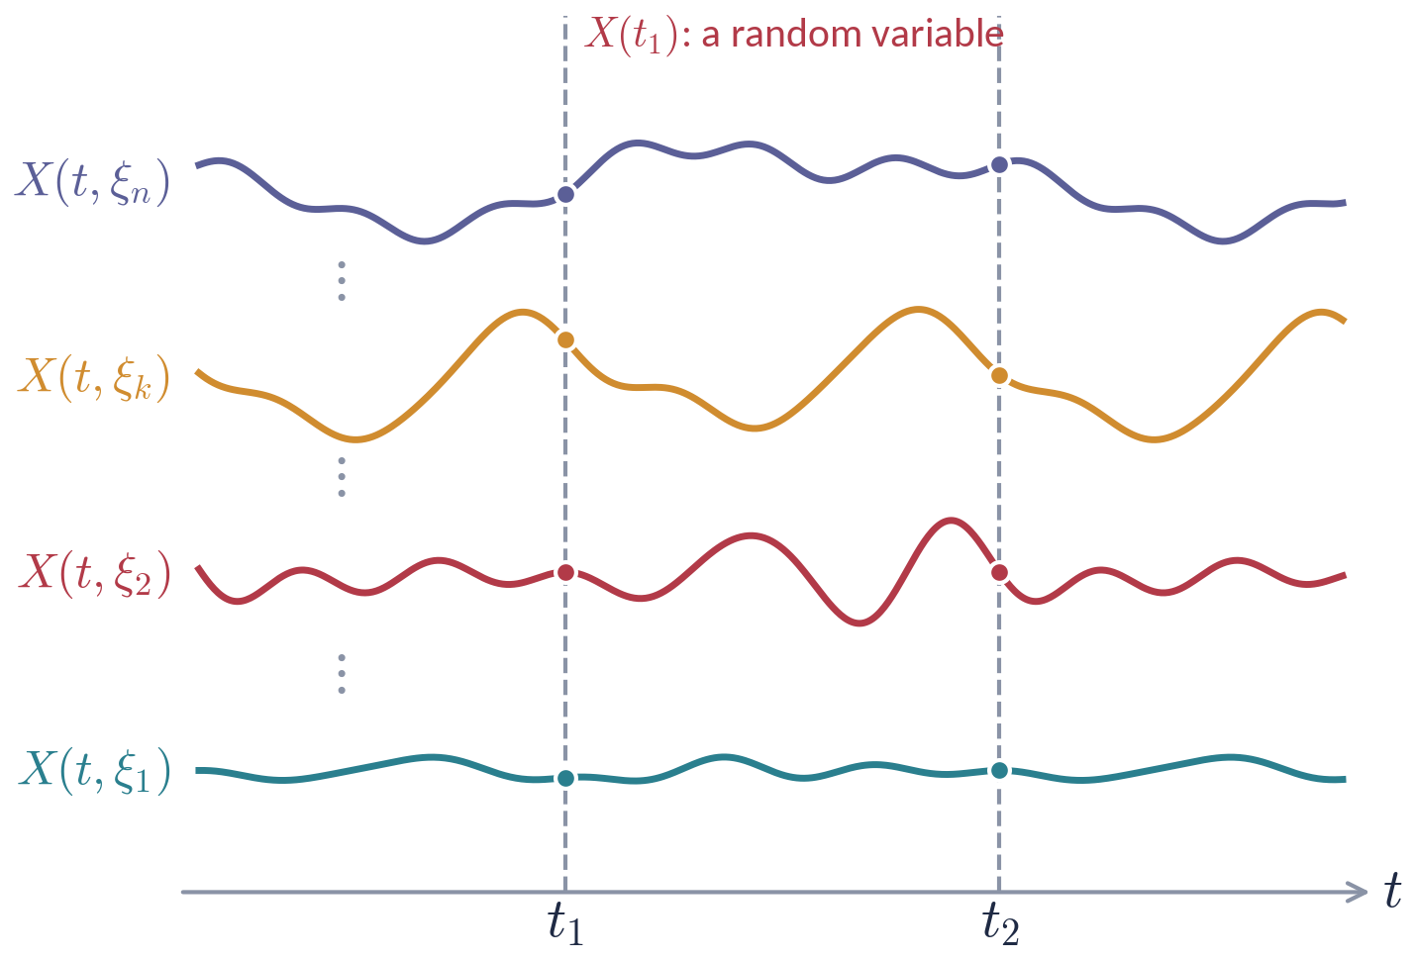
STOCHASTIC PROCESSES X(T)
Stochastic Processes (recall)
Let ξ denote the random outcome of an experiment, ξ∈ S.
To every outcome we assign a waveform X(t,ξ) — a sample path (realization).
The collection of all sample paths (the ensemble) forms the stochastic process X(t).
The index set of t and the values of X may each be continuous or discrete (countable or finite).
Notation
We write X(t) for X(t,ξ), dropping ξ when no confusion arises.
Stochastic Processes · Week 02 · H. R. Rabiee
4 / 44

Slide 5
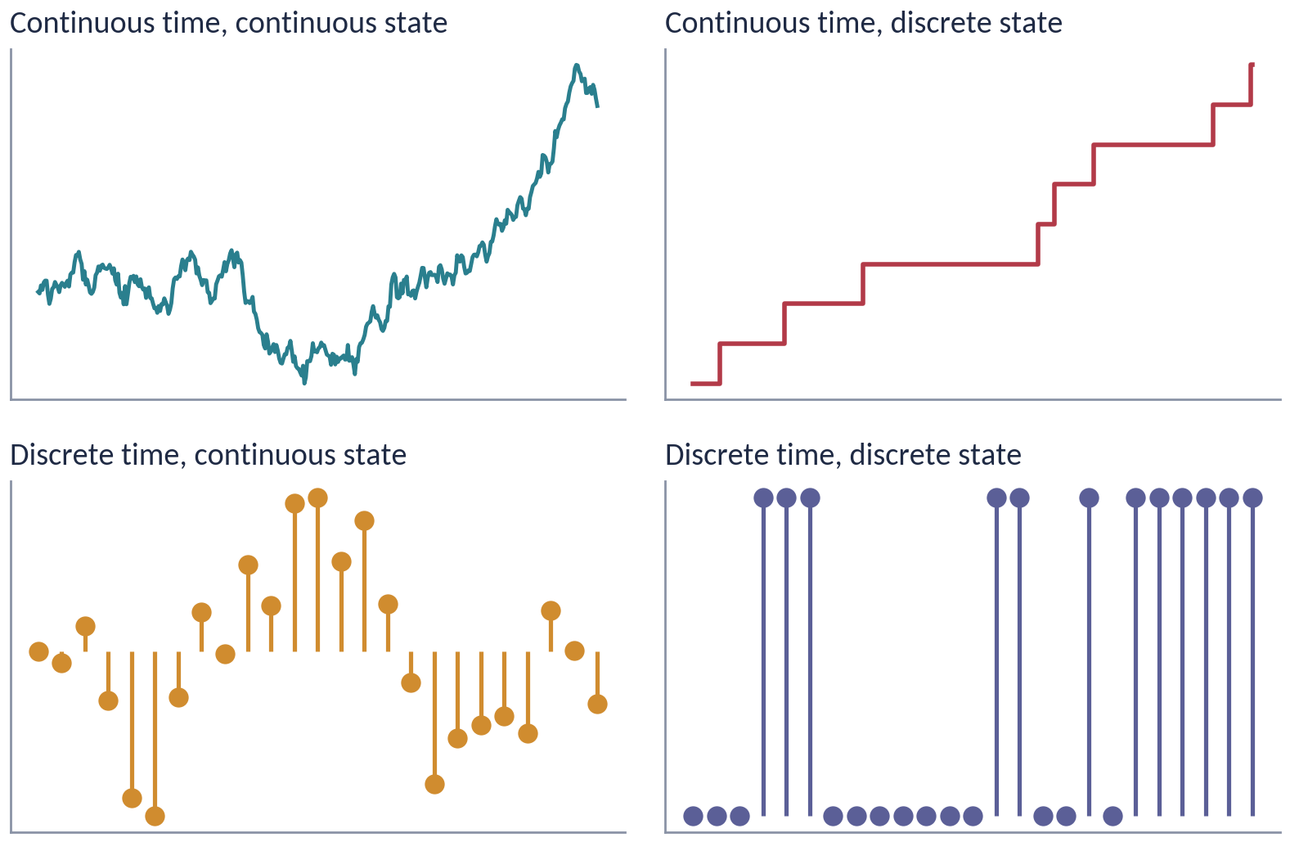
STOCHASTIC PROCESSES X(T)
Two Views of the Same Object
Classification by time index and state space
t fixed
t variable
ξ fixed
a number X(t₁,ξ_{i})
a time function (sample path)
ξ variable
a random variable X(t₁)
the stochastic process X(t)
For fixed ξ_{i}, X(t,ξ_{i}) is a specific time function.
For fixed t₁, X₁=X(t₁,ξ) is a random variable.
The ensemble of all realizations over time is the stochastic process.
e.g. thermal noise · Poisson counts · AR(1) sequence · Bernoulli sequence
Stochastic Processes · Week 02 · H. R. Rabiee
5 / 44

Slide 6
02
01
Stochastic Processes X(t)
02
First-Order Statistics of X(t)
03
Higher-Order Statistics of X(t)
First-Order Statistics of X(t)
04
Mean, Autocorrelation & Autocovariance
05
Stationary Stochastic Processes
06
Strict-Sense Stationary (SSS) Processes
07
Wide-Sense Stationary (WSS) Processes
Week 02 · Stationary Stochastic Processes
6 / 44

Slide 7
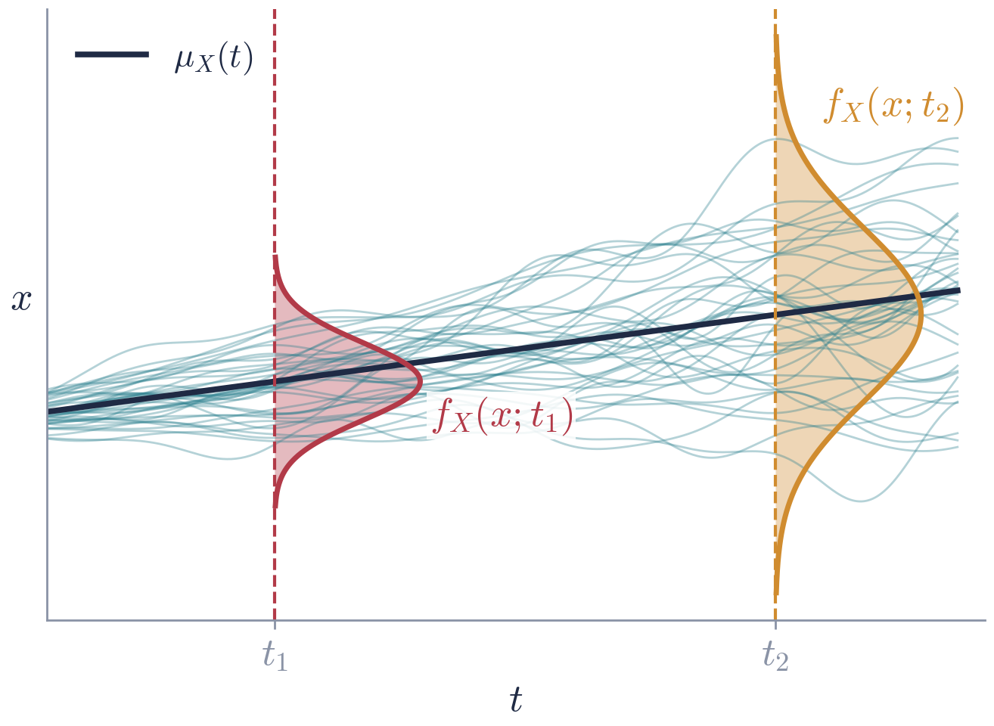
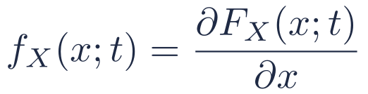

FIRST-ORDER STATISTICS OF X(T)
First-Order CDF and PDF
For a fixed t, X(t) is a random variable. Its distribution function is
First-order distribution
$$F_{X}\left(x;t\right)=P\{X\left(t\right)≤x\}$$
and the first-order pdf of the process is
$$f_{X}\left(x;t\right)=\frac{∂F_{X}\left(x;t\right)}{∂x}$$
F_{X}(x;t) generally depends on t: a different t gives a different random variable.
First-order statistics describe each time instant in isolation — they say nothing about how X(t₁) and X(t₂) are related.
The first-order pdf is a "slice" of the ensemble at one time; here both the mean and the spread change with t.
Stochastic Processes · Week 02 · H. R. Rabiee
7 / 44

Slide 8
03
01
Stochastic Processes X(t)
02
First-Order Statistics of X(t)
03
Higher-Order Statistics of X(t)
Higher-Order Statistics of X(t)
04
Mean, Autocorrelation & Autocovariance
05
Stationary Stochastic Processes
06
Strict-Sense Stationary (SSS) Processes
07
Wide-Sense Stationary (WSS) Processes
Week 02 · Stationary Stochastic Processes
8 / 44

Slide 9
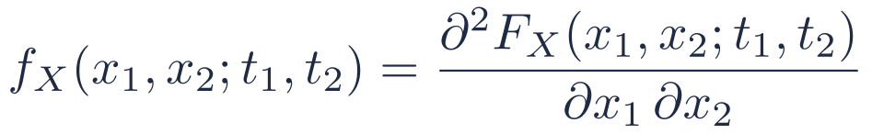
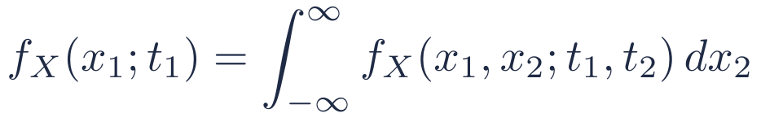
HIGHER-ORDER STATISTICS OF X(T)
Second-Order CDF and PDF
For t=t₁ and t=t₂, X(t) gives two random variables X₁=X(t₁) and X₂=X(t₂). Their joint distribution is
Second-order distribution and density
$$F_{X}\left(x_{1},x_{2};t_{1},t_{2}\right)=P\{X\left(t_{1}\right)≤x_{1}, X\left(t_{2}\right)≤x_{2}\}$$
$$f_{X}\left(x_{1},x_{2};t_{1},t_{2}\right)=\frac{∂^{2}F_{X}\left(x_{1},x_{2};t_{1},t_{2}\right)}{∂x_{1} ∂x_{2}}$$
The second-order density captures the dependence between the process at two instants.
It must be consistent with the first-order density (marginalization):
$$f_{X}\left(x_{1};t_{1}\right)=\int_{−∞}^{∞}{f_{X}}\left(x_{1},x_{2};t_{1},t_{2}\right) dx_{2}$$
Stochastic Processes · Week 02 · H. R. Rabiee
9 / 44

Slide 10
HIGHER-ORDER STATISTICS OF X(T)
n-th Order Distributions
n-th order density
For any n time instants t₁,…,t_{n}, the joint density of X(t₁),…,X(t_{n})
$$f_{X}\left(x_{1},x_{2},…,x_{n}; t_{1},t_{2},…,t_{n}\right)$$
is the n-th order density of the process X(t).
Complete specification of X(t) requires f_{X}(x₁,…,x_{n};t₁,…,t_{n}) for all t_{i}, i=1,…,n, and for all n — an almost impossible task in practice.
These densities are not arbitrary: they must be consistent — symmetric under permuting the pairs (x_{i},t_{i}), and each lower-order density must follow by integrating out variables (Kolmogorov consistency).
In practice we therefore work with a few moments: the mean and the autocorrelation. This motivates the next section.
Stochastic Processes · Week 02 · H. R. Rabiee
10 / 44

Slide 11
04
01
Stochastic Processes X(t)
02
First-Order Statistics of X(t)
03
Higher-Order Statistics of X(t)
Mean, Autocorrelation & Autocovariance
04
Mean, Autocorrelation & Autocovariance
05
Stationary Stochastic Processes
06
Strict-Sense Stationary (SSS) Processes
07
Wide-Sense Stationary (WSS) Processes
Week 02 · Stationary Stochastic Processes
11 / 44

Slide 12
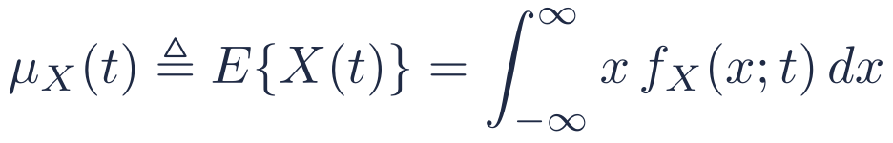
MEAN, AUTOCORRELATION & AUTOCOVARIANCE
Mean and Autocorrelation
Mean (expected value) of a stochastic process
$$μ_{X}\left(t\right)≜E\{X\left(t\right)\}=\int_{−∞}^{∞}{x} f_{X}\left(x;t\right) dx$$
In general, the mean of a process can depend on the time index t.
Autocorrelation function
$$R_{XX}\left(t_{1},t_{2}\right)≜E\{X\left(t_{1}\right)X^{∗}\left(t_{2}\right)\}=\int_{−∞}^{∞}{\int_{−∞}^{∞}{x_{1}}}x_{2}^{∗} f_{X}\left(x_{1},x_{2};t_{1},t_{2}\right) dx_{1} dx_{2}$$
It measures the interrelationship between the random variables X₁=X(t₁) and X₂=X(t₂) generated by the process. For real processes the conjugate * can be dropped.
Stochastic Processes · Week 02 · H. R. Rabiee
12 / 44

Slide 13

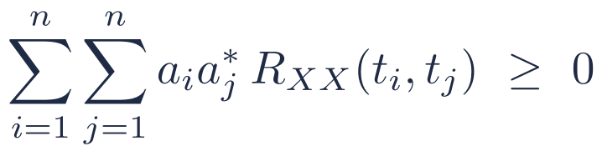
MEAN, AUTOCORRELATION & AUTOCOVARIANCE
Properties of the Autocorrelation Function
1. Hermitian symmetry
$$R_{XX}\left(t_{1},t_{2}\right)=R_{XX}^{∗}\left(t_{2},t_{1}\right)={\left[E\{X\left(t_{2}\right)X^{∗}\left(t_{1}\right)\}\right]}^{∗}$$
2. Average instantaneous power
$$R_{XX}\left(t,t\right)=E\{{\left|X\left(t\right)\right|}^{2}\} ≥ 0$$
3. Non-negative definiteness — for any n, any t₁,…,t_{n} and any constants {a_{i}}_{i=1}^{n}
$$\sum_{i=1}^{n}{\sum_{j=1}^{n}{a_{i}}}a_{j}^{∗} R_{XX}\left(t_{i},t_{j}\right) ≥ 0$$
Proof: let Y=∑_{i=1}^{n} a_{i}X(t_{i}). Then E{|Y|²}=∑_{i}∑_{j} a_{i}a_{j}*E{X(t_{i})X*(t_{j})}≥ 0.
Stochastic Processes · Week 02 · H. R. Rabiee
13 / 44

Slide 14
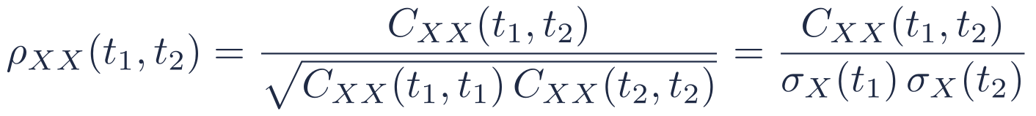
MEAN, AUTOCORRELATION & AUTOCOVARIANCE
Autocovariance and Correlation Coefficient
Autocovariance
$$C_{XX}\left(t_{1},t_{2}\right)=E\{\left[X\left(t_{1}\right)−μ_{X}\left(t_{1}\right)\right]{\left[X\left(t_{2}\right)−μ_{X}\left(t_{2}\right)\right]}^{∗}\}=R_{XX}\left(t_{1},t_{2}\right)−μ_{X}\left(t_{1}\right) μ_{X}^{∗}\left(t_{2}\right)$$
Its diagonal is the variance of the process: σ_{X}²(t)=C_{XX}(t,t).
Correlation coefficient
$$ρ_{XX}\left(t_{1},t_{2}\right)=\frac{C_{XX}\left(t_{1},t_{2}\right)}{\sqrt{C_{XX}\left(t_{1},t_{1}\right) C_{XX}\left(t_{2},t_{2}\right)}}=\frac{C_{XX}\left(t_{1},t_{2}\right)}{σ_{X}\left(t_{1}\right) σ_{X}\left(t_{2}\right)}$$
By the Cauchy–Schwarz inequality, |ρ_{XX}(t₁,t₂)|≤ 1.
ρ_{XX} is a normalized, unit-free measure of how linearly related X(t₁) and X(t₂) are.
Stochastic Processes · Week 02 · H. R. Rabiee
14 / 44

Slide 15
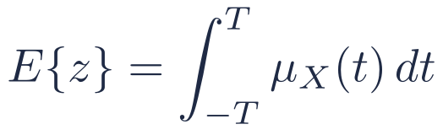
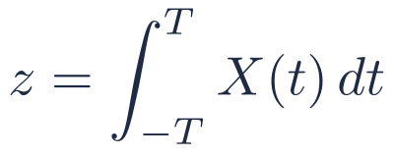
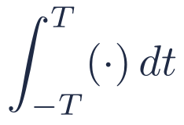
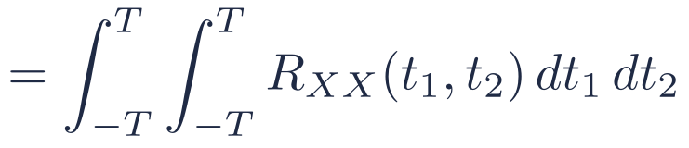
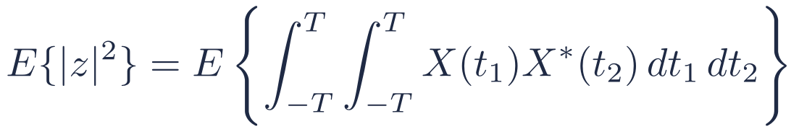
MEAN, AUTOCORRELATION & AUTOCOVARIANCE
Example 1 — The Integrator
Let the random variable z be the integral of the process over [−T,T]:
$$z=\int_{−T}^{T}{X}\left(t\right) dt$$
$$\int_{−T}^{T}{\left(⋅\right)} dt$$
X(t)
z
Mean (expectation and integration commute):
$$E\{z\}=\int_{−T}^{T}{μ_{X}}\left(t\right) dt$$
Coming back later
Second moment:
For a WSS input this double integral collapses to a single integral over τ=t₁−t₂ — see the integrator revisited in Section 07.
$$E\{{\left|z\right|}^{2}\}=E\left\{\int_{−T}^{T}{\int_{−T}^{T}{X}}\left(t_{1}\right)X^{∗}\left(t_{2}\right) dt_{1} dt_{2}\right\}$$
$$=\int_{−T}^{T}{\int_{−T}^{T}{R_{XX}}}\left(t_{1},t_{2}\right) dt_{1} dt_{2}$$
Stochastic Processes · Week 02 · H. R. Rabiee
15 / 44

Slide 16
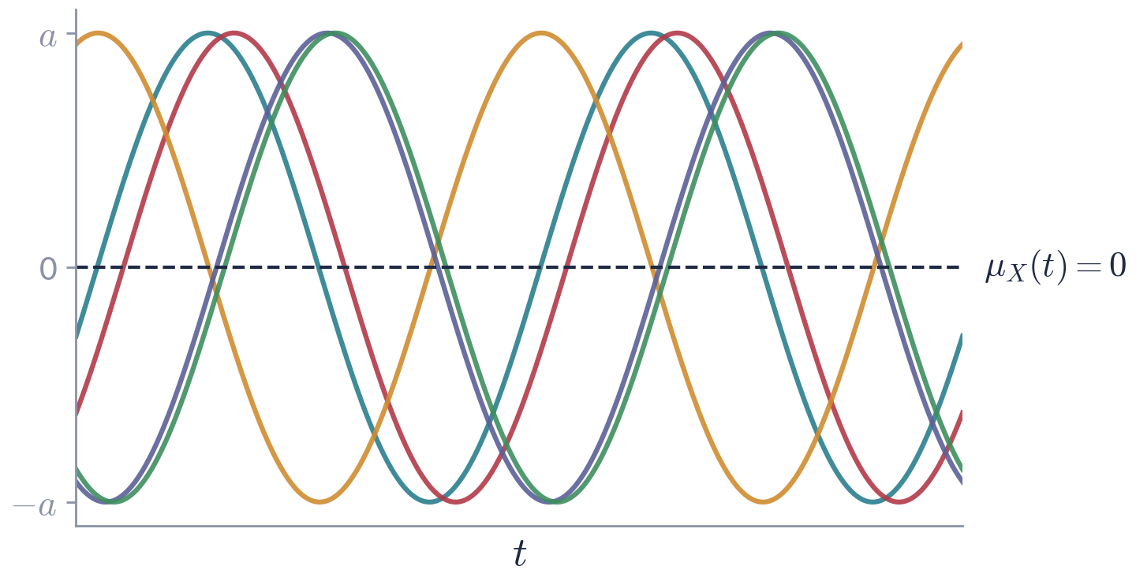
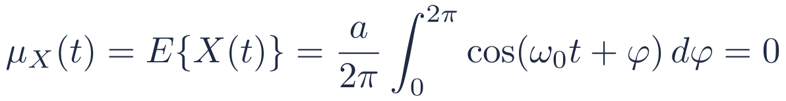
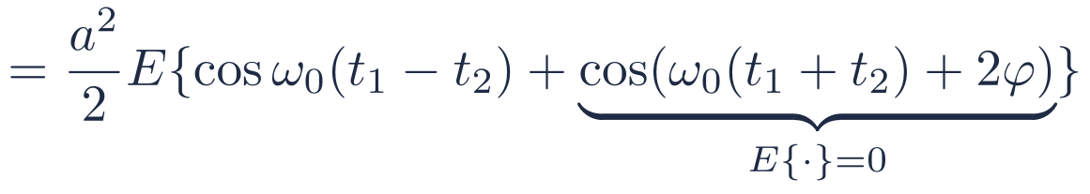
MEAN, AUTOCORRELATION & AUTOCOVARIANCE
Example 2 — Sinusoid with Random Phase
$$X\left(t\right)=acos\left(ω_{0}t+φ\right), φ∼U\left(0,2π\right)$$
$$μ_{X}\left(t\right)=E\{X\left(t\right)\}=\frac{a}{2π}\int_{0}^{2π}{cos}\left(ω_{0}t+φ\right) dφ=0$$
$$R_{XX}\left(t_{1},t_{2}\right)=a^{2}E\{cos\left(ω_{0}t_{1}+φ\right)cos\left(ω_{0}t_{2}+φ\right)\}$$
$$=\frac{a^{2}}{2}E\{cosω_{0}\left(t_{1}−t_{2}\right)+\underset{E\{⋅\}=0}{\underset{⏟}{cos\left(ω_{0}\left(t_{1}+t_{2}\right)+2φ\right)}}\}$$
$$R_{XX}\left(t_{1},t_{2}\right)=\frac{a^{2}}{2}cosω_{0}\left(t_{1}−t_{2}\right), σ_{X}^{2}=R_{XX}\left(t,t\right)=\frac{a^{2}}{2}$$
Observe
The mean is constant and R_{XX} depends only on t₁−t₂. We will call such a process wide-sense stationary.
Stochastic Processes · Week 02 · H. R. Rabiee
16 / 44

Slide 17
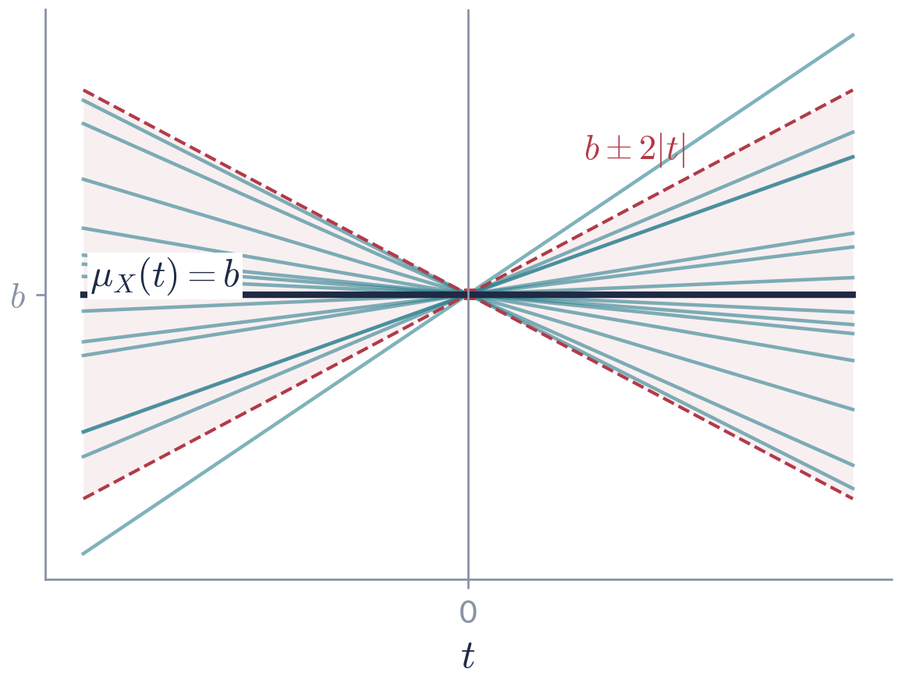

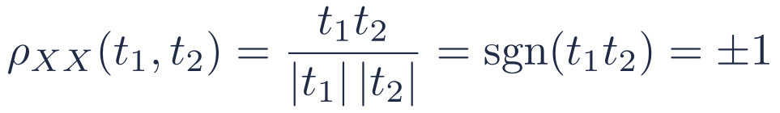
MEAN, AUTOCORRELATION & AUTOCOVARIANCE
Example 3 — Random Line
$$X\left(t\right)=At+b, A∼N\left(0,1\right), b \text{constant}$$
$$μ_{X}\left(t\right)=E\{At+b\}=b$$
$$R_{XX}\left(t_{1},t_{2}\right)=E\{\left(At_{1}+b\right)\left(At_{2}+b\right)\}$$
$$=E\{A^{2}\}t_{1}t_{2}+b E\{A\}\left(t_{1}+t_{2}\right)+b^{2}=t_{1}t_{2}+b^{2}$$
$$C_{XX}\left(t_{1},t_{2}\right)=t_{1}t_{2}, σ_{X}^{2}\left(t\right)=t^{2}$$
$$ρ_{XX}\left(t_{1},t_{2}\right)=\frac{t_{1}t_{2}}{\left|t_{1}\right| \left|t_{2}\right|}=sgn\left(t_{1}t_{2}\right)=±1$$
Observe
Constant mean, but the variance t² grows with |t| and R_{XX} is not a function of t₁−t₂ alone: the process is not stationary.
Stochastic Processes · Week 02 · H. R. Rabiee
17 / 44

Slide 18
05
01
Stochastic Processes X(t)
02
First-Order Statistics of X(t)
03
Higher-Order Statistics of X(t)
Stationary Stochastic Processes
04
Mean, Autocorrelation & Autocovariance
05
Stationary Stochastic Processes
06
Strict-Sense Stationary (SSS) Processes
07
Wide-Sense Stationary (WSS) Processes
Week 02 · Stationary Stochastic Processes
18 / 44

Slide 19
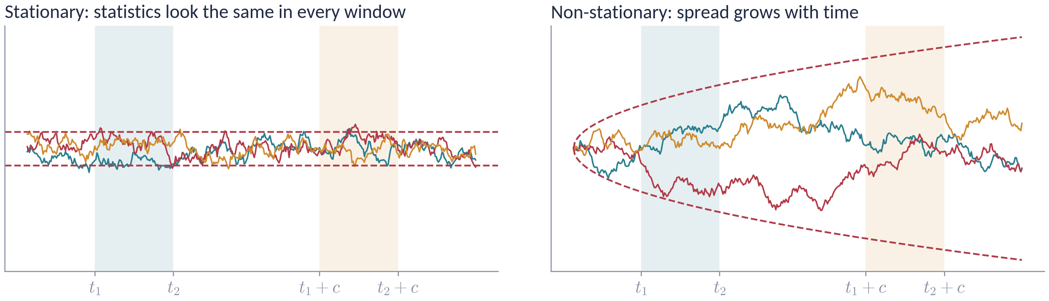
STATIONARY STOCHASTIC PROCESSES
Stationary Stochastic Processes
Stationary processes have statistical properties that are invariant to a shift of the time origin.
First-order stationarity: X(t_{i}) and X(t_{i}+c) have the same statistics for any c.
Second-order stationarity: the pairs {X(t₁),X(t₂)} and {X(t₁+c),X(t₂+c)} have the same joint statistics for any c.
Left: a stationary AR(1)-type process — the ±2σ band is flat. Right: a random walk — the band widens like √t.
Stochastic Processes · Week 02 · H. R. Rabiee
19 / 44

Slide 20
06
01
Stochastic Processes X(t)
02
First-Order Statistics of X(t)
03
Higher-Order Statistics of X(t)
Strict-Sense Stationary (SSS) Processes
04
Mean, Autocorrelation & Autocovariance
05
Stationary Stochastic Processes
06
Strict-Sense Stationary (SSS) Processes
07
Wide-Sense Stationary (WSS) Processes
Week 02 · Stationary Stochastic Processes
20 / 44

Slide 21
STRICT-SENSE STATIONARY (SSS) PROCESSES
Strict-Sense Stationarity: Definition
In strict terms, the statistical properties are governed by the joint pdf. A process is n-th order strict-sense stationary if, for any c,
n-th order SSS
$$f_{X}\left(x_{1},x_{2},…,x_{n}; t_{1},t_{2},…,t_{n}\right)≡f_{X}\left(x_{1},x_{2},…,x_{n}; t_{1}+c, t_{2}+c,…,t_{n}+c\right)$$
The left side is the joint density of X₁=X(t₁),…,X_{n}=X(t_{n}); the right side is the joint density of X₁′=X(t₁+c),…,X_{n}′=X(t_{n}+c).
Strict-sense stationary (SSS)
X(t) is SSS if the equality above holds for all t_{i}, i=1,…,n, for all n=1,2,… and for any c.
Stochastic Processes · Week 02 · H. R. Rabiee
21 / 44

Slide 22


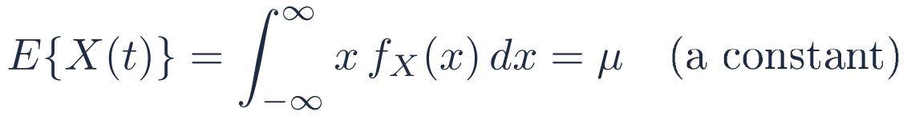
STRICT-SENSE STATIONARY (SSS) PROCESSES
First-Order SSS
For a first-order strict-sense stationary process,
Simple example
$$f_{X}\left(x;t\right)≡f_{X}\left(x;t+c\right) \text{for any }c.$$
An i.i.d. sequence X[n] is SSS of every order: its joint pdf ∏_{i} f(x_{i}) does not involve the time indices at all.
In particular, choosing c=−t gives
$$f_{X}\left(x;t\right)=f_{X}\left(x;0\right)≜f_{X}\left(x\right)$$
i.e. the first-order density of X(t) is independent of t. Consequently
Remark
$$E\{X\left(t\right)\}=\int_{−∞}^{∞}{x} f_{X}\left(x\right) dx=μ \text{(a constant)}$$
Any function of a first-order moment, e.g. E{g(X(t))}, is then constant in time.
$$σ_{X}^{2}\left(t\right)=σ^{2} \text{(a constant)}$$
Stochastic Processes · Week 02 · H. R. Rabiee
22 / 44

Slide 23

STRICT-SENSE STATIONARY (SSS) PROCESSES
Second-Order SSS
Similarly, for a second-order strict-sense stationary process
$$f_{X}\left(x_{1},x_{2}; t_{1},t_{2}\right)≡f_{X}\left(x_{1},x_{2}; t_{1}+c, t_{2}+c\right) \text{for any }c.$$
Choosing c=−t₂:
$$f_{X}\left(x_{1},x_{2}; t_{1},t_{2}\right)≡f_{X}\left(x_{1},x_{2}; t_{1}−t_{2}\right)$$
The second-order density depends only on the difference of the time indices τ=t₁−t₂. Hence
Autocorrelation of a second-order SSS process
$$R_{XX}\left(t_{1},t_{2}\right)=∫∫x_{1}x_{2}^{∗} f_{X}\left(x_{1},x_{2}; τ=t_{1}−t_{2}\right) dx_{1}dx_{2}=R_{XX}\left(t_{1}−t_{2}\right)≜R_{XX}\left(τ\right)$$
$$R_{XX}\left(τ\right)=R_{XX}^{∗}\left(−τ\right)$$
Stochastic Processes · Week 02 · H. R. Rabiee
23 / 44

Slide 24
STRICT-SENSE STATIONARY (SSS) PROCESSES
From SSS to a Weaker Notion
The results for μ and R_{XX}(τ) are consequences of first- and second-order strict-sense stationarity.
n-th order SSS implies k-th order SSS for every k≤ n (integrate out the extra variables).
However, the basic conditions for n-th order stationarity — equality of all joint densities — are usually difficult to verify.
We therefore often resort to a looser definition that only involves the first two moments: Wide-Sense Stationarity (WSS).
SSS asks for …
equal pdfs of every order
under every time shift
i.e. the whole probability law is shift-invariant
WSS asks only for …
constant mean
autocorrelation depending on τ only
i.e. shift-invariance of moments up to order 2
Stochastic Processes · Week 02 · H. R. Rabiee
24 / 44

Slide 25
07
01
Stochastic Processes X(t)
02
First-Order Statistics of X(t)
03
Higher-Order Statistics of X(t)
Wide-Sense Stationary (WSS) Processes
04
Mean, Autocorrelation & Autocovariance
05
Stationary Stochastic Processes
06
Strict-Sense Stationary (SSS) Processes
07
Wide-Sense Stationary (WSS) Processes
Week 02 · Stationary Stochastic Processes
25 / 44

Slide 26
WIDE-SENSE STATIONARY (WSS) PROCESSES
Wide-Sense Stationarity: Definition
Wide-sense stationary (WSS)
A process X(t) with E{|X(t)|²}<∞ is wide-sense stationary if
$$\text{(i)} E\{X\left(t\right)\}=μ \text{(a constant)}$$
$$\text{(ii)} E\{X\left(t_{1}\right)X^{∗}\left(t_{2}\right)\}=R_{XX}\left(t_{1}−t_{2}\right) \text{for all }t_{1},t_{2}$$
For WSS processes the mean is constant and the autocorrelation depends only on the time difference. We write
$$R_{XX}\left(τ\right)=E\{X\left(t+τ\right)X^{∗}\left(t\right)\}, C_{XX}\left(τ\right)=R_{XX}\left(τ\right)−{\left|μ\right|}^{2}$$
These conditions say nothing about the pdfs; they only constrain the average (second-order) behavior of the process.
Example 2 (random phase) is WSS; Example 3 (random line) is not.
Stochastic Processes · Week 02 · H. R. Rabiee
26 / 44

Slide 27
WIDE-SENSE STATIONARY (WSS) PROCESSES
How SSS and WSS Relate
Facts
All processes
SSS ⇒ WSS, provided the second moment is finite.
WSS ⇏ SSS in general.
For a Gaussian process: WSS ⇔ SSS.
SSS
Why the caveat?
infinite
variance
(e.g. Cauchy)
WSS
Gaussian:
WSS = SSS
An i.i.d. Cauchy sequence is SSS, but its mean and variance do not exist — so it is not WSS.
WSS only
The Gaussian case is the key exception, because a Gaussian law is completely fixed by its mean and covariance (next slides).
Stochastic Processes · Week 02 · H. R. Rabiee
27 / 44

Slide 28
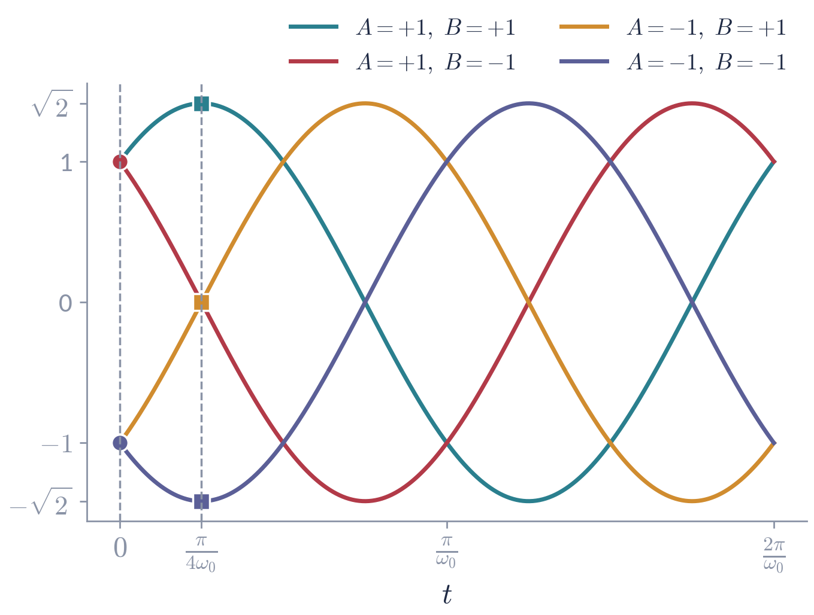

WIDE-SENSE STATIONARY (WSS) PROCESSES
A Process that is WSS but not SSS
$$X\left(t\right)=Acosω_{0}t+Bsinω_{0}t$$
with A,B independent, each equal to ±1 with probability 1/2 (zero mean, unit variance).
Using E{A²}=E{B²}=1 and E{AB}=0:
$$E\{X\left(t\right)\}=0, R_{XX}=cosω_{0}t_{1}cosω_{0}t_{2}+sinω_{0}t_{1}sinω_{0}t_{2}$$
$$R_{XX}\left(t_{1},t_{2}\right)=cosω_{0}\left(t_{1}−t_{2}\right) ⇒ \text{WSS}$$
But at t=0: X(0)=A∈{−1,+1}.
At t=π/(4ω₀): X=(A+B)/√2∈{−√2, 0, +√2}.
The first-order pdf changes with t ⇒ not SSS (not even first-order SSS).
The whole ensemble consists of four sample paths. Circles: values at t=0; squares: values at t=π/(4ω₀). With Gaussian A,B the same process would be SSS.
Stochastic Processes · Week 02 · H. R. Rabiee
28 / 44

Slide 29
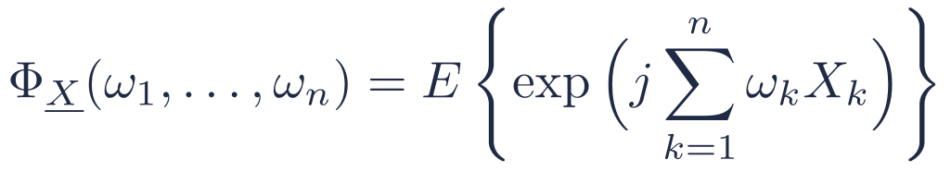
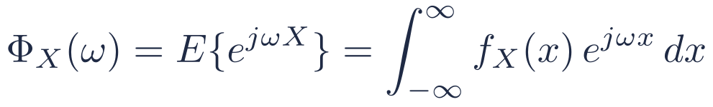
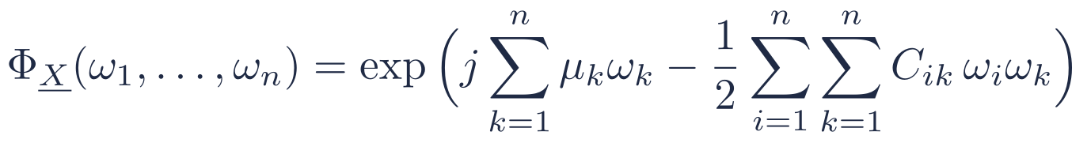
WIDE-SENSE STATIONARY (WSS) PROCESSES
Characteristic Function (recall)
Characteristic function of a random variable
Joint characteristic function of X₁,…,X_{n}
$$Φ_{X}\left(ω\right)=E\{e^{jωX}\}=\int_{−∞}^{∞}{f_{X}}\left(x\right) e^{jωx} dx$$
$$Φ_{\underline{X}}\left(ω_{1},…,ω_{n}\right)=E\left\{exp(j\sum_{k=1}^{n}{ω_{k}}X_{k})\right\}$$
The Fourier transform of the pdf (sign convention e^{+jω x}); it determines the pdf uniquely.
Determines the joint pdf of X₁,…,X_{n} uniquely.
Jointly Gaussian random variables
If X₁,…,X_{n} are jointly Gaussian with means μ_{k} and covariances C_{ik}=Cov(X_{i},X_{k}):
$$Φ_{\underline{X}}\left(ω_{1},…,ω_{n}\right)=exp\left(j\sum_{k=1}^{n}{μ_{k}}ω_{k}−\frac{1}{2}\sum_{i=1}^{n}{\sum_{k=1}^{n}{C_{ik}}} ω_{i}ω_{k}\right)$$
A jointly Gaussian law is fixed completely by its means and covariances.
Stochastic Processes · Week 02 · H. R. Rabiee
29 / 44

Slide 30
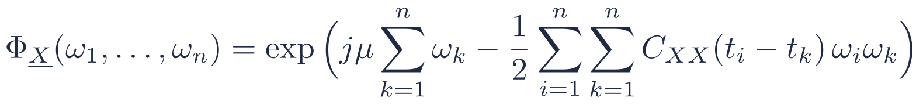
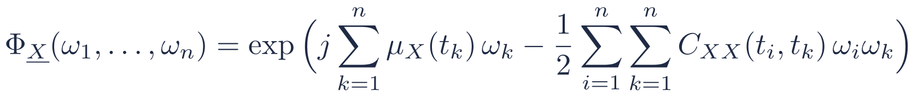
WIDE-SENSE STATIONARY (WSS) PROCESSES
Gaussian Processes: WSS Implies SSS
If X(t) is a Gaussian process, then by definition X₁=X(t₁),…,X_{n}=X(t_{n}) are jointly Gaussian for any n and any t₁,…,t_{n}:
$$Φ_{\underline{X}}\left(ω_{1},…,ω_{n}\right)=exp\left(j\sum_{k=1}^{n}{μ_{X}}\left(t_{k}\right) ω_{k}−\frac{1}{2}\sum_{i=1}^{n}{\sum_{k=1}^{n}{C_{XX}}}\left(t_{i},t_{k}\right) ω_{i}ω_{k}\right)$$
If X(t) is also WSS, then μ_{X}(t_{k})=μ and C_{XX}(t_{i},t_{k})=C_{XX}(t_{i}−t_{k}):
$$Φ_{\underline{X}}\left(ω_{1},…,ω_{n}\right)=exp\left(jμ\sum_{k=1}^{n}{ω_{k}}−\frac{1}{2}\sum_{i=1}^{n}{\sum_{k=1}^{n}{C_{XX}}}\left(t_{i}−t_{k}\right) ω_{i}ω_{k}\right)$$
Shifting all instants by c (X_{k}′=X(t_{k}+c)) leaves every t_{i}−t_{k} unchanged, so the joint characteristic function — and hence the joint pdf — of {X_{k}′} is identical to that of {X_{k}}, for all n and all c.
Gaussian process: wide-sense stationary ⇔ strict-sense stationary. The Gaussian law depends only on second-order statistics, which is exactly what WSS fixes.
Stochastic Processes · Week 02 · H. R. Rabiee
30 / 44

Slide 31
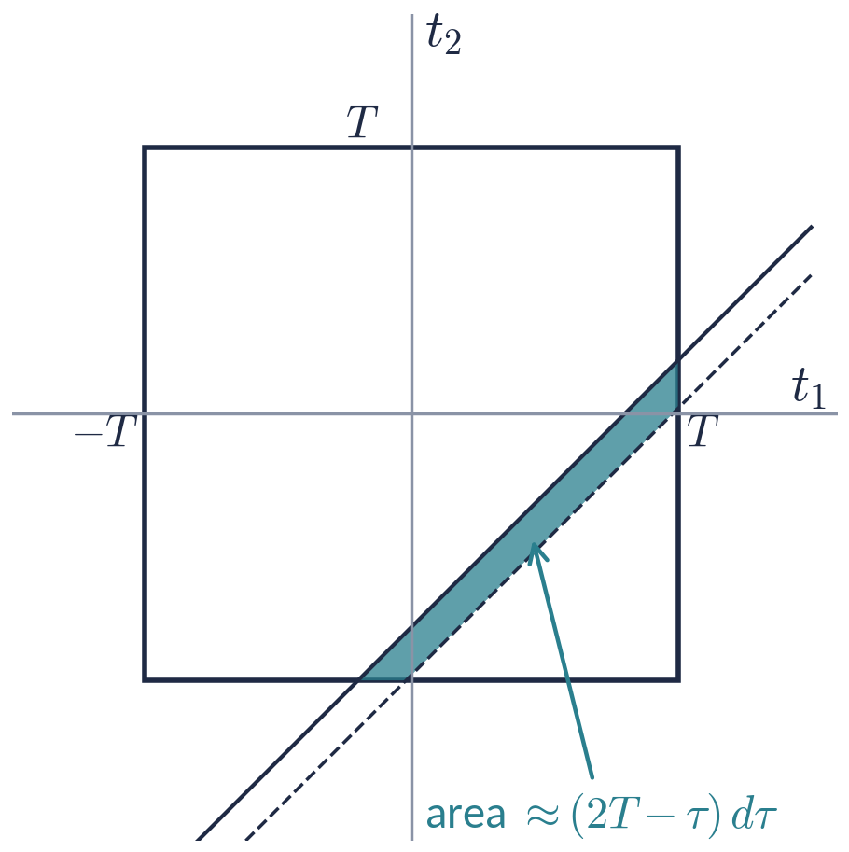
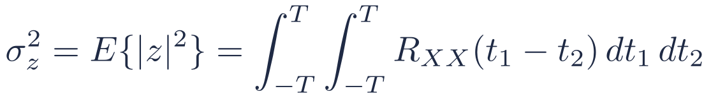
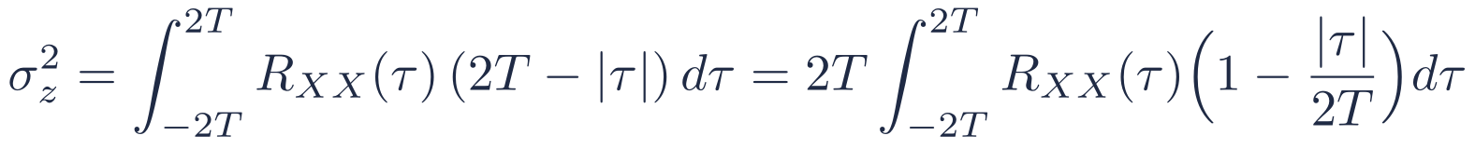
WIDE-SENSE STATIONARY (WSS) PROCESSES
Example 1 Revisited — Integrator with WSS Input
Let X(t) be a zero-mean WSS process and z=∫_{−T}^{T}X(t) dt. Then
$$σ_{z}^{2}=E\{{\left|z\right|}^{2}\}=\int_{−T}^{T}{\int_{−T}^{T}{R_{XX}}}\left(t_{1}−t_{2}\right) dt_{1} dt_{2}$$
As t₁,t₂ range over [−T,T], τ=t₁−t₂ ranges over [−2T,2T], and R_{XX}(τ) is constant on each strip τ<t₁−t₂<τ+dτ. For τ>0 the strip has area
$$1/2{\left(2T−τ\right)}^{2}−1/2{\left(2T−τ−dτ\right)}^{2}≈\left(2T−τ\right) dτ$$
(by symmetry, (2T−|τ|) dτ in general). Hence the double integral reduces to a single one:
$$σ_{z}^{2}=\int_{−2T}^{2T}{R_{XX}}\left(τ\right) \left(2T−\left|τ\right|\right) dτ=2T\int_{−2T}^{2T}{R_{XX}}\left(τ\right)\left(1−\frac{\left|τ\right|}{2T}\right)dτ$$
Stochastic Processes · Week 02 · H. R. Rabiee
31 / 44

Slide 32
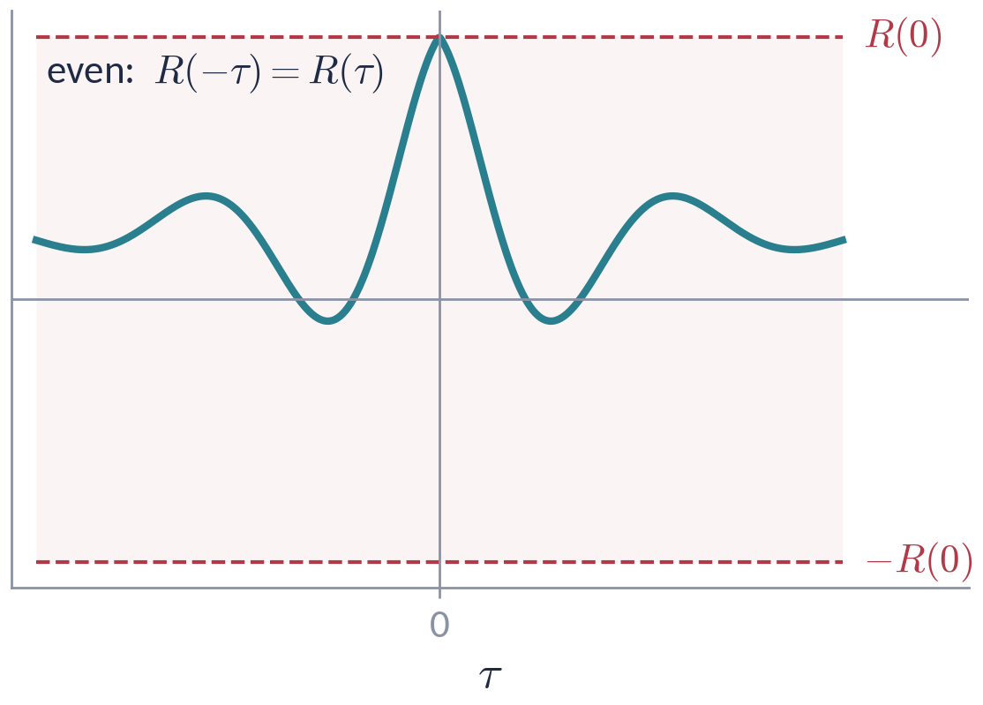

WIDE-SENSE STATIONARY (WSS) PROCESSES
Autocorrelation of a Real WSS Process: Properties 1–2
1. Even symmetry
$$R_{XX}\left(−τ\right)=E\{X\left(t−τ\right)X\left(t\right)\}=R_{XX}\left(τ\right)$$
(For complex processes: R_{XX}(−τ)=R_{XX}*(τ).)
2. Value at the origin = average power
$$R_{XX}\left(0\right)=E\{X^{2}\left(t\right)\} ≥0$$
$$σ_{X}^{2}=E\{X^{2}\left(t\right)\}−E\{X\left(t\right)\}^{2}=R_{XX}\left(0\right)−μ_{X}^{2}=C_{XX}\left(0\right)$$
A typical autocorrelation: even, largest at τ=0, and confined to [−R(0),R(0)] (property 3, next slide).
Stochastic Processes · Week 02 · H. R. Rabiee
32 / 44

Slide 33
WIDE-SENSE STATIONARY (WSS) PROCESSES
Autocorrelation of a Real WSS Process: Property 3
3. The maximum is at the origin
$$\left|R_{XX}\left(τ\right)\right|≤R_{XX}\left(0\right) \text{for all }τ$$
Proof (Cauchy–Schwarz inequality for random variables, |E{UV}|²≤ E{U²}E{V²}), with U=X(t+τ), V=X(t):
$$R_{XX}^{2}\left(τ\right)=(E\{X\left(t+τ\right)X\left(t\right)\})^{2}≤E\{X^{2}\left(t+τ\right)\} E\{X^{2}\left(t\right)\}=R_{XX}^{2}\left(0\right)$$
Remarks
The proof uses ensemble averages E{·}, not time integrals: R_{XX}(τ) is defined through expectations.
Consequently |ρ_{XX}(τ)|=|C_{XX}(τ)|/C_{XX}(0)≤ 1 for WSS processes.
If R_{XX}(τ₀)=R_{XX}(0) for some τ₀≠0, then R_{XX} is periodic with period τ₀.
Stochastic Processes · Week 02 · H. R. Rabiee
33 / 44

Slide 34
WIDE-SENSE STATIONARY (WSS) PROCESSES
Cross-Correlation and Cross-Covariance
Two processes X(t) and Y(t)
$$R_{XY}\left(t_{1},t_{2}\right)=E\{X\left(t_{1}\right) Y^{∗}\left(t_{2}\right)\}$$
X(t)
T(·)
Y(t)
$$C_{XY}\left(t_{1},t_{2}\right)=R_{XY}\left(t_{1},t_{2}\right)−μ_{X}\left(t_{1}\right) μ_{Y}^{∗}\left(t_{2}\right)$$
Typical setting: Y(t) is the output of a system driven by X(t); R_{XY} tells us how input and output are related (Week 03: LTI systems).
Jointly WSS
X(t) and Y(t) are jointly WSS if each is WSS and R_{XY}(t₁,t₂) depends only on τ=t₁−t₂. Then
$$R_{XY}\left(τ\right)=R_{YX}^{∗}\left(−τ\right), {\left|R_{XY}\left(τ\right)\right|}^{2}≤R_{XX}\left(0\right) R_{YY}\left(0\right)$$
Stochastic Processes · Week 02 · H. R. Rabiee
34 / 44

Slide 35
WIDE-SENSE STATIONARY (WSS) PROCESSES
Independent, Uncorrelated and Orthogonal Processes
Definitions
Independent: {X(t₁),…,X(t_{n})} and {Y(t₁′),…,Y(t_{m}′)} are independent for all n,m and all time instants — their joint pdf factors.
Uncorrelated: C_{XY}(t₁,t₂)=0, i.e. R_{XY}(t₁,t₂)=μ_{X}(t₁)μ_{Y}*(t₂), for all t₁,t₂.
Orthogonal: R_{XY}(t₁,t₂)=0 for all t₁,t₂.
Independent ⇒ uncorrelated:
Careful
$$R_{XY}\left(t_{1},t_{2}\right)=E\{X\left(t_{1}\right)\} E\{Y^{∗}\left(t_{2}\right)\}=μ_{X}\left(t_{1}\right) μ_{Y}^{∗}\left(t_{2}\right)$$
The converse fails in general.
It holds when X and Y are jointly Gaussian.
Uncorrelated + one process zero-mean ⇒ orthogonal.
$$⇒ C_{XY}\left(t_{1},t_{2}\right)=μ_{X}\left(t_{1}\right)μ_{Y}^{∗}\left(t_{2}\right)−μ_{X}\left(t_{1}\right)μ_{Y}^{∗}\left(t_{2}\right)=0$$
Stochastic Processes · Week 02 · H. R. Rabiee
35 / 44

Slide 36
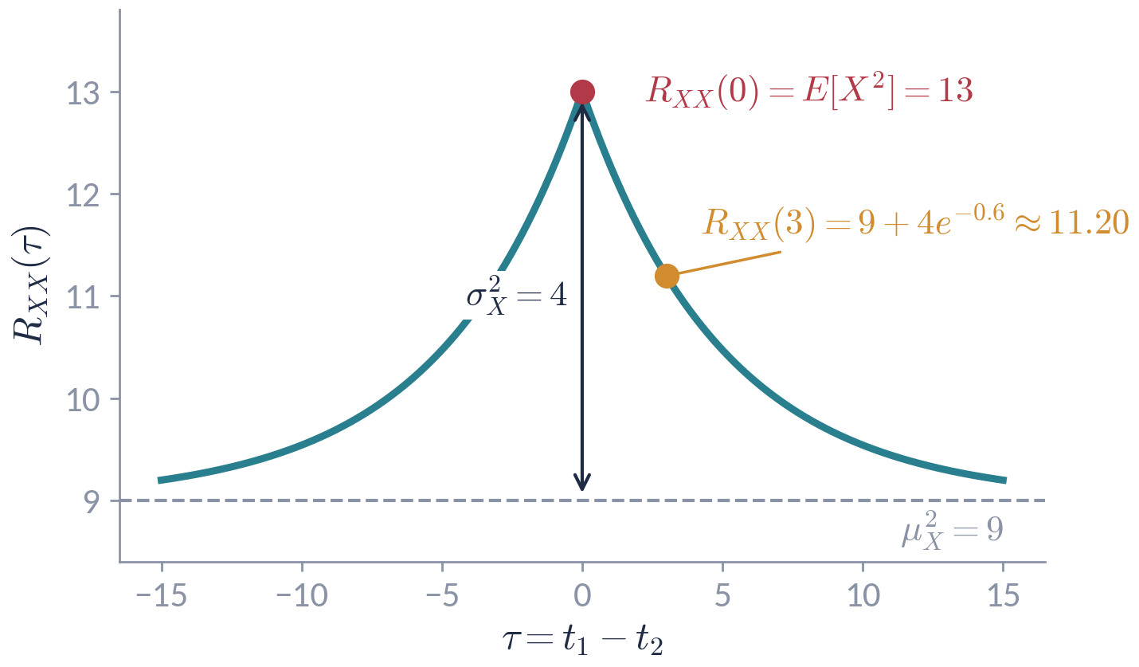

WIDE-SENSE STATIONARY (WSS) PROCESSES
Example 4 — Second-Order Statistics of a WSS Process
X(t) has mean and autocorrelation
$$μ_{X}\left(t\right)=3, R_{XX}\left(t_{1},t_{2}\right)=9+4e^{−0.2\left|t_{1}−t_{2}\right|}$$
Constant mean and R_{XX} a function of t₁−t₂ only ⇒ WSS. Let Z=X(5) and W=X(8).
$$E\{Z\}=E\{W\}=3$$
$$E\{Z^{2}\}=R_{XX}\left(5,5\right)=R_{XX}\left(0\right)=13$$
$$E\{W^{2}\}=R_{XX}\left(8,8\right)=R_{XX}\left(0\right)=13$$
$$Var\left(Z\right)=Var\left(W\right)=13−3^{2}=4$$
Stochastic Processes · Week 02 · H. R. Rabiee
36 / 44

Slide 37
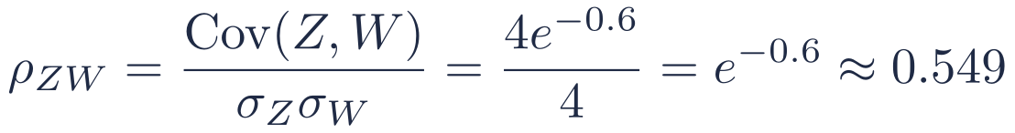
WIDE-SENSE STATIONARY (WSS) PROCESSES
Example 4 — Continued
$$E\{ZW\}=E\{X\left(5\right)X\left(8\right)\}=R_{XX}\left(5,8\right)=9+4e^{−0.2\left|5−8\right|}=9+4e^{−0.6}≈11.195$$
$$Cov\left(Z,W\right)=E\{ZW\}−E\{Z\}E\{W\}=4e^{−0.6}≈2.195$$
$$ρ_{ZW}=\frac{Cov\left(Z,W\right)}{σ_{Z}σ_{W}}=\frac{4e^{−0.6}}{4}=e^{−0.6}≈0.549$$
$$E\{{\left(Z−W\right)}^{2}\}=E\{Z^{2}\}+E\{W^{2}\}−2E\{ZW\}=26−2\left(9+4e^{−0.6}\right)≈3.61$$
Takeaway
Only the lag |8−5|=3 matters: X(105) and X(108) have exactly the same second-order statistics as X(5) and X(8).
Stochastic Processes · Week 02 · H. R. Rabiee
37 / 44

Slide 38
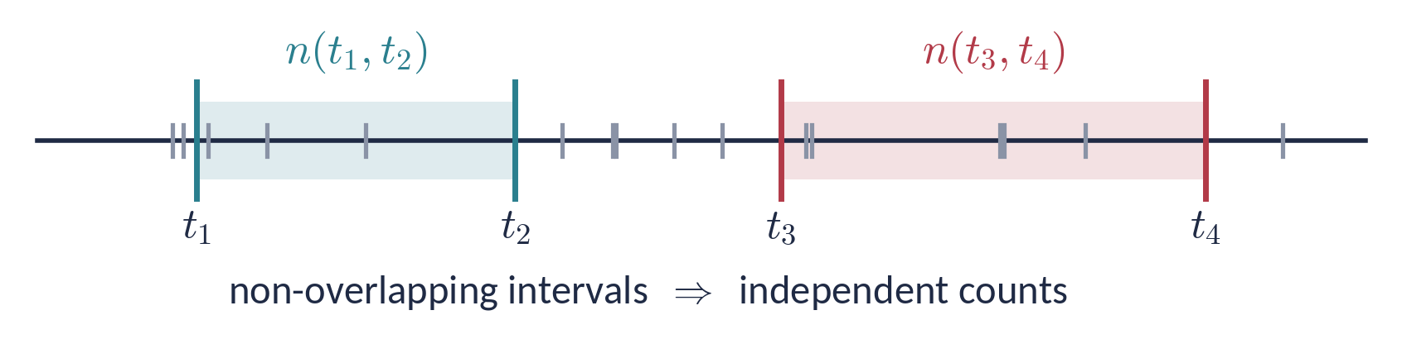
WORKED EXAMPLES · POISSON ARRIVALS
Example 5 — The Poisson Process
Consider a Poisson process with rate λ. Let n(t₁,t₂) be the number of points in the interval (t₁,t₂], t₁≤ t₂.
Two defining properties
(a) The count in an interval of length t₂−t₁ is Poisson with parameter λ(t₂−t₁):
$$P\{n\left(t_{1},t_{2}\right)=k\}=e^{−λ\left(t_{2}−t_{1}\right)}\frac{{\left[λ\left(t_{2}−t_{1}\right)\right]}^{k}}{k!}, k=0,1,2,…$$
(b) Counts in non-overlapping intervals are independent (independent increments).
Stochastic Processes · Week 02 · H. R. Rabiee
38 / 44

Slide 39
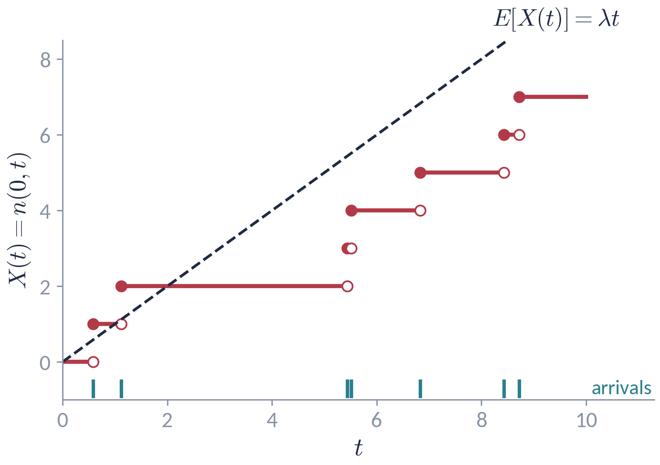



WORKED EXAMPLES · POISSON ARRIVALS
Example 5 — Mean of the Counting Process
Define the counting process
$$X\left(t\right)=n\left(0,t\right), t≥0$$
Since n(0,t)∼Poisson(λ t):
$$E\{X\left(t\right)\}=λt$$
$$E\{X^{2}\left(t\right)\}=Var+{\text{mean}}^{2}=λt+λ^{2}t^{2}$$
$$σ_{X}^{2}\left(t\right)=λt$$
The mean grows linearly with t, so X(t) is not stationary — not even first-order.
Stochastic Processes · Week 02 · H. R. Rabiee
39 / 44

Slide 40

WORKED EXAMPLES · POISSON ARRIVALS
Example 5 — Autocorrelation of the Poisson Process
Suppose t₁<t₂ and split n(0,t₂)=n(0,t₁)+n(t₁,t₂):
In general (any order of t₁,t₂)
$$R_{XX}\left(t_{1},t_{2}\right)=E\{n\left(0,t_{1}\right) n\left(0,t_{2}\right)\}$$
$$R_{XX}\left(t_{1},t_{2}\right)=λmin\left(t_{1},t_{2}\right)+λ^{2}t_{1}t_{2}$$
$$=E\{n^{2}\left(0,t_{1}\right)\}+E\{n\left(0,t_{1}\right) n\left(t_{1},t_{2}\right)\}$$
$$C_{XX}\left(t_{1},t_{2}\right)=λmin\left(t_{1},t_{2}\right)$$
$$=λt_{1}+λ^{2}t_{1}^{2}+E\{n\left(0,t_{1}\right)\} E\{n\left(t_{1},t_{2}\right)\}$$
$$=λt_{1}+λ^{2}t_{1}^{2}+λt_{1}⋅λ\left(t_{2}−t_{1}\right)=λt_{1}\left(1+λt_{2}\right)$$
The third line uses independent increments: n(0,t₁) and n(t₁,t₂) count non-overlapping intervals.
Observe
R_{XX} is not a function of t₁−t₂ alone, so X(t) is not WSS — even though its increments are stationary.
Stochastic Processes · Week 02 · H. R. Rabiee
40 / 44

Slide 41
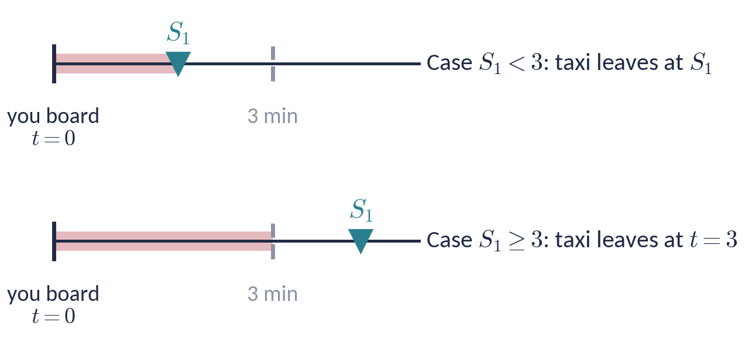
WORKED EXAMPLES · POISSON ARRIVALS
Example 6 — Waiting Time for a Taxi
Problem
Taxis wait in a queue for passengers. Passengers arrive according to a Poisson process with an average of 60 passengers per hour.
A taxi departs as soon as two passengers have been collected, or 3 minutes after the first passenger got in — whichever comes first.
You get in a taxi as the first passenger. What is your average waiting time until departure?
Hint: condition on the first arrival after you get in the taxi.
Stochastic Processes · Week 02 · H. R. Rabiee
41 / 44

Slide 42
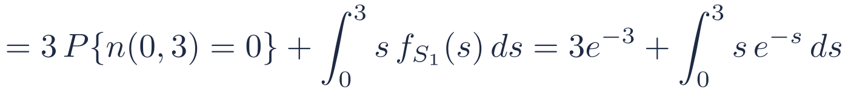
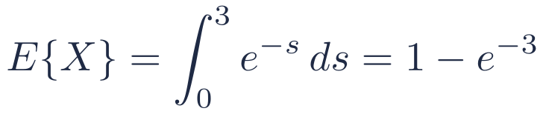
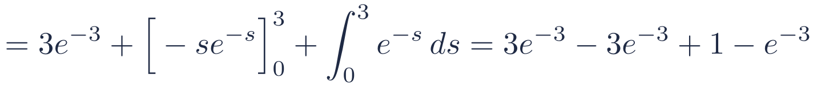
WORKED EXAMPLES · POISSON ARRIVALS
Example 6 — Solution
With minutes as the unit of time, arrivals are Poisson with λ=1. Let S₁ be the arrival time of the next passenger: S₁∼Exp(1), P{S₁>s}=e^{−s}. Your waiting time is X=min(S₁,3).
Shortcut
For a non-negative X, E{X}=∫₀∞ P{X>s} ds:
$$E\{X\}=E\{X∣S_{1}≥3\}P\{S_{1}≥3\}+E\{X∣S_{1}<3\}P\{S_{1}<3\}$$
$$E\{X\}=\int_{0}^{3}{e^{−s}} ds=1−e^{−3}$$
$$=3 P\{n\left(0,3\right)=0\}+\int_{0}^{3}{s} f_{S_{1}}\left(s\right) ds=3e^{−3}+\int_{0}^{3}{s} e^{−s} ds$$
$$=3e^{−3}+[−se^{−s}]_{0}^{3}+\int_{0}^{3}{e^{−s}} ds=3e^{−3}−3e^{−3}+1−e^{−3}$$
Why Exp(1)?
By independent increments (memorylessness), the time from your boarding to the next arrival is exponential, whatever happened before.
$$E\{X\}=1−e^{−3}≈0.950 \text{min}≈57 \text{s}$$
Stochastic Processes · Week 02 · H. R. Rabiee
42 / 44

Slide 43
WRAP-UP
Summary
Strict-sense stationary
Wide-sense stationary
Condition
All n-th order pdfs invariant to time shift
μ constant and R_{XX}(t₁,t₂)=R_{XX}(t₁−t₂)
Involves
The complete probability law
First and second moments only
Checking it
Usually hard
Usually easy
Relation
SSS ⇒ WSS (if E{|X|²}<∞)
WSS ⇏ SSS, except for Gaussian processes
Examples
i.i.d. sequences; random-phase sinusoid
Acos ω₀t+Bsin ω₀t with uncorrelated A,B
Stochastic Processes · Week 02 · H. R. Rabiee
43 / 44

Slide 44
NEXT WEEK
Ergodic Stochastic Processes
Stochastic Analysis of LTI Systems
When can time averages replace ensemble averages? What happens to R_{XX}(τ) when a WSS process passes through a filter?
Have a good day!
44 / 44

