Slide 1
Data Visualization in R
November 22, 2014

Slide 2
Outline
R basics, environment, and workflow
Data management
data structures: vector, matrix, data.frame
data input: from command line, from file
Basic visualization
GGplot2 visualization
https://github.com/stochasticTreat/R_data_vis_lecture

Slide 3
R: strange and fantastic
Console window:
>
Script window: scripts, programs
executing commands from a script:
highlight block or place cursor on line and press “command+enter”
source the script file:
>source(“script file name”)
press “run” (RStudio)
Workspace:
All variables and states in current session.
Can be saved and re-loaded.
Working directory
setwd("path to working directory”)
Rstudio: Sesssion > Set Working Directory
R: Misc > changer working directory
Documentation
press function + f1 with a cursor on a term ( Rstudio )
question mark on console line before a term
> ?c

Slide 4
R environment
Notable differences from other languages
one indexed: counting starts at 1, not 0
assignment operators
“<-” does the same as “=“
“->” also exists.
semicolons optional
# is the comment character
NA: data not available; NaN: not a number; NULL: null
Printing to console
> v1
a Bob c d e
1 2 3 8 4
> print(v1)
a Bob c d e
1 2 3 8 4
> cat(v1)
1 2 3 8 4

Slide 5
Vectors
Vector: one or more elements
Creating a vector
By range
> v0 = 1:4 #v0 is a vector
> v0
[1] 1 2 3 4
By concatenation
> v1 = c(1,2,3,8,4) #v1 is a vector
> v1
[1] 1 2 3 8 4

Slide 6
Indexing
Indexing
one element
> v1[5]
multiple elements by passing a vector of indexes
> v1[3:5]
[1] 3 8 4
> v1[c(1,3,4)]
[1] 1 3 8
logical indexing
> v1[c(T,F,F,F,T)]
[1] 1 4
- naming elements / making a dictionary
> names(v1)<-c('a','Bob','c','d','e')
> v1
a Bob c d e
1 2 3 8 4
> v1['Bob']
> v1[c('Bob','d')]
Bob d
2 8

Slide 7
matrix data structure
By supplying data
> m1 = matrix(data=1:12, nrow=3)
> m1
[,1] [,2] [,3] [,4]
[1,] 1 4 7 10
[2,] 2 5 8 11
[3,] 3 6 9 12
By combining vectors
> m2 = cbind( 1:10, (1:10)^2 )
> # rbind() also exists
> # you can also bind together other matricies as long as the dimensions match
> m2
[,1] [,2]
[1,] 1 1
[2,] 2 4
[3,] 3 9
[4,] 4 16
[5,] 5 25
[6,] 6 36
[7,] 7 49
[8,] 8 64
[9,] 9 81
[10,] 10 100

Slide 8
matrix data structure
Indexing: matrix[row,column]
> m2[,1]
[1] 1 2 3 4 5 6 7 8 9 10
> m2[1,]
[1] 1 1
Naming dimensions
> colnames(m2)<-c("James","Ted")
> head(m2, 2)
James Ted
[1,] 1 1
[2,] 2 4
> m2[,"James”]
[1] 1 2 3
Gotchya
> m2[,"James"] #The output from this is a vector. To keep the matrix data type, use drop=FALSE
[1] 1 2 3
> m2[,"James",drop=FALSE]
James
[1,] 1
[2,] 2
[3,] 3

Slide 9
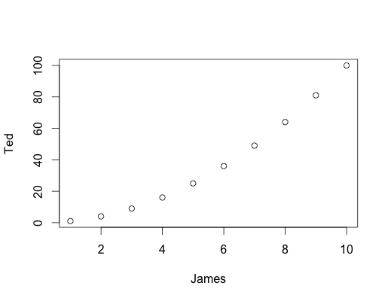
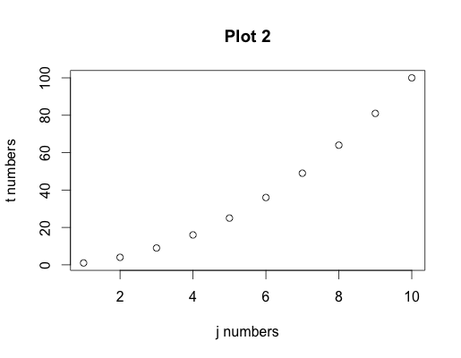
basic visualization: plot()
> plot(x=1:10, y=10:1)
> plot(m2)
> #automatically uses the first two columns
> plot(m2, xlab="j numbers",
ylab="t numbers", main="Plot 2")

Slide 10
data.frame
Creation
df1 = as.data.frame(m2)
> df2 = data.frame(james2=1:3, ted2=c("a","b","c")) #multiple data types
> df2
james2 ted2
1 1 a
2 2 b
3 3 c
Access patterns
Everything you can do with a matrix
Also allows $<column name>
ex: > df1$james2
Factors: they will prevent you from doing some things, but allow others
> df2$ted2
[1] a b c
Levels: a b c
To remove factors:
use stringsAsFactors=FALSE durring creation of the data.frame
df2$ted2 <- as.character( df2$ted2 )
To add factors:
df2$ted2 <- factor(df2$ted2, levels=c("b","c","a"))

Slide 11
ggplot2
> install.packages('ggplot2')
> libary('ggplot2')
A simple plot:
#load some data
sdat = read.table(”.injuriesVsWrithingTimeVsRegion.txt", header=T, sep="\t")
#plot the data
ggplot(data=sdat, aes(x=Injuries, y=Time))+
geom_point()
#color the points
ggplot(data=sdat, aes(x=Injuries, y=Time, color=Region))+
geom_point()

Slide 12
mapping data
> #color the points
> ggplot(data=sdat, aes(x=Injuries, y=Time, color=Region))+
geom_point()
>#re order the colors
>sdat$Region <- factor(sdat$Region, levels=c("Australia", "Middle.East","Africa", "Asia”, "C.America","N.America","S.America", "Europe"))
> ggplot(data=sdat, aes(x=Injuries, y=Time, color=Region))+
geom_point()

Slide 13
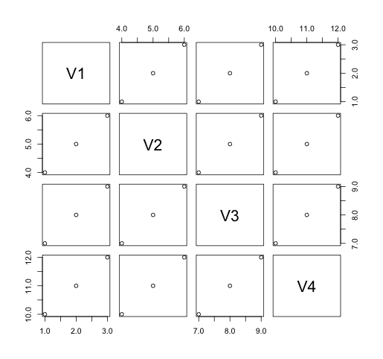
Trellis plot
Trellis plots let you compare all pairs of columns
Valuable for exploratory data analysis
> m1
[,1] [,2] [,3] [,4]
[1,] 1 4 7 10
[2,] 2 5 8 11
[3,] 3 6 9 12
>plot(as.data.frame(m1))

Slide 14
histogram function
> x = sample(x=1:50, size=100, replace=T)
> hist(x)

