Slide 1
Search and
Hack Oregon Meeting
Arcy, Catherine, Robert, Sam, Jason

Slide 2
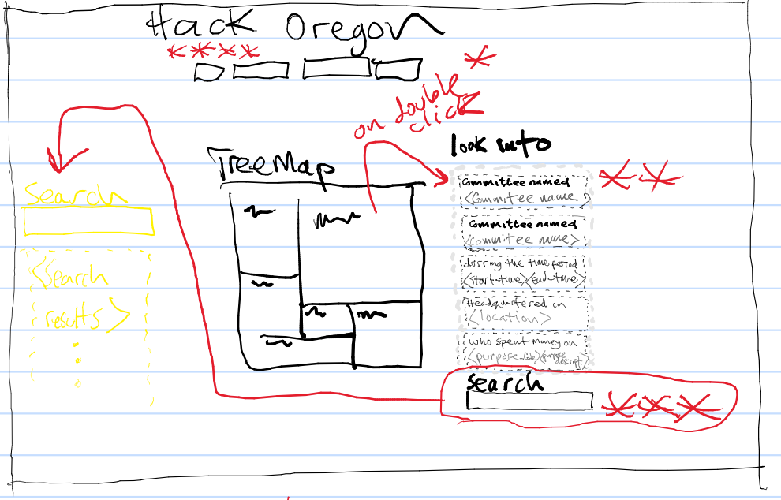
Searching-filtering layout
Who what when where navigation buttons:
When user loads a visualization, the results sent to that visualization by the data base are limited by the “look into” filters saved in the filter cookie
Look-into list
1) On double click of list item:
List item removed
2) On page load:
Cookie is checked to populate the list
Search Box
Search could be in other parts of screen
On clicking search result item places the item in cookie and the “look into” list
On double click of visual element/node/committee:
The committee name or purpose code is put into the list and the filter-cookie

