Slide 1

Swing MVC

Slide 2
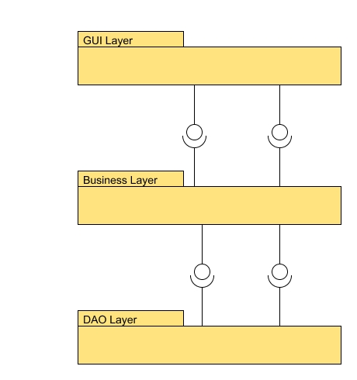
Application Layering
A Layer is a collection of components that
Perform similar tasks.
Isolate implementation details from the code that uses the layer.
Does not make assumptions about the code using the layer.
These properties imply that in a layered architecture, a layer can make use of the layers underneath it but not of the layers lying above it.
A layer communicates with the layer beneath it through interfaces.

Slide 3
The Façade Pattern
A Façade is used to provide a simple interface to a complex subsystem.
In the context of UI, a façade helps identify and isolate server calls.
public interface BakeryFacade {
Customer insertCustomer(Customer customer) throws BakeryException;
Customer findCustomer(String phone) throws BakeryException;
Customer updateCustomer(Customer customer) throws BakeryException;
Order placeOrder(Order order) throws BakeryException;
List getOrders() throws BakeryException;
List getCustomerOrders(Customer customer);
}

Slide 4
Façade Options
One façade for the whole application
  Keeps implementation simple
  May start becoming crowded
One façade per type of operation
  One façade per ‘service’ type keeps code organized
  More work if more than one implementations are desired.

Slide 5
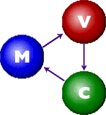
The MVC components
Model – A representation of the application data suitable for displaying the UI
View – The collection of visual components that comprise the UI
Controller – Provides UI with behavior
  Executes business logic through the façade.
  Performs UI-level business logic and validation
  Instructs the model to populate the view

Slide 6
Web MVC
The view knows only how to display a prescribed model. There is no logic attached.
The model is a simple transformation of the application data logic (e.g. as a Map)
The controller receives requests from the view, processes them by applying business logic and validation, changes the model, and populates the view.

Slide 7
Example of Web MVC
public ModelAndView handleRequest(HttpServletRequest request, HttpServletResponse response) throws ServletException, IOException {
Map context = new HashMap();
String command = getCommand(request);
User user = getUser(request);
if ("ViewStandings".equals(command)) {
context.put("league",facade);
} else if ("ViewGames".equals(command)) {
context.put("user",user);
context.put("admin", facade);
. . .
} else if ("EditGame".equals(command)) {
long id = Long.parseLong(request.getParameter("id"));
Game game = (Game) facade.getGame(id);
context.put("game",game);
} else if("EditGameDate".equals(command)) {
long id = Long.parseLong(request.getParameter("id"));
Game game = (Game) facade.getGame(id);
context.put("game",game);
} else if ("ShowGames".equals(command)) {
String name = request.getParameter("id");
Team team = facade.getTeam(name);
context.put("team",team);
} else if("SubmitGameDate".equals(command)) …
} else {
context.put("message","Page not found for "+request.getRequestURI());
return new ModelAndView("Error",context);
}
return new ModelAndView(command,context);
}
<html>
<head><title>ViewGames</title></head>
<body>
<h2>Locates</h2>
<table border=1" cellspacing="2" cellpadding"=1">
<th>Date</th><th>Home</th><th>Visitor</th><th>Score</th>
#foreach ($game in $admin.Games)
<tr>
<td>
#if ( $user.canChangeDate($game) )
<a href="EditGameDate.htm?id=$game.Id">$game.Date</a>
#else
$game.Date
#end
</td>
<td>$game.HomeTeam.Name</td>
<td>$game.VisitingTeam.Name</td>
<td>
#if ( $user.canChangeScore( $game) )
<a href="EditGame.htm?id=$game.Id">$game.Score</a>
#else
$game.Score
#end
</td>
</tr>
#end
</table>
<p/>
<a href="index.html">Home</a>
</body>
</html>

Slide 8
The ‘right’ level for MVC
UIs are built hierarchically. You combine components to create a panel. Then combine panels to create a screen. It is important to decide at which level MVC applies.
The component level is not the correct granularity for MVC where behaviors are tightly linked to the view. (Swing Model-UI delegate)
MVC works well at the panel and screen level.

Slide 9
GUI Design Principles
Use a facade to access business logic - Hides business logic implementation details and make the UI independent of the number of physical tiers.
Design user interfaces at the component and not the container level. For example, extend JPanel and not JFrame - Enables reuse of views. For example, the application may use single-frame, popup frames, internal frames, docable frames, et cetera.
Access the view through an interface - Makes it easier to switch view implementations. Allows controllers to be unit-tested with mock views.
Use an assembler class to “wire” the components together – Easy to change dependencies.
Introduce dependencies in the constructor – Avoid ending up with unsatisfied dependencies.

Slide 10
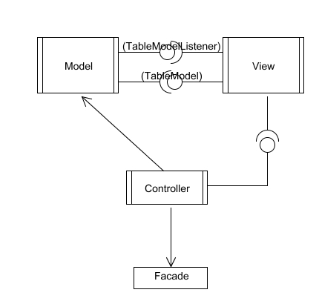
MVC For Swing
The view accesses the model through an interface (example, TableModel)
The model sends updates to the view by registering it as a listener (example, TableModelListener)
The controller manipulates the view through an interface.
The controller manipulates the model either directly or through interfaces.
The controller accesses business logic through a façade.

Slide 11
Advantages
Server-side business logic can be updated independently of the UI (Façade).
Client-side business logic can be updated without affecting the view (Controller).
The view can be replaced without affecting the controller.
The controller can be tested without instantiating GUI components.

Slide 12
Testing the controller
public class CustomerViewController {
. . .
public void addCustomer() {
Customer customer = customerView.getCustomer();
if (ValidationUtil.isEmpty(customer.getLastName())) {
bakeryView.reportMessage("Last name must be set.");
return;
}
if (ValidationUtil.isEmpty(customer.getFirstName())) {
bakeryView.reportMessage("First name must be set.");
return;
}
if (ValidationUtil.isEmpty(customer.getPhone())) {
bakeryView.reportMessage("Phone must be set.");
return;
}
try {
customer = facade.insertCustomer(customer);
customerView.setCustomer(customer);
bakeryView.reportMessage("Customer added.");
} catch (BakeryException ex) {
bakeryView.reportMessage("Insertion failed.");
customerView.clear();
}
}
public class CustomerViewControllerTest extends TestCase {
private CustomerViewController controller;
private MockBakeryFacade facade = new MockBakeryFacade();
public void setUp() {
controller = new CustomerViewController(facade,customerView,bakeryView);
}
public void testAddCustomer() {
Customer customer = new Customer();
customerView.setCustomer(customer);
controller.addCustomer();
assertEquals("Last name must be set.",bakeryView.getMessage());
customer.setLastName("last");
controller.addCustomer();
assertEquals("First name must be set.",bakeryView.getMessage());
customer.setFirstName("first");
controller.addCustomer();
assertEquals("Phone must be set.",bakeryView.getMessage());
customer.setPhone("123");
controller.addCustomer();
assertEquals("Customer added.",bakeryView.getMessage())
}

Slide 13
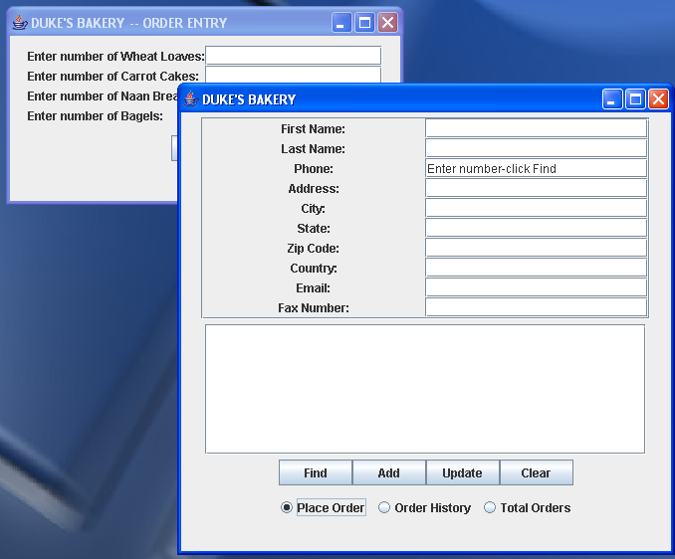
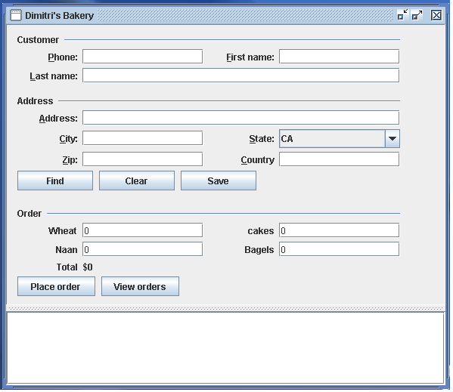
Replacing the UI

Slide 14
The Role of Actions
Actions transmit information about user activities.
Each action can function as a controller for the screen that originated.
Or delegate to the controller of the screen.
The second way is preferable since:
  An action may originate from different components.
  Several actions may share common code.

Slide 15
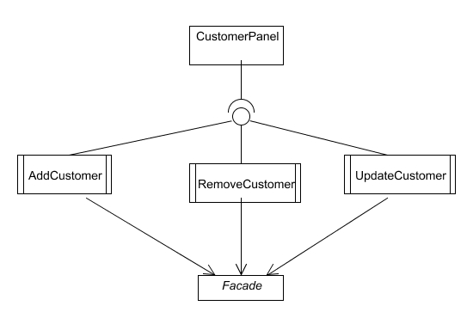
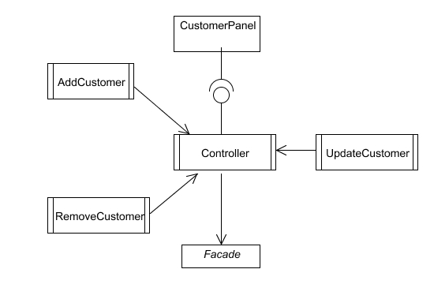
MVC versus MVA
Model - View - Actions
Model – View - Controller

Slide 16
Recipe
Write the models.
Create a view by arranging visual components in a Panel. Do not attach any listeners to the components (example, CustomerPanel).
Make the view implement an interface (example CustomerView).
Write a controller with constructor dependencies on the façade and view interfaces. Manipulate the view via interface methods or through the model.
Link the view actions to the controller.

Slide 17
Modifications
Connect actions to components by using a registry.
Create the model in the controller.
Create the controller in the view.
For complex screens, write an MVC for each sub-view and create a master controller that manipulates the individual components.

Slide 18
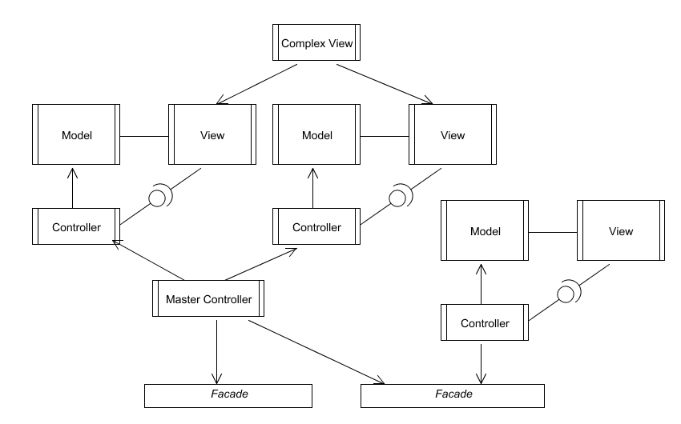
Sample Application

Slide 19


Thank you!

