Slide 1

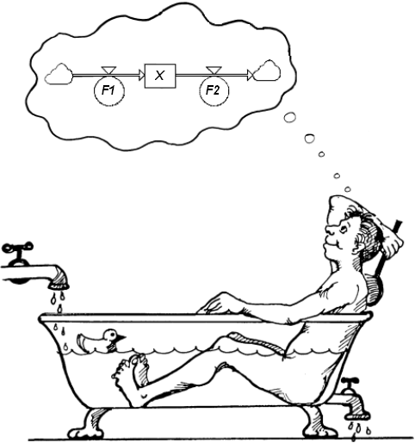
L2. MODELLING IN StochSD
I. Two ways to CSS modelling
System Dynamics
Downloading StochSD
IV. Making a StochSD model
V. Stage and Stock
VI. Attributes in a macro model
VII. Micro vs. Macro modelling
© Leif Gustafsson 211204
(File: L2_Modelling_in_StochSD.pptx)

Slide 2
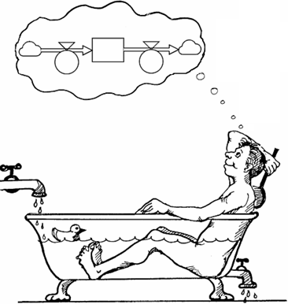
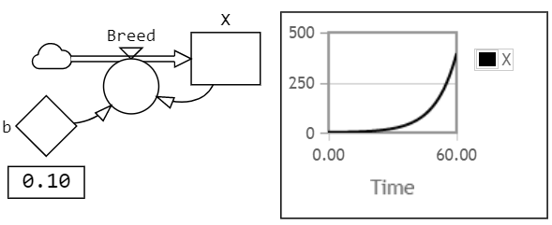
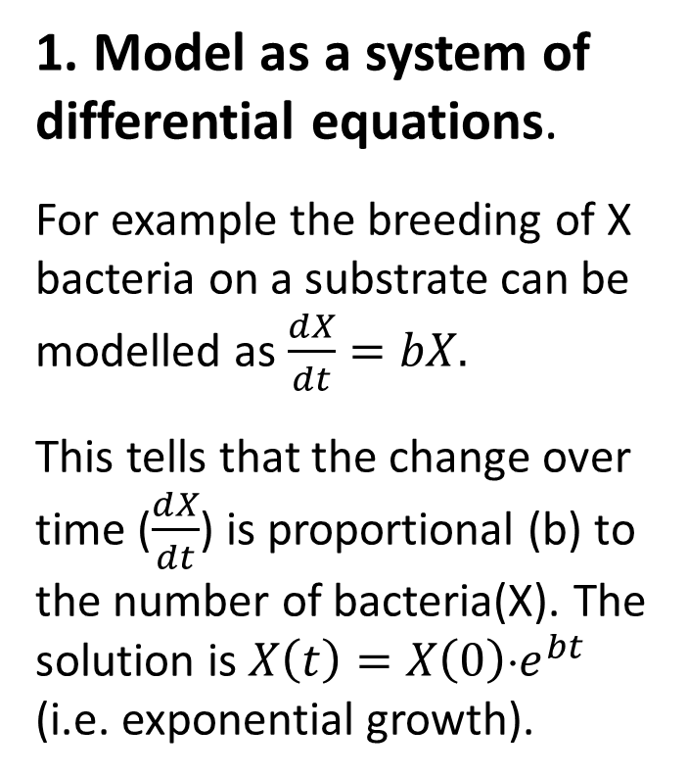
I. Two ways to CSS modelling (CSS = Continuous System Simulation)
1. Model as a system of differential equations.
For example the breeding of X bacteria on a substrate can be modelled as $\frac{dX}{dt}=bX.$
This tells that the change over time ($\frac{dX}{dt}$) is proportional (b) to the number of bacteria(X). The solution is ${X\left(t\right)=X\left(0\right)⋅e}^{bt}$ (i.e. exponential growth).
2. Model in terms of Stocks and Flows: System Dynamics
approach.
The Bacteria model in StochSD starting at X(0)=1 bacterium & b=0.1.

Slide 3
II. System Dynamics (SD)
+
+
A
a) SD makes the structure visible. The dynamic behaviour is understood in terms of Positive and Negative loops.
A
(+)
(–)
B
+
B
-
Negative loops also opens the way for control - making the system seek a goal.
Exponential growth
Exponential decline
b) The bathtub analogy of a stock filled and drained by inflows and outflows makes the ‘integration over time’ concept intuitive.
c) First focusing on the model structure,
then on the algorithm of each element, leads to good modelling.
d) The various types of stochasticity are closely related to the primitives: Stock, Flow, Parameter and Link.
Book: Thinking in Systems (221 pages) by Donella Meadows, 2008.

Slide 4

a) Causal-loop diagram
A coarse way to understand the main development (before the stock, flow, etc. symbols are included).
Here demonstrated by a RABBIT POPULATION on an isolated island.
Food supply
+
+
Birth rate
Food supply
per rabbit
(–)
+
(+)
–
+
(+) Positive loops create growth.
It is the motor that drives a system.
RABBIT POPULATION
–
(–)
(–) Negative loops regulates
(stabilizes) the process.
Death rate
+

Slide 5
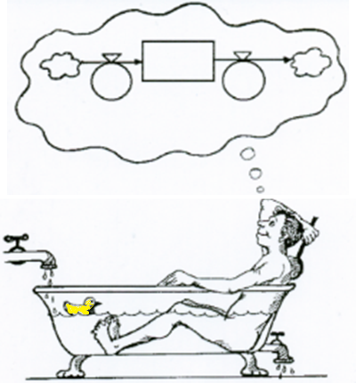
b) The bathtub analogy
The dynamics arise from stocks filled by inflows and drained by outflows.
Mathematically, this is ‘integration over time’ made easy.

Slide 6


Updating of stocks over time is called integration
The Time Step (DT) for updating the model must be small enough to produce good accuracy.

Slide 7


The main elements (primitives)
In the System Dynamics approach, the model is constructed by describing the system under study in terms of the primitives:
Stock: (state variable, compartment).
Flow: (continuous flow or transition of entities). (If not attached to a stock it starts or ends in a cloud.)
Auxiliary: (for algebraic calculation with + - * / √ etc.).
Parameter: (describes impact from the systemus’ environment).
Link: (transfers information from one primitive to another).
Cloud: (shows that the start or end of a flow is outside the borders of the systemus). Automatically included of aesthetic reasons.

Slide 8
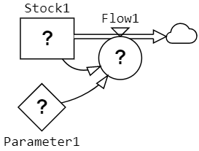
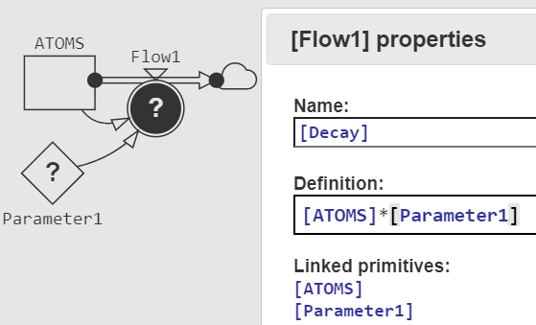
c) First make the STRUCTURE of primitives then give the ALGORITHMS of these primitives
First, the structure of a StochSD model is built in a click-and-draw manner using the primitives.
Thereafter, each primitive (except for Links) is opened to be renamed and to define an algorithm or value.

Slide 9




d) Stochasticity (~ randomness)
Five types of uncertainty:
Initial value stochasticity in a Stock:
Transition stochasticity in a Flow:
Parameter stochasticity in a Parameter:
Signal stochasticity by an Auxiliary:
Structural stochasticity: (uncertainty of model structure).
This will be treated later on in the course.

Slide 10
III. Downloading StochSD
StochSD (Stochastic System Dynamics) is an open-source package for Continuous System Simulation (CSS) based on the System Dynamics approach.
StochSD is available in two versions: StochSD Desktop and StochSD Web. Both versions of StochSD work on Windows, Mac OS X and Linux. We recommend the desktop version.
Installation instructions
StochSD Desktop for Windows, Mac OS X or Linux is downloaded from StochSD’s home page: https://stochsd.sourceforge.io.
The “StochSD User’s Manual and Tutorial” in .pdf can also be downloaded from the home page, or directly by ctrl-clicking:
StochSD User's Manual.

Slide 11
IV. Making a StochSD model of a Rabbit population
Information about the systemus
A rabbit population on an isolated island where 10 rabbits are introduced. They eat, breed and die of old age.
The food is supplied at a constant rate of 100 kg of carrots per month.
The number of rabbits born per month is proportional to the size of the population and to the square root of the amount of food per rabbit and month. The proportional constant is the fertility parameter that is calculated to 0.2.
The average length of life is 20 months, which is about the same as 5% of the population dying each month.
A so-called causal-loop diagram of this was shown at Slide 4.
Now, open StochSD to build your first model!

Slide 12
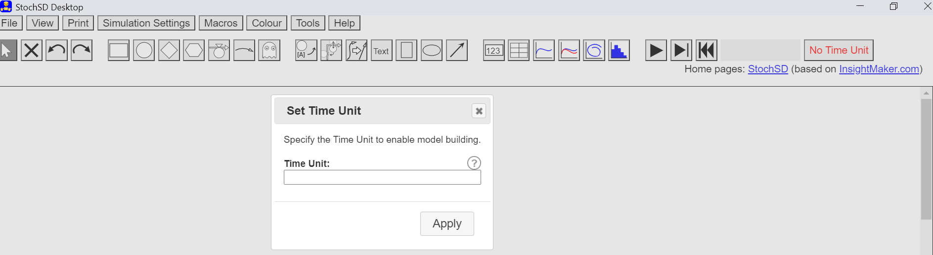
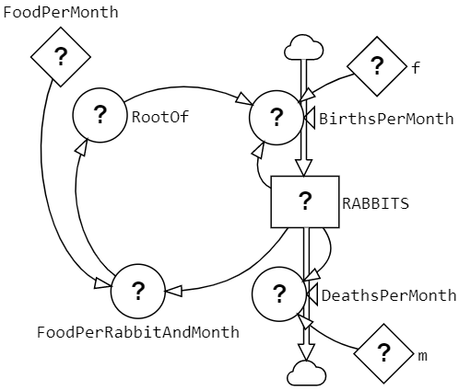
Open StochSD to build the Rabbit model
1. Specify the Time Unit to use throughout this modelling. E.g. ‘Month’.
2. Build the model structure by placing and connecting the primitives.
3. Double-click the primitives and rename them. (You may do the renaming and defining the algorithm at the same time.) Rotate the name around the primitive to an aesthetic position.

Slide 13

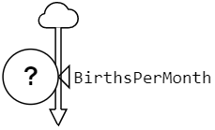
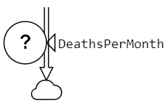





4. Open and define each primitive. (Here you can only use Linked primitives, Functions (e.g. SQRT(~) for the square root of ~), Numbers and + - * /) :
a) 10 (initial value)
b) [f]*[RABBITS]*[RootOf]
c) [m]*[RABBITS]
d) 0.2
e) 0.05
100
[FoodPerMonth]/[RABBITS]
Sqrt([FoodPerRabbitAndMonth])
When a primitive is defined the ? will disappear.

Slide 14
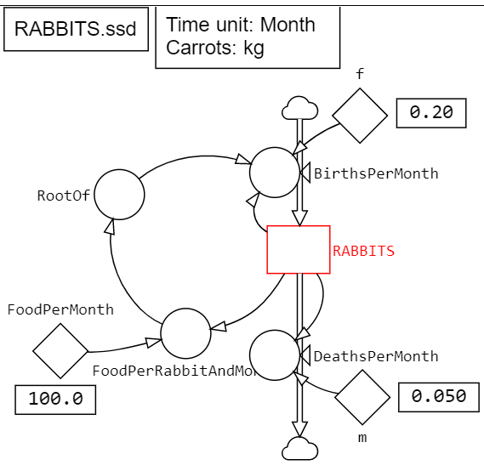
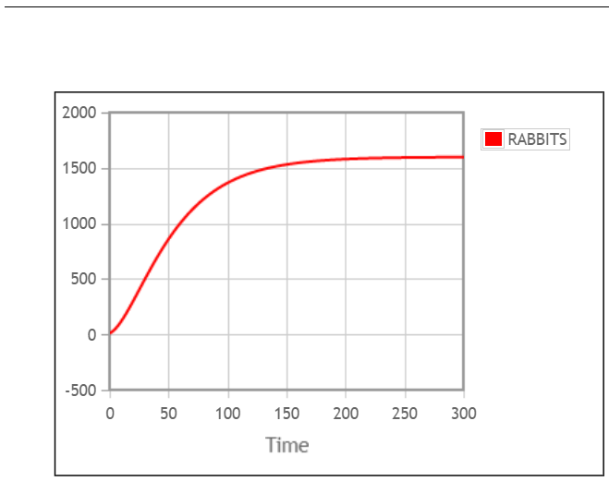
Simulation of the final model
File name and Sorts added in Text boxes.
Three Number boxes added.
The RABBIT stock coloured in red makes its result in red.
In Simulation Settings: Set Length to 300 and Time Step to e.g. 0.5 Months. Then press the Run button: .

Slide 15
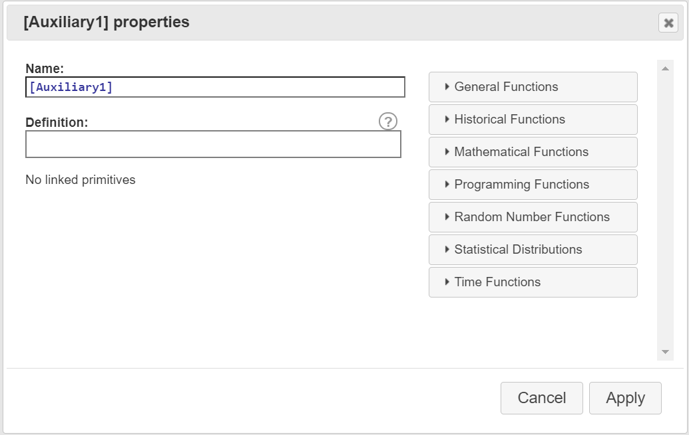
Functions and Converter
The Function Library is reached from ‘within’ each Primitive.
The Library is divided into 7 categories – see above!

Slide 16
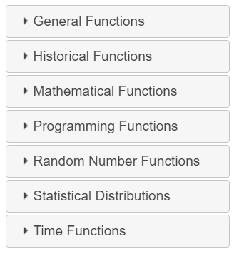
Some functions
General Functions
IfThenElse
Pulse
Step
Ramp
StopIf
Random Number
Functions
Uniform
Normal
Exponential
Poisson
etc.
Historical Functions
Delays
Fix
Statistical Functions
Time Functions
Current Time
Time Start
Time Step
Time Length
Time End
Mathematical Functions
Sin
Cos
Sqrt
Log
etc.
Click these functions for explanation.
Programming Functions

Slide 17


The Converter
The Converter is a Table Look-Up function with which Y = function(X) can be tabulated (e.g. directly from measured data).
(Of course ‘X’ and ‘Y’ can take any names.)

Slide 18
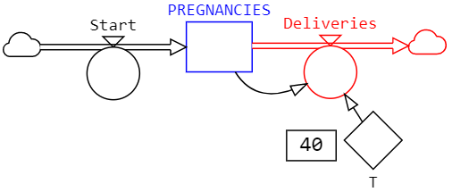
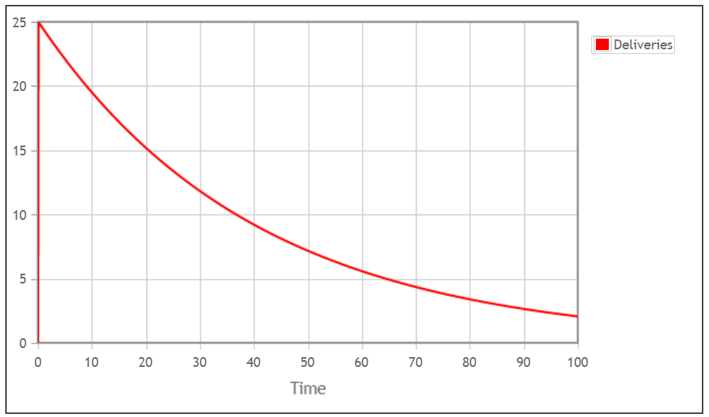
V. Stage and Stock – a common mistake
A Stage is where the entities reside (‘sojourn’) during a period of time. This sojourn time in a stage can have any distribution depending on what it models.
A Stock always generates an exponential distribution. Below, a model where a cohort of 1000 women start their pregnancies at time=0.
For example a pregnancy stage is about 40 weeks ± a few weeks.
Assuming ‘Stage = Compartment’ often creates absurd results.
Only a few processes, like radioactive decay, may be accurately modelled by a single compartment.

Slide 19
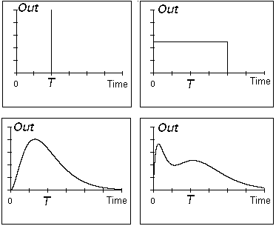
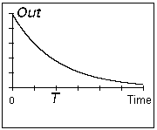
Stage vs. Stock
The duration in a stage can have any statistical distribution.
A real stage has a certain distribution that should be reproduced in the model.
in
out
Stage
T
Same average sojourn time T.
A stock always produces an exponential sojourn time distribution.
in
out
Stock
T
Confusion of Stage and Stock may create absurd results!
19

Slide 20
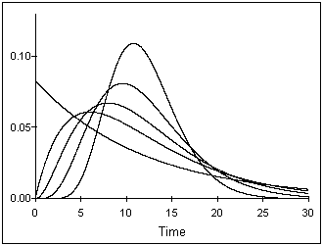
A stage must be represented by a structure of stocks
It is often important to model the sojourn-time distribution of a stage.
The sojourn-time distribution of a stage can be modelled exactly or sufficiently approximated by a structure of Stocks and Flows in series and/or parallel.
Example: A stage (average sojourn-time = T) is often represented by k serial stocks (each with the time constant T/k. (k-Erlang(T/k) distrib.)
T
T
in
out
…
Stage
X₁
X₂
X_{k}
Sojourn time distribution
k=10
The k-Erlang(T/k) distribution of the sojourn time for k=1, 2, 3, 5 and 10 stocks in a series.
k=1
k=5
k=3
k=2
T

Slide 21
Feasible and unfeasible sojourn-time distributions
Most processes in real life require a finite time to be performed
For e.g. biological/medical processes a finite time is required for digesting, transportation of nutrients, defeating a disease, developing a cancer, growing an embryo, etc.
For such a process modelled by a single stock is unfeasible because it means that the probability of performing the process in almost zero time [i.e. finishing it within (0,ε)] is larger than finishing it in any other time interval (t, t+ε) of length ε.
The k-Erlang(T/k) sojourn time distribution for k=1, 2, 3, 5 and 10 with the same overall time constant T=10 time units.

Slide 22
Example: An epidemic SIR model
An infectious disease that has the three consecutive stages S→I→R. [Susceptible, Infectious & Recovered].
S
I
R
A macro model describes how a population (consisting of n individuals) is distributed over the stages S, I and R, and how it becomes redistributed over time by the epidemic.
The probability of each Susceptible individual being infected is p⋅I per time unit, where p is a progression parameter.
⇒ The S→I flow during a short time-step DT becomes: DT⋅p⋅S⋅I
The example continues on next slide

Slide 23
Stage-to-Stock expansion
S
I
R
• The S stage is just a container holding the Susceptibles.
S
S
• The R stage is just a container holding the Recovered.
R
R
However, the I-stage holds the Infectious persons during the disease process as long as they are contagious. If this period (sojourn) is exponentially distributed (which is never observed for a disease) then the stage should be represented by a single stock.
A more realistic assumption is a k-Erlang distribution where k ≥ 3. For k=3 you get:
I
I1
I2
I3
The model based
on stocks will then be:
S
I1
I2
I3
R

Slide 24
VI. Attributes in a macro model – SIR example
Adding an attribute in Micro modelling is trivial – But in Macro modelling extra attributes (beyond the dynamic stage attributes S, I & R) multiplies the size and complexity of the model.
Attribute: Sex = {male, female}
S_{m}
I_{m}
R_{m}
S
I
R
Attribute expansion
S_{f}
I_{f}
R_{f}
Adding several attributes in a Macro model is very costly!
For example: add Sex={Male, Female}, Age={Child, Adolescent, Adult, Old}, Smoking={Yes, No}, Fortune={Rich, Average, Poor} will make the model 2*4*2*3 = 48 times larger in terms of stocks – and create a huge network of links to describe how each of the 48 groups can infect the susceptibles in every other group.

Slide 25
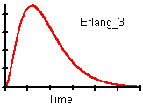
VII. Micro vs. Macro modelling
CONCEPTUAL SIR MODEL
Structure and relations
100 individuals (50 males & 50 females)
Stages: S, I, R
Attributes: Sex (m & f)
Sojourn-time distribution
in Infectious stage.
6 Stages (double frames)
S_{m}
I_{m}
R_{m}
Attribute expansion
S_{f}
I_{f}
R_{f}
Stage-to-stock expansion
1:1 mapping
S_{m}
I1_{m}
I2_{m}
I3_{m}
R_{m}
Macro model
S_{f}
I1_{f}
I2_{f}
I3_{f}
R_{f}
SUS.
Attr
= f
Micro model
10 Stocks (Single frames)
?
INF.
Micro modelling require huge amounts of information while expansions makes macro modelling heavy.
REC.
n=100 individuals
25

Slide 26
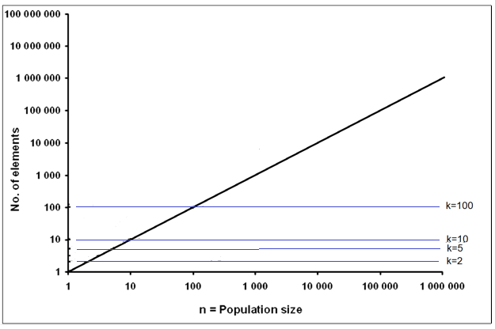
Model size for micro and macro models
For a Micro model the size growths in proportion to the number of entities (e.g. individuals, cars, blood cells, etc.).
For a Macro model the size growths with the number of Stocks (k) [after 1) Stage-to-Stock expansion and 2) Attribute expansion].
For a homogeneous model (no or few attributes), a macro model is very small and fast even if it covers millions of entities.
Micro model size
Macro model size

Slide 27
References
StochSD’s Home Page, https://stochsd.sourceforge.io, 2021.
StochSD (Stochastic System Dynamics). A CSS language for the course.
StochSD User’s Manual and Tutorial.
Lab 1: Structure and Behaviour.
Forrester, J.W. Principles of Systems, Cambridge, Wright-Allen Press, Cambridge, MA, 1968.
Kreutzer, W. System Simulation: Programming Styles and Languages, Addison-Wesley Publishing Company Inc, Sydney, 1986.
Meadows D.H. Thinking in Systems: A Primer. Chelsea Green Pub., White River Junction, Vt, 2008.

Slide 28
End L2

