Slide 1
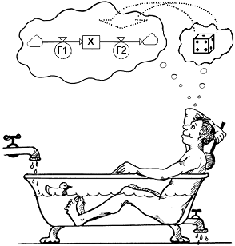
L5. STOCHASTIC MODELLING
I. CONTINUOUS MATTER OR
DISCRETE ENTITIES
II. DETERMINISTIC OR STOCHASTIC
MODEL
III. TYPES OF UNCERTAINTY
IV. CONSEQUENCES OF NEGLECTING
UNCERTAINTIES
V. STOCHASTICS MUST DESCRIBE
REALITY
VI. COMBINED SIMULATION
VII. A COSMETIC FLAW
© Leif Gustafsson, 211115
File: L5_Stochastic_Modelling.pptx

Slide 2
I. CONTINUOUS MATTER OR DISCRETE ENTITIES
⇒
X
⇒
F_{in}
F_{out}
⇒
N
⇒
Classical CSS regards every content as continuous and infinitely divisible (like water).
Time slicing: In CSS the model is updated in small time steps, DT, from Start to End.
Start
DT
End
The content is transferred between Stocks by flows in small quantities DT*F; where F is the flow rate, and DT is a time-step − small enough to make the calculations accurate.
The Stock X is then updated as: X(t+DT) = X(t) + DT*F_{in} – DT*F_{out}.
This is not possible for the discrete case where N (e.g. persons) must remain integer. (Half an entity may not be transferred!)

Slide 3
The discrete case
For the discrete case two additional conditions must be fulfilled:
1) The Stocks must be initialized as integers.
2) The discrete entities must be transferred in whole pieces,
i.e. DT*F_{in} and DT*F_{out} must have integer numbers.
Transfers can be arranged according to a schedule or randomly.
2a) Deterministic transfers according to some schedule, e.g. regularly (triggered by e.g. by a pulse-train)
2b) Random transfers according to a random process that statistically agrees with our knowledge, and preserves the integrity of the entities. The foundation is here usually based on the so-called Poisson process (to be discussed later on).

Slide 4
II. DETERMINISTIC OR STOCHASTIC MODEL
To make a useful model, we need information about the studied system – its structure, relations and data.
Often we have incomplete information. Then we can use the information we have or can get. For example, we can make many observations and create a reasonable probability distribution (e.g. over the number of customers per hour, mm rain per day, etc.). We thus have the options:
- Use average values ⇒ deterministic model.
- Or use the probability distributions ⇒ stochastic model.
In some cases a deterministic model is sufficient for your purpose of the model study.
In other cases including statistical information into the model is crucial , because it will affect the outcomes. You can then also quantify the uncertainties (e.g. as variations and confidence intervals).

Slide 5
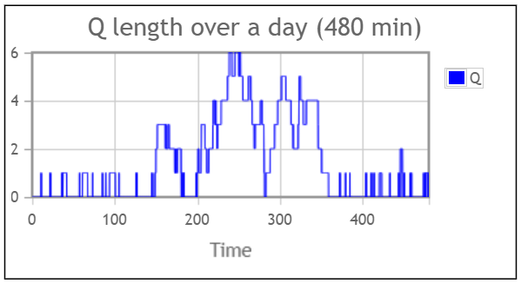
Example: A queuing model
A queuing model is a concept that includes all types of waiting for a resource. The users are ‘queuing’ (waiting) for the resource (not necessary in a line, although this may help our thinking). The resource is busy or idle.
Now assume that customers arrive randomly with an intensity λ= 8 customers/hour and are served by a singe server (capacity μ=10 customers/ hour.)
λ
μ
Customers in a queue
Resource
When arrival intensity λ is less than serving intensity μ a deterministic model, will never create a queue. However, a stochastic model may correctly show long queues and waiting times because of random arrivals and service times.

Slide 6
When will a deterministic model produce the same results as the average of a stochastic one?
For many (but not all) linear models.
For many (but not all) models with large number of entities (because of the Law of large numbers telling that variations become small compared to their averages).
In other cases you should not expect consistent results.
The best way is to check whether a deterministic model produces unbiased results is to test against a stochastic model.
A deterministic model has some advantages: It is simpler. It requires only one simulation. It strongly facilitate sensitivity analysis, parameter estimation and optimisation.
And many hazards and disadvantages: It may seriously distort the results and conclusions. It removes all variations and thus all possibility to statistical estimates such as variations, confidence intervals, correlations, min or max values, etc.

Slide 7
III. TYPES OF UNCERTAINTY
Uncertainties can be of two main types: Structural or Statistical.
A) Structural uncertainty is modelled by testing different structures.
B) Statistical uncertainties are modelled by drawing random numbers from proper statistical distributions.
Uncertainties refer to:
Initial values of stocks.
Transitions (flows). (Only for discrete entities.)
Parameter values.
Signals.
Below, we will demonstrate each type of uncertainty by an example using an epidemic SIR model.

Slide 8
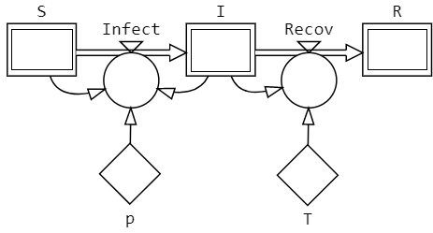
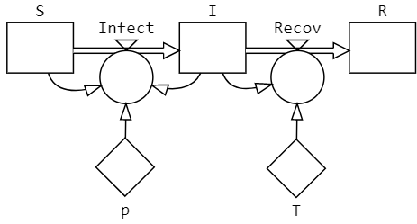
Example: Epidemic SIR model
A simple epidemic model consists of three connected stages S, I & R.
These letters stand for the number of Susceptibles, Infectious and Removed, respectively.
The rate of new cases being infected is proportional to the number of S and of I, where the proportional parameter is p.
However, The stage I will also lose cases to R because of recovery after on average T time units (i.e. Recov=I/T per time unit).
To simplify, we assume that each of the stages S, I & R can be described by a single stock.

Slide 9
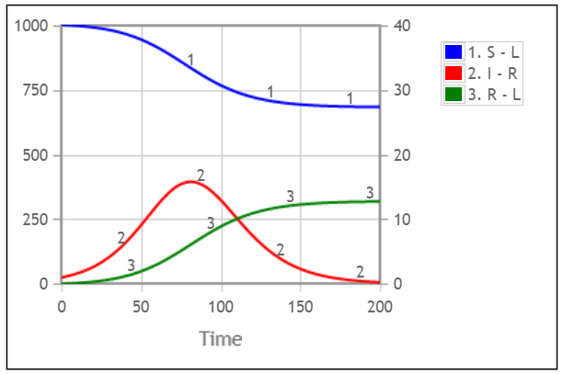
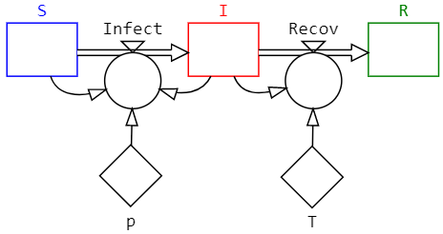
Basic SIR mode to be followed
We start with a deterministic SIR model with the following specifi-cation: S(0)=1000, I(0)=1, R(0)=0, p=0.0003 & T=4 (DT=0.1).
We see that the number of infectious (Right axes) rises to a peak and then decline (because of to few susceptibles to infect.) However, after the epidemic, there are still a number of susceptibles (Left axes).
This model and its behaviour will later be compared to what happens when different types of stochasticity enter the model.

Slide 10
A) Structural uncertainties
The immunity in R may be temporary and require a flow back to S.
S
I
R
The I-stage may require a more complicated structure of substages
(stocks) I₁ … I_{n} in series and/or parallel.
S
I₁
I₂
I₃
R
A susceptible may enter an Exposed stage (E) before being infectious.
S
E
I
R
An Authority may take actions when the number of infectious becomes large.
Authority
S
I
R

Slide 11
The sojourn time in a stage – also a structural issue
The single most common error in CSS modelling is to confuse Stage and Stock! Usually a stage has to be described by a structure of stocks and flows in order to preserve the sojourn time distribution.
Stage
Stage-to-stock expansion.
See L2 slides 17-20
For a stochastic model with discrete entities, each transition is a Poisson process (described by PoFlow in StochSD)!

Slide 12
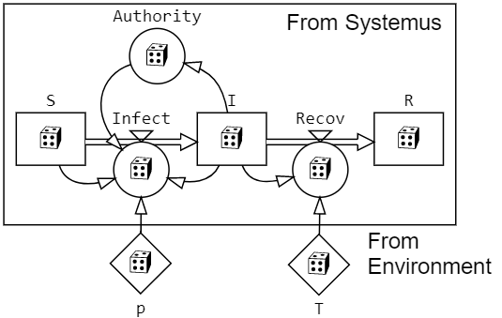




B) Statistical uncertainties
An Authority that intervenes by restriction when the number of infectious becomes unreasonable large is added to include all four types of statistical uncertainty in the model.
The four types of statistical uncertainties are all modelled by drawing random numbers from a proper statistical distribution. We then have a stochastic model.
B1) Initial-value stochasticity – Stock
B2) Transition stochasticity – Flow
B3) Parameter stochasticity – Parameter
B4) Signal stochasticity – Information link
(but controlled by an Auxiliary)

Slide 13

B1) Initial value uncertainty
Each Stock must be initialised by a number!
This number of persons in S, I and R may be uncertain.
In particular, this may apply for the number of already immune (in R). If this number is substantial, it will also reduce the initial number in S (because the whole population is N=S+I+R.)
Whether you should set an estimated value or draw a value from some statistical distribution depends on the studied system and your purpose with the model.

Slide 14
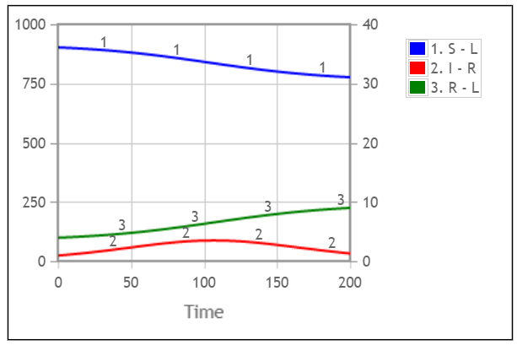
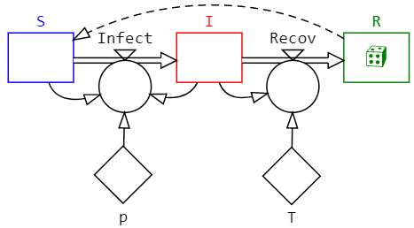
The SIR model with Initial Value stochasticity
Here we make R(0) random implying S(0)=1000-R(0). For e.g. R(0)=100 and thus S(0)=900 we get:
Comparing with the deterministic case, the development is still deterministic, but the 10% initially moved from S to R makes a large difference! Compare with the basic behaviour at Slide 9.

Slide 15

B2) Transition uncertainty
The theoretical base for random transition of entities is the Poisson process.
When transition events occur independently and randomly over time with an expected constant intensity (λ), we have a homogeneous Poisson process.
If the expected number of events per time unit is λ, this is described by the statistical distribution Poisson(λ).
However, the time step is DT is usually not unity, why we expect DT*λ events during each DT, which is realized by Poisson(DT*λ).
However, we usually have a non-homogeneous Poisson process where the intensity λ(t) varies over time. This is accomplished by keeping λ(t) piecewise constant over sufficiently small time intervals, DT. (Thus no extra complication!)
[For continuous matter, transition stochasticity to describe a Poisson process vanishes because of the Law of large numbers. E.G. water molecules in a river. Poisson(DT*VeryLargeNumber) ≈ DT*VeryLargeNumber.]

Slide 16
The Poisson distribution with intensity λ
The number of events occurring in a time interval (e.g. DT) when the events occur independently and one at a time is Poisson distributed ̶ Po(λ).
λ can take any real value ≥ 0 and Po(λ) is always an integer ≥ 0.
The probability function is p(x) = e^{-λ}⋅λ^{x}/x! for x ∈{0, 1, …}.
λ=2
λ=5.5
x
x
Expected value and variance: E[Po(λ)] = Var[Po(λ)] = λ.
The intensity λ=F is the expected number of events during 1 time unit. During DT we thus expect DT*F transition events.
Including the Poisson distribution, we get Po(DT*F) events during DT.
The stochastic implementation is independent of the step-size, DT,
because Po(DT⋅F) can be replaced by Po(½DT⋅F) + Po(½DT⋅F).

Slide 17
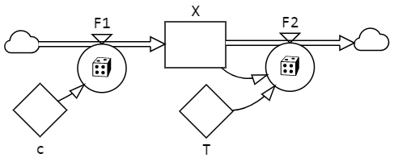
Realisation of the Poisson process
Regard the following deterministic model and see how Poisson processes are introduced in F1 and F2.
Deterministic model
X(t+DT) = X(t) + DT*F1 – DT*F2
X0 = 0
DT*F1 = DT*c
DT*F2 = DT*X/T
Stochastic model
X(t+DT) = X(t) + DT*F1 – DT*F2
X0 = 0
⇒ DT*F1 = Po(DT*c)
⇒ DT*F2 = Po(DT*X/T)
However, DT*F is not allowed on the left side of an algorithm! Thus:
F1 = DT*c/DT =c ⇒ F1 = Po(DT*c)/DT
F2 = DT*X/T/DT = X/T ⇒ F2 = Po(DT*X/T)/DT
Or with PoFlow:
F1 = c ⇒ F1 = PoFlow(c)
F2 = X/T ⇒ F2 = PoFlow(X/T)
Note: Although DT*F1–DT*F2 = DT*(F1-F2), PoFlow(F1) – PoFlow(F2) ≠ PoFlow(F1-F2).

Slide 18
All transition processes are not Poisson!
All transition processes are not Poisson processes. For example: Arrivals may be scheduled (and vary somewhat around the scheduled time).
Customers arriving to a restaurant may come alone, in pairs or in larger groups. Here you can have one Poisson process for each size of the group (N=1, 2, 3, …).
Customers may withdraw (balk) when a waiting queue is too long. If you know the probability of balking as function of queue length, you can include a balking flow using another Random Number Generator.

Slide 19
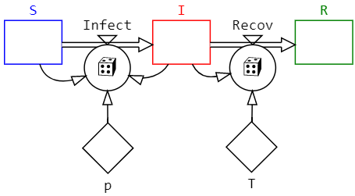
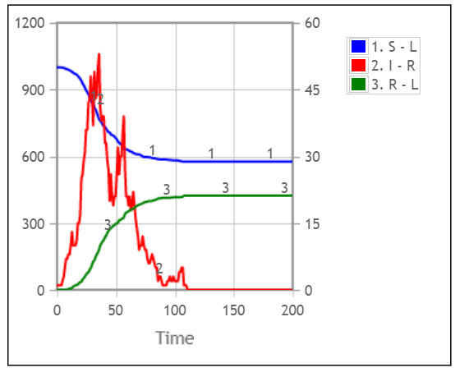
The SIR model with transition stochasticity
Transition stochasticity is in StochSD obtained by replacing the deterministic flows Infect=p*S*I and Recov=I/T by Infect=PoFlow(p*S*I) and PoFlow(I/T), respectively.
[PoFlow(λ) is short for Poisson(DT*λ)/DT. It shows the correspondence between the deterministic and stochastic cases.]
In this particular replication (simulation run) we had an epidemic, in other replications the single Infectious may recover before infecting a Susceptible. The average epidemic size is about 54.5 persons, which strongly contradicts the deterministic model that always gives 318.5 persons.

Slide 20

B3) Parameter stochasticity
Parameter stochasticity describes irregularities generated
outside the system borders. E.g. from weather, arriving
customers, accidents, etc.
Two random aspects have to be considered:
- The size of the unexplained change.
- The time-point of the change or changes.
Any type of distribution (often empirical) may be involved.
Parameter stochasticity is strongly affected by the size of the
used time-step, DT. Therefore ‘sample-and-hold’ is necessary
to be independent of DT.
(In StocSD Fix(RandDist(parmeters), SampleTime) is used.)

Slide 21
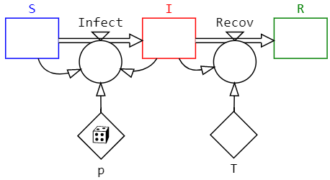
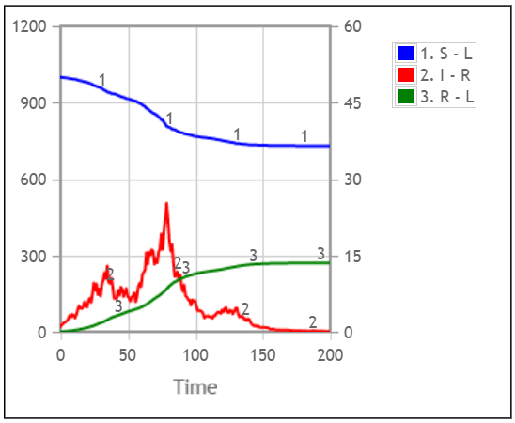
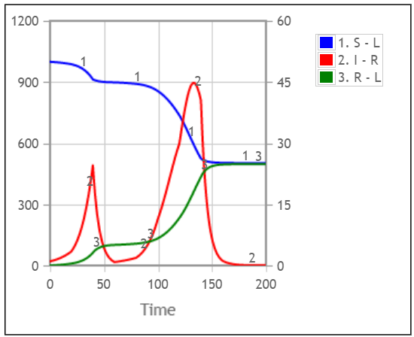
The SIR model with parameter stochasticity
Two replications of the SIR model where the parameter p is varied as p=Rand(0, 0.0006), thus keeping the same average p=0.0003.
In the first replication p is changed each day, and in the second each 20 days.
p= Fix(Rand(0, 0.0006), 1)
p= Fix(Rand(0, 0.0006), 20)

Slide 22
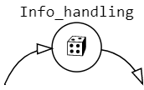
B4) Signal stochasticity
Information is transferred by links. However, the link has no name and is not accessible, why it can only passively transmit a message defined by e.g. an Auxiliary.
For example, to the deterministic SIR model, we add an Authority that receives information about the number of infectious persons, makes and announces its decision in order to decrease the rate of S → I. (See Slide 12, above)
The signal caries the information. However, this information may be uncertain both to its content and to the time the receivers get it.
For example, in the SIR example in Slide 12, the information about stage I may be poorly estimated and the delay time for the Authority to analyse it, come to a decision and deliver it is also uncertain – but may be stochastically modelled.
22

Slide 23
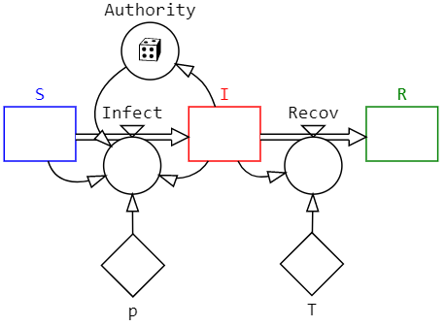
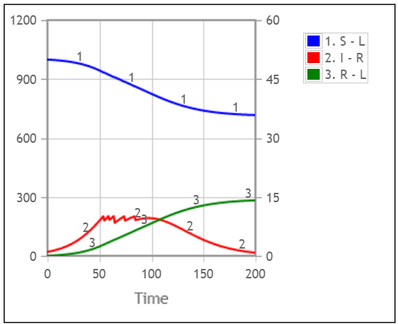
The SIR model with signal stochasticity
The Authority estimates the number of infectious every day. If I>10 it takes measures that reduce the Infect flow by 20 to 80%, which here is described by: Authority=IfThenElse([I]>10, Rand(0.2, 0.8), 1).
If the time for data collection, decision and actualisation takes an uncertain time, you can also describe this by a delay of random length drawn from a proper statistical distribution.

Slide 24
IV. CONSEQUENCES OF NEGLECTING UNCERTAINTIES
Neglecting transition stochastics
(Transition stochasticity only exists for discrete entities)
Neglecting transition stochastics for discrete entities may distort the model behaviour and the results. (Remember the queuing example at Slide 5.)
There are cases where the average from a deterministic model equals the expected value from a stochastic model of the same structure:
a) Many (but not all) linear models where the termination criterion is
fixed in time.
b) Many (but not all) models where all compartments and transitions
contain large numbers.
(If the systemus is deterministic, then the model should of course also be deterministic.)

Slide 25
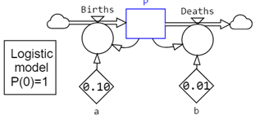
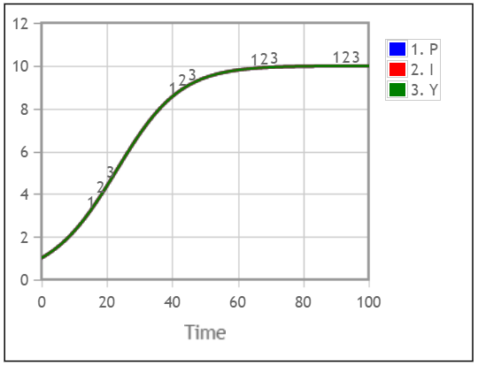
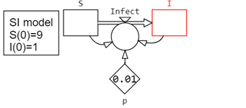
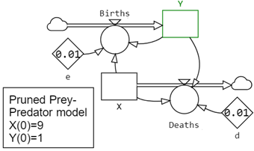
Deterministic models hide important information
Example: Deterministic Logistic, SI & Prey-predator models:
The behaviours of these three deterministic models are identical.
Now lets introduce transition stochasticity!

Slide 26
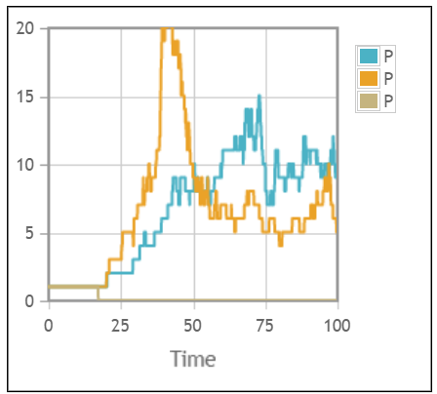
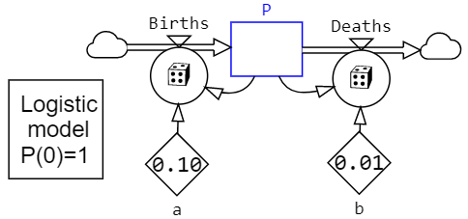
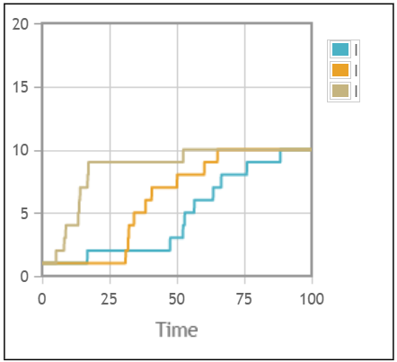
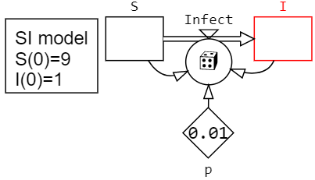
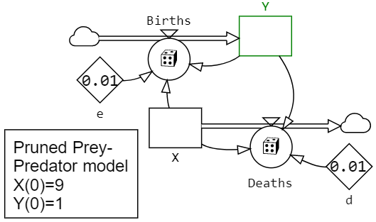
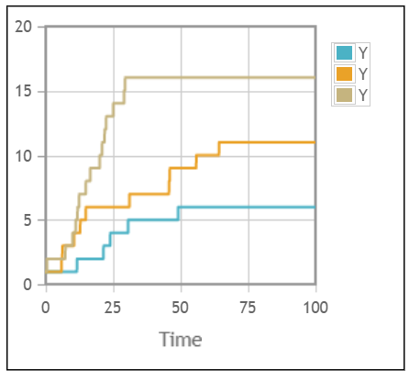
Stochastic models reveal important information
Only transition stochasticities.
A stochastic logistic model and three replications of the model.
Large variations, different end results. One replication went extinct (to zero)!
A stochastic SI model and three replications of the model.
Monotonic rise to the same level.
A stochastic pruned prey-predator model and three replications of the model.
Monotonic rise to different levels.

Slide 27
Example: Prey-predator model
Two species: The prey and the predator
(e.g. Rabbits and Foxes)
The prey (X) increase by reproduction and decrease by
meeting the predators. The prey are also affected by
mutual competition.
The predators (Y) increase by eating preys, and a certain
fraction dies each time unit.
There are three possible equilibria:
Both X & Y, Only X survives, and X=Y=0.

Slide 28
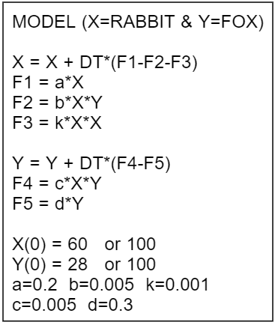
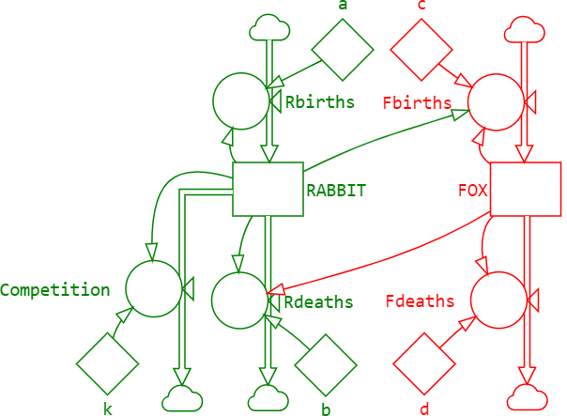
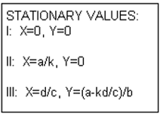
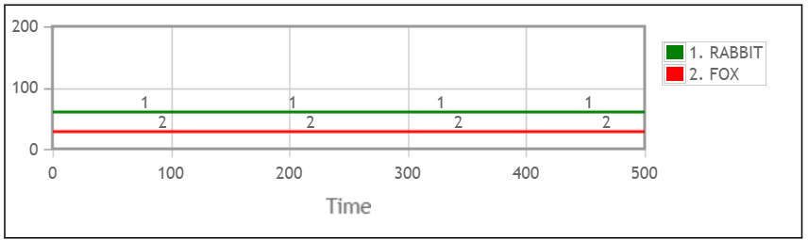
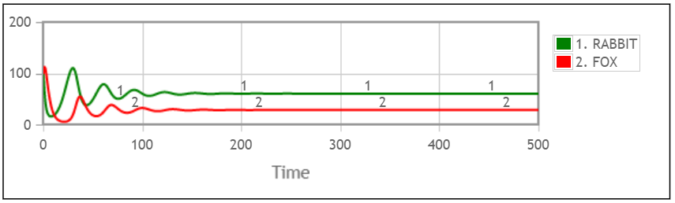
Deterministic prey-predator model
The model remains in, or will soon reaches, balance after which nothing more happens. It cannot switch to another stationary situation.

Slide 29
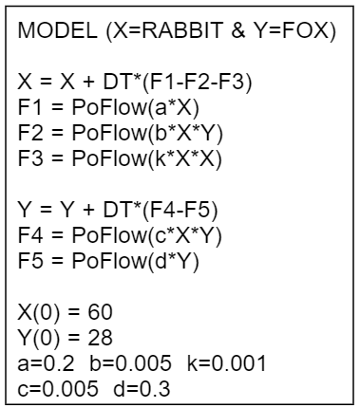
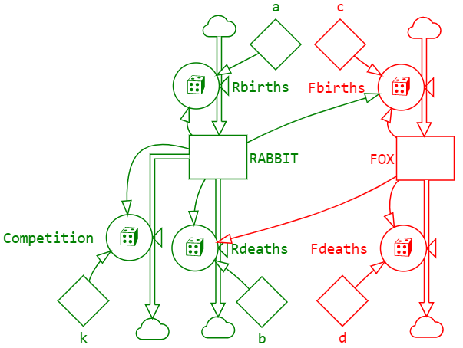
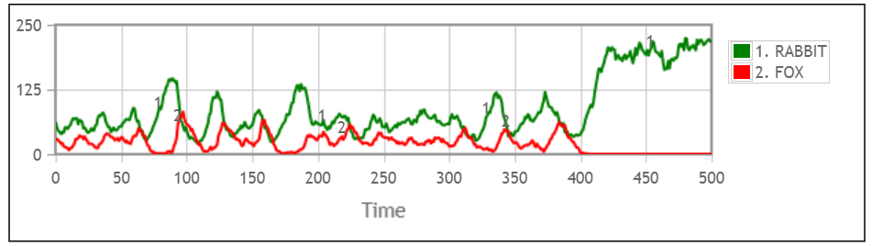
Stochastic prey-predator model
Here FOXES became extinct!
Conclusions: 1) The stochastic variations will excite the dynamics!
2) Possibility to switch to another dynamic mode (extinction)!
3) The averages differ from that of the deterministic model!

Slide 30
SUMMARY of: Why transition stochasticity?
Transition stochastics excite dynamics, and dynamics change the stochastic conditions. Dynamics and transition stochastics are inseparable!
The behaviour and the averages from the stochastic model may be substantially different compared to those from a deterministic model.
Persistent variations may be lost if stochastics are removed.
A stochastic model (unlike a deterministic model) may switch to another mode, e.g. by extinction.
Much information is lost if transition stochasticity is removed.

Slide 31
2) Neglecting Initial-value stochastics
Example: The SIR model, where I(0) = 0, 1 or 2 infectious persons (same probability = 1/3) are returning from abroad to a susceptible population. What is the expected size of an epidemic?
Using StatRes to test 10,000 replications of each case with DT=0.1.
a) Deterministic model with I(0)=1: R(End) = 319.5 persons.
b) Deterministic model + IV-stochasticity:
Average R(End) = 213.9 persons. 95% C.I. 211.0 – 216.9.
d) Transition stochasticity with I(0)=1:
Average R(End) = 56.1 persons. 95% C.I. 53.7 – 58.5.
d) Transition + IV stochasticities:
Average R(End) = 53.9 persons. 95% C.I. 51.5 – 56.3.
Neglecting Initial-value stochastics may distort behaviour and results.

Slide 32
3) Neglecting parameter stochastics
Parameter stochasticity will often, directly or indirectly, affect the transitions.
Parameter stochasticity can take any distribution,
and the times for parameter changes can also have
any distribution.
A general treatment of this case is not possible.
Fast varying parameter stochastics tend to ‘average out’ while slow varying stochastics will make a heavier impact on the model behaviour.
Neglecting parameter stochastics may distort behaviour and results. It will also reduce model variations and confidence intervals.

Slide 33
4) Neglecting signal stochastics
Signal stochasticity will often, directly or indirectly, affect the transitions.
Signal stochasticity can take any distribution,
and the times for parameter changes can also have
any distribution.
A general treatment of this case is not possible.
Fast varying signal stochastics tend to ‘average out’ while slow varying stochastics will make a heavier impact on the model behaviour.
Neglecting signal stochastics may distort behaviour and results. It will also reduce model variations and confidence intervals.

Slide 34
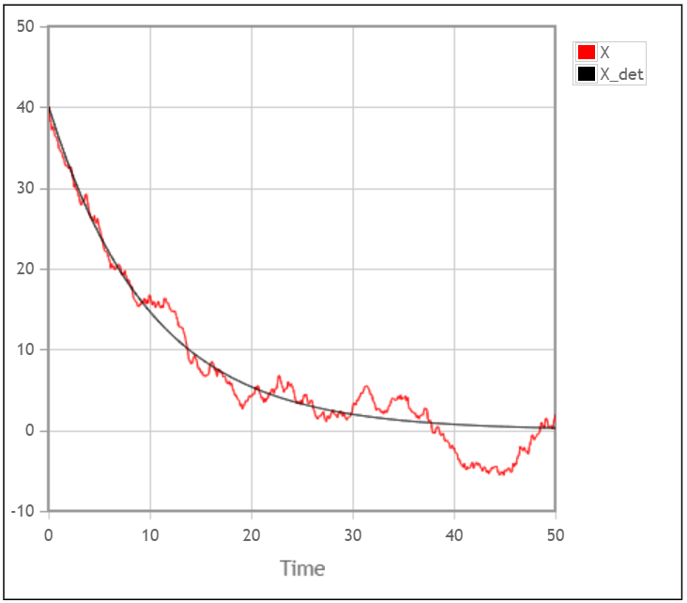
V. Stochastics must describe reality
A Poisson process, where non-decayed radioactive atoms X decay by a fraction a per time unit, can be implemented as a deterministic model as: dX/dt = - a⋅X.
Now we describe this process by instead adding e(t) = random N(0,1)-distributed noise to the transitions as: dX/dt - a⋅X + b⋅e(t); (where X(0)=40, a=0.1, b=4, DT=0.1.)
This stochastic model produces a number of artifacts:
Non-integer numbers of atoms.
Negative number of atoms may occur.
Continued variations, even after all atoms are decayed.
Sudden increases in the number of atoms.
Stochastic variations unrelated to the remaining number of atoms.
The model’s behaviour depends on the time-step used.
Such artifacts, when part of a larger model, may generate severe consequences that are hard to trace back to their root cause. For example:
Variations without appropriate reasons may excite other parts of the model.
X < 0 may trigger various phenomena, e.g. driving other processes backwards.
If a logarithm or the root of X is used, the model will crash when X becomes negative.

Slide 35
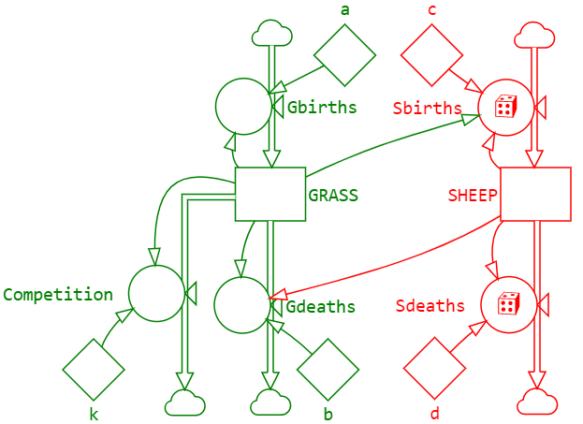
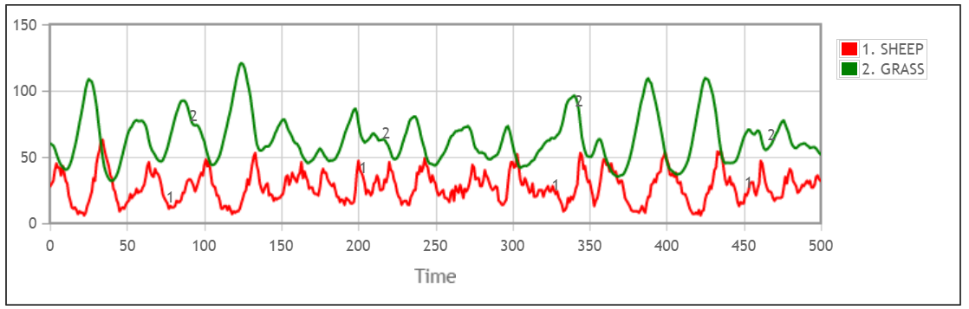
VI. Combined simulation
There are systemus where some parts are continuous and others discrete. Traditionally, such processes have been modelled by combining CSS and DES in a so-called combined simulation languages, which mixes concepts from micro and macro modelling and uses different time-handling methods to be synchronized.
In StochSD, mixing interacting continuous and discrete processes is straight-forward. For example, we assume that the stochastic prey-predator system with discrete rabbits and foxes (see slides 27-29) is replaced by continuous grass preyed on by discrete sheep – everything else the same.
With the transition stochasticity removed from the prey (Grass) (cf. slide 29), its development becomes smoother, although it is still affected by the stochastics from the predators (Sheep).

Slide 36
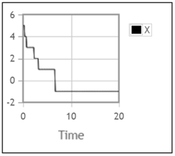
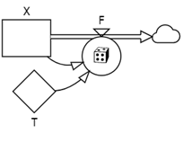
VII. A cosmetic flaw
Both deterministic and stochastic CSS time-slicing require an infinitesimally small DT to be exact. The Poisson process is defined for infinitesimally small DT. For a finite DT, a stochastic outflow has a small chance to be larger than the content of its compartment, thus creating a negative population in the compartment.
With e.g. one entity left (X=1), the PoFlow(X/T) might occasionally get the outcome DT⋅F =2 because of a too large DT. This results in X = -1.
X=X+DT*F
X(0)=5
F=PoFlow(X/T)
The problem arises because F is not updated for each event during a DT. The risk of this artifact approaches zero when DT is reduced.
The artifact makes just a small bias, usually with no further consequences because of the property: PoFlow(neg. number)=PoFlow(0)=0.
In StochSD [X] < 0 can be prevented by checking “◻ Restrict to non-negative values”.

Slide 37
References
Lab 3: Deterministic vs. Stochastic Model Building and Simulation.
Gustafsson L. Poisson Simulation – A Method for Generating Stochastic Variations in Continuous System Simulation. Simulation 74:5, 264-274, May 2000.
Gustafsson L. Poisson Simulation as an Extension of Continuous System Simulation for the Modeling of Queuing Systems. Simulation 79:9, 528-541, September 2003.
Gustafsson L. Studying Dynamic and Stochastic Systems Using Poisson Simulation. In Liljenström H. and Svedin U. Eds. Micro – Meso – Macro: Addressing Complex Systems Couplings. World Scientific Publishing Company. Singapore, 2004.
Gustafsson L., Sternad M., Gustafsson E., The Full Potential of Continuous System Simulation Modelling, Open Journal of Modelling and Simulation, 5, 253-299, 2017.
Gustafsson L. and Sternad M. The Poisson Simulation Approach to Combined Simulation, 2009, Report. http://www.signal.uu.se/Publications/pdf/r091.pdf
Kermack W.O. and McKendrick, A.G. Contributions to the mathematical theory of epidemics. Proc. Roy. Soc. A 115, 700-21, 1927.
Volterra, V. Fluctuations in the abundance of a species considered mathematically, Nature, 118, 558-560, 1926.

Slide 38
End L5

