Slide 1
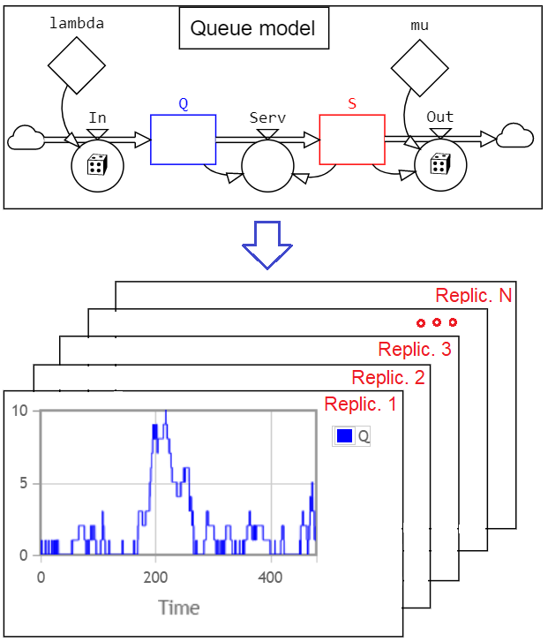
L6. STATISTICAL OUTPUT ANALYSIS
I. RANDOM INPUT – RANDOM OUTPUT
II. STATISTICAL OUTPUT ANALYSIS
IIA. Internal statistics
IIB. External statistics
- The StatRes tool
IIC. The treacherous confidence interval
III. THE STATRES TOOL APPLIED TO
A SIR MODEL
External statistics
© Leif Gustafsson, 211115
File: L6_Statistical_Output_Analysis.pptx
Internal statistics

Slide 2
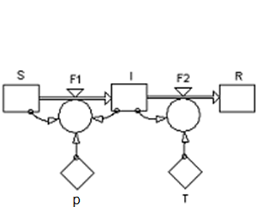
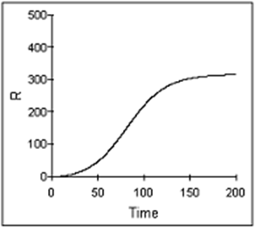
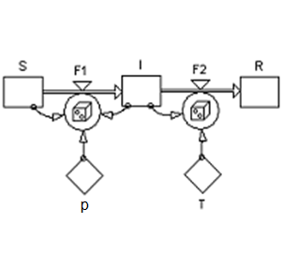
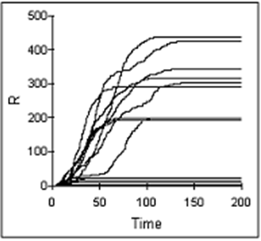
I. RANDOM INPUT – RANDOM OUTPUT
50 replications of a deterministic SIR model – all giving the same value of R=Recovered(after an epidemic)!
50 replications of a stochastic SIR model – 9 created an epidemic and in 41 the initially infectious recovered before spreading the disease!
Each replication of a stochastic model gives a different result. Many replications must then be performed - followed by statistical analysis!

Slide 3
II. STATISTICAL OUTPUT ANALYSIS
Randomness has two main aspects:
● Random input must be modelled by drawing numbers from appropriate distributions.
● Random output must be analysed to get the results on a statistical form.
Stochastic MODEL
Statistical analyses:
• Statist. Distributions
• Averages
• Standard deviations
• Min, Max
• Conf. Intervals
• Correlations
• ...
Initial value stochasticity
Transition stochasticity
Calcu-
lations
Stochastic outputs
Random
numbers
Parameter stochasticity
Signal stochasticity
Random numbers produce random outputs which require statistical analyses and result presentation.

Slide 4
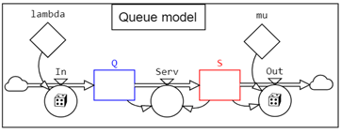
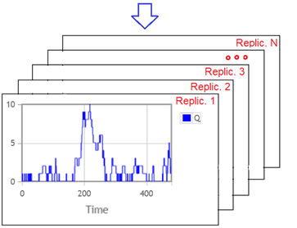
Example: A queuing system* (to be discussed)
A simplified model of a shop with a single server to which customers arrive with an intensity of λ=1/6 customers per minute, and the service rate is μ=1/5 per minute. (I.e. one customer each 6 minutes on average and service time on average 5 minutes, why no queues would form in a deterministic model.)
The shop is open for 8 hours = 480 minutes.
Queuing model in StochSD
Q = Q + DT*(In - Serv)
S = S + DT*(Serv - Out)
In = PoFlow([lambda])
Serv = Min([Q], 1-[S])/DT
Out = Min(PoFlow([mu]*[S]),1/DT)
lambda=1/6, mu=1/5, Q(0)=0, S(0)=0
External statistics
Internal statistics
*) This very simple model is similar to an ideal M/M/1/∞ model, but it differs in some aspects.
• We don't handle the customers after closure time.
• Theory assumes ‘equilibrium’ at start, We have Q=S=0.
• Theory is based on a very long time period (lim t→∞).
• One DT is required for transition into Q and another from Q to S. • It does not allows more than one service per DT. In simulation we are mainly interested in describing a real system rather than an idealized mathematical construction.

Slide 5
Internal and external statistics
Two kinds of statistics can be obtained from stochastic simulation.
A) Internal statistics concerns the stochastic variations within a replication.
It is often convenient to make these statistical calculations (average, standard deviation, min, max, etc.) during the replication by counting events, summing up quantities X and their squares X², testing if X is the largest or smallest value, etc. However, in StochSD you have direct access to functions such as: • PastMean([X])
• PastMedian([X])
• PastStdDev([X])
• PastMax([X])
• PastMin([X])
• PastCorrelation([X], [Y])
Where you also can specify part of the replication (default is the whole replication).
B) External statistics concerns the stochastic variations over many replications.
In StochSD, data collection from many independent replications, followed by a statistical analysis and presentation is handled by the StatRes tool.
There is on important difference between the statistics within a replication and over many replications. Within a replications you will usually have a strong dependence between the values X(t) and e.g. X(t+DT), while the values from different replications are independent experiments. (We will return to this.)

Slide 6
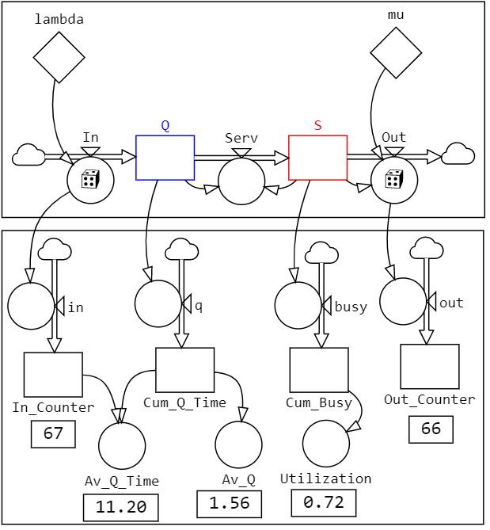
IIA. Internal statistics (from the queuing model)
Sometimes you have to construct your own devices for measuring the outcomes from a stochastic model. For example, to measure the consequences of queuing Number of arriving and served customers, Queue length, Waiting times, Utilization of the server, etc.
MEASURING DEVICES
in = In
busy = S
out = Out
Measuring Stocks initiated to 0.
Av_Q_Time = [Cum_Q_Time]/([Out_Counter]+eps)
Av_Q = [Cum_Q_Time]/(T()+eps)
Utilization = [Cum_Busy]/(T()+eps)
eps ≈ 2e-16 protects the denominator to be zero when the stock is empty.

Slide 7
The observations within a replication are NOT independent
The sequence of values in a time series are seldom independent – especially if they are close in time. For example the temperature at 12:00 and 12:01 are probably very close. This dependence is, of course, usually true for a dynamic model. X(t) and X(t+DT) are often very close (dependent).
This is not a problem when calculating the average, min, max, standard deviation etc.
However, when calculating a confidence interval around an estimate X, you use a formula that assumes a Normal distribution, which in turn is based on the Central Limit Theorem that assumes independence.

Slide 8
IIB. External statistics - over many replications
The external statistics are collected from the end results of the individual replications.
‘End result’ is not a limitation because in the model you can ‘sample and hold’ a value from any point in time. For example, you can preserve the half-time value of the queue length by [Q_halftime] = Fix([Q], 240) and study Q_halftime from the replications.
You can also use cumulated values calculated in the model such as In_Counter, Cum_Busy or calculated values such as Av_Q and Av_Q_Time that represent what happened during the whole (or part of) the replications. (See Slide 6.)

Slide 9
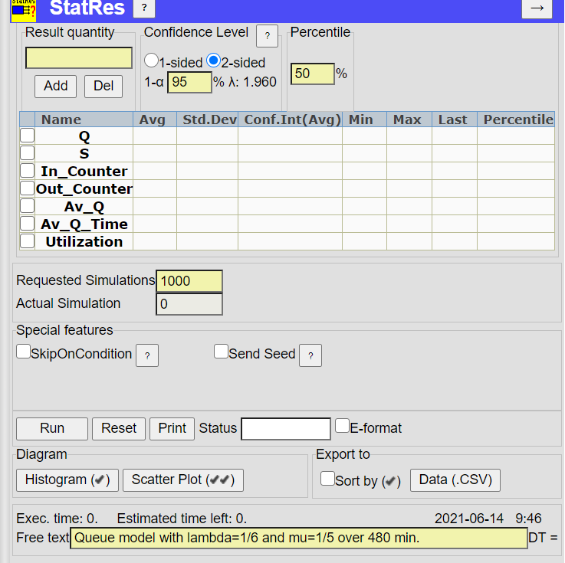
The StatRes tool
The StatRes tool is found in the StochSD’s Tools menu.
After opening it from the queuing model you can e.g. specify and add Q and S (end values of each replication), In_Counter, Out_Counter, Av_Q, Av_Q_Time and Utilization.
Specify the number of replications.
Press the
RUN button.
Comments can be made as
free text.

Slide 10
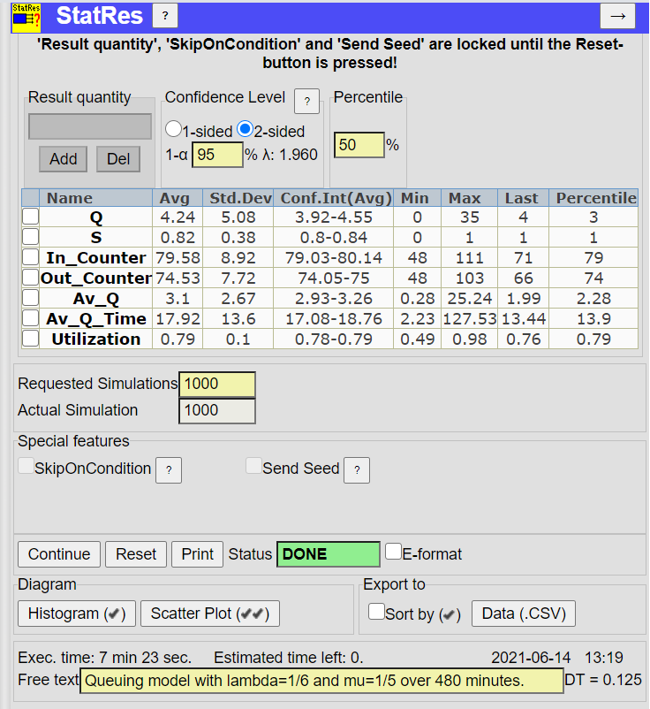
StatRes runs the specified number of replications, makes statistical analyses and presents the results
The main statistical analysis of 1000 replications of the queuing model shows Averages, Standard Deviations, Confidence intervals around the estimated averages, Min, Max and Percentile (specified above. Here 50% gives the Median).
• By checking the boxes to the left of the Names you can make Histograms or Scatter plots of selected quantities.
• The 1000 replications with DT=0.125 took 7:23 minutes.

Slide 11
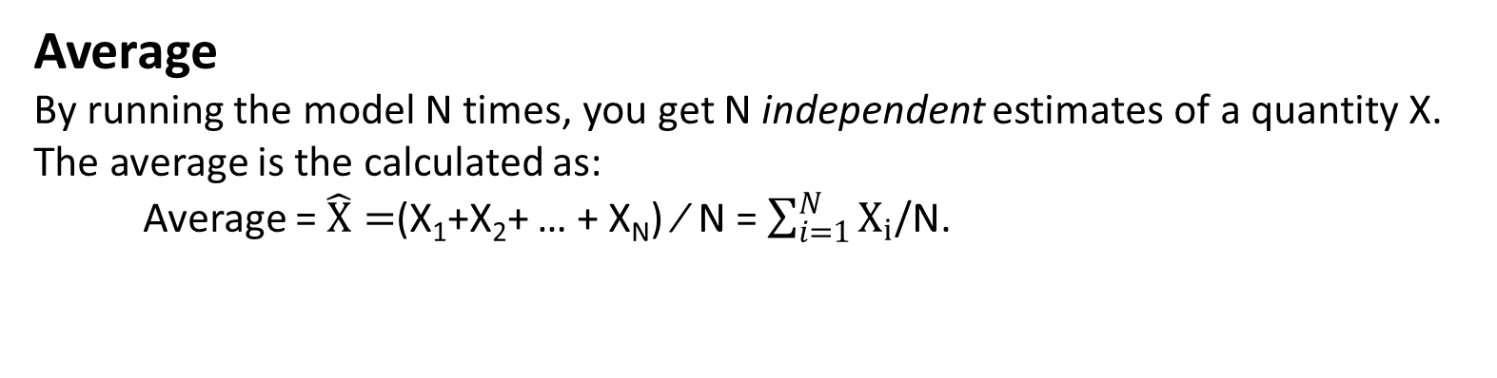
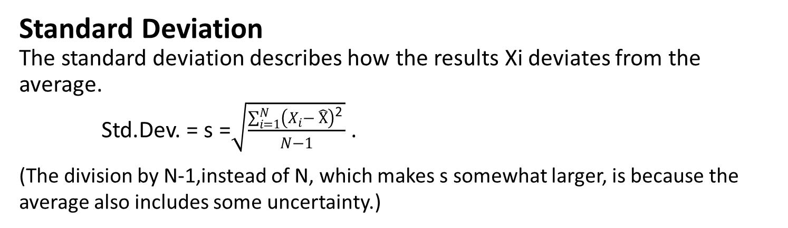
Statistics from StatRes
The following statistics are calculated for the specified model quantities from the N replications:
Average
By running the model N times, you get N independent estimates of a quantity X. The average is the calculated as:
Average =$\hat{X}=$(X₁+X₂+ … + X_{N}) ⁄ N = $\sum_{i=1}^{N}{X_{i}}$/N.
Standard Deviation
The standard deviation describes how the results Xi deviates from the average.
Std.Dev. = s =$\sqrt{\frac{\sum_{i=1}^{N}{\left(X_{i}− \hat{X}\right)\text{2 }}}{N−1}}$ .
(The division by N-1,instead of N, which makes s somewhat larger, is because the average also includes some uncertainty.)

Slide 12
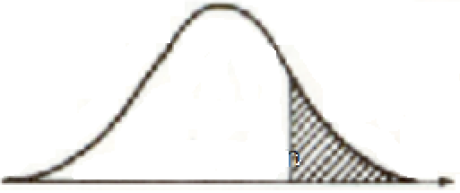


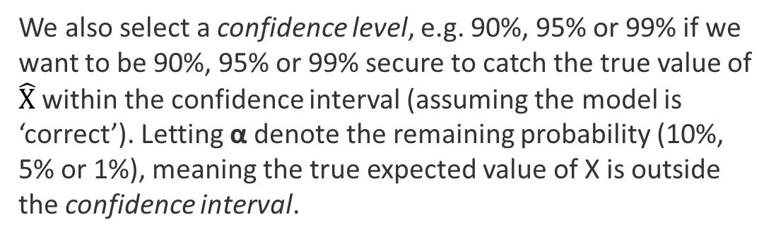
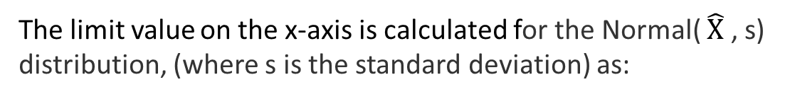
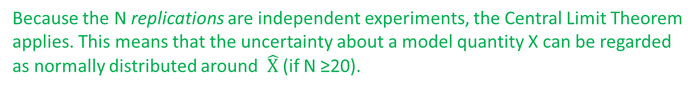
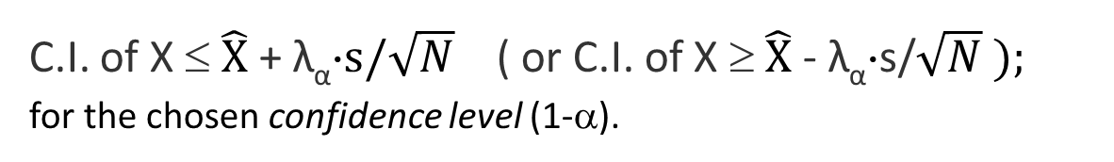
Confidence Intervals around the estimated average ($\hat{X}$)
Because the N replications are independent experiments, the Central Limit Theorem applies. This means that the uncertainty about a model quantity X can be regarded as normally distributed around $\hat{X}$ (if N ≥20).
1-sided confidence interval (C.I.)
If the uncertainty is one-sided (e.g. we know that it is larger than zero, or that the glass can not be more than full), we select the 1-sided confidence interval in StatRes. See Figure.
Area α
Area 1-α
$$\hat{X}$$
C.I. around$\hat{ X}$
We also select a confidence level, e.g. 90%, 95% or 99% if we want to be 90%, 95% or 99% secure to catch the true value of $\hat{X}$ within the confidence interval (assuming the model is ‘correct’). Letting α denote the remaining probability (10%, 5% or 1%), meaning the true expected value of X is outside the confidence interval.
The limit value on the x-axis is calculated for the Normal( $\hat{X}$ , s) distribution, (where s is the standard deviation) as:
C.I. of X ≤ $\hat{X}$ + λ_{α}⋅$s/\sqrt{N}$ ( or C.I. of X ≥ $\hat{X}$ - λ_{α}⋅s/$\sqrt{N} );$
for the chosen confidence level (1-α).

Slide 13
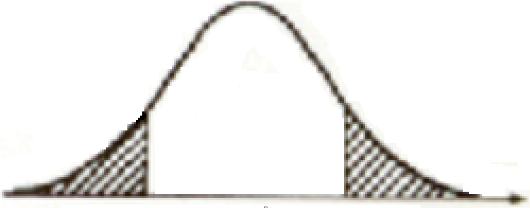
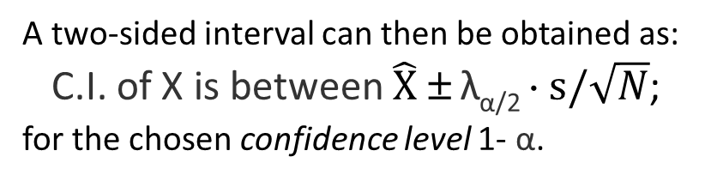



Confidence Intervals around$\hat{ X}$ - continued
2-sided confidence interval (C.I.) If the uncertainty is two-sided, we choose the 2-sided confidence interval in StatRes. Then the uncertainty α to be excluded is divided into α/2 on the left side and α/2 on the right side, giving a confidence level 1- α for the area in between, See Figure.
Area α/2
Area α/2
Area 1-α
$$\hat{X}$$
C.I. around$\hat{ X}$
A two-sided interval can then be obtained as:
C.I. of X is between $\hat{X}$ ± λ_{α/2} ⋅ $s/\sqrt{N}$;
for the chosen confidence level 1- α.

Slide 14
Min and Max
The minimal and maximal values of a quantity X from the N replications are calculated.
Note that the values compared are the end values of each replication. If you want the largest or smallest value within each of the N replications, you use the X=PastMin() and X=PastMax() functions in StochSD.
Percentiles
To obtain values of the cumulated distribution function (c.d.f.) F(X) you can specify the percentile for when F(X) ≤ 50% (median) or any other percentile.
By reading the percentiles for 2.5% and 97.5% you find an interval where 95% of the outcome values of X are located.
Histogram
You may also display a distribution or density function f(X) as a Histogram. Here you can select the number and intervals of the bars. See an example at the next Slide.
Scatter Plot (X-Y diagram)
You may also use a Scatter Plot to display the correlation between two quantities X and Y. Here you also get the correlation coefficient calculated. See an example at the next, next Slide.
Export the data
The StatRes data can also be exported in CSV format (Comma Separated Values) as sorted or unsorted tables. These data can then be further analysed in e.g. a spreadsheet.

Slide 15
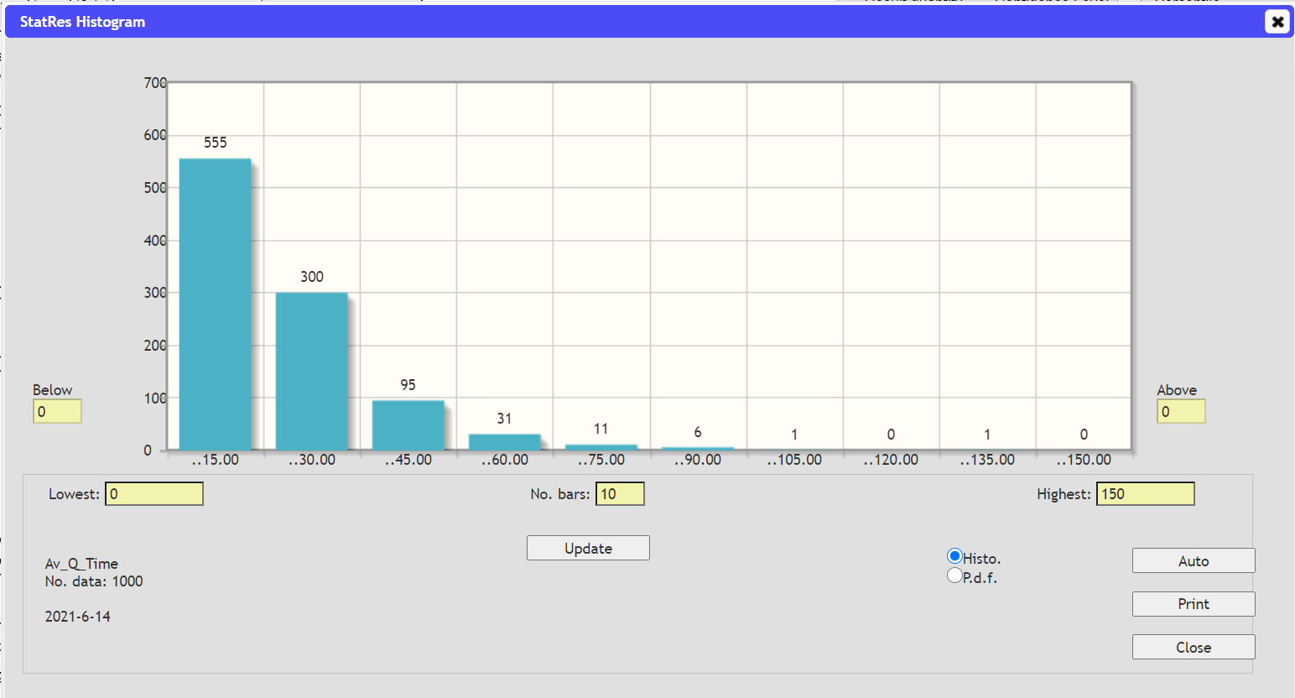
Histograms from StatRes
Histogram of Average Queue Time. Here you can set number of bars and their intervals.

Slide 16
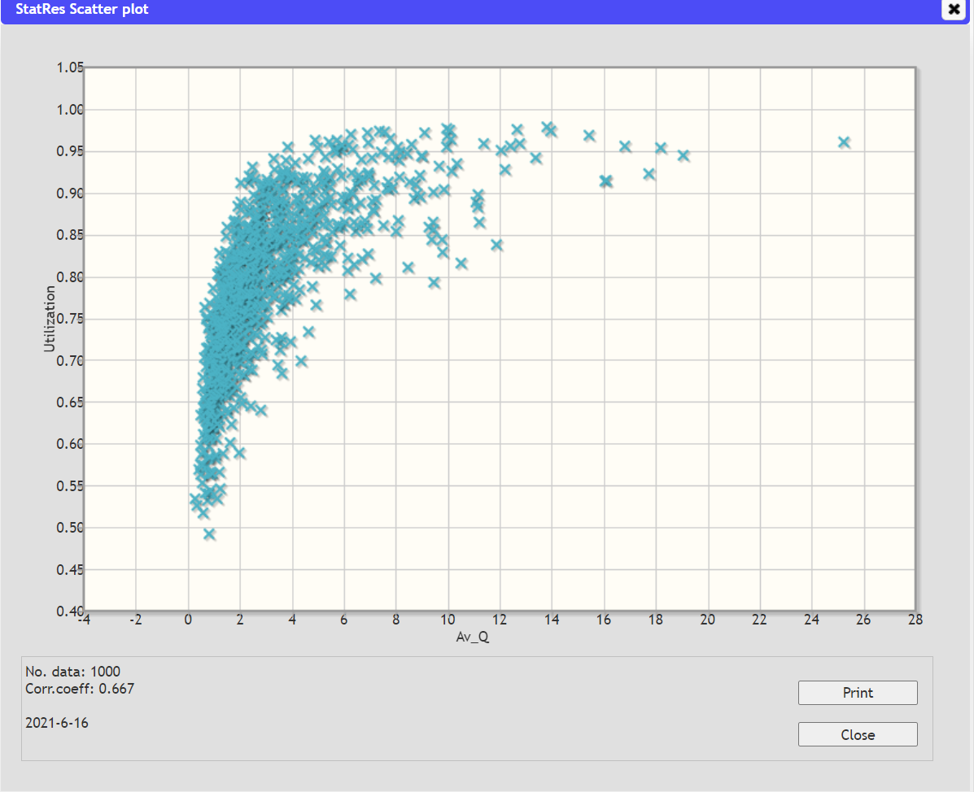
Scatter plot from StatRes
Scatter Plot of Average Queue Length vs. Utilization (i.e. Busy time of the server).
The coefficient of correlation was here 0.667.

Slide 17
IIC. The treacherous confidence interval
The question ‘How much can I trust my estimates?’ is crucial. For this purpose the confidence interval was constructed for a number (N) of observations/experiments on a studied system where it works well.
However, confidence intervals around estimates from a model of the systemus is a complicated issue with many pitfalls! First you must understand that in simulation, the confidence interval is a measure of the model’s behaviour – not of the of the behaviour of the systemus.
Problem 1: A model is usually a huge simplification of the systemus. Left out parts, and variations replaced by averages may significantly make the model less variable than the systemus. Further, uncertainties about the structure of the systemus is not included, and data are not perfect. This implies that the confidence intervals around the model estimates become smaller than corresponding confidence intervals in a real study on the systemus, and they may also be biased.
Problem 2: If you have a stochastic model with initial value, transition, parameter and signal stochasticities you get a certain C.I. around an estimate. At the removal of each of these uncertainties, the C.I. will become smaller (and falser) and you will end up with a deterministic model where the C.I. interval is zero. The more you hide or neglect the more precise your model results. (In an ideal world, it should be the opposite!)
Still this is correct. The simpler the model the more precise you know the behaviour of the model – but not of the systemus!

Slide 18
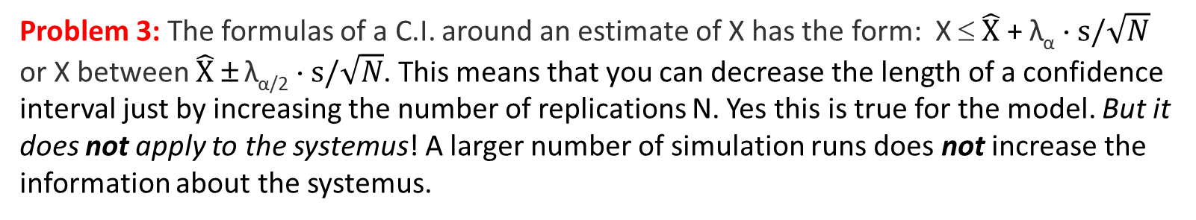
Problem 3: The formulas of a C.I. around an estimate of X has the form: X ≤ $\hat{X}$ + λ_{α} ⋅ $s/\sqrt{N}$ or X between $\hat{X}$ ± λ_{α/2} ⋅ $s/\sqrt{N}$. This means that you can decrease the length of a confidence interval just by increasing the number of replications N. Yes this is true for the model. But it does not apply to the systemus! A larger number of simulation runs does not increase the information about the systemus.
An estimate of a C.I. for a quantity in the system under study must be based on knowledge from experiments on/observations of the system under study – not on the model.
Why then are confidence intervals included in StatRes?
The answer is that you must also understand your model and its properties!
Further, say that you want to compare two models of a planned store to tell how you should allocate the personal resources between (pay desk, service to help the customers, administrative work, etc.) for the store to function well? You then want to compare estimates of the alternative configurations and see if one (model) solution is significantly better.
Confidence intervals is also a base for test of a hypothesis. It decides with what confidence you can reject a hypothesis.
As long as you keep in mind that statistics from simulation (= experiments on a model) tells about the model (and not about the systemus) it’s OK! BUT THE VALIDITY OF THE MODEL REMAINS TO BE SHOWN! This will be discussed in lectures L8 and L9.

Slide 19
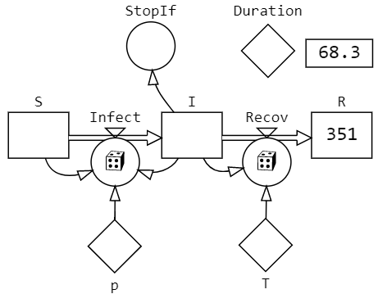
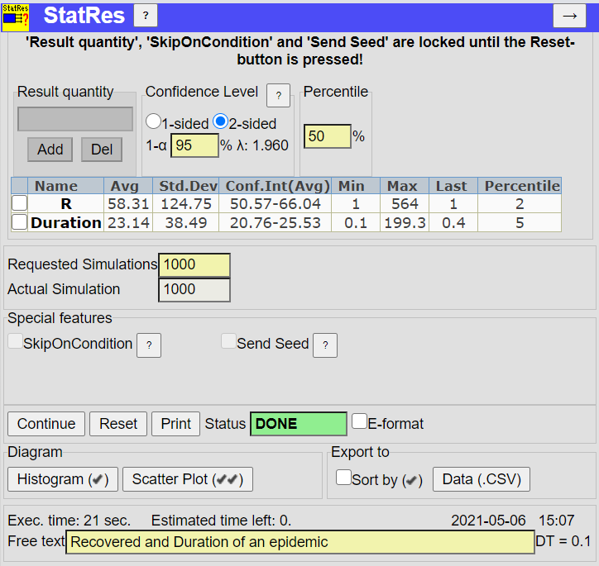
III. The StatRes tool applied to a SIR model
Because a stochastic model gives a new result for every replication, you need to perform many replications (simulation runs) so that the model can display “all” aspects of its behaviour. So the statistical analysis must be based on many trials.
SIR model with Transition stochasticity
Nothing more can happen in a SIR model when stage I is depleted. StopIf then breaks the replication. The Duration primitive just includes time T().

Slide 20
References
StatRes: A StochSD tool for external statistical analysis and result presentation. 2021. (At StochSD’s Home Page, https://stochsd.sourceforge.io.)
Bratley, P. Fox, B.L. Schrage, L.E. A Guide to Simulation, Springer-Verlag, NY, 1983. [Chapter 2: Variance Reduction, Chapter 3: Output Analysis]
Devore, J.L. (2004) Probability and Statistics for Engineering and the Sciences. 6th Edition, Thomson Learning, Inc., Toronto.
Gross, D. and Harris, C.M. Fundamentals of Queueing Theory. John Wiley & Sons, Inc. 1998.
Gustafsson L., Sternad M., Gustafsson E., The Full Potential of Continuous System Simulation Modelling, Open Journal of Modelling and Simulation, 5, 253-299, 2017.
Law AM and Kelton WD. Simulation Modelling and Analysis, 2d ed. McGraw-Hill, New York, 1991. [Chapter 9: Output Analysis]

Slide 21
End L6

