Slide 1
L7. EXPERIMENTAL DESIGN AND VARIANCE REDUCTION (an orientation about more advanced aspects)
Design matrix for a 2³ factorial design
Factor combi- nation | Factor A | Factor B | Factor C | Response
1 | - | - | - | R1
2 | + | - | - | R2
3 | - | + | - | R3
4 | + | + | - | R4
5 | - | - | + | R5
6 | + | - | + | R6
7 | - | + | + | R7
8 | + | + | + | R8
I. Experimental design
Variance reduction
IIA. Common random numbers
IIB. Antithetic sampling
© Leif Gustafsson 211119
(File: L7_Exp_Design_& Var_Red.pptx)

Slide 2
I. Experimental design
Simulation is used to understand the behaviour of complex systems by modelling and experiments on the model. Unlike many mathematical models, there is no comprehensive formula that relates the outcome to a number of quantities. Instead we have to find out the relationships between input quantities and resulting outcomes by experiments. Further, for a stochastic model, several independent replications are required to describe the behaviour in statistical terms.
To understand a model with many input quantities and possible also alternative structures or relations between the components requires a very large number of experiments. In the past we have met sensitivity analysis for a deterministic model – see L3. However, with experimental design you can do much better and get more information about the model with a minimum number of simulation runs.
Purpose of the experiments
To understand the model how structure, parameters, etc. affect the model behaviour.
Comparison of alternative configurations
Search for a solution that satisfies given specifications
Optimization od performance (See L3)
Etc.

Slide 3
Terminology
Experimental design is a science with its roots in experiments on physical systemus, in particularly in agriculture. Therefore, the terminology differs somewhat from what is used in modelling and simulation.
In experimental design input quantities or assumptions are called factors, and outputs measures are called responses.
The factors are classified as quantitative or qualitative. For a simulation model, quantitative factors are parameters and initial conditions, while qualitive factors are structures and relations between primitives.
The factor can take different values or qualities called levels.
Example: 10 factors that can take 3 different levels (e.g. low, medium & high) will require 3¹⁰ = 59 049 simulation runs (already for a deterministic model).

Slide 4
Experiments on physical systemus vs. simulation models
For experiments on a physical system, you have to distinguish between controllable and uncontrollable factors.
For example in agriculture, you can control when, where and how much you sow and how you will use fertilizers and pesticides, but you cannot control the weather and the market price.
However, for a simulation model everything is controllable.
Comparisons | Physical systems | Simulation models
What is studied | The real systemus | A simplified description
Factors | Quantitative & qualitative | Quantitative & qualitative
Experiment conditions | Partly controllable | Fully controllable (Including RNGs and seeds)
Number of experiments | Usually limited (e.g. econ., phys., time limits) | Almost unlimited
Independence between experiments | Often problematic (e.g. a new crop on the same land may be affected by the previous one.) | Yes

Slide 5
2^{n} factor designs
Parameters Initial values
Factors(Levels)
Responses
Model structures Relations
In particular, there are two fundamental measures you need to extract in order to understand the model:
Investigate the effects of the factors on the responses
Investigate the interactions between factors
To achieve this in an efficient way (as few simulations as possible) we now introduce the 2^{n} factorial design. The ‘n’ stands for n factors and the ‘2’ stands for that each factor is realize at two levels (High & Low), which often are denoted by + and – signs. (High and Low will have numerical values for quantitative factors, but they can also stand for alternative structures or relations for qualitative factors.)
2^{n} also stands for the necessary number of replications when simulating each factor once at each level.

Slide 6
The design matrix for a 2^{n} factorial design
By numbering all combinations of 3 factors A, B and C that can take 2 levels each, we obtain the following table, called design matrix.:
Design matrix for a 2³ factorial design
Factor combination | Factor A | Factor B | Factor C | Response
1 | - | - | - | R1
2 | + | - | - | R2
3 | - | + | - | R3
4 | + | + | - | R4
5 | - | - | + | R5
6 | + | - | + | R6
7 | - | + | + | R7
8 | + | + | + | R8
Each combination of factors is here specified at a row where the rightmost cell shows the response (result of the simulation).

Slide 7
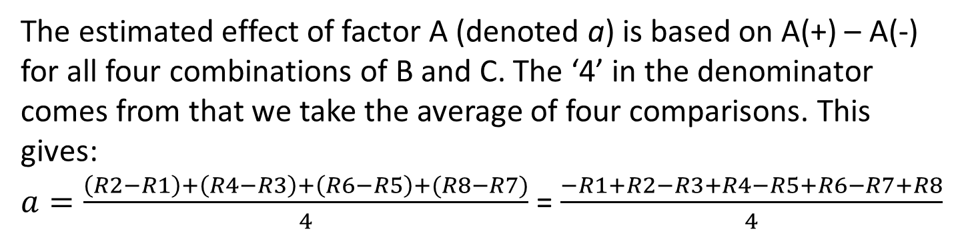
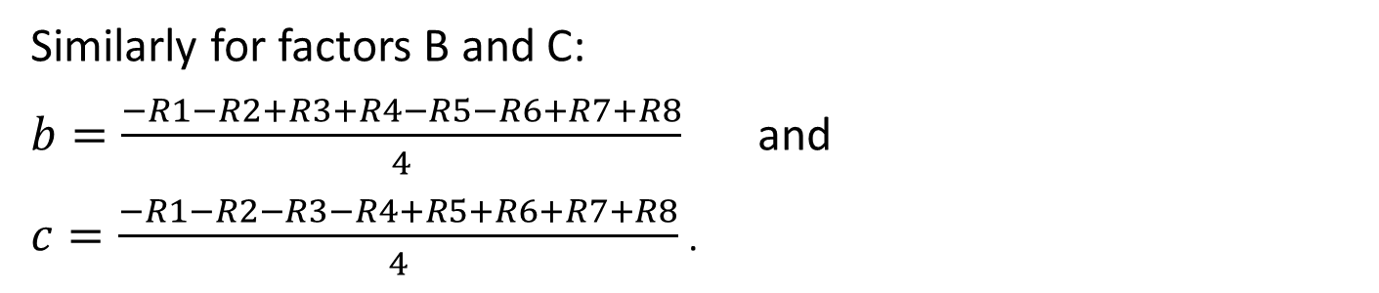
Results – main effects …
After the 2³=8 simulations are done you can extract both effects and interactions for the factors A, B and C.
The estimated effect of factor A (denoted a) is based on A(+) – A(-) for all four combinations of B and C. The ‘4’ in the denominator comes from that we take the average of four comparisons. This gives:
$a=\frac{\left(R2−R1\right)+\left(R4−R3\right)+\left(R6−R5\right)+(R8−R7)}{4}$ = $\frac{−R1+R2−R3+R4−R5+R6−R7+R8}{4}$
The signs of Ri (i=1,2,..8) can be directly obtained from the Factor A column.
Similarly for factors B and C:
$b=\frac{−R1−R2+R3+R4−R5−R6+R7+R8}{4}$ and
$c=\frac{−R1−R2−R3−R4+R5+R6+R7+R8}{4}$.
Note that each estimate here is based on 4 comparisons (from 8 simulations)!

Slide 8
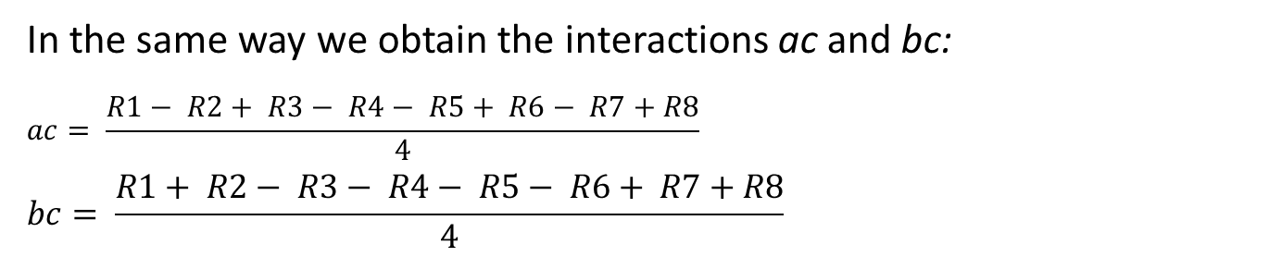
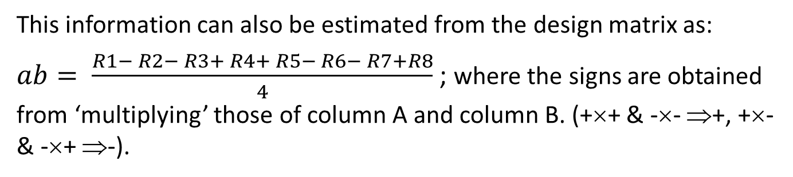
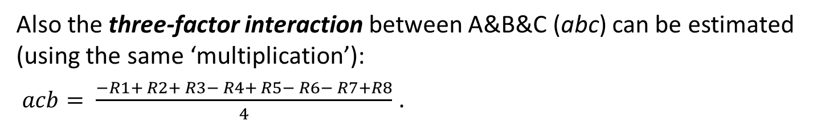
… and interactions
The main effect of a estimates the average change of the response A(+) – A(-) for all combinations of B and C (ditto for b and c).
However, this difference may depend on whether B (or C) is on its high or low level. If so, we say that we have a (two-factor) interaction between A and B (who's estimate we denote ab).
This information can also be estimated from the design matrix as:
$ab= \frac{R1− R2− R3+ R4+ R5− R6− R7+R8}{4}$ ; where the signs are obtained from ‘multiplying’ those of column A and column B. (+×+ & -×- ⇒+, +×- & -×+ ⇒-).
In the same way we obtain the interactions ac and bc:
$$ac= \frac{R1− R2+ R3− R4− R5+ R6− R7+R8}{4}$$
$$bc= \frac{R1+ R2− R3− R4− R5− R6+ R7+R8}{4}$$
Also the three-factor interaction between A&B&C (abc) can be estimated (using the same ‘multiplication’):
$acb= \frac{−R1+ R2+ R3− R4+ R5− R6− R7+R8}{4}$ .

Slide 9
Summary
Compared to study one factor at a time with four replications (two on high and two on low level), the 2³ factorial design will give you estimates of:
Main effects of A, B and C (also based on eight experiments),
Additional estimates of the interactions between A, B and C,
Estimates that are mutually independent.
There are many variations of factorial designs:
You may have other number of factors,
You may use other number of levels,
You may make several replication for each factor combination,
You can skip combinations of less interest to strongly reduce the number of simulations (fractional factorial design).

Slide 10
Further analysis of factorially designed experiments
With factorial design you can estimate main effects of the results for the factors as well as interactions between them. However, you also want to know if these estimates are statistically significant.
To answer this question you can use variance analysis (ANOVA from ANalysis Of VAriance). This, roughly speaking, means that you make two (or more) replications of each factor combination to obtain an error term. You also calculate the variances of the estimates from the design matrix. Then you can make confidence intervals (one- or two-sided on a preferred confidence level). Finally, you test which estimates are statistical significant.
This requires statistical knowledge and there are some pitfalls. This presentation is only meant as an overview to show that there exist powerful methods to extract much information from a limited number of simulations.

Slide 11
Practical advice for factorial designs
Get to know the model before you design the investigation, perhaps with a pilot study.
Don't include more factors (and levels) than necessary. The number of simulations growths exponentially with the number of factors.
You can always extend the design matrix by introducing a new factor (without wasting the already made simulations.)
When you find that some factors or interactions are of less interest, they can be removed.
Variance analysis can tell about the significance of the estimates.
A design matrix is often a sound and flexible base for performing a complicated simulation study.

Slide 12
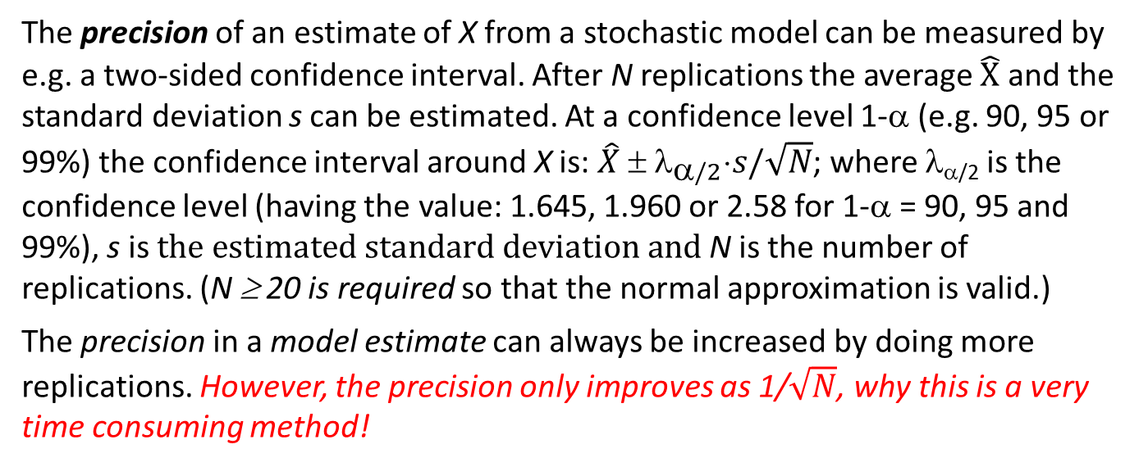
II. Variance reduction
Background
The precision of an estimate of X from a stochastic model can be measured by e.g. a two-sided confidence interval. After N replications the average $\hat{X}$ and the standard deviation s can be estimated. At a confidence level 1-α (e.g. 90, 95 or 99%) the confidence interval around X is: $\hat{X} ± λ_{α/2}⋅s/\sqrt{N}$; where λ_{α/2} is the confidence level (having the value: 1.645, 1.960 or 2.58 for 1-α = 90, 95 and 99%), s is $the estimated standard deviation and$ N is the number of replications. (N ≥ 20 is required so that the normal approximation is valid.)
The precision in a model estimate can always be increased by doing more replications. However, the precision only improves as 1/$\sqrt{N}$, why this is a very time consuming method!
Example: Assume that you have estimated the mean of a quantity X based on 1000 simulation runs. Now you want to increase the precision by a factor 10, then 10²=100 times as many replications (i.e. 1000*100 = 100 000 replications) are required with this ‘brutal-force’ method!
Often there are more efficient methods to increase the precision of an estimate by reducing the standard deviation, s (or equivalent, the variance s²). Such techniques are, therefore, called variance reduction. Below, we will just give two examples.

Slide 13
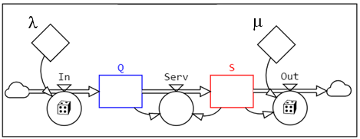
Example: Queuing system
To be concrete, we will now exemplify with the two most common (out of many) variance reducing methods. But first we recapitulate the so –called M/M/1 queuing system, e.g. a shop or drop in establishment to which customers arrive randomly and independently with an arrival intensity of λ persons per hour. If the only server is not busy, the customer is served directly, otherwise he or she has to wait “in queue”. The service intensity μ is 1/expected service time. (λ < μ). See L5 slide 5 and L6 slides 4-6.
Arriver
Queue
Server
Variance reduction was developed and works best for micro models.
Micro model
λ
μ
For macro models variance reduction is less developed.
Macro model

Slide 14
IIA. Common random numbers
(When comparing alternative configurations)
Idea: Use the same sequences of random numbers for the two (or more) configurations to be compared. When randomness influences the alternative configurations in the same way the difference between the results will become less dependent on the randomness. For example, the same number of customers arrive, and the they arrive at the same ‘randomly scheduled’ times.
Example: Doctor’s reception (a queuing system). We want to compare the results with one doctor and with one doctor & a nurse. After simulating these cases we find differences in queue lengths, queue times, use of the doctor and nurse resources, etc. But are the differences because of randomness (more patients arrived, more arrivals close in time, longer treatment times, etc.)?
To eliminate these random factors (without making the model deterministic) we use one generator for the arrivals and another for the service (treatment) times. The two cases (with and without the nurse) are started with the same seeds! Then the number of patients, their arrival times and treatment times become the same in the two alternatives. The randomness from arrival and treatment times are then removed or at least decreased.

Slide 15
IIB. Antithetic sampling
(To get better estimates)
Idea: Influence from randomness on results can be reduced by grouping the replications in pairs. The second replication then uses antithetic (mirrored) numbers. Then (Res1+Res2)/2 will be a more precise estimate than Res1 and Res2.
This implies that if the random sequence in the first replication tends to be high it will be low in the second one. Then the average result, (Res1+Res2)/2 will reduce the randomness in the results.
Example: Average outcome of a die (A trivial example)
Original sequence: 2, 1, 4, 3, 2, 6 ⇒ Result1=18/6=3.
Antithetic sequence: 5, 6, 3, 4, 5, 1 ⇒ Result2=24/6=4.
(Result1+Result2)/2 =(3+4)/2=3.5 is a ‘good’ estimate of the expected result.
Example: A queuing model
Assume that the first sequence is generated from U(0,1), mapped to a proper RNG by the inverse-transform method, and producing a series of arrivals (or services) that are larger than expected. Then the next series is mirrored to 1-U(0,1) (starting with the same seed) inversely mapped to a proper RNG, and producing a series of arrivals (or services) that are smaller than expected.
(Result1+Result2)/2 is then an estimate with better precision (less variance).

Slide 16
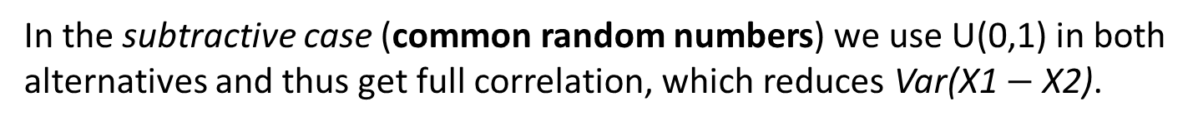
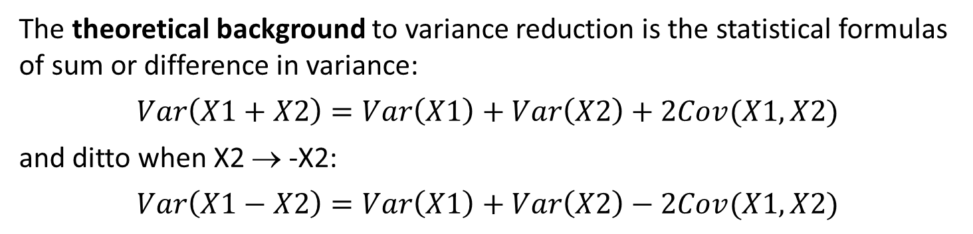
Theoretic background
The theoretical background to variance reduction is the statistical formulas of sum or difference in variance:
$$Var\left(X1+X2\right)=Var\left(X1\right)+Var\left(X2\right)+2Cov(X1,X2)$$
and ditto when X2 → -X2:
$$Var\left(X1−X2\right)=Var\left(X1\right)+Var\left(X2\right)−2Cov(X1,X2)$$
In the additive case (antithetic sampling): (X1+X2)/2) we want to make the covariance negative to reduce Var(X1+X2). This is accomplished by 1-U(0,1) for X2 (which is preserved by the inverse-transform mapping, see L4, slide 22).
In the subtractive case (common random numbers) we use U(0,1) in both alternatives and thus get full correlation, which reduces Var(X1 $−$ X2).
The above text is about an ideal case. Depending on a number of conditions, to be shortly discussed in the next slide, you can seldom reach a full effect. In fact, under bad conditions, variance reduction might even backfire.

Slide 17
Problems with variance reduction in CSS
Variance reduction is usually used in micro modelling, e.g. Discrete Event Simulation (DES) and similar approaches where each entity/object is modelled and time is advanced by Event Scheduling.
In macro modelling with CSS, there are no individual entities and Time Slicing is used to advance time DT by DT. Further, stochastic CSS is a rather new method where variance reduction is not separately investigated.
The main issue in variance reduction is to maintain synchronization of the random numbers between the replications. This means that the same random number in one replication should be used for the same entity and type (e.g. arrival time or service time) in the other replication. In CSS there are several possibilities and problems:
Map U(0,1) with the invers transform method to a proper Distribution(..) for the RNG. This will always require exactly one U(0,1). (E.g. the Rejection method may require several U(0,1) destroying the synchronisation.
Use separate U(0,1) → RNGs streams dedicated to type and place in the model (e.g. to Arrivals or to Service).
Synchronization with Event Scheduling over time (used in DES) is easier to handle than Time Slicing in CSS where each (often ‘empty’) DT calls all the RNGs. Also, change of DT destroys the synchronization.
In DES random numbers are personal and can be stored in the entity for its next event time, while in CSS the entities are lumped as content in a stock.

Slide 18
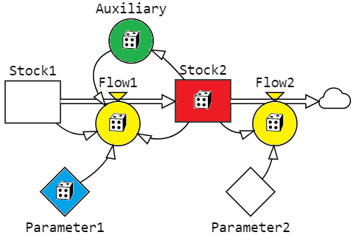
Ideal conditions for variance reduction in CSS
SeedOfSeeds
Seed 1
Seed 2
Seed 3
Seed 4
Inversion method
Seed 5
U(0,1)
Poisson(.) RNG
Output
estimates
SeedOfSeed for automatic generation of Seeds.
Separate seed for each U(0,1).
Use the invers transform method for U(0,1) → RNG.
One U(0,1) for each RNG (e.g. Poisson, exp, normal, …) at each place.
Each RNG for each task. (‘Synchronisation between configurations’.)
Draw random number only when the condition for an event is TRUE – not at every DT.
To my knowledge, no CSS language including StochSD meets all of these ideals.

Slide 19
References
Bratley, P. Fox, B.L. Schrage, L.E. A Guide to Simulation, Springer-Verlag, NY, 1983. [Chapter 2: Variance Reduction, Chapter 8: Programming to Reduce Variance]
Gross, D. and Harris, C.M. Fundamentals of Queueing Theory. John Wiley & Sons, Inc. 1998.
Law AM and Kelton WD. Simulation Modelling and Analysis, 2d ed. McGraw-Hill, New York, 1991. [Chapter 11: Variance Reduction Techniques, Chapter 12: Experimental Design and Optimization]

Slide 20
End L7

