Slide 1
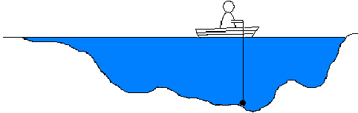
L3. IMPORTANT TECHNIQUES
I. OBJECTIVE FUNCTION
II. SENSITIVITY ANALYSIS
III. OPTIMIZATION
IV. IDENTIFICATION & PARAMETER ESTIMATION
© Leif Gustafsson, 211113
L3_Important_Techniques.pptx
Notes:
1

Slide 2
Sensitivity analysis, Optimization and Model fitting are frequently used in model building, validation and analysis
In Model building:
Sensitivity analysis is used to test accuracy. (Does a component has to be included? How accurately must it be known and described?)
Model fitting (To fit the model to the data from the systemus.)
In Validation:
Sensitivity analysis to test how sensitive the model outcomes are to the uncertainties in e.g. parameter values or initial values.)
Model fitting to test how well the model fits “new” independent data from the systemus.
In Analysis:
Sensitivity analysis (to study effects of different impacts on the outcome.)
Optimization (to find the best result)
Sensitivity analysis, Optimization and Model fitting, all require an objective function!
Notes:
2

Slide 3
I. OBJECTIVE FUNCTION
An objective function, often denoted V, is a quantitative description of the purpose in terms of the model quantities, x_{i.} (Stocks, Flows, Parameters, Auxiliaries, etc.).
Examples:
V = 2.8·x- 1.5·x - 620 Profit of producing x item, where each
item brings 2.8 Euros and the variable
costs are 1.5 Euro per item and the
fixed cost is 620 Euros.
V = f(x_{w}, x_{f}, x_{p}) Yield of a crop - which in turn depends
on the amounts of water, fertilizer, pesticides.
An objective function V = f(x₁, x₂, x₃) can also be restricted by constraints. For example, the amount of water (x₁) is limited to x₁ ≤ 50 m³/day and the economy limits the amount of fertilizer (x₂) and pesticides (x₃) to 30x₂ + 265x₃ ≤ 2000 Euro; where x₂ and x₃ are the kg of fertilizer and pesticides, respectively.
Notes:
3

Slide 4
The subjective purpose/objective function
In simulation modelling the purpose becomes visible in the objective function. For example in ‘Screening to reduce cervical cancer’ (see Slide 26) you may use different objective functions:
To minimize the prevalence of a pre-stages.
To minimize the number of cancers.
To save as many lives as possible (many cancers can be cured).
To save as many life-years as possible.
To include costs in the objective function (that e.g. could be used for saving lives and injuries in traffic.)
Any combination of the above points.
Since the purpose and thus the objective function is subjective, it can always be discussed and criticized!

Slide 5
II. SENSITIVITY ANALYSIS
To study the sensitive of an outcome (e.g. objective function) V=f(x₁, x₂, … x_{n}) to a small change of an input quantity x_{i}.
- How sensitive is one quantity for a change in another?
- Which quantities are especially sensitive/insensitive?
- How accurate is our model?
Absolute sensitivity: ΔV/Δx
(How much does V change when x changes a little?)
Relative sensitivity: ΔV/V/Δx/x
(What is the relative change of V ( in %) when x changes
by e.g. one percent?)
Notes:
4

Slide 6
Examples: (The sensitivity of THE MODEL)
Parameter change:
How much will an epidemic increase if the infectiousness is increased
by 1%?
Change in input:
How much will the yield of a crop increase if the amount of rain
will increase by 10 mm.
Change in initial conditions:
How much will an epidemic increase if the initial number of infected
persons is increased by 1 person?
Structural change:
How many more patients can a hospital handle if the number of
doctors is increased by 5%?
Notes:
5

Slide 7
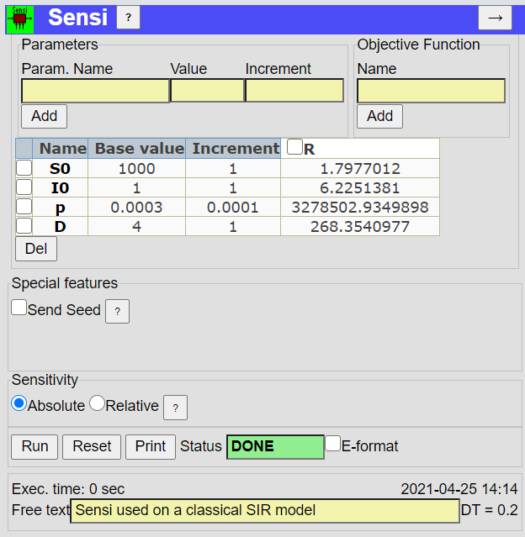
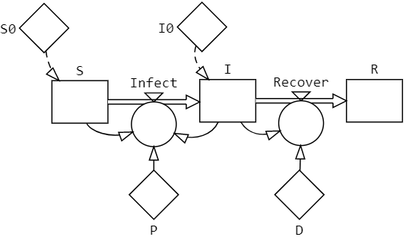
The Sensi tool of StochSD
StochSD has the tool Sensi to do sensitivity analysis. Here we demonstrate its use on a classical SIR model (S=Susceptible, I=Infectious, R=Recovered)
The results of changing initial values S0 & I0 and the parameters p and D on Recovered (R).
You may also choose “Relative sensitivity”.

Slide 8
III. OPTIMIZATION
Optimization is to find the maximum or minimum of a function or model output V, which depends on the values of a number of independent variables (often called ‘parameters’ (x_{i}). There may also be constraints, which restricts the values x_{i} may take.
f(x)
f(a)
Because: max(function) = -min(-function),
it is sufficient to treat only one of these
Cases, e.g. minimization!
x
a
-f(x)
a
x
The formulation of the so called Nonlinearly Constrained Problems (NCP) is:
-f(a)
Minimize V(x₁, x₂, … x_{n}) under possible constraints of what values x_{i} can take.
This formulation is very general. For example it covers also maximation by including two minus signs!
Notes:
6

Slide 9
Optimization can be performed by different methods:
Analytically: for simple functions by setting dV/dx=0.
Operations Research: specific techniques like Linear Programming,
Dynamic Programming, Game Theory, …
Numerical search methods: can be used for all kinds of models, e.g. for simulation models.
The quantities x_{i} can be continuous or discrete:
Continuous: Costs, Body temperature, Time in a disease,
Amount of medicine, etc. Continuous parameters can take an
“infinite” number of values. (Use a search method.)
Discrete: Number of servers, Machine A or B, Vaccine or not, etc.
(Test the different alternatives separately.)

Slide 10
Local and global maxima (ditto minima)
Global maximum
V
x₂
Local maxima
x₁
x₂
x₁
Two views of the same ”landscape”.
Notes:
8

Slide 11
How search methods work
For different parameter values (x₁, x₂) the objective function (V) gets different values.
But the landscape is invisible – so you don’t see the top or bottom!
Each simulation (fixed values of x₁ and x₂) only gives the value of V(x₁, x₂) at the investigated point. (Compare with exploring the depth of a lake from a boat by using a stone in a string.)
Search methods start to evaluate (simulate) the result at one point (x₁, x₂). Then by testing (simulating) for new points, the search method finds its way up to a top (or down to a bottom) in a systematic way.

Slide 12
Search methods may find a local optimum!
V=f(x₁, x₂)
x₂
x₁
Depending on the starting point, the search will find a local or a global optimum!
This problem can be handled using knowledge about the system (e.g. you know that there is only one maximum), or by starting from different points and comparing the optima.
Notes:
9

Slide 13
Search methods (strategies for a systematic search)
x
A. Search methods for one dimension
Golden section search
x₃
B. Search methods for several dimensions
x₂
B1. Methods using only function values
Tabulation
Search in co-ordinate directions
Simplex method (Used in StochSD’s tool Optim)
x₁
B2. Methods using function values and first derivatives
Steepest descent method
B3. Methods using function values, first and second derivatives
Newton method
Quasi-Newton methods
Notes:
10

Slide 14
Breaking criterion
For all search methods a criterion ‘when to end the search’ is required. This is accomplished by specifying a number, ε, such that the search ends when:
a) The improvement in parameter space is less than ε or
b) The improvement of the objective function is less than ε or
c) A mixed criterion based on a) and b).
V
Break when:
a) |x_{(i+1)} – x_{(i)}| < ε₁
b) |V(x_{(i+1)}) - V(x_{(i)})| < ε₂
c) Combination of a) and b)
< ε₂ ?{
V(x_{(i)})
V(x_{(i+1)})
x
x_{(i)}
x_{(i+1)}
x_{(opt)}
< ε₁ ?
Note: x_{(i)} here means the i:th replication of x - not the i:th dimension.
Notes:
11

Slide 15
A. Search methods for one dimension
Golden section search: To find a minimum/maximum within an interval (a, b) containing an optimum (here a minimum).
V
*
*
*
*
*
x
a
e
c
d
b
• Calculate V at two inner points c and d.
• If V(c) < V(d) we can limit the new interval to ad. Otherwise if V(c) > V(d) the new
interval becomes cb (to keep at least one optimum in a shorter interval).
• Then a fifth point, e, is chosen to the left of c and V(e) is calculated, which restricts
the interval to ed. And so on until the interval is small enough (less than ε).
After a number of steps the relative distances between the points can change so that you only remove very thin slices which makes the method inefficient.
To prevent this the inner points c, d, e … are located at about 38 or 62 percent of the current interval. (These proportions are called the ‘golden section’ [ac:ad = ad:ab].)
Notes:
12

Slide 16
B. Search methods for several dimensions
B1. Methods using only function values:
Tabulation: Evaluate V at a number of points in a grid.
V
x₂
•
•
•
•
•
•
•
•
•
•
•
•
•
•
•
•
•
•
•
•
•
•
•
•
x₁
When a first coarse map is accomplished, you know about where an optimum is located.
Map this region in further details etc. until the optimum is well located.
+ It is easy to use.
+ It maps the “whole landscape” and therefore has a chance to
distinguish between local and global optima.
- This method requires an extreme number of calculations/simulations.
Notes:
13

Slide 17
Search in the co-ordinate directions
In this method a linear search (e.g. a golden section search) is used sequentially in each co-ordinate (parameter) direction. Thereafter, this procedure is repeated until no further improvement is obtained.
x₂
*
x₁
+ It is easy to use without support of an optimizer.
- This method can get stuck in ”sharp ditches or ridges” that are not
parallel to the search directions. (Here all co-ordinate directions
from such a point are less optimal, which fools this method!)
Notes:
14

Slide 18
Simplex method
a)
•
To optimize V(x₁, x_{2,…,} x_{n}), place n+1 starting points (•) in the n-dimensional parameter space. (This ”figure” is called a simplex.)
?
•
•
worst
•
In two dimensions the simples is a triangle, in three it is a tetrahedron, etc.
best
b)
•
?
A new simplex is obtained by replacing the worst (w) point by a new one by using:
•
w
•
•
b
a) Reflection away from the worst point.
•
The simplex method by Nelder and Mead, 1965.
This method is used by the StochSD tool Optim.
b) Reflection and expansion if still better.
c)
c) Contraction away from worst point.
•
•
?
[d) Shrinkage towards best point (b).]
w
•
b
•
+ A very robust method.
d)
•
?
+ Can swiftly handle constraints.
•
w
?
?
•
b
Notes:
15

Slide 19
The simplex method in action: V=f(x₁, x₂)
x₂
•(12)
• (17)
•(16)
•(11)
•(9)
•(15)
•(10)
•(14)
•(8)
•(13)
•(5)
•
•(4)
•(6)
•(7)
Δx₂
•
•
(x₁,x₂)
Δx₁
x₁
Replace the worst point by reflection, expansion or contraction!

Slide 20
B2. Methods using both function values and derivatives
The derivative measures the slope of the objective function in the ”invisible landscape”.
V
The slope between x_{(i)} and x_{(i+1)}
V(x_{(i)})
•
V(x_{(i+1)})
•
x
x_{(i)}
x_{(i+1)}
By mapping the slopes in all dimensions, the gradient pointing in the steepest direction is found. By using this information the search will be more efficient in a smooth landscape.
Notes:
16

Slide 21
The steepest descent method
x₂
Gradient
x₁
a) Test the slope in all (n) dimensions around the actual point.
Calculate the gradient (which points in the steepest upward direction).
The opposite direction is the steepest descent.
b) Make a line search (e.g. a golden section search) to find the optimal point along this direction. (This is not the final optimum because the landscape changes.)
c) Repeat steps a) and b) until the breaking criterion is satisfied.
x₂
Calculation effort per “step”:
- Function evaluation: 1 simulations
- Derivatives: n simulations
- Line search: m simulations.
x_{(i+2+m)}
•
•
x_{(i+4+m+m’)}
Although much better than search in co-ordinate directions, it is not a very fast method.
•
x_{(i)}
x₁
Notes:
17

Slide 22
B3. Methods using function values, first and second derivatives
Newton methods
The second derivatives measure the curvature of the ”invisible landscape” around the position in all dimensions. (This information is collected in a Hessian matrix.)
By using information about function value, slope and curvature, this method finds a more efficient direction to perform the line search and also uses curvature to predict an appropriate ‘step-length’ for the line search. Therefore, it finds the optimum in fewer steps.
Calculation effort per “step”:
- Function evaluation: 1 simulation. - First derivatives: n simulations
- Second derivatives: n² simulations - Line search: m simulations.
Quasi-Newton methods
There are improved methods, called Quasi-Newton methods, that does not calculates the second derivatives. Instead it starts as a gradient method and successively builds up information about the curvature as the search proceeds.
The search process first moves to the ‘goal area’. There it refines the search. Only close to the goal the Newton and Quasi-Newton methods converge very rapidly because the curvature in this restricted area becomes well mapped.
Notes:
18

Slide 23
Robustness - chance to succeed
Methods based on derivatives are efficient for
1) a smooth ‘parameter landscape’
2) when you want a very accurate result about position (x₁,x₂,.. x_{n})
or value of the objective function V=f (x₁,x₂,.. x_{n}).
In an irregular landscape (with discontinuities in the objective function or its derivatives) the gradient-, Newton and Quasi-Newton methods are not very robust. They may fail (get stuck).
Only when you need a very high precision on a ‘smooth parameter landscape’ are methods using derivatives recommended. This is often not the case for simulation models.
When there are constraints (parts of the parameter space is not allowed). Then, some type of ‘walls’ has to be included to prevent the search process to reach the constrained areas. This is more tricky to implement for search methods using derivatives.
The simplex method handles constraints by including V = ‘very high/low value’ when it tests a restricted position.
Notes:
19

Slide 24
What optimization method to use in simulation?
In simulation, the knowledge about the real system is limited. Then it is not meaningful to try to obtain very high accuracy for model estimates. Sometimes constraints are necessary. Methods based on derivatives are then not a good option.
In simulation, the simplex optimizer should usually be the first choice, because:
+ it is reasonably efficient.
+ it is very robust.
+ it makes it simple to include constraints.
The StochSD tool Optim uses a simplex optimizer!

Slide 25
The optimizer and the model
An optimizer is a program that controls the parameter settings of
a model, and runs the model repeatedly, using a search method to find the optimum.
After each run the value of the objective function V is returned to the optimizer, which sets new values of the parameters x₁, x₂ ... x_{n} for the next run, and so on until the break criterion, specified to the optimizer, is fulfilled.
Optimizer
Simulation program
Function eval: 1 run
(Gradient: n runs)
(Curvature: n*n runs)
(Line search: m runs)
Break criterion
x₁, x₂ ... x_{n}
Input
V
MODEL
V
x₁ x₂ ...x_{n}
Notes:
21

Slide 26
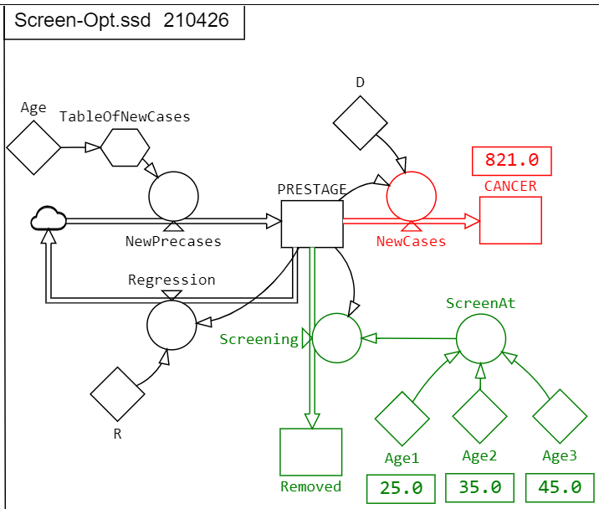
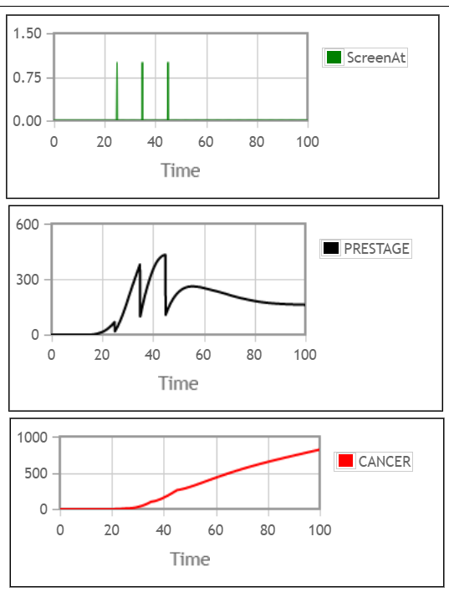
Example: Screening optimization
Cervical cancer has a pre-stage that can be detected (in 75%) by screening in order to reduce the cancer incidence. What are the optimal ages to perform 3 screening rounds?
Let the StochSD optimizer ‘Optim’ search for the best ages: Age1, Age2 and Age3 that minimizes the number of CANCER cases.

Slide 27
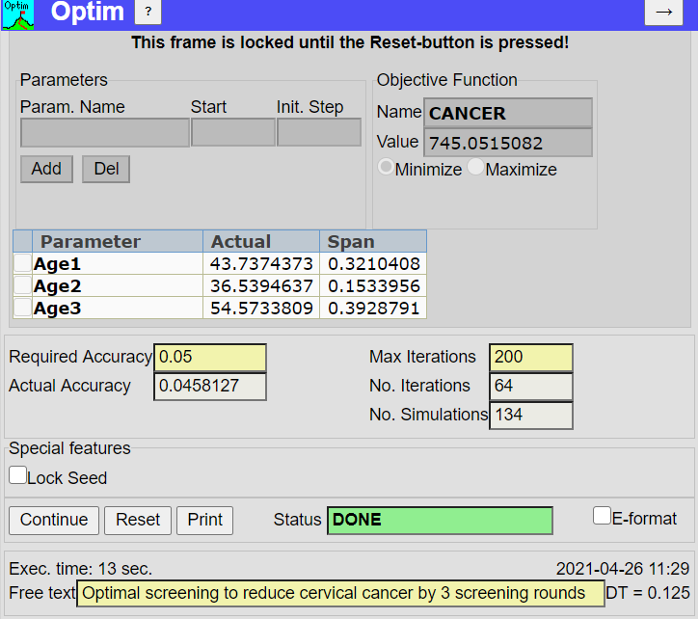
The Optim tool of StochSD (a simplex optimizer)
Specify parameters
Specify V
Min or Max?
Results fields
Enter ε for break
|V(x_{i+1})-V(x_{i})|<ε
Start or Continue the optimization
Optimal screening ages will reduce cancer to 745 cases.

Slide 28
Optimization under constraints
Often, it is not feasible to use any combination of parameter values x₁.. x_{n}. The parameter space is then constrained.
Example: You want to minimize the number of cervical cancers, V, which depend on parameters like Number of vaccinated, Number of screened and Amount of household information about protection. But there are constraints (restrictions):
- Number of vaccinated: x₁ ≤ 350 000 (Capacity limit)
- Number of screened: x₂ ≤ 2 600 000 (Attendance limit)
- Number of households: x₃ ≤ 4 000 000 (Capacity limit)
- Limited economic resources: x₁⋅Cost_{Vacc}+x₂⋅Cost_{SCR}+ x₃⋅Cost_{INFO} ≤ 92 M Euro.
There are general methods (like adding a penalty function to the objective function) but they are tricky to use for search methods using derivatives.
For methods using only function values, like the simplex method, constraints are easily handled. Just include a program line in the model:
If outside the feasible parameter space then V= +/- 999999999 and the search method understands that it has found a very bad point and continues in another direction!
Notes:
20

Slide 29
An optimization may be very large
Assume that you have a medium size simulation model which takes one minute to run on your fast computer. The model describes the efficiency of medical screening of a population, and you want to estimate the optimal age-schedule for 1, 2, ... 15 screening rounds during a lifetime. How long will it take?
Each optimization requires, say, 300 replications on average
(depending on number of screenings and accuracy set in the break criterion). Then you need 15*300=4 500 minutes or 75 hours!
(But there is no big problem to let a computer run for say a week!)
Notes:
22

Slide 30
IV. IDENTIFICATION & PARAMETER ESTIMATION
Ways of model building:
1. Model building using laws of nature (physical, chemical, etc.). In this
cases you rely on the knowledge about nature to model the structure,
which in turn generates the model behaviour. (A white-box model)
2. Identification & Parameter estimation. The model which behaves
most like the real system under study is selected.
In this case you don’t know the systemus’ structure relations and the parameter values. Instead you settle by finding any structure and parameter values where model behaves as similarly as possible as the systemus. This is a so-called black-box model that only ensures that the input-output relation resembles that of the systemus (for the tested situations).
3. Combinations of 1 and 2 where some parts of the structure and some
parameters are known while other have to be obtained from model
fitting. (A grey-box model)

Slide 31
Parameter estimation is nested within identification!
Identification (or ‘system identification’): Find the ‘best’ model structure among the candidate models M₁, M₂, … M_{m}.
Parameter estimation: For a given model structure M_{i,} find the ‘best’ set of values for the parameters (x₁, x₂, … x_{n}).
1a) Choose a model structure.
1b) Fit the parameter values so that model’s behaviour
resembles the systemus’.
2a) Try another model structure.
2b) Fit the parameter values.
Etc.
Then choose the model structure and set of parameter values that makes the best fit.

Slide 32
Parameter estimation in practice
Parameter estimation is finding the set of parameters that minimizes the difference between the behaviours of the systemus and the model.
(Also initial values can be handled as parameters in StochSD.)
Input
y_{systemus}
Systemus
+
The square of the difference:
e² = (y_{systemus} - y _{model})²
is to be minimized
(Least-square fit – there
are also other methods).
e(t)
-
Model
y_{model}
x₁ x₂ ...x_{n}
For the same input, the outputs should be as similar as possible.
This means that the difference should be as small as possible, which means that we have a minimization problem that is best handled by an optimizer!
Notes:
25

Slide 33

Least-square calculations
The difference e(t) = y_{systemus} - y _{model} is squared and integrated
over the time period studied. V = ∫e²(t)dt becomes our objective function to be minimized with the help of an optimizer.
y_{systemus}
y_{syst}=TABLE(...)
y_{mod}= ...
e(t)=Y(t)_{syst} – Y(t)_{mod}
e2=e*e
V=V+dt*e2 (accumulates e² over time)
+
e(t)
e²
-
y_{model}
V
Then, let an optimizer run the model over and over again searching for the set of parameter values that minimizes V (i.e. that gives the least-square estimate of the difference).
In StochSD this can be done with the tool Optim.
Notes:
26

Slide 34
The model you successfully fitted to the systemus may still be a bad model!
When you fitted the model to the system, you tuned a number of quantities (parameters, initial values etc.).
The cumulated value (V) of squared errors (e²) also gives a measure of how well the model is fitted.
However, the model structure may still be poor. Perhaps you should try another model structure and see if that can be better fitted to the system (i.e. giving V a smaller value).
(Perhaps you can also reach the same value of V with a simpler model.)
The parameter values has only a meaning in the context with the arbitrary model you chose. Further, there is no guaranty that the input-output model is good for untested situations.

Slide 35
References
StochSD’s Home Page, https://stochsd.sourceforge.io, 2021.
Optim – Optimizer for StochSD.
Sensi – Sensitivity analyser for StochSD.
Lab 2: Important techniques (Model fitting, Optimization and Sensitivity analysis).
Gill E, Muray W and Wright M.H. Practical optimization. Academic Press. 1982.
Law AM and Kelton WD. Simulation Modelling and Analysis, 2d ed. McGraw-Hill, New York, 1991.
Ljung L. System Identification: Theory for the User, Prentice-Hall, Inc., NJ, 1999.
Nelder J.A. and Mead R. A Simplex Method for Function Minimization. Computer Journal, 7, 308-313, 1965.
Press WH, Flannery B.P., Teukolsky S.A. and Vetterling WT: Numerical Recipes (in Fortran, Pascal or C), Cambridge University Press, 1989 (and later versions).

Slide 36
End L3

