Slide 1
L9. SIMULATION vs. SPECULATION
I. Principles for model construction
White-box model
Black-box model
Grey-box model
The limits of simulation
Modelling past and future
III. Predictions about the future
What can we know about the future?
Can prediction models fulfil basic requirements?
Modelling from observed behaviour
Chaotic systems
Other limits to modelling the future
Red flags
Scenarios
White-box model
Black-box model
About the
past
OK
OK
About the
future
(May be
OK ?)
SPECU-LATION
SPECU-LATION
© Leif Gustafsson, 211121
L9_Simulation_vs_Speculation.pptx

Slide 2
I. PRINCIPLES FOR MODEL CONSTRUCTION
A systemus can be modelled in different ways depending on the purpose and accessible information:
White-box model. Based on knowledge about the studied system and its behaviour such as structure of components and relations between these components (e.g. from Laws of nature, known relations, parameter values, etc.).
SYSTEMUS
Based on knowledge
Based on IO comparisons
Black-bock model. Based only on the relations between inputs and outputs (without considering what happens inside the systemus). E.g. we model the stimuli → response of a dog without describing the dog.
Any model structure that can create the required input-output relation will do. But do not draw any conclusion about how this relation is accomplished.
MODEL
(White)
MODEL
(Black)
Grey-boxmodel. Based on a mixture of both.
For example, you e.g. use the known structure and try to complement with realistic types of formulas for the flows. The unknown parameters are estimated by system identification.
MODEL
(Grey)

Slide 3
White-box model
u
y
X
A white-box model is constructed from knowledge about structure, relations, parameter values, etc. (First principles, Laws of nature, etc.).
A dynamic white-box model aims to describes the processes within the systemus in terms of state variables (Stocks in StochSD) denoted X_{i}; i=1..n.
In mathematical terms: the state variables X = (X₁ X₂ … X_{n}) are affected by the inputs u = (u₁, u₂, … u_{m}), and the outputs y = (y₁, y₂, … y_{p}) are affected by X (and possible also u).
White-box models gives an understanding of the systemus and works well for technical systems where we have all necessary information. However, this is often not the case. Furthermore, in many cases such a model would be extremely complex.

Slide 4
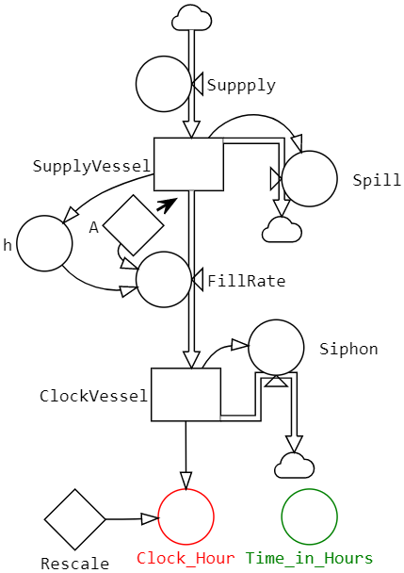
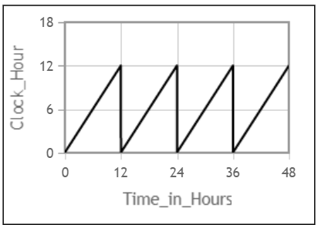
White-box model example: Ctesibius (285–222 BC) water clock
StochSD model
With a white-box model of a clock you describe the ‘inside’ of it. Then you can use the model to redesign the clock (change volumes, algorithms, parameter values etc.)
For example, what would happen if the Supply vessel was empty at start (instead of filled to the reference volume)?
Or what if the Supply inflow would vary over time around its average?
Or how much would it affect the clock if the siphon (that empties a full clock vessel) was a bit slower?
Supply
vessel
⎯
⎯
⎯
⎯
⎯
⎯
⎯
⎯
⎯
⎯
⎯
⎯
Siphon
Clock vessel
By keeping the content of the Supply vessel constant (by spill over) the Clock vessel will be filled at a constant rate during 12 hours.
Thereafter, the siphon will rapidly empty the Clock vessel, starting a new 12-hour period.

Slide 5
(Specification of the water clock for the interested)
Formulas in SI units. 12 h = 43,200 s.
SupplyVessel
Supply = 0.00012 (or more)
Hight h = 1 m
SupplyVessel Area:1 m²
Tap area: A=0.000025 m² (0.5x0.5 cm²)
v=SQRT(2*g*h) (Torricelli's law)
FillRate=v*A = A*SQRT(2*g*h) m³/s = 0.000025*SQRT(2*9.82*h(t)) =
= [for h=1 m] =0.0001108 m³/s)
ClockVessel
Volume until siphon empties ClockVessel (after 12 h) =
43200*A*SQRT(2*9.82*1) m³ = 4.788 m³
( => Scale: 1 ClockHour ↔ 4.788/12 m³)
⇒ Volym V = 1 m3

Slide 6
Black-box model
u
y
A black-box model is adequate when the purpose only is to understand (describe or optimize) the relations between the external inputs (u) to and the outputs y, without considering what really happens within the systemus. Such a model also requires far less information.
For example: How much milk (y₁) and meat (y₂) do I get if I increase the supply of food (u₁) and water (u₂) by 10%?
The method to construct the input-output model is called system identification.
First you try to find a proper model (e.g. differential equation of some order, a polynomial of some grade, etc.). Then the parameters are estimated so that the model behaves as similarly as possible to the system under study.
Repeat this by test different model structures. Then trim the parameters for each candidate model to find the one that best behaves as the systemus.
A disadvantage of a black-box model is that there is no structural description of the systemus to relate to for understanding. Further, the model parameters are only related to the chosen model, why they have no physical interpretation.

Slide 7
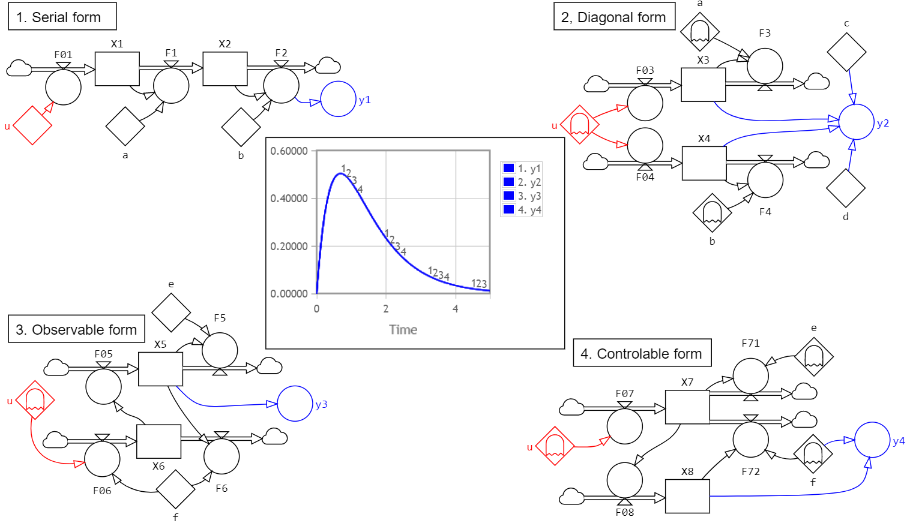
Black-box models example:
Four realization of an observed input-output relation: dy2/dt + 3*dy/dt + 2*y = u(t),
here demonstrated with u(t) = PULSE(Time=0, Volume=1)
Parameter values:
a=1, b=2
c = 2, d = -2
e = 3, f = 2
The model structures between u and y are just different fantasy constructions to obtain the observed in-out relation.

Slide 8
Grey-box model
u
y
(X)
Often the systemus is partly known. For example, you may know the main structure behind the process. A so-called grey-box model partly based on knowledge about the systemus and partly on the relations between input and output can then be constructed. A number of unknown parameters must still be estimated by system identification.
This approach is often necessary for modelling of biological, ecological, climatological, economical, medical, sociological, etc. systemus.
Example: Grey-box SEIR model
Now we will study an influenza epidemic from incidence data of the disease.
Since 1927 we have a basic understanding of the structure of an epidemic process where susceptible persons (S) becoming exposed (E), being infectious (I), and getting recovered (R). It is also known that the disease is transmitted by meetings between S and I in proportion p, and that the expected duration in E and I are D_{e} and D_{i} , respectively.
This makes a so-called SEIR model, although the parameters p, D_{e} and D_{i} for this particular epidemic are unknown, see Figure at next slide.

Slide 9
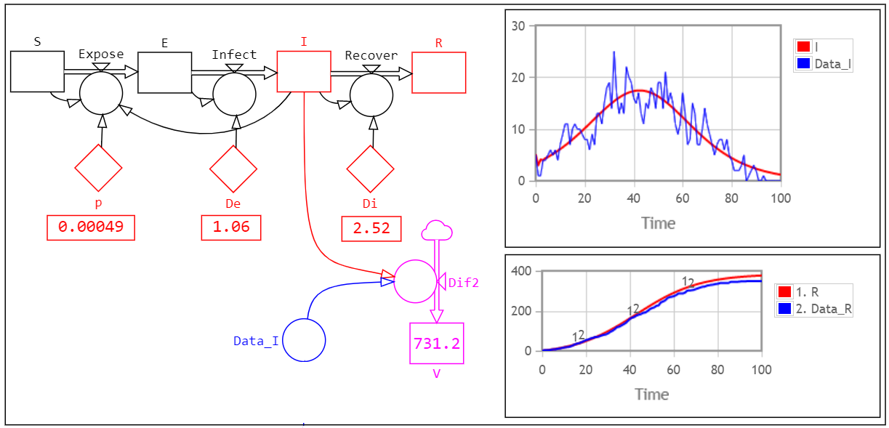
Parameter estimation using the Optim tool in StochSD, to fit the model to data, gave p=0.00049, D_{e}=1.06 days and D_{i}=2.52 days (see Figure).
Conclusions: In this grey-box model we used a realistic model structure. Therefore, the parameters have a ‘physical’ meaning and their values bring some information about the epidemic process.
We could also use the fitted model to simulate the effects of a specific vaccination program where a fraction of the susceptibles are moved directly from S to R stage.

Slide 10
II. THE LIMITS OF SIMULATION
Simulation makes it possible to include dynamics, stochastics, mathematics, logic, statistics, etc. into a model of a studied system. This often implies a powerful expansion of what is possible and meaningful to study.
But a model requires information about the structure, relations between components, parameter and initial values, impacts from the environment, and the behaviour of the studied system. We also need more and independent information to validate the model, evaluate he results, etc.
When information is missing, the gap is often filled in by e.g. guesses, assumptions that the systemus will stay the same as before, wishful thinking or personal inclinations derived from hope or fear. Then be very sceptical!
The easiness of just constructing a model, making some simulations and present the results (without identification, validation, evaluation, etc.) and the trust in computer calculations have made simulation the new crystal ball used for all kinds of speculations and manipulations.
It is thus important to understand what modelling and simulation can accomplish and what it cannot. In short:
Simulation cannot create information about the systemus.
It can only structure the existing information into a model.
It can also tell how the model (not the systemus) behaves!

Slide 11
Modelling past and future
 | White-box model | Black-box model
About the past | OK | OK
About the future | (May be OK for an unknown time) | SPECULATION
A mixture of the two principles:
The past can be observed, recorded, analysed, etc. But about the future we lack information for modelling, fitting and validation!
We don’t even know what important future information we are missing!

Slide 12
Compare these two statements:
Past: This has happened. Let’s use the information to make a model that explains it!
Future: We don’t know what will happen. But we will try to model it !?!?
To assume that ‘everything else’ will remain the same as now is just a hope that sooner rather than later will be falsified! And you don’t know when, why or how!

Slide 13
III. PREDICTIONS ABOUT THE FUTURE
Prediction about the future is of great importance for planning and for avoiding future disasters. For example:
Economic predictions to make a budget, investments, etc. for next year. Demographic prognoses for making new schools buildings and training new teachers. Weather forecasts to decide when to harvest, or when not to go sailing. Medical judgements to decide what treatment to try.
The problem with using modelling and simulation for prediction is the lack of future information for the model building, model fitting to the system under study, validation, evaluation of the results, etc.
However, some systemus change slowly, other fast or abruptly. Some (like season of the year) show a regular pattern. Other behaviours seems to have a statistical distribution so we can optimise the expected outcome.
Despite this, modelling and simulation may in some cases be an (although problematic) approach to speculate about the future. But if prediction is taken as knowledge, it can be very dangerous or costly.

Slide 14
What can we know about the future?
Imagine that you lived in year 1900 and predicted the 20:th century. Would you then have foreseen:
An almost 4 times larger world population?
That the known universe is now 100 000 000 000 larger than we thought? (‘Stars’ were galaxies.)
Television, computers, cell phones, airplanes, space rockets, robots, internet, antibiotics, DNA, RNA, CRISPR Cas9, nuclear energy, family planning, fertilizers, etc.?
Two world wars?
Extinction by nuclear weapons should become a real threat?
… (to mention but a few)
The future development during the coming century will not be easier to predict.
The future is intrinsically unknown!!!

Slide 15
When is the information we have sufficient for prediction?
When we believe that the information we have is sufficient to predict a reasonable time ahead it is often worthwhile. For example:
The planets of our solar system are massive objects that have moved according to the Newtonian laws without major external impacts for millions of years. It is meaningful to predict their future positions and e.g. solar eclipses for long periods ahead.
Demographic data are usually rather stable (if not major catastrophes or unpredicted mass migration will happen). E.g. you know that the children born last year will require school buildings, teachers, etc. a number of years from now.
During the last million years, ice has covered a large fraction of the earth about 85-90% of the time. The statistics is somewhat unregular showing about 100,000 year cycles with interglacial periods of about 10,000-15,000 years. The current ‘Holocene’ interglacial began about 11,700 years ago. Should we try to predict and take actions?
Predictions rely on todays information and knowledge and the assumption that no unknown important impact will happen.

Slide 16
Black swans (unknown unknown)
A black swan is a rare and unexpected event that:
Is an unpredictable ‘outlier’
Has an extreme impact
Can be explained only after the fact.
Although it is rare, black swans will appear in various fields during a century. (See examples on the previous slide.)
Also for a white-box model, the prediction of the future can be falsified by a black swan.
The longer the forecast, the weaker the prediction of many reasons!

Slide 17

Can a prediction model fulfil basic requirements?
In Lecture L8 we saw that a simulation model required:
PROBLEM DEFINITION
- Purpose
- System boundaries &
details level
Purpose
Problem definition
• Purpose
• Systemus’ limits and detail level
Model structure
Sci. laws or Identification
Validation with indep. data
Problem solving
Result evaluation
Result presentation
MODELLING
- Find model structure
- Model fitting
Occam’s razor
VALIDATION
INFORMATION
PROBLEM SOLVING
RESULT EVALUATION
RESULT PRESENTATION
If important aspects are missing, then the study is just a speculation!

Slide 18
Basic requirements of a prediction model - continued
Purpose: The purpose is a subjective issue that often changes over time and cultures. For example:
Svante Arrhenius (1896) Can CO₂ prevent the next ice age?
H₂O and CO₂ are the main components of life. How much will higher CO₂ increase the crop and forest production?
Can and should we prevent climate change because of CO₂?
A simulation model has one or a few closely related purposes! Acting on model results without regarding consequences of other aspects is hazardous!
Model structure: New knowledge and technology, may affect the model structure, its relations, and show new impacts from the environment.
Model fitting is impossible against non-existing data.
Problem solving inherits all problems described above.
Validation data about the future (independent of those used in the model fitting) are also impossible to obtain.
Result evaluation is impossible against non-existing data.
Result presentation will inherit all the above problems.

Slide 19
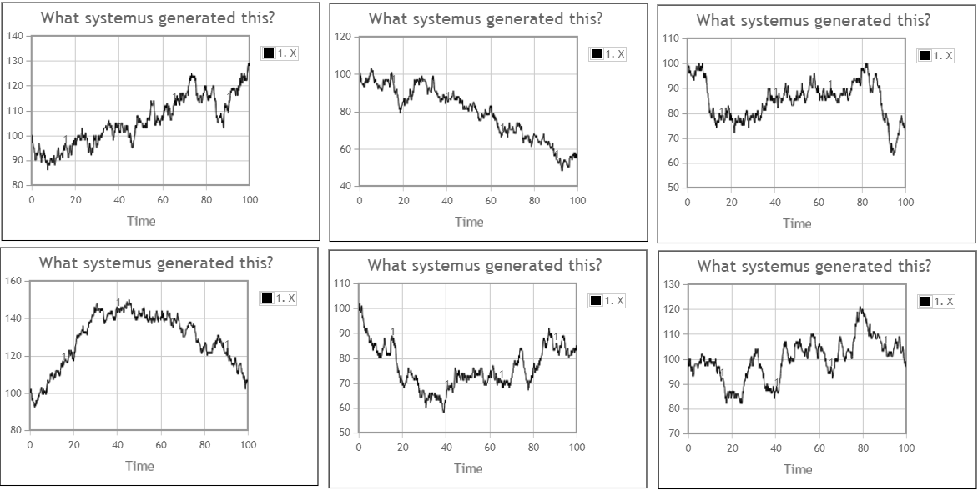
Modelling from observed behaviour?
Describe the behaviour of each diagram.
What models would produce these behaviours?
What future behaviour do you predict for each case?

Slide 20

It is technically easy to construct a model and adjust some parameters so that it behaves similarly to one of these time-series.
However, all the six diagrams are replications from this simple model!
Try it !!!
(In words: Items are randomly added to the stock X by F1 with an expected frequency of 5 per time unit. Items are also randomly subtracted from the stock X by F2 with the same expected frequency.)
Humans search for an explanation behind what they see. This is an efficient generator of prejudices and false conclusions!

Slide 21
Chaotic systems
Deterministic systems (both systemus or models) can in principle be predicted. However, some of them are only predictable for a limited time and then appear to behave in a chaotic way.
Example: A system of two bodies with the masses m₁ and m₂ at the distance r can be described by Newton’s equations as: F₁ = F₂ = G⋅m₁⋅m₂/r² and initial conditions. Its behaviour can be correctly predicted over all future time.
m₁
m₂
F₁
F₂
However, already with 3 bodies we get a chaotic system that (except for special cases) can only be predicted for a limited period of time (although the model is perfectly deterministic).
Determinism does not imply predictability.
Chaotic systems are found in disciplines such as physics, astronomy, meteorology, engineering, chemistry, computer science, economics, ecology, environmental sciences, epidemiology, sociology ̶̶̶ you name it!

Slide 22
For a chaotic system arbitrary small changes in initial values, parameters, or disturbances from the environment will significantly change the future behaviour dramatically after a certain time.
Thus, any measurement error, change of time-step or integration method will (after a while) change the model results drastically!
Sensitivity to initial conditions is also called the ’butterfly effect’ after the paper ”Predictability: Does the Flap of a Butterfly's Wings in Brazil Set Off a Tornado in Texas?” published by the meteorologist and mathematician Edward Lorenz in 1972.
The chaotic part of the behaviour growth exponentially as e^{λt}. The λ is called the Lyapunov exponent, and it is a measure of how fast a perturbation δX(0) of the initial conditions will grow:
|δX(t)| ≈ |δX(0)|· e^{λt}.
So far, we have avoided chaotic systems, because we try to make simple low order models (if possible linear). But here comes an example:

Slide 23
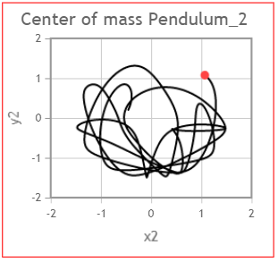
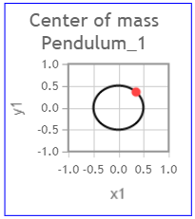
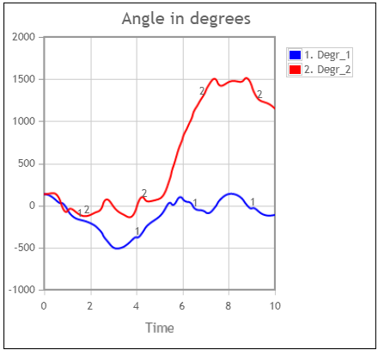
Example: Double pendulum
Another small deterministic systemus that can behave in a chaotic way is a double pendulum, shown to the right. The two linked pendulums have lengths l₁ = l₂ = 1 meter and masses m₁ = m₂ = 1 kg. The centres of mass are denoted (x₁, y₁) and (x₂, y₂) and the angles to a vertical line are θ₁ and θ₂. Simulations in StochSD with the initial values θ₂=135º, θ₂ =135º and starting from rest was done.
θ₁
(x₁, y₁)
θ₂
(x₂, y₂)
Both pendulums rotate around their points of attachment (small white circles).
(The StochSD model uses the formulas in: https://en.wikipedia.org/wiki/Double_pendulum
This article also includes nice animations of the movements.)

Slide 24
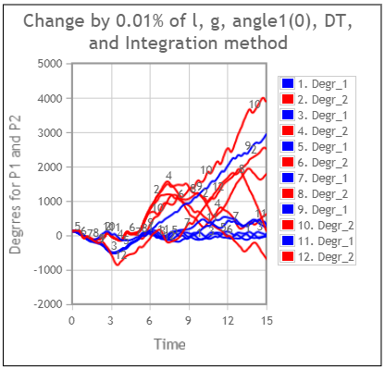
Double pendulum - continued
Introducing one very small change (by 0.01 % of its value) for: l, g (gravity), θ₁(t=0), DT, Euler → RK4, etc. will produce a chaotic behaviour after a few seconds.
1 & 2: Baseline
3 & 4: l₁ and l₂ increased by 0.1 mm
5 & 6: g=9.82 → 9.821 m/s²
7 & 8: θ₁(0)=135° → 135.1°
9 & 10: DT=0.01 → 0.010001
11 &12: Euler → RK4
Predictions beyond the first seconds are pure nonsense!

Slide 25
For a complex systemus chaos is virtually everywhere
The cancer cell that got its last hit from cosmic radiation would not have happened if you stood 0.000001 mm away in any direction.
The collision would not have happened if the earlier passed traffic light was not green (or red) or if the driver had not taken that last cup of coffee before leaving home.
This genetic effect with its consequences would not have happened if another of the 100,000,000 sperms had fertilized the egg.
The earth moves with a speed of 30 km/s around the sun, so if the big comet had hit the planet a few seconds earlier it would have hit the Caribbean sea and the dinosaurs (and humans) would … (something else).
… and don’t forget about the butterfly!

Slide 26
Other limits to modelling of the future
Models are purposely huge simplifications of a changing reality.
Limited knowledge (structure, relations, parameters, behaviour, etc.)
Unknown future responses by society, ecologic system, climate, etc.
In the long run, various complex systems will interact.
The interactions from the environment are often not predictable.
Unknown unknowns.
These issues are usually of little concern when modelling the past. Then we know what happened, and discrepancies between systemus’ and model’s behaviour become visible.

Slide 27
Red flags 
 Crucial parts of ‘What scientific modelling must contain’ is
missing or insufficient.
 Correlations are treated as causalities.
 Divergent opinions are seen as a threat rather than an asset.
- Discussion with dissidents is avoided.
- Consensus conferences are held to eliminate a split opinion.
 Name calling instead of respect and listening.
 The purpose is not open for discussion. Intervention on one issue
usually effects many other fields (not included in your model).
 Political, ideological, economical and other interests are involved.
 Mass media supports one side, which influences the opinion.
 Non-scientific arguments such as 90% of researchers believe …
(Facts and arguments matter, not what researchers believe.)
 Observations significantly disagree with model behaviour
during the prediction period.
 Speculations about the future are presented as knowledge.

Slide 28
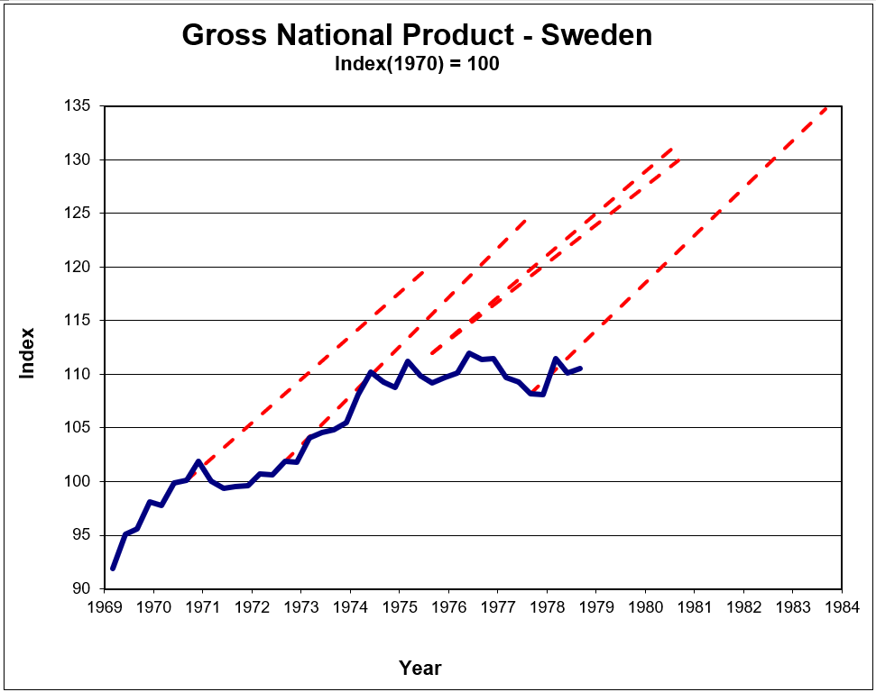
The hedgehog syndrome created by wishful thinking
Long-term prognoses have a central role in the Swedish planning system.
However, when the underlying models included constraints that full employment and balance in foreign trade would be achieved during the forecast period, the so-called hedgehog syndrome appeared – see Figure.
The use of these biased GNP prognoses then spilled over to prognoses in other sectors (such as industrial production, planning, etc.), which also inherited the hedgehog effect.
Data from ”Bröms J. and Nabseth L.: Önsketänkande eller prognos (Wishful thinking or prognose), Kommentarer till långtidsutredningen 1978, Industriförbundet, Stockholm, 1978.” (In Swedish)

Slide 29
Misuse of simulation
When I (LG) was a professor at the Swedish University of Agricultural Sciences, there was a discussions about that models and simulations should replace expensive field experiments.
The opposite is true: Modelling requires much, specific and accurate information – it does not produce it!

Slide 30
Answer these questions before simulating the future
Assume that you get all possible resources (computer, software, expertise, etc.) to simulate the situation of a complex but important system far into the future.
How do you know what is regarded as important to include in a model describing the future?
How do you build and fit the model to future conditions?
How do you handle the chaotic parts of the studied system?
How do you validate the model against new (non-existing) data that are independent to those you didn’t have for model fitting?
How do you evaluate pros and cons of the future situation to the future society and its technology and values?
How do you create confidence intervals around important model estimates? And how many replications (N) should it be based on?
How do you foresee the black swans and their impacts?

Slide 31
Scenarios
When speculating about the future, scenarios are often to prefer to modelling and simulation. You then focus on a number of interesting dimensions and discuss different consistent combinations of outcomes. In particular, this more humble approach spans up a number of interesting scenarios for discussion, and is a better protection against categorical conclusions about the future.
(However, modelling and simulation can sometimes be valuable parts of different scenarios.)

Slide 32
References
Gleick J. Chaos: Making a new Science. Penguin Books, 1987, 2008.
(Popular science)
Molander P. Systemanalys I Sverige en översikt (Systems Analysis in Sweden – an overview). Forskningsrådsnämnden, Delegationen för systemanalys. Rapport NR 42-D, 1981. (In Swedish) (Shows the hedgehog syndrome, slide 28.)
Strogatz S.H. Nonlinear Dynamics and Chaos: With Applications to Physics, Biology, Chemistry, and Engineering, Second Edition. Westview Press, 2015. (Introduction to nonlinear dynamics and chaos, with mathematical examples
from many fields.)
Taleb N.N. The Black Swan: The Impact of the Highly Improbable. Random House, Second edition 2010.
Wikipedia, Chaos theory. https://en.wikipedia.org/wiki/Chaos_theory, last edited on 27 October 2021.
Wikipedia, Double pendulum. last edited on 24 September 2021. (With nice animations of a double-rod pendulum.)

Slide 33
End L9

