Slide 1
L1. BASIC CONCEPTS
Influence
Systemus’ behaviour
SYSTEMUS
1)
1)
3)
Input
Output
MODEL
2)
Experiments
I. System (Can be a Systemus or a Model.)
II. Purpose
III. System under study = ‘Systemus’
Both are Systems
IV. Model
V. Micro and Macro models
VI. Simulation
© Leif Gustafsson 240112
(File: L1_Basic_Concepts_Compressed.pptx)
VII. Macro modelling

Slide 2
System, Purpose, Systemus, Model & Simulation
This course is about describing a system under study (= systemus) by a simplified model, and performing experiments on the model
(= simulation) in order to understand the studied system.
A system is a number of related components. However, both the system under study and the model of it satisfies this definition – but it is of fundamental importance to distinguish these two concepts. For example, the system under study can be described by a system of equations, which is a model!
The system under study (e.g. a forest, factory, farm, hospital, epidemic) usually has many aspects, why you must formulate a purpose (objective, aim, goal) of the study used as a compass to only model the relevant parts and perform and performing adequate experiments.
To avoid this confusion, we will call the system under study for systemus. (System = Systemus or Model.)

Slide 3
I. SYSTEM (Systemus or Model)
Naturally related components in a structure
SYSTEM
Sub-systems
Hierarchy: Also the parts of a system are sub-systems composed of parts, etc.
A System is ‘more’ than the sum of its parts. You can’t understand it by looking at its parts one by one, because the structure of the components is important since it decides how the components interact.
3

Slide 4
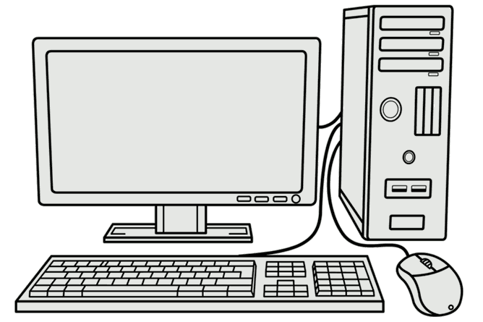
System - a number of related components
Each of these parts is also a complex system in itself.

Slide 5
II. PURPOSE
There is a reason (problem, curiosity, hope to get rich, doing something meaningful, etc.) behind making a study. This we call purpose (~ goal, aim, objective).
To make a model study, you must decide what parts of the universe to include and what to leave out. The purpose of the study guides you to define the borders of the System under study in terms of: space, time and detail level.
Purpose
Input
Output
SYSTEMus

Slide 6
Purpose, Goal and Objective are related (subjective) concepts
Purpose: The reason for doing something to achieve a desired result.
Goals: Goals are statements describing the desired result.
Objectives: Objectives are concrete specification (often in mathematical terms) of the means to achieve the goals.
Instead of discussing all aspects, we will usually use the term Purpose, from which we can derive the goals and specify one or several objectives (perhaps also with constraints). More about Objectives in lecture L3.

Slide 7
The purpose is your only compass through all steps in a simulation study.
It helps to define your goal in operative terms.
It helps to define the borders between the system under study and its environment.
It helps to chose between various types of models.
It tells what to include in the model.
It tells what behaviour is important to fit against the behaviour of the systemus.
It tells what to validate.
It guides in the choice of experiments and analysis of results.
It helps to evaluate the results and conclusions of the model study.
It helps you in the presentation of the study, results and conclusions.
We will return to this in more detail when we discuss how a modelling project should be performed (in lecture L8)!

Slide 8
III. SYSTEM UNDER STUDY (= Systemus)
You define the systemus - its borders, content, detail level, etc. depending on the purpose with your study.
This definition of the system under study divides the universe into the systemus and its environment.
SYSTEMUS
Environment
The Systemus has borders in space and time, but also specifies what objects are of interest and what level of details is useful.
However, it is seldom possible to make the systemus completely unaffected by its environment. (But this influence can often be described as a parameter or time series.

Slide 9
Two ways of studying a systemus
Study the systemus.
But:
Planning the experiments
Understanding the results
Analysing the outcomes
Conclusions
...
require a model !
Study a model of the systemus.
But:
The problem to solve
The structure
The data
Model fitting
Validation
…
require (knowledge about) the systemus !
Either way - you need both the systemus and the model!

Slide 10
IV. MODEL
A model is a simplified description of the systemus where the brain is usually involved.
Perception
Representation
SYSTEM under study
Mental
MODEL
Formalised
MODEL
The real world is immensely complicated, has numerous aspects and is consists of myriads of components. (A single mole of a substance contains 6*10²³ molecules, each with a structure of atoms.)
The mental model is a fuzzy and unreliable construction in your head, and it cannot be shared by others.
We need a formalised model that describes the important aspects of the systemus (in accordance to our purpose). A formal model can be shared, discussed and improved on.

Slide 11
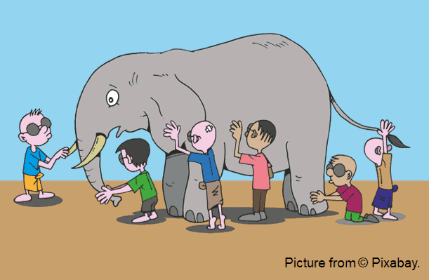
Your mental model depends on your purpose, knowledge, available information, interest, etc.
Your experience of the system under study is just a mental model !
But the real system (a city, population, etc.) is something else than what you have in your mind!

Slide 12
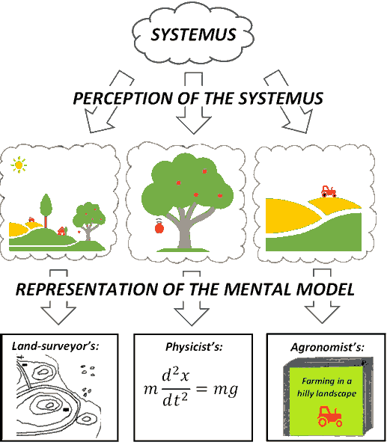
A system under study has many aspects that can be described by different models

Slide 13
A correct model does not exist !!!
“Essentially, all models are wrong, but some are useful.” [George Box]. – and useful only for a given situation and a specific purpose!
“A theory [model] should be as simple as possible – but no simpler.” [Albert Einstein’s version of Occam’s razor]
A model is good only if it describes the relevant aspects of the system under study according to the purpose.
A model/theory is preferred if it:
describes more,
is better tested,
is smaller (more comprehensive).

Slide 14
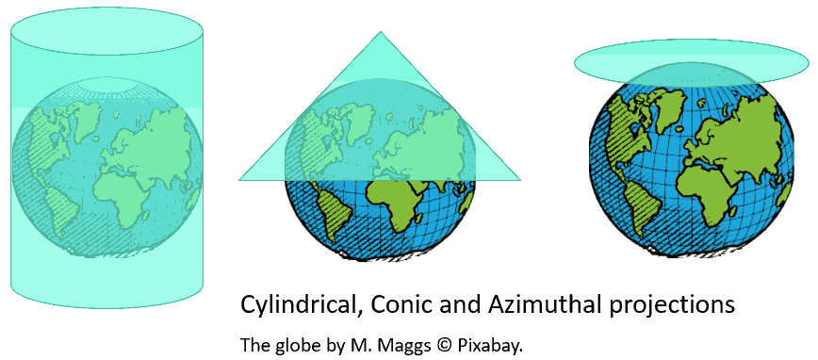
Also a well-defined systemus can be modelled in different ways depending on the purpose!
A globe preserves distances, angles and areas, but is bulky. A map is often more convenient and has good properties where the projection ‘touches’ the globe, but larger distortions outside this region.

Slide 15
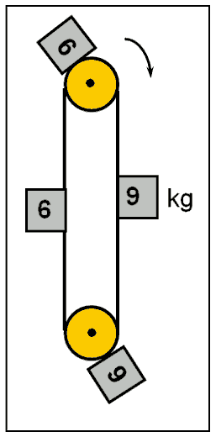
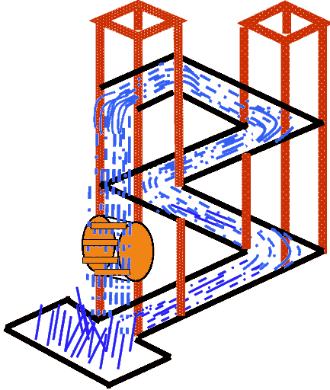
Every model doesn’t correspond to a possible systemus!
Models of impossible systemus (here two perpetuum mobiles)

Slide 16
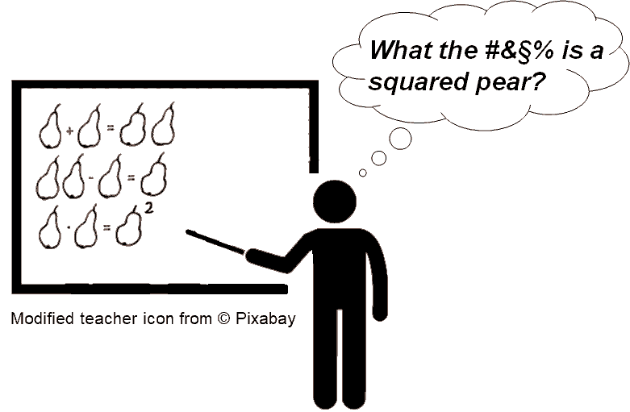
Without strict rules you may create the most absurd models !!

Slide 17
Why use a model ?
Can’t avoid it! Our thinking deals with models!
Models are simplified descriptions.
A model is a good way to structure information.
A formalised model can be discussed and criticised.
On some models you can do experiments (simulation).
There is no real system, but we plan to make one.
The system’s environment cannot be controlled in an experimental study of the real system.
Too expensive, time-consuming or dangerous to experiment on the real system.
Models have pedagogic merits.
Model building brings knowledge and insight.
Etc.

Slide 18

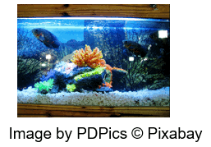

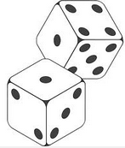
Classifications of models:
Static model (Changes can only come from external input)
Images by Jazellas © Pixabay
Dynamic model (Changes are generated by the model itself)
Deterministic model (No randomness)
Stochastic model (Randomness)

Slide 19
Different types of models
Many biological,
ecological, medical,
epidemi-ological, agricultural, etc. models belong here!
Static
Dynamic
Statistical models
Dynamic &
stochastic
models
Dynamic &
stochastic
models
Stochas-tic
dx/dt
Algebraic models (+ - × /)
Dynamic
models
(or Stocks & Flows)
Determi-nistic
dx/dt

Slide 20
V. MICRO vs. MACRO MODELS
Micro model (Describes the individual entities)
Macro model (Describes only the numbers of entities of different types)
‘Micro’ and ‘Macro’ are relative terms in relation to a given systemus. The systemus can be described as a micro model (where each main object is separately described) or by a macro model (where we only keep track of the number of such objects being in different stages).

Slide 21
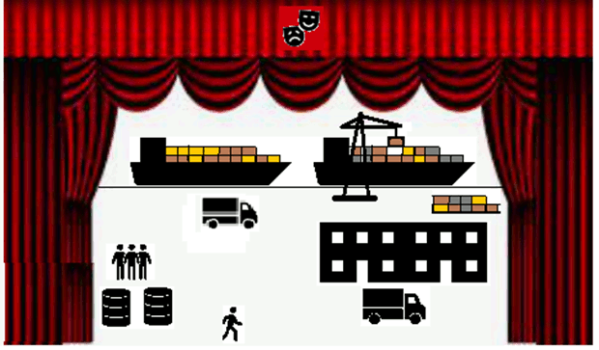
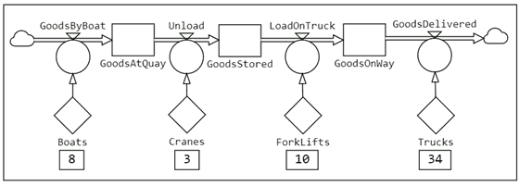
Micro and Macro models of a harbour
A micro model describes the individual entities of the systemus.
It resembles a theatre stage where the actors and props (e.g. boats, cranes, lorries) act together (e.g. to transport goods).
Curtains from © Pixabay.
A macro model (lumped model, aggregated model) only describes the amounts or numbers of (e.g. goods in the process).
StochSD model of the transport of goods.

Slide 22


A disease in a population
Micro and macro views for different purposes
Medicine:
Disease process within
each individual.
Stages: S, I & R
A micro view!
S I R
S I R
2. Epidemiology:
Numbers of persons in different stages of a disease process.
A macro view!
51
7
14
Susceptible(Healthy)
Infectious
Recovered

Slide 23
VI. SIMULATION (= experiment on a model)
For a complex systemus, analysis is seldom possible – then try simulation!
Influence
Systemus’ behaviour
SYSTEMUS
1)
1)
3)
Input
Output
MODEL
2)
Experiments
1) Describe the system with a model (and inputs with corresp. data).
2) Perform the experiments by changing parameters, initial values,
structure, etc. of the model.
3) Draw conclusions about how the systemus’ behaviour.

Slide 24
Experiments can be done on many types of models
Simulation with physical models
Aircraft model in a wind tunnel
A ship model in a basin with controlled waves
Test loadings on a bridge model
Unfrozen chickens cannoned at a full size cockpit to simulate collision with birds
Simulation with computer models
Macro models
Discrete Event Simulation (DES)
Agent Based Models (ABM)
Micro models
Continuous System Simulation (CSS e.g. StochSD)

Slide 25
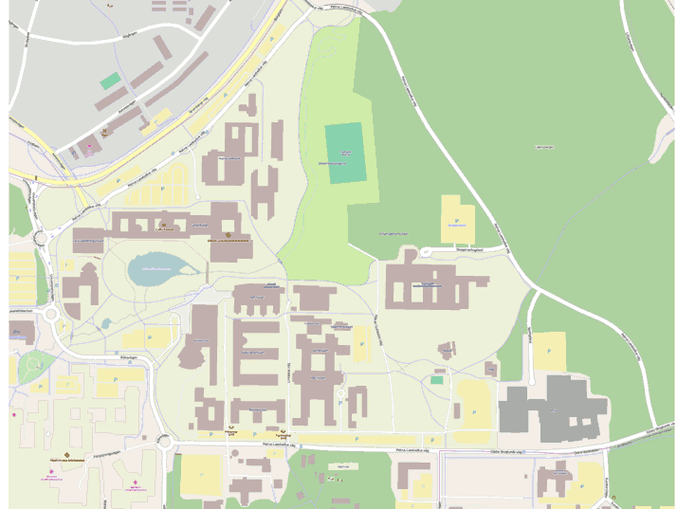
A Swedish university campus
© OpenStreetMap Contributers: Umeå University, Sweden. https://www.openstreetmap.org/copyright

Slide 26
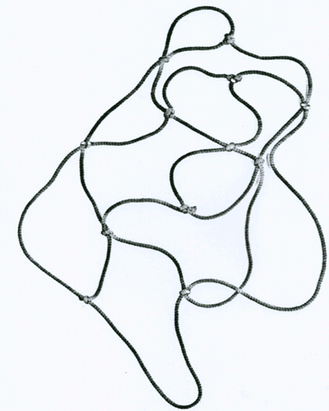
With some models you can perform experiments!
A model (map) like that at the preceding slide is simplified by a network of strings (‘roads’) connecting 1) Entrance, 2) Library, 3) Aula, 4) Restaurant, etc. (A string between two nodes only represent length.)
This model only preserves distances (but not directions, areas, etc.).
(1)
(2)
(3)
This is a simulation model because you can perform experiments on it!
To find the shortest distance between (1) Entrance and (4) Restaurant – pinch (1) and (4) and stretch. The stretched string is the shortest way!
(4)
Teacher: Make a ‘string-web’ and demonstrate!

Slide 27
SIMULATION: Experiment on a model in order to understand a Systemus. This has two parts:
I. Technical part: Model → Results (L2-L7)
Examples
Shortest distance
Strength
Cost
⋅⋅⋅
Static model
e.g. string-web or spreadsheet
Values
Experiments
Examples
Population(t)
Trajectory(t)
Infectious(t)
⋅⋅⋅
Dynamic model
e.g. Dif. Equations or Stocks & Flows
Behaviours i.e. functions(time)
II. Equivalence part: Systemus ↔ Model (for a given purpose)
Fitting the Model to the Systemus (L3, L8-L9)
Validation (L8-L9) (Test of model’s behaviour against the systemus’)
Result Evaluation (Are the results realistic, robust, acceptable from
(L8-L9) other aspects, etc.)

Slide 28
Why computer simulation ?
Mathematical/Statistical analysis is only possible in very simple cases:
- Simple (small)
- Linear
- Deterministic
- Time invariant
- Mathematically well defined
Simulation is based on
modelling using:
Mathematics, Statistics
Logics. Numerical methods,
Empirical relations.
Simulation can handle:
complex systems
Non-linearity
Dynamics
- Stochastics
- Time variability
- ”Non-mathematical” functions
> logical conditions
> delays
> events
> empirical relations
> etc.
Simulation
models
Mathematics
Statistics
- Often oversimplified models.
+ Results in a formula.
+ Models can be complex when necessary.
- No formula. Results only from many experiments.

Slide 29
Computer Simulation offers:
Very powerful tools: Concepts, Time handling, Graphics, Statistical analysis etc.
Unlimited material (Compare with your meccano, electrical railroad etc.)
Extreme freedom in the model building process.
Large space for creativity
This freedom must be balanced by:
- Letting your purpose guide you.
- An ambition to simplify (”Occam’s razor”).
- Understanding the system under study.
- Model fitting, validation, etc. etc.

Slide 30
VII. MACRO MODELLING
Input
Output
Depending on your purpose and available information, you can use the information about:
SYSTEMUS
Input
Output
MODEL
The Systemus’ structure to build a similar model structure.
White-box model. This shows the mechanisms that create the model behaviour.
u
y
X
The input − output relation of the Systemus.
Black-box model. In this case any model with a similar
input − output relation will do. The model structure
may be very different from that of the systemus.
u
y
Mixture of structure and input − output information.
Grey-box model. You use what you have.
u
y
(X)

Slide 31
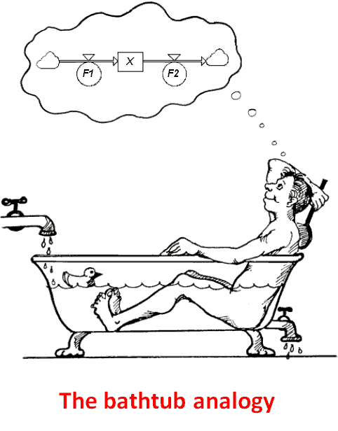

Macro modelling and simulation with StochSD
Building blocks
Compartment
Flow with controller
Auxiliary
Constant
Information link
Outside the system borders

Slide 32
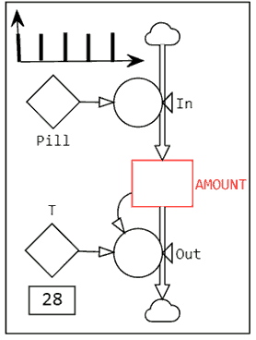
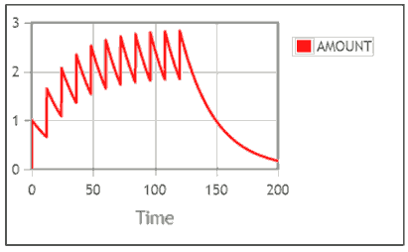
Demonstration: Dose administration
To be cured, 1 gram of Penicillin is taken each 12th hour during 5 days (=120 h).
The elimination of the Penicillin has the time constant T=28 hours, which means that 1/28th of the remaining content is eliminated each hour.
This is a dynamic process. (The system itself generates changes over time.)
SYSTEMUS: Input of pills. Amount of substance in body. Output of the substance.
StochSD MODEL: Very simplified macro model as shown below.
• What will happen?
• How will penicillin accumulate?
• What will happen after the 120 hours?
• What if you need at least 1.5 grams for a real effect?
• How to reach the effect earlier (AMOUNT ≥ 1.5 g)?

Slide 33
References
Churchman C.W. The Systems Approach. Dell Publishing Co. Inc. NY, 1968/1979.
Fishman, G.S. Principles of Discrete Event Simulation. John Wiley & Sons, NY, 1978.
Kreutzer, W. System Simulation: Programming Styles and Languages, Addison-Wesley Publishing Company Inc, Sydney, 1986.
Law AM and Kelton WD. Simulation Modelling and Analysis, 2d ed. McGraw-Hill, New York, 1991.
Luenberger, D.G. Introduction to Dynamic Systems. Theory, Models and Applications, John Wiley & Sons, Inc., New York, 1979.
Wikipedia. Simulation. https://en.wikipedia.org/wiki/Simulation. Last edited on 20 October 2021.
Kontchakov R. Modelling concepts. https://citeseerx.ist.psu.edu/viewdoc/download?doi=10.1.1.228.867&rep=rep1&type=pdf. (A number of good slides.)

Slide 34
End L1

