Slide 1
Clustering Cloud Types
from the Geostationary Operational Environmental Satellite (GOES-16)
Nazia Farhat, Katherine Haynes, Jason Stock, Joe Strout
CS 535 Project Presentation
May 6, 2020
Notes:
Hello, this is <title>, presented by <names>.

Slide 2
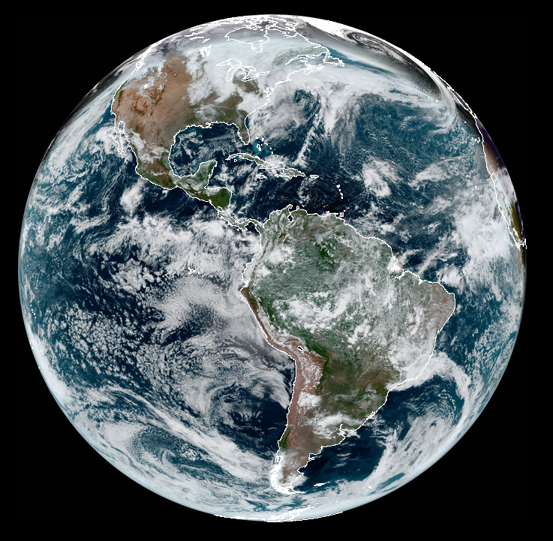
Problem Statement
Accurately identifying and predicting cloud types is important
Enhance understanding of climate system
Aid climate change evaluation
Further weather process understanding
Improve weather forecasts
Goal: Determine how well cloud types natively emerge from minimally-processed GOES-16 channels
k-means Complete
k-means + Autoencoder
Deep Embedded Clustering
Notes:
Our project is based on the idea of identifying cloud types from minimally-processed satellite data. This is an important problem with many real-world applications. We apply three different methodologies to 16-channel multispectral data from the GOES-16 satellite: a simple k-means "complete" clustering; k-means plus an autoencoder, and deep embedded clustering.

Slide 3
Methodology: k-means Complete [1/3]
Baseline study: simple k-means clustering algorithm on a subset of the data
data from 219,904 images, 3 channels (#2, 8, 13) each
Apache Spark + MLlib
13 compute nodes × 4 workers/node = 52 worker threads
clusters (k) varied from 2 to 10
evaluated by within-set sum of squared errors (WSSSE)
Notes:
Our first experiment was a classic K-means clustering algorithm. This was done on a subset of the data, using three channels selected to provide broad coverage of the spectrum. The analysis was done in Apache Spark using MLlib, and run in parallel on 13 machines. The number of clusters was varied from 2 to 10, and evaluated using within-set sum of squared errors (or WSSSE).

Slide 4
Methodology: k-means + Autoencoder [2/3]
A Simple Autoencoder (SAE) learns a compressed representation of data by learning a latent vector to approximate the identity function from the GOES-16 input
Improvements made with use of a Convolutional Autoencoder (CAE)
Generate samples from the latent vector to cluster using k-means
Three primary steps:
Develop a neural network that accurately represents the data
Cluster the latent vectors output to identify underlying characteristics
Evaluate cluster performance with changes in channel combinations

Slide 5
Methodology: Deep Embedded Clustering [3/3]
Convolutional Autoencoder pre-trained to generate representative latent features of the clusters explored
Soft cluster assignment of input data by a custom layer initialized with k-Means cluster centers of pre-trained encoder output
A Transforming network formed by stacking custom layer on pre-trained encoder
Improved clustering by simultaneous minimization of Autoencoder reconstruction loss and Transforming network clustering loss
Self-learning clustering approach to determine contributing channels and evaluate different clustering generated from those channels

Slide 6
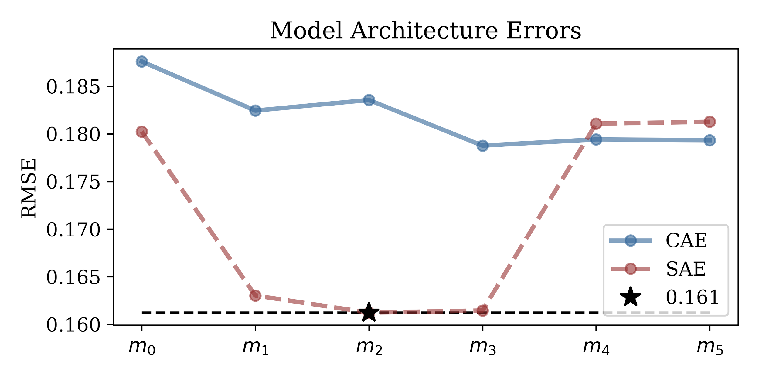
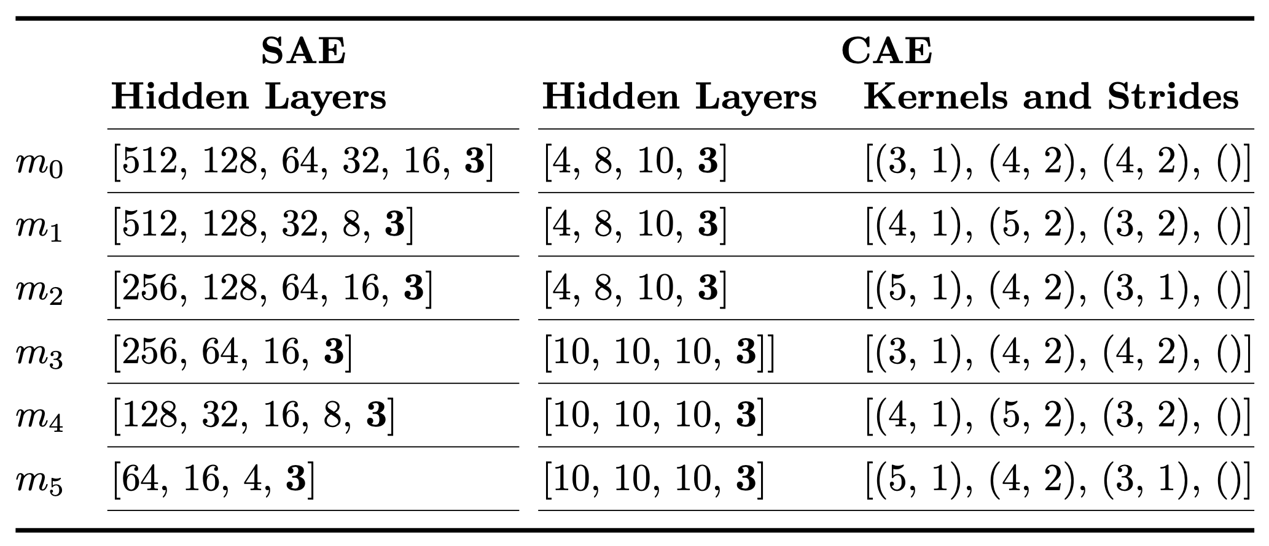
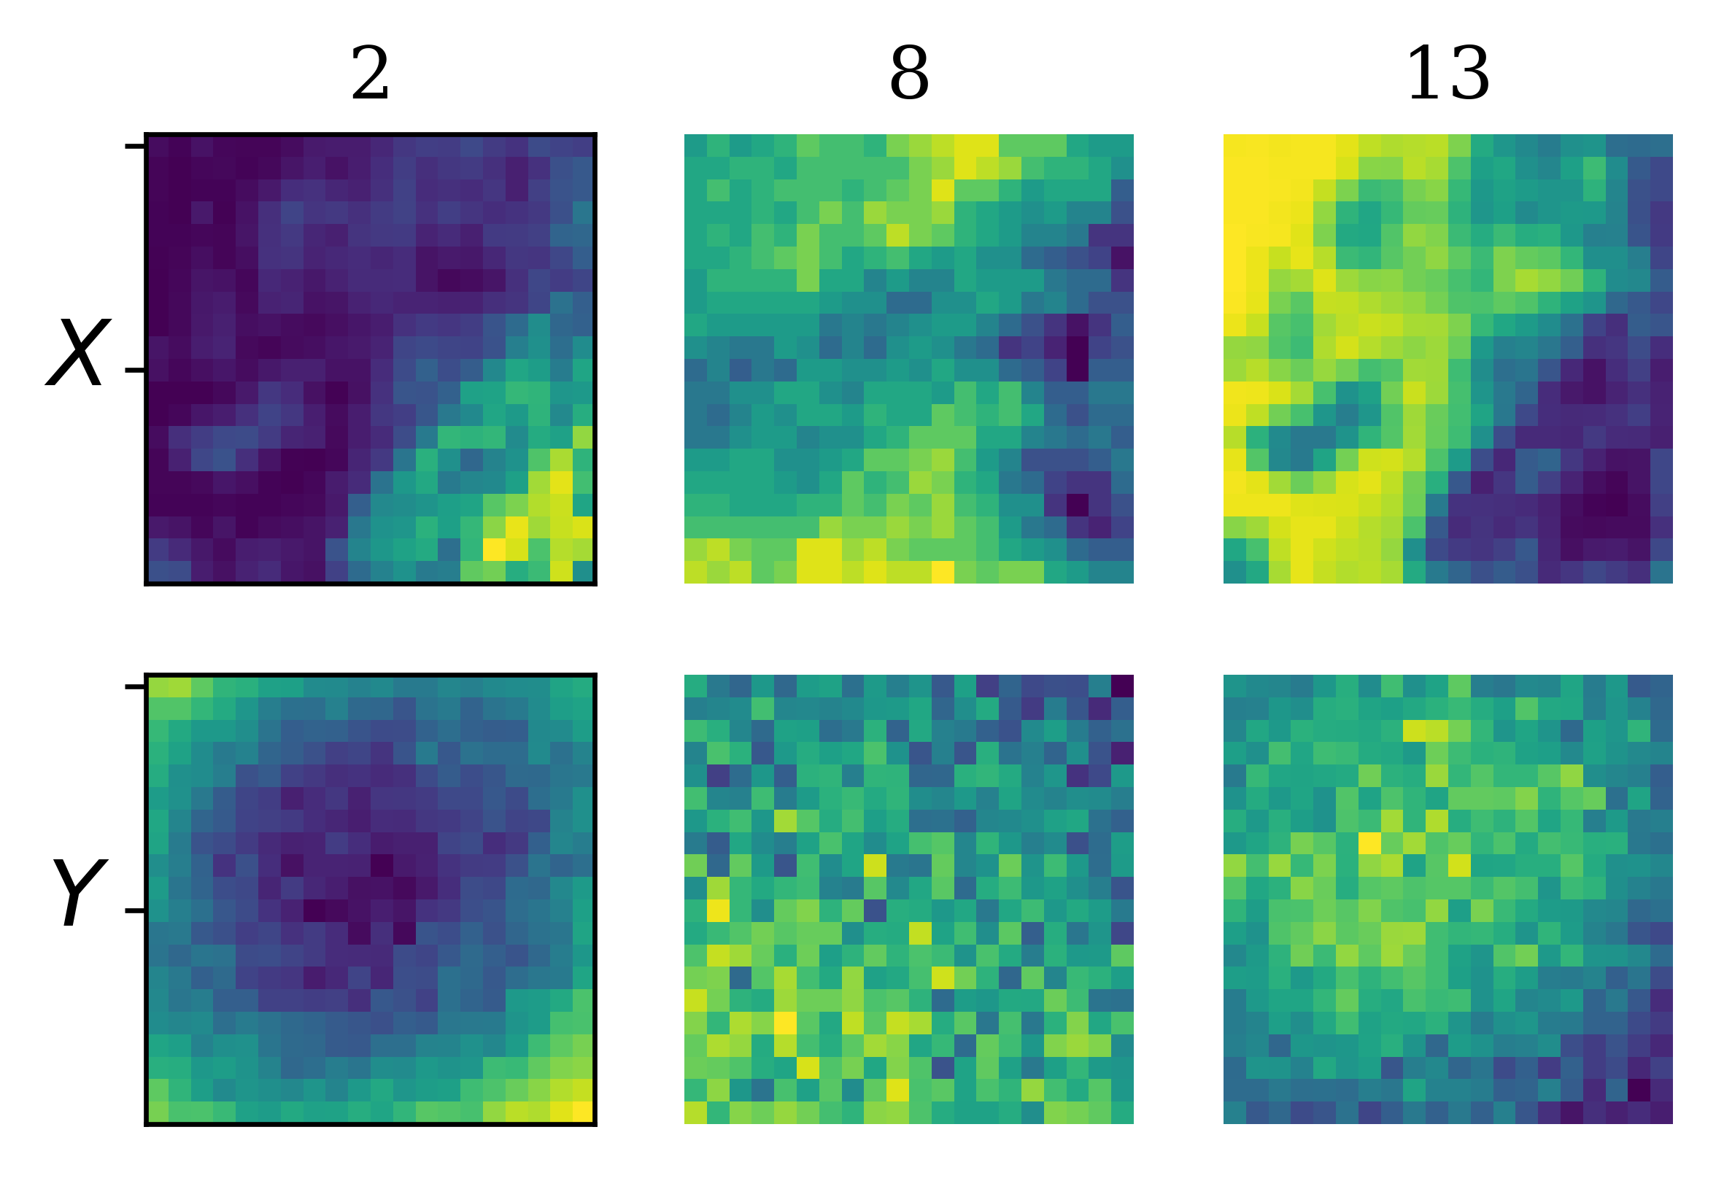
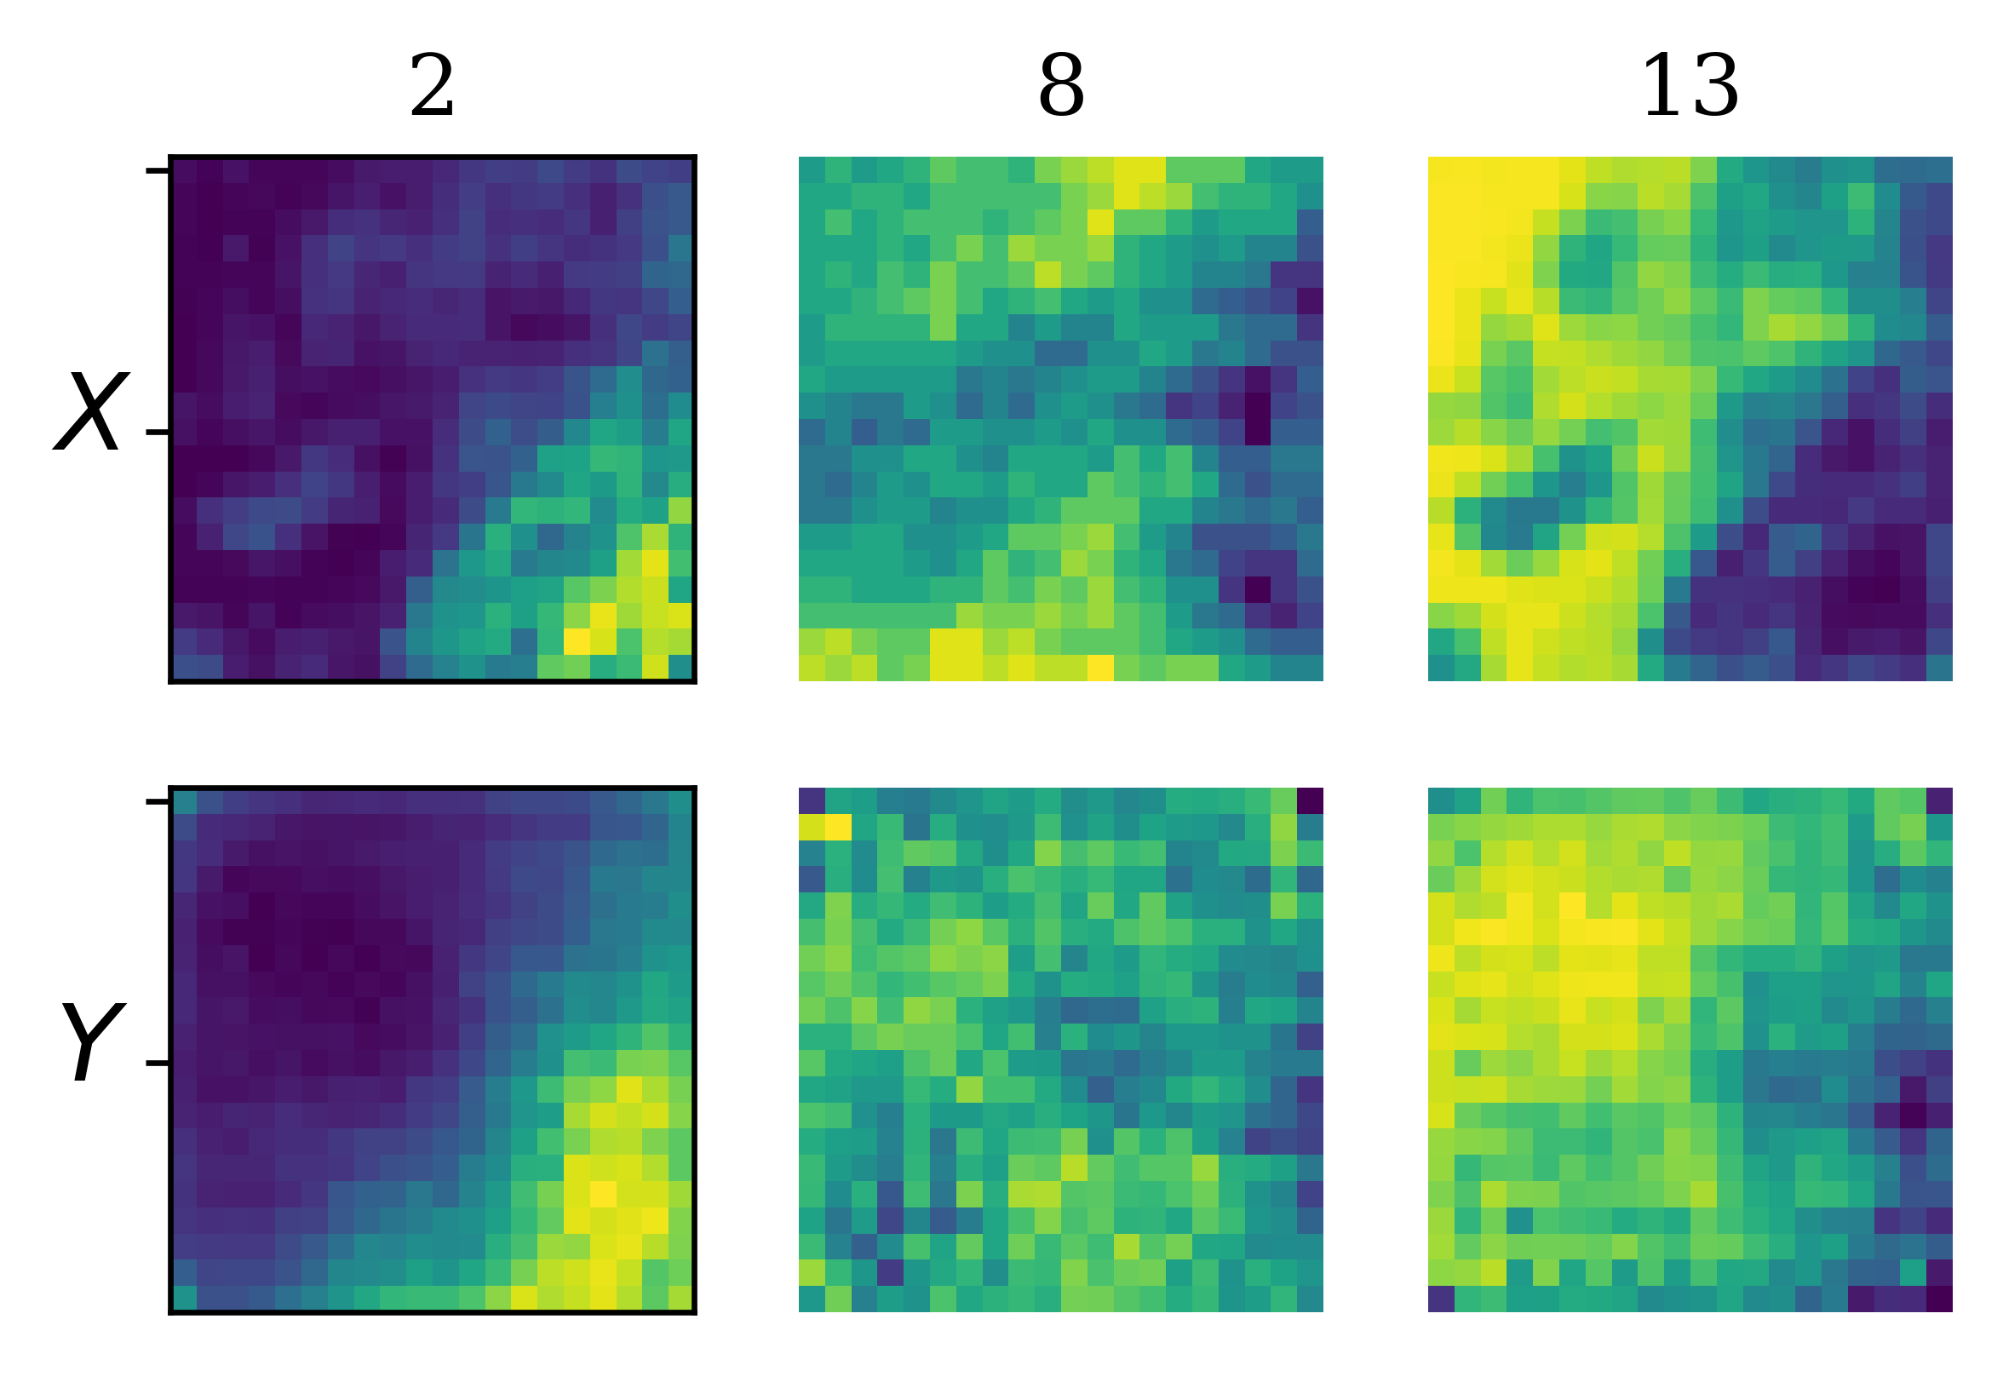
Evaluation: Network Architecture [1/3]
Vary network architectures to find the best performing
Loss: RMSE, Optimizer: Adam (default β), lr: 0.001, epochs: 10, batch size: 512, latent dim: 3
The CAE shows more stable results
SAE 𝑚₂ with 700,595 trainable parameters
CAE 𝑚₃ with 8,662 trainable parameters
a) Simple Autoencoder
b) Convolutional Autoencoder

Slide 7
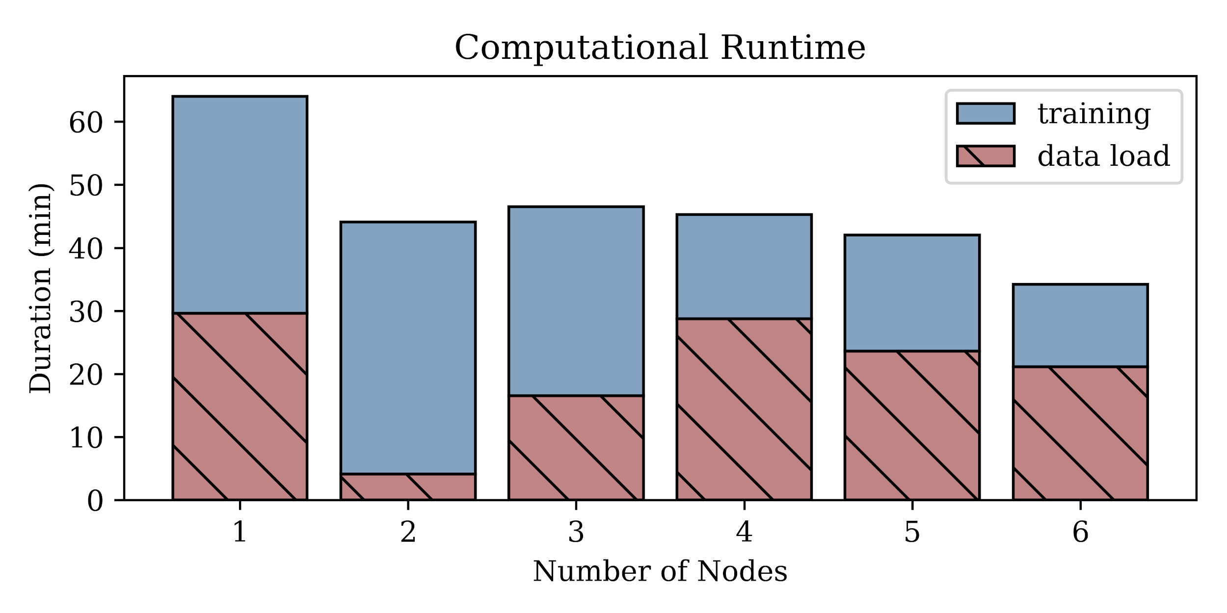
Evaluation: Computational Performance [2/3]
How do changes in the number of batches impact network IO and performance?
Cluster of HP-Z420-XeonE5-2650v2 workstations; 8x2.5Ghz processor with 32 GB memory
All models run on the CPU using the distributed PyTorch Gloo backend architecture
Scaling from one node to six yield a 2✕ improvement in training times

Slide 8
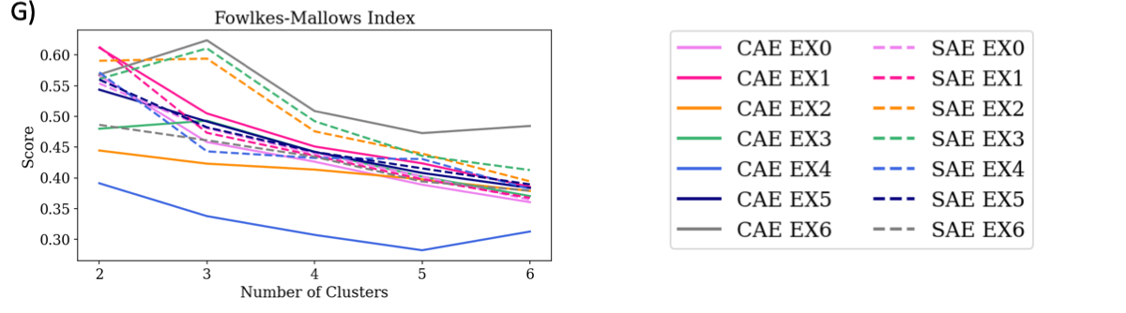
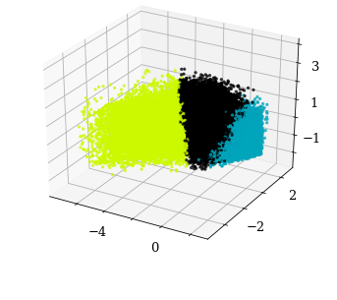
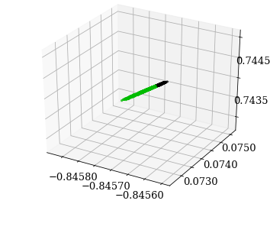
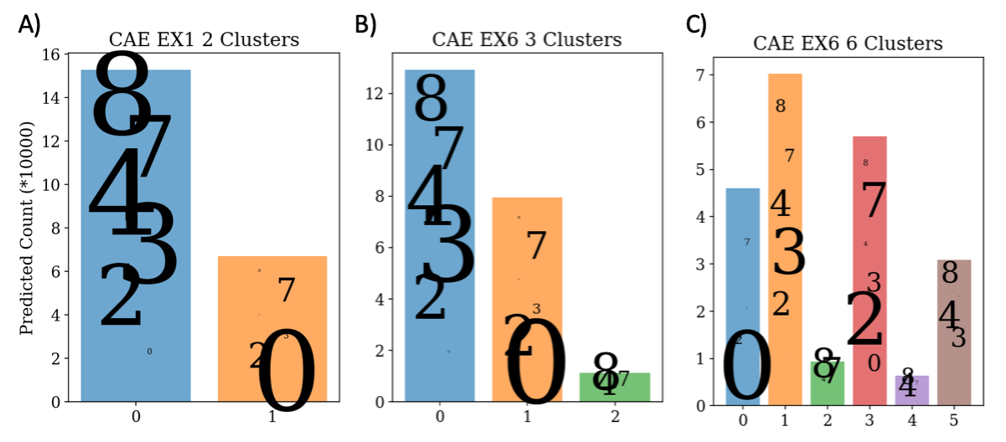
Evaluation: Clustering of Latent Vectors [3/3]
CAE EX6 (3 Clusters)
CAE EX4 (2 Clusters)
Best Performers:
CAE EX1 with 2 clusters (Channels 3, 13)
CAE EX6 with 3 clusters (Channels 2, 8, 13)
Broad, well-spanned
Worst: CAE EX4 (Channels 8, 9, 10)
Linear, minimal range
2 Clusters separates clear from cloudy
3 Clusters separates clear, cloudy, and ice
6 Clusters (1-1 type match)
Clear
2, 3, 4 Low level
7-8 Similar definitions

Slide 9
Conclusions
Successfully implemented 3 big data clustering algorithms
Found that 3 clusters match cloud types best
Separate clear and cloudy conditions, with possibility for ice
k-means clustering on autoencoder-produced latent vectors shows promising skill at detecting cloud type from native GOES-16 data
CAE more stable and consistent than SAE
Infrared and visible channels together performed best
Deep embedded clustering shows potential
Able to detect sensitivity to the same channels as the autoencoder

