Slide 1

sama
Business Analytics Recommendations for Project Success in 2021
Building a sustainable inclusive economy.

Slide 2
ABOUT SAMA
25% of the Fortune 50 trust Sama to deliver secure, high-quality training data and validation for the technology teams driving humanity forward. From self-driving cars to smart hardware, Sama fuels AI.
Founded over a decade ago, we’re experts in image, video, and sensor data annotation and validation for machine learning algorithms in industries including automotive, navigation, AR/VR, biotech, agriculture, manufacturing, and e-commerce.
Our staff is driven by a mission to expand opportunities for low-income people through the digital economy, and our social business model has helped lift over 50,000 people out of poverty.

Slide 3
EMPLOYEE PERFORMANCE - CASE STUDY 1
1.37
0.95
477
Average productivity score
Average quality score
75% +
10.5
Number of employees in the project
Employees with perfect attendance
Highest productivity score

Slide 4
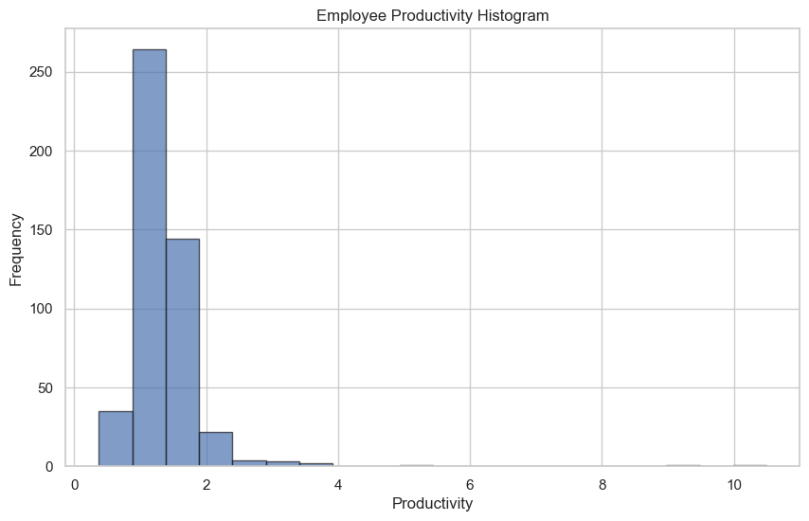
PRODUCTIVITY
The highest productivity score recorded was 10.5
75% had a productivity score greater than the average (1.375)
Lowest productivity score of 0.3

Slide 5
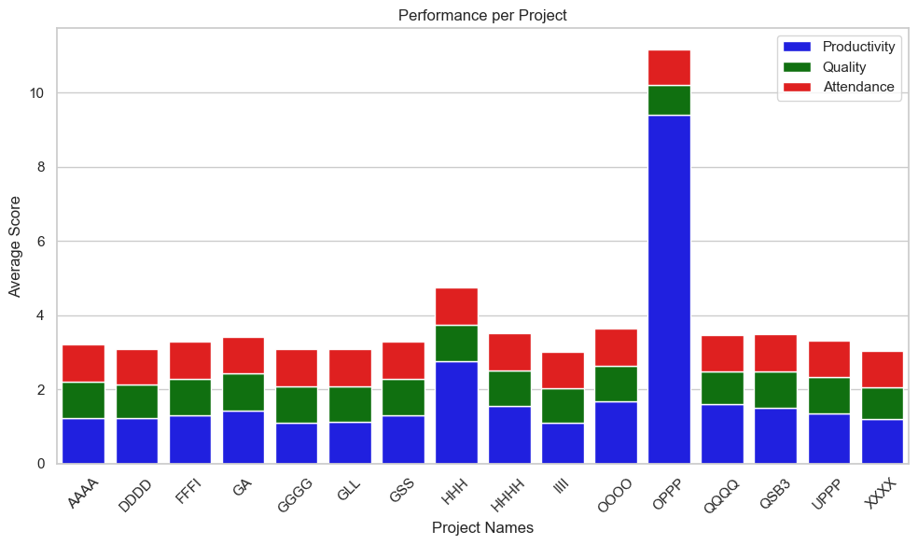
PERFORMANCE PER PROJECT (2020)
Project OPPP had the highest productivity score.
All projects had nearly the same attendance score.
Project GGGG had the lowest productivity score.
Project score correlates with attendance on a small scale.

Slide 6
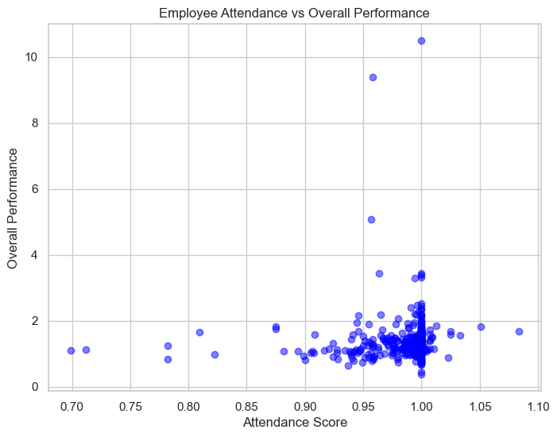
EMPLOYEE ATTENDANCE VS OVERALL PERFOMANCE
Most of the employees had the median attendance, quality, and productivity score.
The overall performance of employees had a direct correlation with the attendance score.

Slide 7
CAPACITY PLANNING (2021) - CASE STUDY 2
6
11
33
Number of understaffed projects
Number of overstaffed projects
13
75
Number of projects available
The number by which they are understaffed
The number by which they are overstaffed

Slide 8
KEY RECOMMENDATIONS
Project managers work to ensure that each employee records a perfect attendance score.
Employees on projects with low productivity scores should be put through training and development avenues to increase productivity.
Incentivize employees to ensure continuous improvement in productivity, quality of work, and attendance.
Project managers to implement feedback and communication mechanisms for constructive input to employees and address performance-related concerns promptly
Project managers to take employees from projects whose headcount is more than the required headcount by 5 and above and reassign them to understaffed projects to ensure maximum output per project. They are projects with sub-project IDs; 16, 18, 55, and 81.

