Slide 1
LoRA for Multilingual Grapheme-to-Phoneme Conversion
Parameter-Efficient Adaptation of ByT5-G2P on Romanian and Modern Greek
Dan-Gabriel Tudor · Ştefan-Rareş Stoian
Faculty of Mathematics and Informatics, University of Bucharest
LLM for NLP — 2026
https://github.com/stoianraresstefan/G2P-Parameter-Efficient-Fine-Tuning

Slide 2
The grapheme-to-phoneme (G2P) task
• G2P maps spelling to pronunciation — a sequence of phonemes (IPA).
• It is the front-end of text-to-speech and supplies the lexicons behind speech recognition.
• Example: Romanian *porneşte* (“[it] starts”) → p o r n e ʃ t e, where ⟨ş⟩ → /ʃ/.
• Spelling-to-sound mappings are irregular even in shallow orthographies — so G2P is nontrivial.

Slide 3
Why multilingual G2P matters
• High-quality pronunciation lexicons need linguistic expertise and are scarce for most languages.
• Pretrained multilingual models (CharsiuG2P / ByT5-G2P) transfer across ~100 languages from a single network…
• … and need only an ISO-639-3 language tag to transcribe a word.
• Strong off the shelf — but still benefit from per-language adaptation when in-language data exists.

Slide 4
The cost problem
• Adapting by full fine-tuning stores a full copy of ~300M weights per language: K languages ⇒ K × 300M.
• It can also overwrite previously learned languages (catastrophic forgetting).
• Parameter-efficient fine-tuning (PEFT) — LoRA, adapters — is standard for LLMs and ASR…
• … but has not been adopted for G2P. This is the gap we study.

Slide 5
Research question
Can LoRA match full fine-tuning of ByT5-G2P on low-resource languages while training under 1% of the parameters — and how do they compare on catastrophic forgetting?
• First systematic study of LoRA for multilingual G2P.
• Evaluated on Romanian and Modern Greek (SIGMORPHON 2021, low-resource).

Slide 6
Method: one model, four adaptation strategies
• Base model: CharsiuG2P ByT5-small (~300M params, byte-level, no language-specific vocabulary).
– Zero-shot — pretrained model, no training (0%).
– Frozen head — train only the LM head (0.19%).
– LoRA — low-rank updates on attention q/k/v/o, r ∈ {8,16}, α = 2r (0.39–0.78%): W + (α/r)·BA.
– Full fine-tuning — all parameters (100%).
• Greedy decoding; input prompt <ron>: / <gre>: .

Slide 7
Data and experimental setup
• SIGMORPHON 2021, low-resource: Romanian (Latin / Romance) and Greek (Greek script / Hellenic).
– 800 / 100 / 100 words per language; IPA targets.
• Metrics: PER (character-level edit rate) and WER; forgetting on held-out English (eng-us) IPA.
• Compute: Kaggle dual T4 GPUs; HuggingFace transformers + peft.

Slide 8
Main results
Method | Ro PER | Ro WER | El PER | El WER
Zero-shot | 4.48 | 22.00 | 1.56 | 10.00
Frozen head | 4.48 | 23.00 | 1.71 | 11.00
LoRA (r=8) | 4.11 ± 0.20 | 18.67 ± 2.36 | 7.32 | 35.00
LoRA (r=16) | 3.36 | 15.00 | 7.17 | 35.00
Full FT | 1.76 | 10.00 | 2.80 | 16.00
SIGMORPHON'21 WER | -- | 10.00 | -- | 21.00
• Romanian: adaptation helps — full FT best (PER 1.76, WER 10); LoRA r=16 (3.36) beats zero-shot (4.48) at 0.78% of params.
• Greek: zero-shot already excellent (PER 1.56); no fine-tuning improves it.

Slide 9
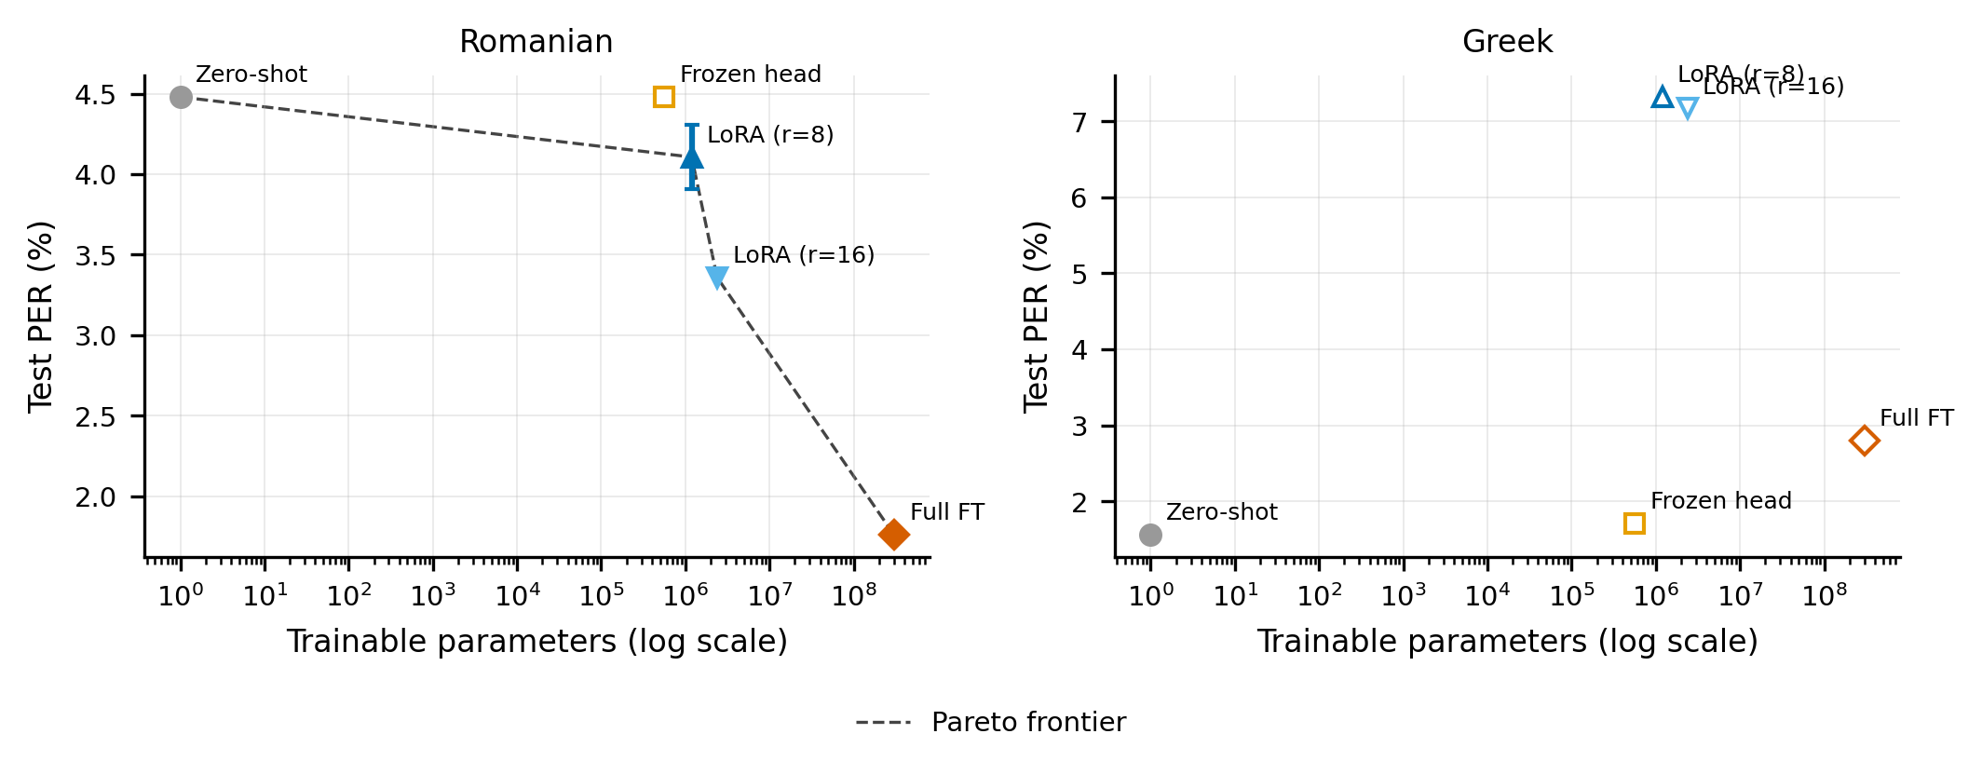
Accuracy vs. cost: the Pareto view
Romanian: each extra parameter budget buys lower PER. Greek: zero-shot dominates the frontier.

Slide 10
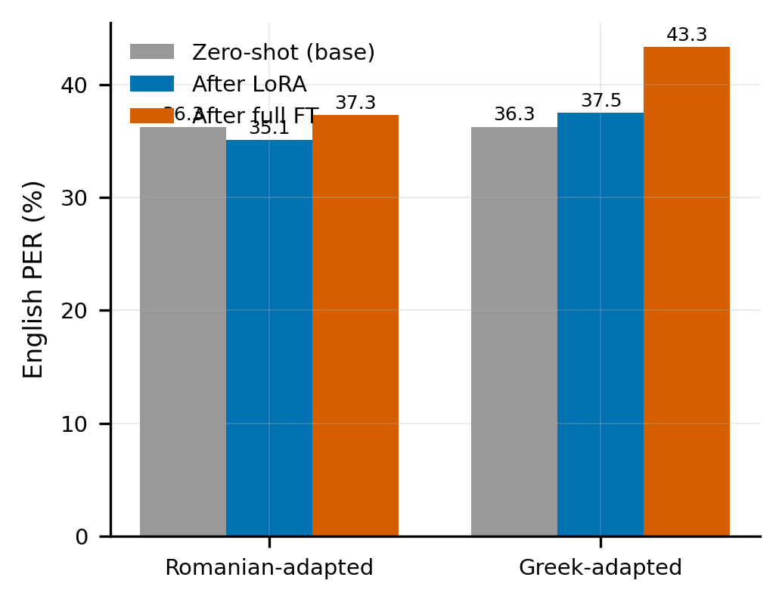
Catastrophic forgetting on English
• Base model: PER 36.3.
• Full fine-tuning forgets most (Greek-adapted 43.3, +7).
• LoRA / frozen-head stay near baseline.
• Frozen base ⇒ multilingual ability preserved.
• The cleanest argument for PEFT.

Slide 11
Limitations and future work
• Scope: two languages, two LoRA ranks, mostly single-seed, one base model, isolated words, no adapter baseline.
• Threat to validity: Greek zero-shot likely inflated by WikiPron/SIGMORPHON pretraining overlap (within-split leakage is 0% exact).
• Future: adapters and wider rank sweep; more languages/scripts; self-training; sentence-level G2P; robustness.

Slide 12
Conclusion
• LoRA approaches full fine-tuning where adaptation helps (Romanian PER 4.48 → 3.36) at <1% of the parameters.
• Per-language storage drops from K × ~300M to K × ~1–2M weights.
• By freezing the backbone, LoRA preserves the multilingual base where full fine-tuning forgets it.
Takeaway: PEFT is a practical default for per-language G2P deployment.

Slide 13
Thank you — Questions?
https://github.com/stoianraresstefan/G2P-Parameter-Efficient-Fine-Tuning

