Slide 1


SMART INDIA HACKATHON 2026
Problem Statement ID – SIH26038
Problem Statement Title – Explainable AI for Diabetic
Retinopathy Screening in Rural India
Theme – MedTech / BioTech / HealthTech
PS Category – Software
Team ID – 110084
Team Name – Beta Alanine

Slide 2
RetinaScan AI — Explainable Diabetic Retinopathy Screening
Beta Alanine
Detailed explanation of the proposed solution:
AI screening app that grades diabetic retinopathy severity from fundus images (5 stages: No DR → Proliferative)
Grad-CAM heatmap overlay shows exactly which retinal region drove the diagnosis
EfficientNet-B0 (PyTorch), fine-tuned on APTOS 2019, for the model; FastAPI backend + browser-based UI for clinicians
How it addresses the problem:
Deployable locally at a PHC with no per-request cloud dependency (demoed live on Render)
Cuts reliance on scarce ophthalmologists for first-level screening
Visual explanation builds trust instead of a black-box output
Innovation and uniqueness:
Explainability is core to the workflow, not an add-on
Explainability validated end-to-end — model, Grad-CAM, and web app all tested live on real fundus images
Roadmap: batch-screening mode for camp-style rural outreach (not yet built)

Slide 3
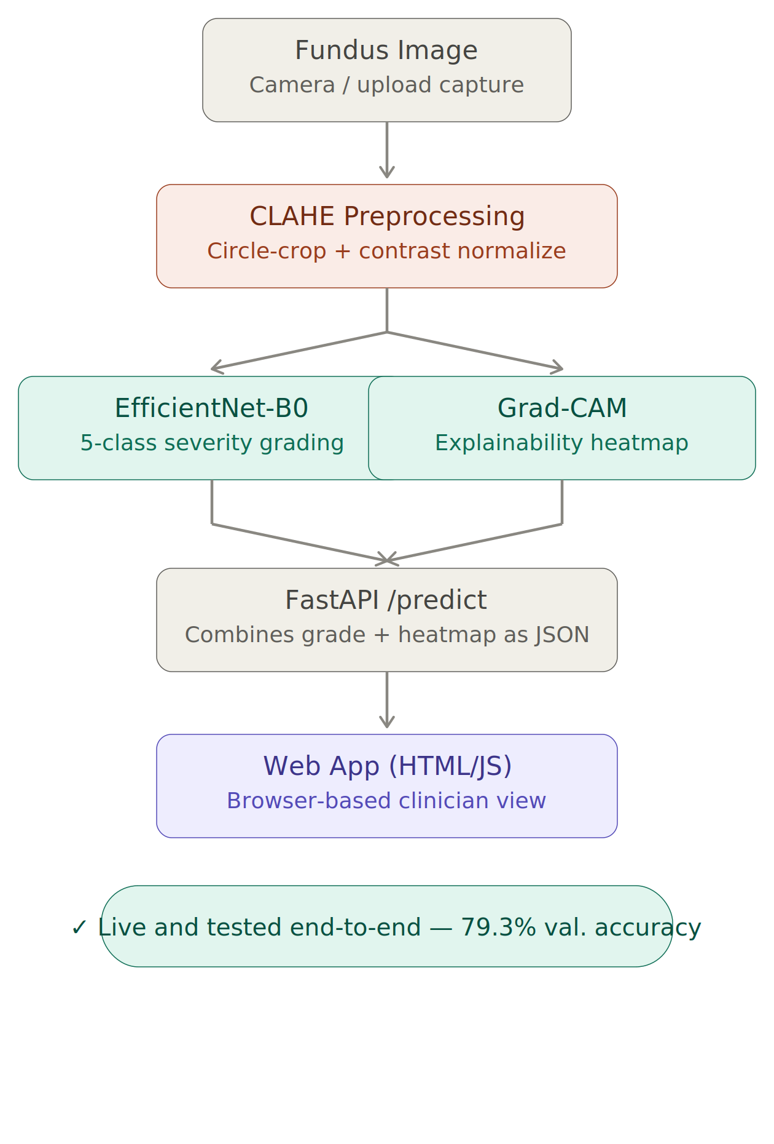
TECHNICAL APPROACH
Beta Alanine
Model: EfficientNet-B0 (ImageNet-pretrained), fine-tuned end-to-end for 5-class DR severity classification.
Explainability: Grad-CAM, computed on the final convolutional block, to generate lesion-localizing heatmaps.
Preprocessing: CLAHE (Contrast Limited Adaptive Histogram Equalization) + crop + resize to 224×224 RGB, to normalize the wide variation in fundus image lighting/contrast seen across cameras.
Backend: FastAPI serving a single /predict endpoint — accepts a multipart image upload and returns the severity grade, per-class confidence scores, the processed image, and the heatmap overlay as a JSON response. The model checkpoint loads once at startup and stays in memory, avoiding repeated disk I/O per request.
Frontend: A single-file HTML/JS interface — no build pipeline — so the demo can run on any machine with a browser.
Class-imbalance handling: weighted cross-entropy loss, with class weights computed from the training distribution, since DR datasets are naturally skewed toward "No DR" cases.
Pipeline

Slide 4
FEASIBILITY AND VIABILITY
Beta Alanine
Feasibility:
Proven tech (CNN + Grad-CAM), public dataset ready, mature PyTorch/OpenCV ecosystem speeds up build, low-hardware web deployment
Challenges and risks:
Class imbalance (mostly "No DR" images)
Real-world image quality varies from clean training data
Heatmaps can look right but be clinically wrong
False negatives on severe cases are dangerous
Strategies:
Weighted loss for imbalance
CLAHE preprocessing for image variation
Validate Grad-CAM against annotated lesion data
Tune for high recall on severe cases
Position as screening/referral aid, not final diagnosis

Slide 5
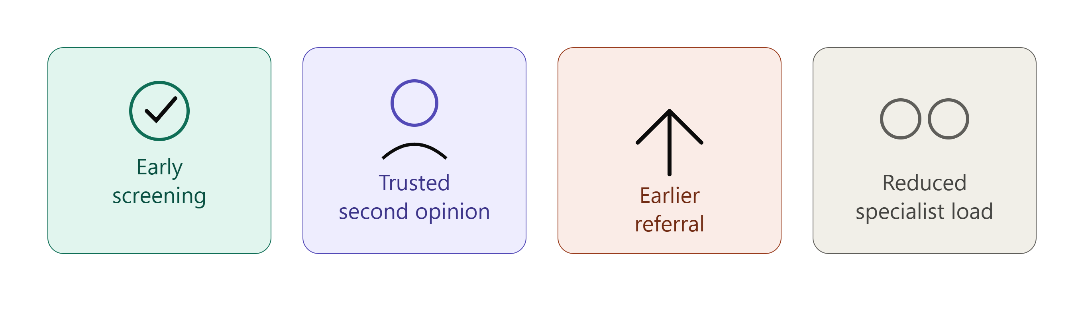
IMPACT AND BENEFITS
Beta Alanine
Potential impact on the target audience:
Rural/PHC patients get early DR screening without traveling to a specialist
Health workers get a trustworthy, explainable second opinion, not a black box
Enables earlier referral before vision loss becomes irreversible
Reduces the burden on India's limited pool of ophthalmologists for first-level screening
Builds patient trust and follow-up compliance since they can see the visual reasoning, not just a verdict
Benefits of the solution:
Social: wider access to eye care, fewer preventable blindness cases
Economic: less specialist dependency, avoids costlier late-stage treatment
Operational: deployable locally at a PHC with no per-request cloud dependency (demoed here on Render)
Scalability: low-cost to replicate across many PHCs — no per-patient licensing
Sustainability: low-hardware requirement keeps running cost near zero

Slide 6
RESEARCH AND REFERENCES
Beta Alanine
References:

