Slide 1
COPYRIGHT
On
PROJECT
Real-Time-Exercise-Detection-and-Mental-Wellness-Recommendation-System
Keshav Soni 2210991787
Khushal Goyal 2210991791
Kushal Goel 2210991835
Rishi Raj 2210992163
Supervised By
Dr. Lalit K. Sharma
Department of Computer Science and Engineering,
Chitkara University, Punjab

Slide 2
Abstract
Project Harmony is a web-based mental health platform designed to connect individuals with qualified mental health professionals, including psychologists and psychiatrists. The platform enables real-time communication through video and voice calls, along with a secure chat system, ensuring timely and accessible support. It also features a community forum where users can share experiences and seek peer advice, promoting a supportive environment.
The system is built using modern web technologies, with Next.js for the frontend, Node.js and Express.js for the backend, and a hybrid database approach using Firebase Fire store for real-time communication and MongoDB for user and forum data. Firebase Authentication ensures secure user login and data protection, while Send bird integration powers seamless calling features.
Project Harmony aims to provide a unified, secure, and scalable solution that combines professional consultation and community interaction, making mental health support more accessible, efficient, and user-friendly.

Slide 3
TABLE OF CONTENTS
Introduction
Problem Statement
Technical Details
Key Features
Our Design
Future Scope
Conclusion
References/Links used

Slide 4
INTRODUCTION
Mental health issues are increasing rapidly due to stress, lifestyle changes, and social pressures. However, access to timely and reliable mental health support is still limited due to factors such as stigma, lack of awareness, high costs, and fragmented digital solutions. Many individuals struggle to find trusted professionals or platforms that provide both expert guidance and peer support in one place.
Project Harmony is a web-based mental health platform designed to address these challenges by connecting users with qualified professionals, including psychologists and psychiatrists. It enables real-time communication through video calls, voice calls, and chat, ensuring quick and effective support. Additionally, the platform includes a community forum where users can share experiences and seek advice in a safe environment.
Built using modern technologies like Next.js, Node.js, Firebase, and MongoDB, the system ensures performance, scalability, and security. Overall, Project Harmony aims to make mental health support more accessible, reliable, and user-friendly.

Slide 5
Introduction
Project Harmony is a modern web-based mental health platform designed to make support more accessible.
It connects users (clients) with mental health professionals such as psychologists and psychiatrists.
Core Functionalities:
Real-time video calling and voice calling
Instant chat system
Community forum for peer interaction
Objective:
To create a safe, secure, and interactive ecosystem
To provide both professional help and community support in one platform
Enables communication through:
Video calls
Voice calls
Real-time chat

Slide 6
PROBLEM STATEMENT
Mental health support is often difficult to access due to several challenges. Individuals struggle to find qualified and trustworthy professionals quickly, and existing platforms usually provide only limited services, such as consultation or community support, but not both in one place. This fragmentation forces users to switch between multiple platforms, reducing convenience and effectiveness.
Another key issue is the lack of real-time communication, as many systems do not support instant video or voice interaction, which is essential for proper consultation. Additionally, privacy and security concerns discourage users from sharing sensitive information online.
Social stigma further prevents people from seeking help openly, and the absence of safe, anonymous spaces limits peer support opportunities.
There is a need for a unified, secure, and scalable platform that provides:
Easy access to qualified mental health professionals
Real-time communication (video, voice, chat)
A supportive community environment
Strong data privacy and security

Slide 7
Significance
Project Harmony is significant as it addresses the growing need for accessible and reliable mental health support. It helps overcome barriers like limited availability of professionals, high costs, and social stigma by providing a digital platform for easy access to expert help.
The platform integrates professional consultation, real-time communication (video, voice, chat), and a community forum into a single system, improving convenience and user engagement. It also ensures privacy and security, encouraging users to seek help without hesitation.
Additionally, the community feature promotes peer support, reducing feelings of isolation. With the use of modern technologies, the platform is scalable and efficient, allowing future enhancements.
Overall, Project Harmony contributes to making mental health support more accessible, efficient, stigma-free, and user-friendly, ultimately improving the well-being and quality of life of individuals.

Slide 8
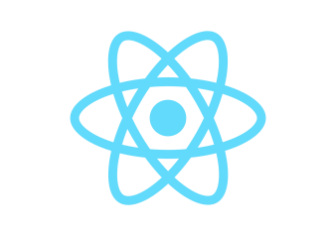
Software requirements
Frontend Development:
HTML, CSS, JavaScript: The frontend user interface will be developed using HTML for structure, CSS for styling, and JavaScript for interactivity and dynamic content generation.
Next.js
Next.js serves as the core frontend framework, enabling reusable UI components, efficient state management, and seamless API integration. It also provides built-in features like server-side rendering (SSR) and static site generation (SSG) for better performance.
Routing in Next.js
Next.js uses a file-based routing system, removing the need for React Router. Routes are created automatically based on the folder structure, making navigation simple and efficient.
Why Next.js?
Next.js is chosen for its performance, scalability, and ease of use. Its hybrid rendering and component-based architecture help build fast, dynamic, and user-friendly applications.

Slide 9
Software requirements
Backend Development
Next.js and Express.js: The backend will be developed using Node.js with Express.js as the framework. Node.js is chosen for its non-blocking, event-driven architecture, which is well-suited for handling multiple requests efficiently. Express.js simplifies the process of building web applications and APIs. The Node.js API documentation and Express.js documentation will be used as key references.
Database Management
MongoDB with Mongoose: MongoDB will serve as the NoSQL database for storing unstructured data. Mongoose will be used to provide a schema-based solution for MongoDB, making it easier to enforce data validation and relationships. The MongoDB documentation and Mongoose guide will be essential resources.
API Testing
Postman: Postman will be employed to test the APIs developed for the project. It allows for easy testing and debugging of endpoints, ensuring they function as expected before deployment. The Postman documentation will guide the setup and usage of Postman.

Slide 10
User-Friendly Interface: Designed for easy navigation, allowing users to quickly access services like consultation, chat, and forums, improving overall user experience.
Session Management: Efficient handling of user sessions and appointments ensures smooth interaction between users and mental health professionals with minimal errors.
Real-Time Communication: Provides instant updates and interaction through chat, voice calls, and video calls, ensuring timely support and transparency.
Secure Authentication & Data Protection: Implements secure login and data handling using Firebase Authentication, ensuring user privacy and trust.
Professional Dashboard: Mental health professionals can manage user interactions, view session history, and monitor consultations through an intuitive dashboard.
Performance Optimization: Utilizes real-time technologies and optimized architecture to ensure fast response times and a seamless user experience.
KEY FEATURES

Slide 11
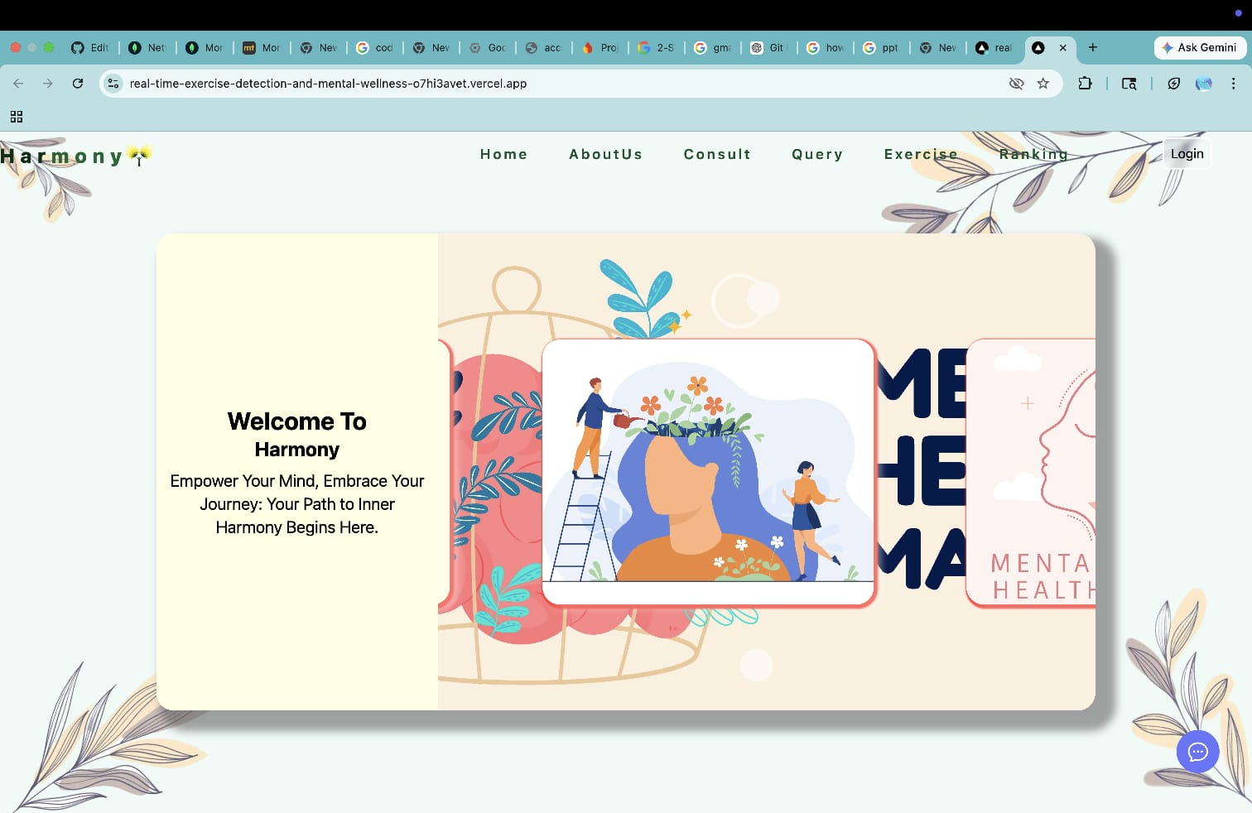
Our Design

Slide 12
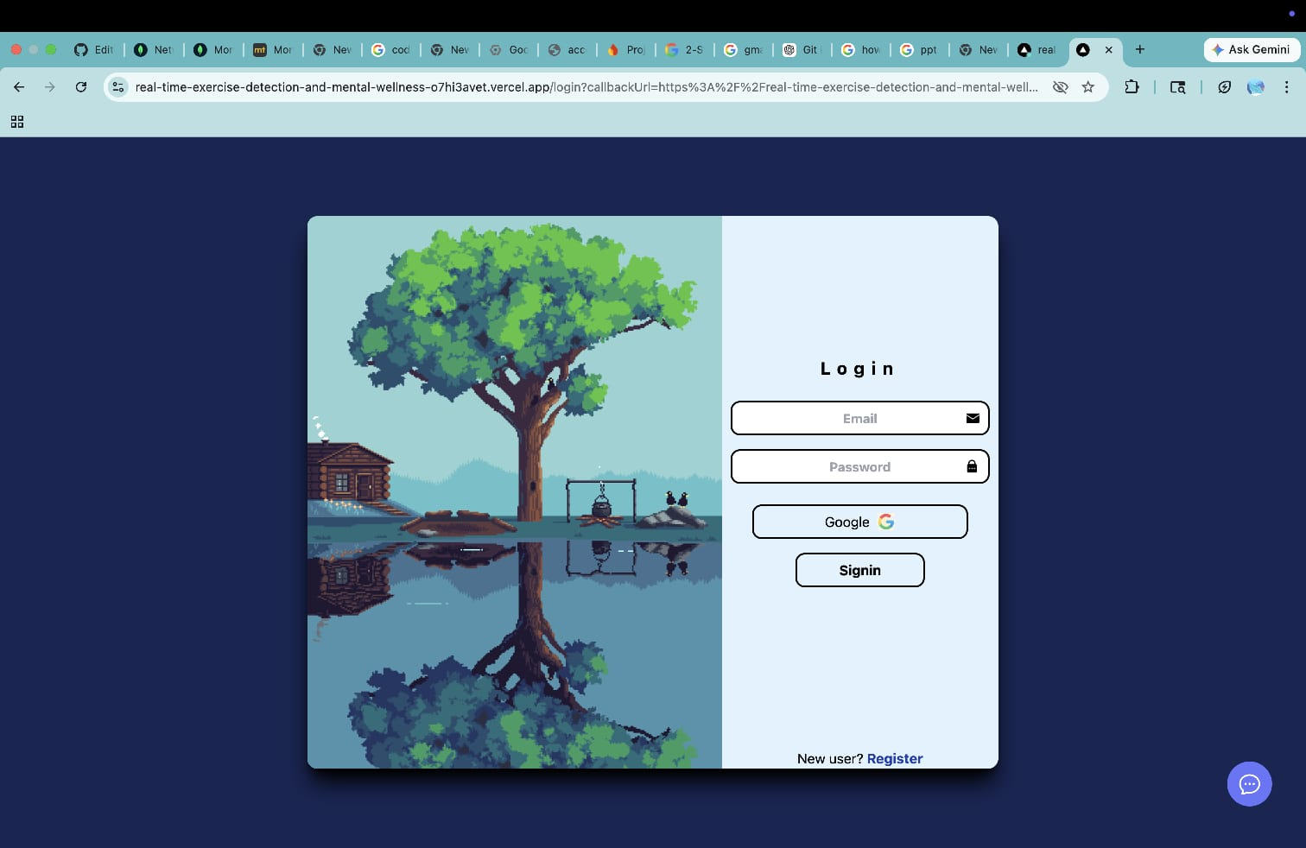
Our Design

Slide 13
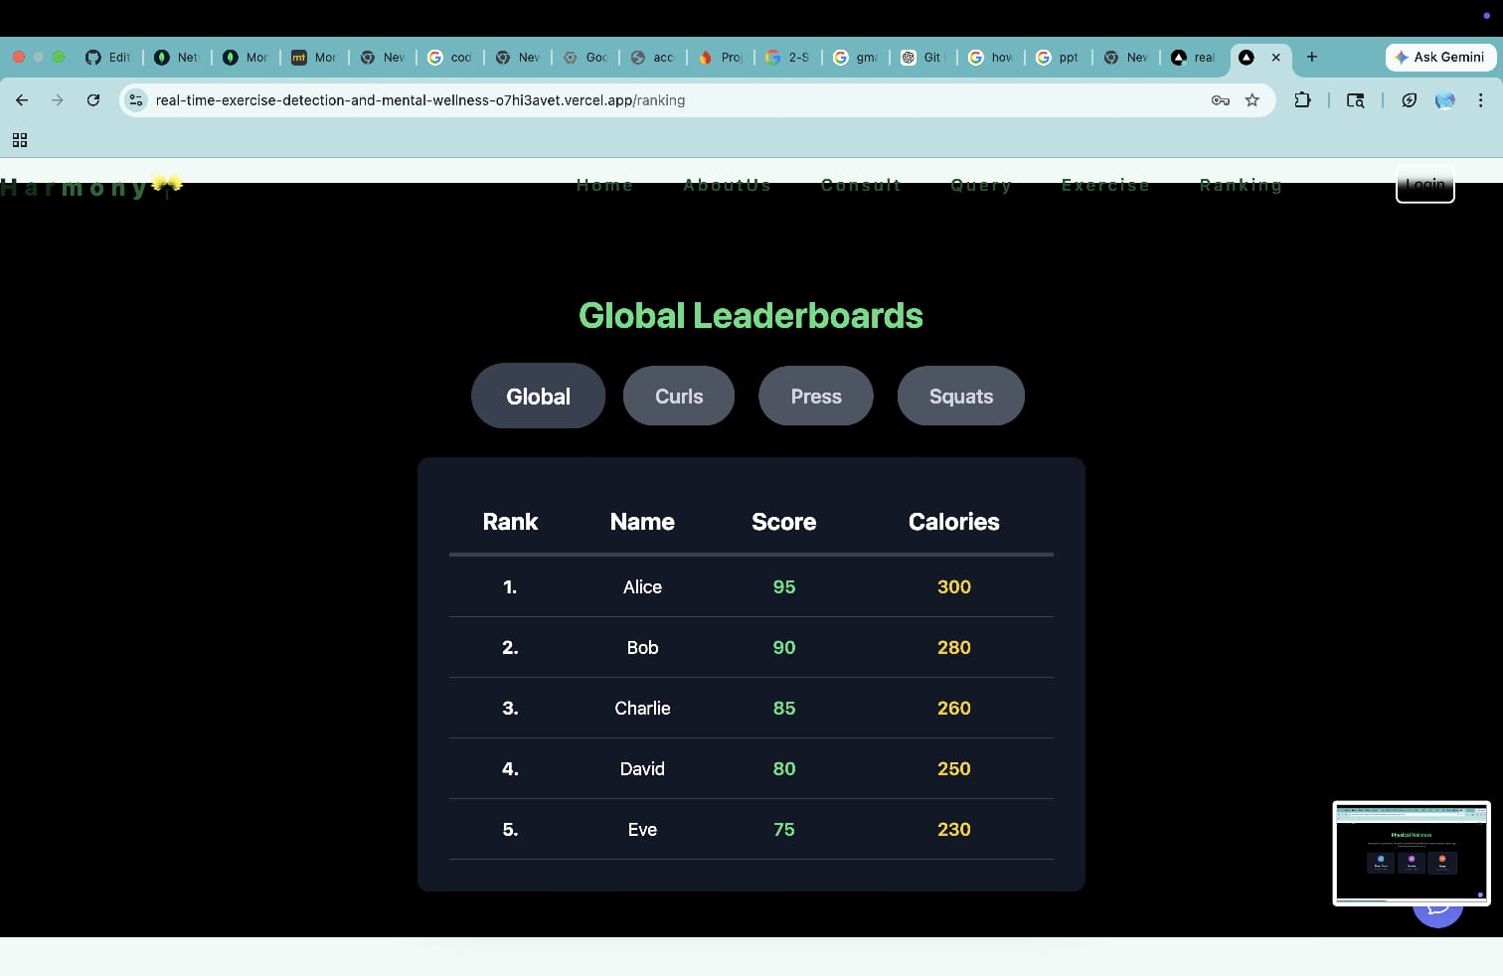
Our Design

Slide 14
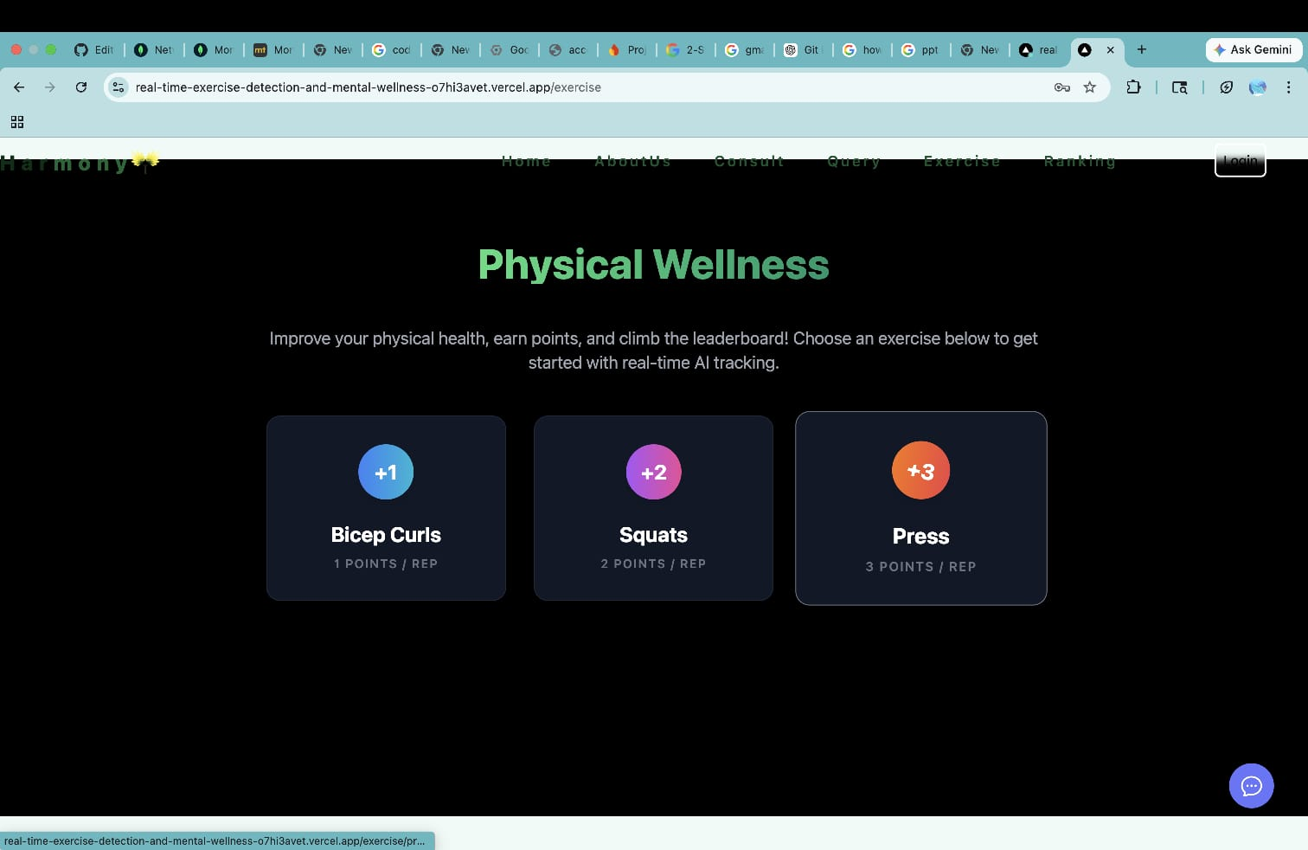
Our Design

Slide 15
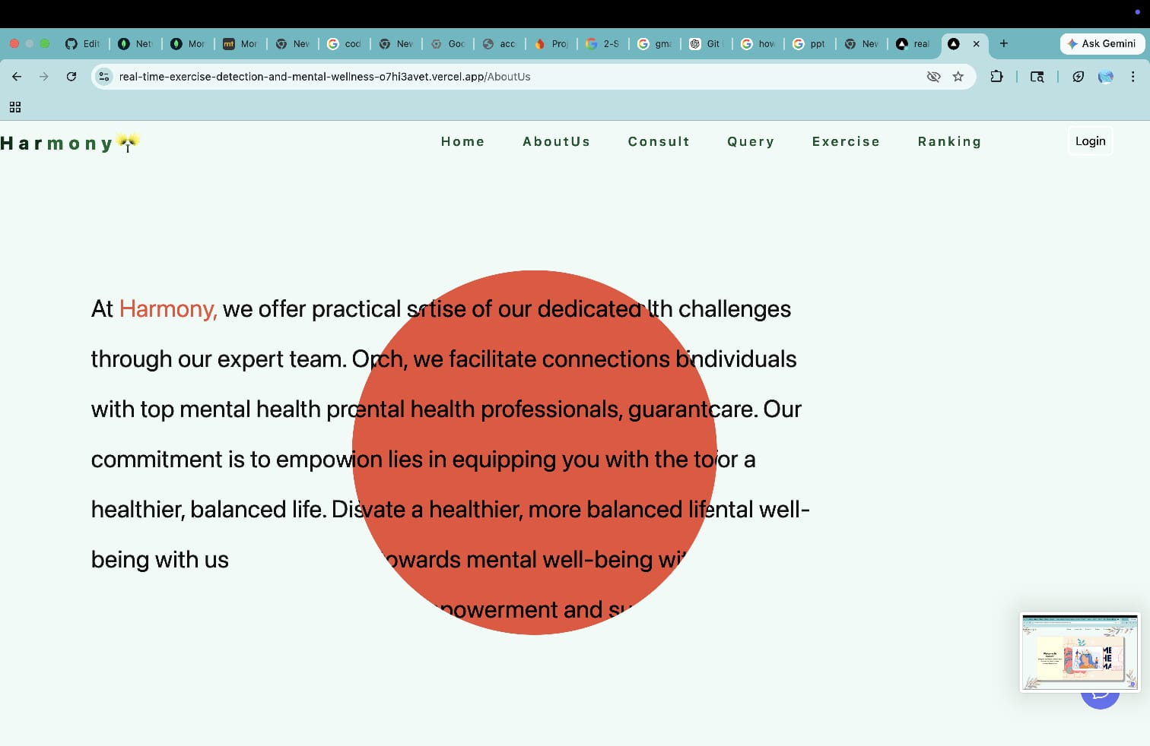
Our Design
User Profile

Slide 16
Future Scope
Project Harmony has strong potential for expansion into a more advanced and intelligent mental health ecosystem.
🤖 AI-Based Mental Health Assistance Integration of AI to provide mood analysis, personalized suggestions, and early detection of mental health issues.
😊 Emotion & Sentiment Analysis Analyze user conversations or inputs to understand emotional states and recommend appropriate support.
📅 Appointment Scheduling System Allow users to book sessions with professionals, set reminders, and manage schedules efficiently.
📱 Mobile Application Development Expand the platform to Android and iOS for better accessibility and user reach.
🌐 Multilingual Support Support multiple languages to make the platform accessible to a wider and diverse audience.

Slide 17
CONCLUSION
Project Harmony successfully presents a comprehensive web-based mental health platform that connects users with qualified mental health professionals while also providing a supportive community environment. By integrating features such as real-time video and voice communication, secure authentication, and a community forum, the platform offers a complete solution for modern mental health needs.
The use of advanced technologies like Next.js, Node.js, Firebase, MongoDB, and Sendbird ensures that the system is scalable, secure, and efficient. It not only enables quick access to professional help but also encourages peer interaction, helping users feel less isolated.
Overall, Project Harmony addresses key challenges in mental healthcare by making support more accessible, reliable, and user-friendly. It has the potential to significantly improve user well-being and can be further enhanced into a more advanced and intelligent mental health ecosystem in the future.

Slide 18
References/Links used
●Project Repository
https://github.com/stoicbrains/Real-Time-Exercise-Detection-and-Mental-Wellness-Recommendation-System-2163-1791-1787-1835-
Documentation
Next.js → https://nextjs.org/docs
Tailwind CSS → https://tailwindcss.com/docs
Framer Motion → https://www.framer.com/motion/
Node.js → https://nodejs.org
Express.js → https://expressjs.com
Firebase → https://firebase.google.com
MongoDB → https://www.mongodb.com
Sendbird → https://sendbird.com

Slide 19


