Slide 1

Akademia Górniczo-Hutnicza im. Stanisława Staszica
Wydział Elektrotechniki, Automatyki, Informatyki I Elektroniki
Katedra Informatyki
Semantic-oriented performance measurement and visualization of distributed applications.
Master's Thesis Defense Presentation
2011 July 18
Tadeusz Kozak
Supervisor Włodzimierz Funika Ph.D

Slide 2
Agenda
Measurements Overview
Motivation & Objectives
SemSimMon Concept
Design & Implementation
Concluding Remarks and Future Work

Slide 3
Motivation
There are many works on the subject
    SCALEA, SCALEA-G
    Semmon, G-PM,
    DIPAS, perfSONAR and more
    All these projects aim at monitoring systems that are highly distributed and operate in a heterogeneous environment
There still is a space for innovation
    All these projects focus on a single technology only
    They are focusing on a single type of applications
    Often are tremendously complex which makes them useful with large application deployments

Slide 4
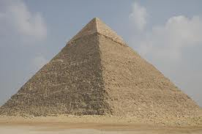
Objectives
To research existing monitoring tools
To design an ontology that will provide an accurate description of the problem domain
To create an measurement system that:
    Works with a variety of target application types
    Uses the ontology designed and others
To provide complete documentation of proposed system

Slide 5
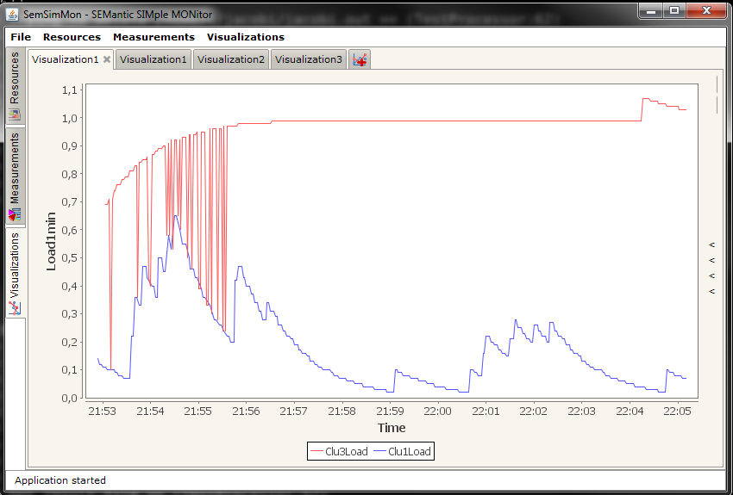
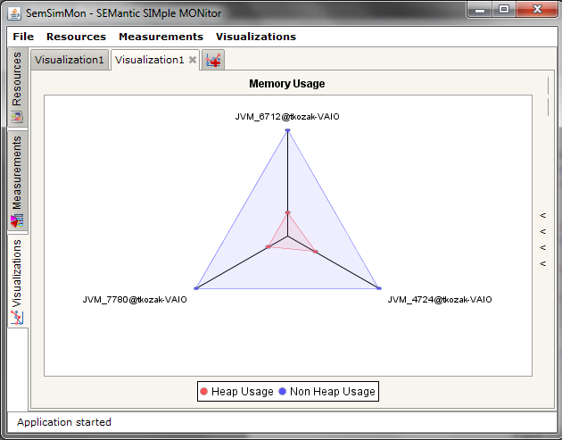
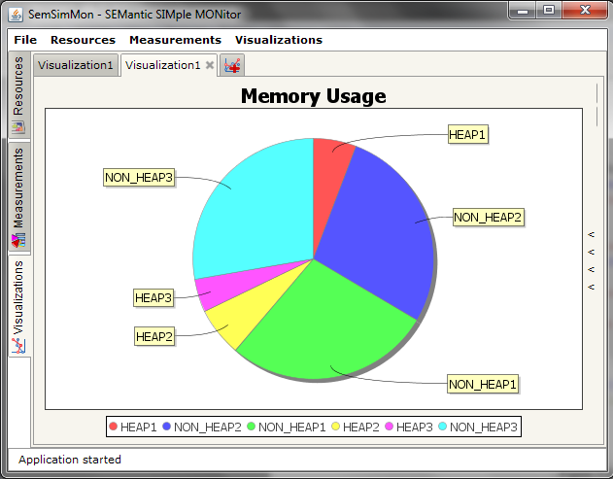
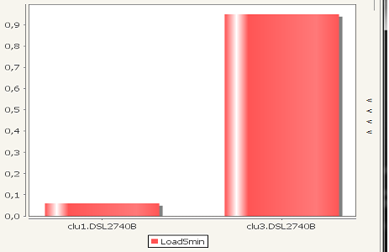
SemSimMon at a glance
A measurement system, covering data gathering and visualization
Uses an ontology to describe the measurement entities (resources, capabilities)
Uses two low-level monitoring platforms:
    OCM-G for MPI-based applications written in C/C++
    JMX for any application created using Java
Provides 4 visualization types:
    Time series plot
    Bar Chart
    Pie Chart
    Spider Web Chart

Slide 6
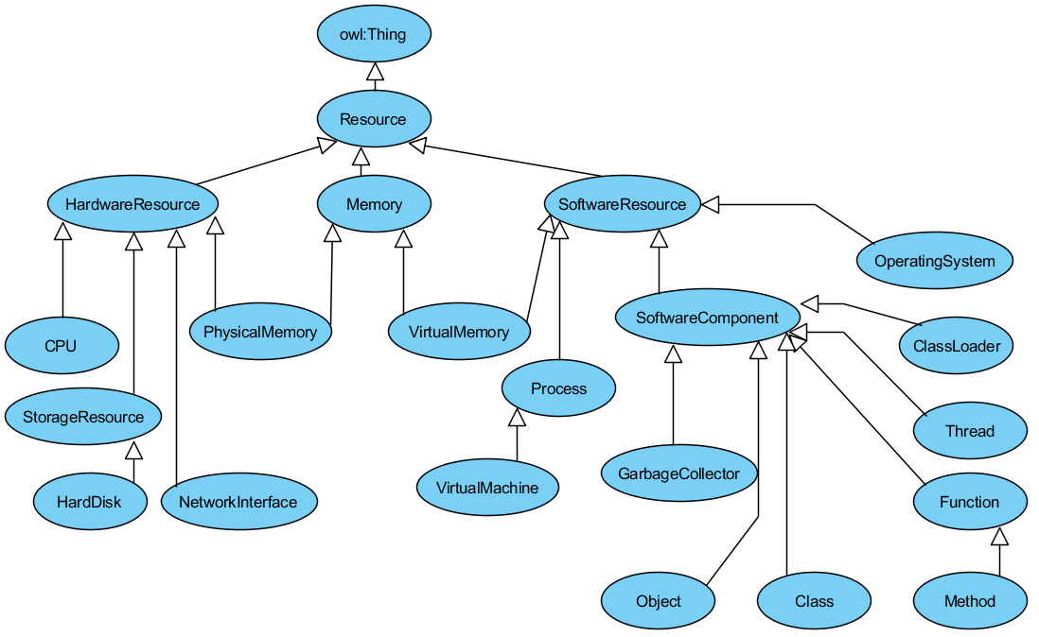
Resources semantics

Slide 7
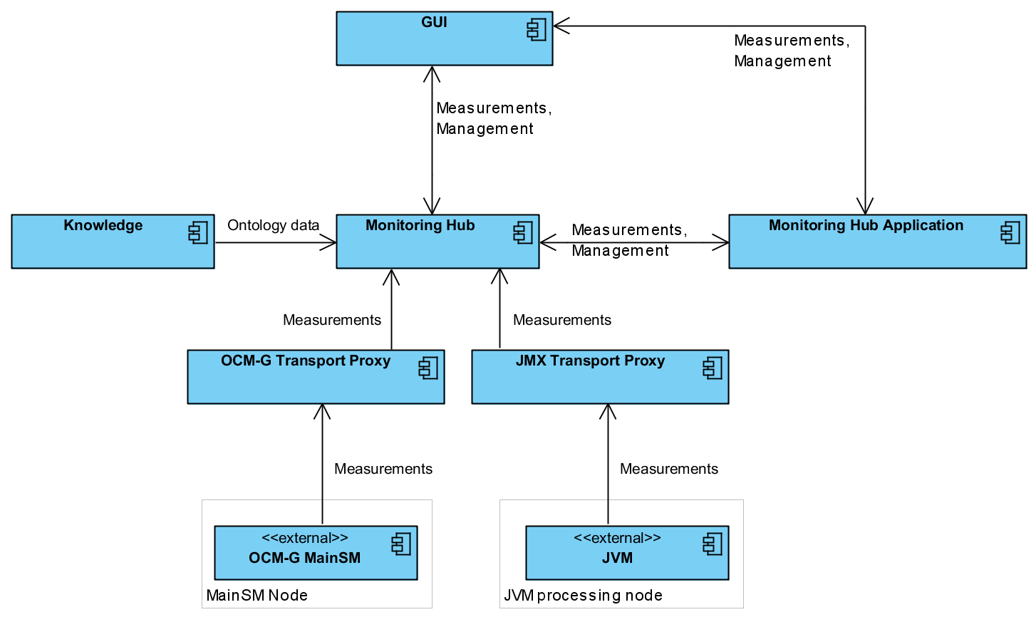
System architecture
Management
Measurements

Slide 8





Implementation notes
System is implemented using the Java platform
User interface is powered by the Apache Pivot
For the ontology management
the Jena framework is employed
All components are wrapped up using the Spring IoC container implementation
Apache Maven is used as a build manager

Slide 9
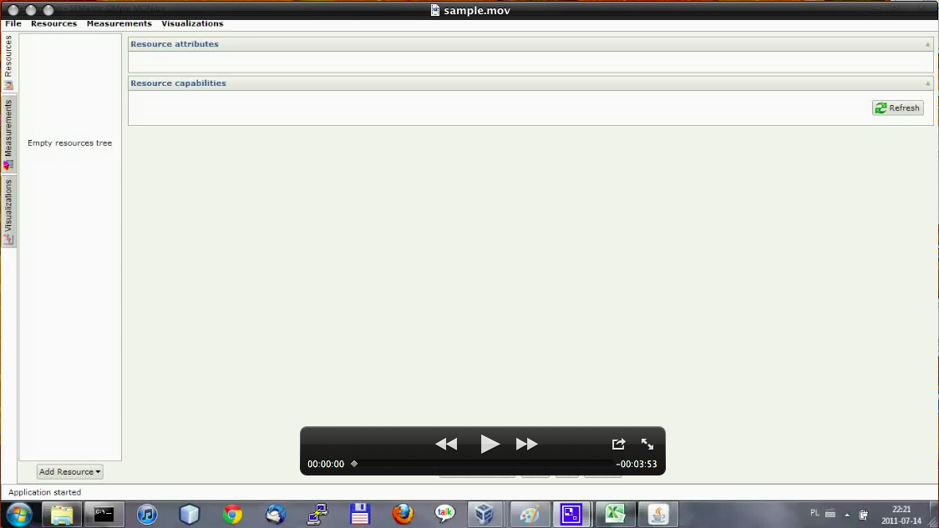
Implementation results
Working with application screencast:

Slide 10
Tests
Application was tested in performance and usability context
Performance test
    3 instances of test application were monitored
    During the test 20 measurements and visualizations were created
    JProfiler was employed to gather SemSimMon components' resources usage data
Usability test
    Covered real-world example of application solving linear systems
    Test application was implemented using J2EE and MPI
    Application was used to evaluate its performance

Slide 11
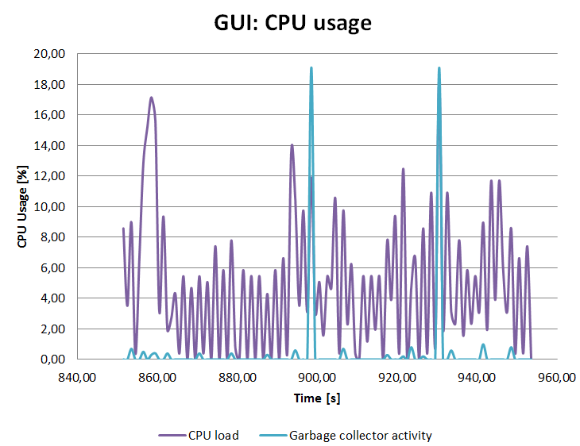
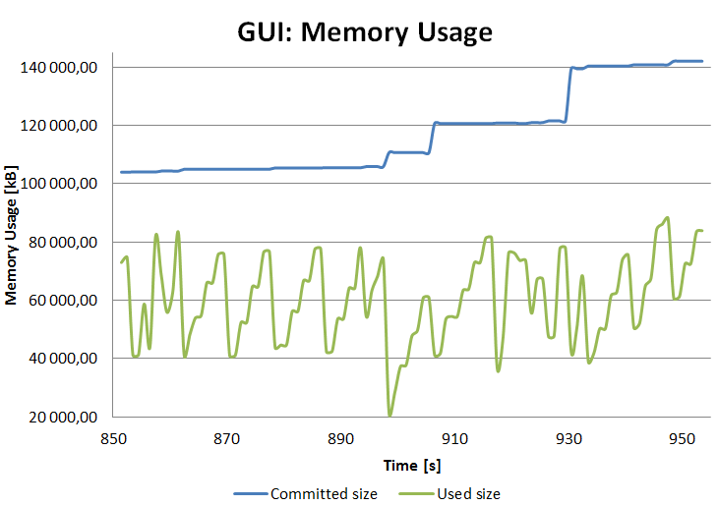
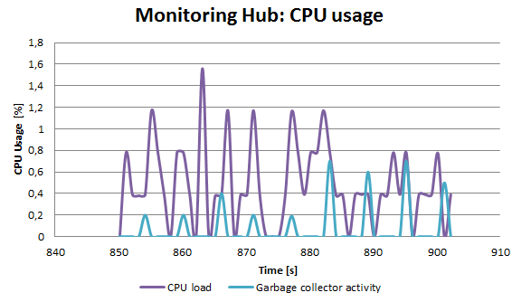
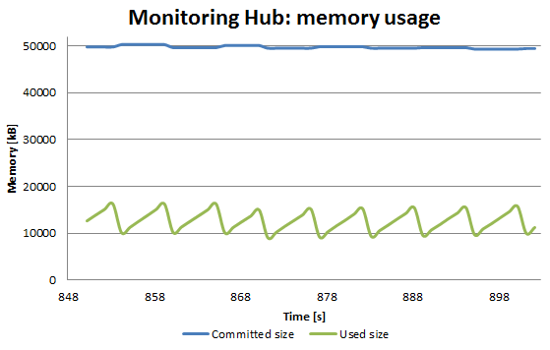
Performance test results

Slide 12
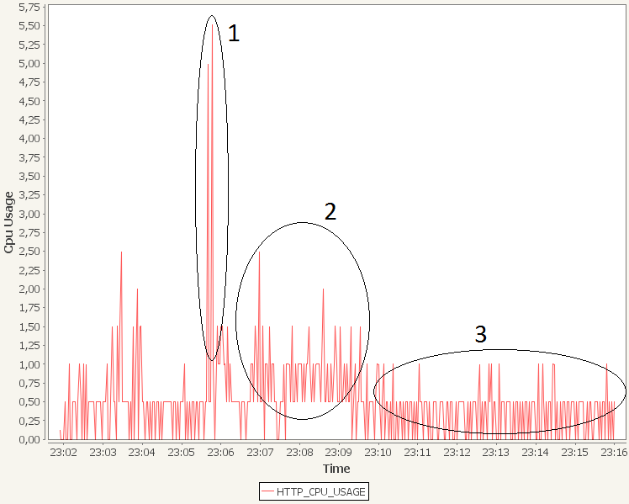
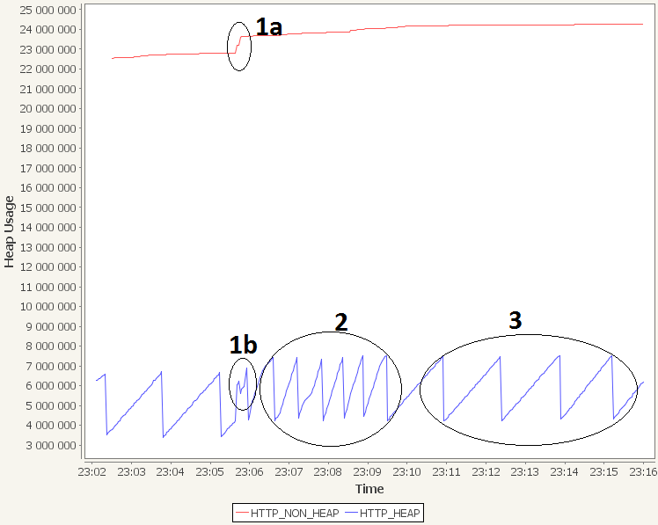
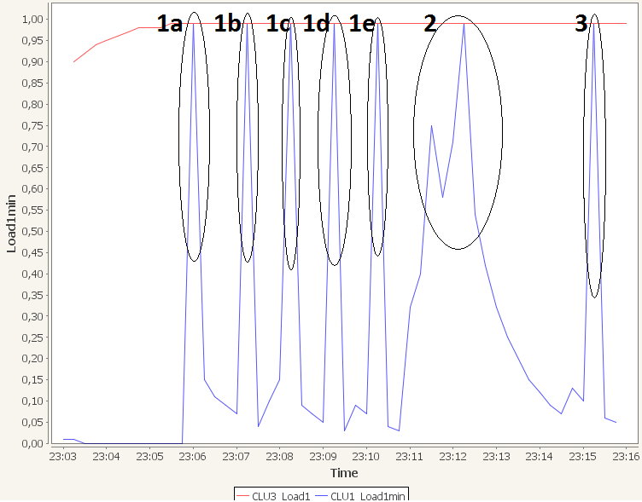
Usability test results

Slide 13
Conclusions
From the design stage
    The Monitoring Hub embedded into GUI simplifies work with smaller applications and should simplify student's work
    Use of the ontology database for storing only the relationships between entities, allowed high performance of measurements.
Regarding technologies used
    Apache Pivot perfectly fits the requirements of the GUI module implementation.
    Apparently OCM-G use should be revised, due to some stability issues that arose during the work.

Slide 14

Future work
Improve the system's semantic
    Add a measurement unit as an attribute of a capability
    Add a probe as an attribute of a capability
Monitor long-running tasks or 24/7 systems
Usability enhancements
    Use SSH for tunneling GUI ↔ Monitoring Hub connection
    Improve bulk operations
    Add persistence of application
    state

Slide 15
Acknowledgments
Master's Examination Committee:
    Renata Słota Ph.D
    Marek Gajęcki Ph.D
    Włodzimierz Funika Ph.D, Adviser
Authors of the original Semmon:
    Piotr Godowski
    Piotr Pęgiel
Authors of the OCM-G

