Slide 1
Alexa Voice and more
Steven Pears
DDD Wales – 24th March 2018

Slide 2
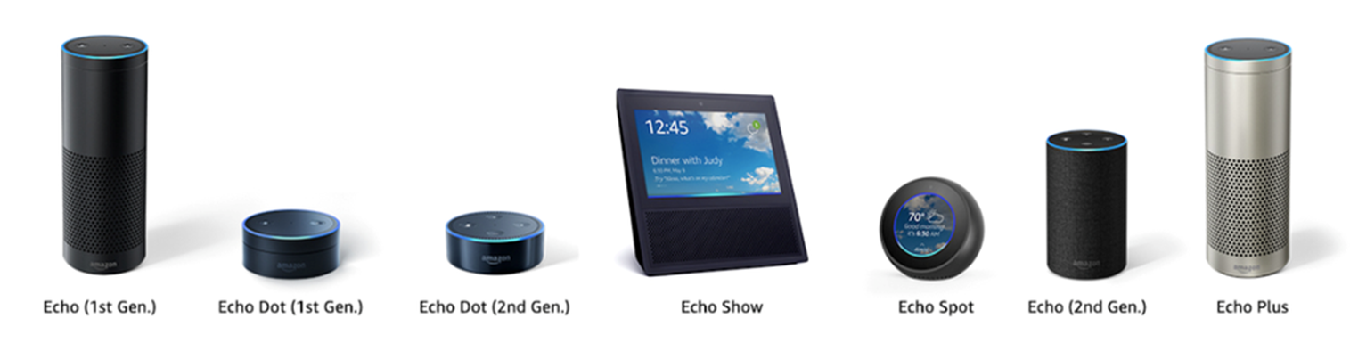
Alexa

Slide 3
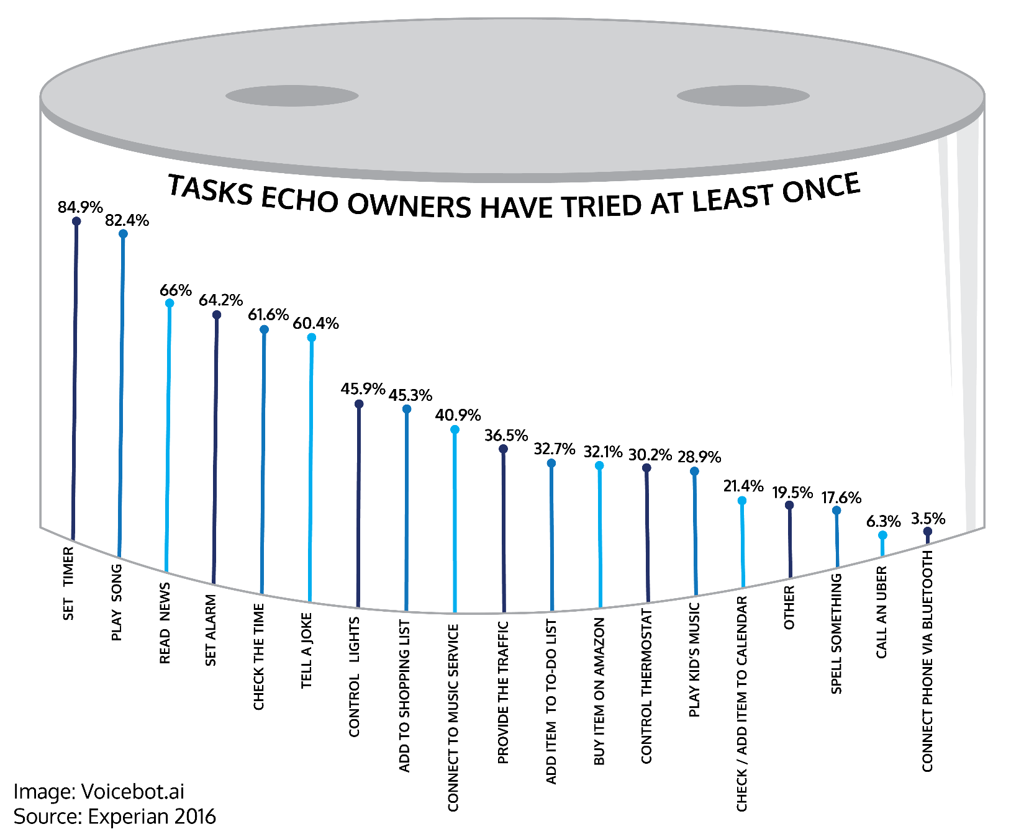
Alexa

Slide 4
About Me
Day Job - AWS / .NET Core
Alexa & Me – 9 Months?

Slide 5
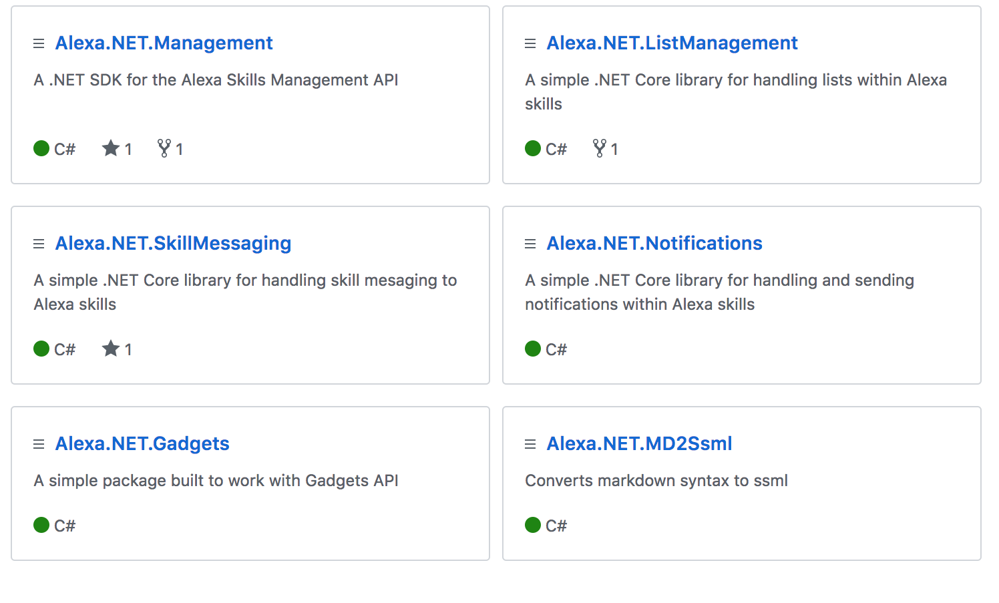
About Me

Slide 6
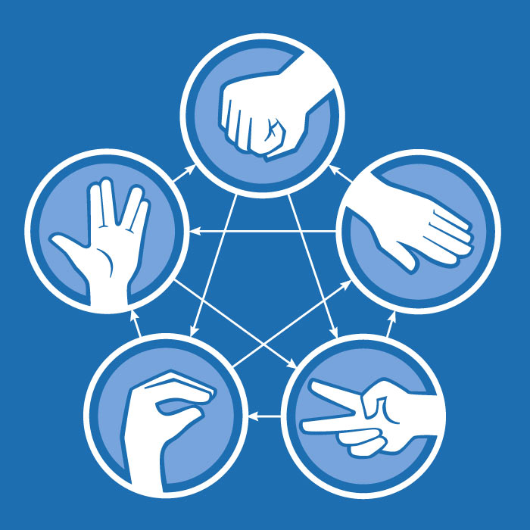
The Client: NoTone Ltd
Big Bang Theory’s
Rock
Paper
Scissors
Lizard
Spock
Image from ThinkGeek.com

Slide 7
Demo 1
Current Skill Overview

Slide 8

Request Lifecycle
{ request }

Slide 9
Request Lifecycle – Request JSON
Request Data
Context
Device Information
User Information
Session State
Session:{},
Context:
{
"version": "1.0",
"session": {
"attributes": {
"key": "string value"
},
},
"context": {
"System": {
"device": {
"deviceId": "string", ….
},
"user": {
"userId": "amzn1.ask.account.[unique-value-here]",
"permissions": {
"consentToken": "ZZZZZZZ..."
}

Slide 10
Request Lifecycle
{ request }
🎉

Slide 11
AWS Lambda
Quicker to get working
Secure by Default
Free!

Slide 12
Alexa.NET
Open Source NuGet
Associated Packages
Active Support

Slide 13
Request Lifecycle
{ request }
🎉
{ response }

Slide 14
Request Lifecycle – Response JSON
Response
Speech
“Card”
Session State
Directives
{
"version": "1.0",
"sessionAttributes": {},
"response": {
"outputSpeech": {
"type": "PlainText",
"text": "Playing the requested song."
},
"directives": [
{
"type": "AudioPlayer.Play",
"playBehavior": "ENQUEUE",
}
}
}

Slide 15
Request Lifecycle
{ request }
🎉
🔊
{ response }

Slide 16
Request Types
Launch Requested
End of Session
Intent

Slide 17
Intents
Utterance
What the user says
Slots (variables)
Names
Numbers
Cities
Custom

Slide 18
Demo 2
Intent – what are the moves?

Slide 19

New Intent – Fake Results
Alexa, ask Developer Wales
To fake some results
Okay. What are Player 1 moves?
{….}
Rock, Paper, Spock
Okay. And Player 2?
{….}
Lizard, Spock, Rock
{….}
Great. Here are the results….

Slide 20
Demo 3
Intent – Debug Results

Slide 21
Expressive Response - SSML
Speech Synthesis Markup Language
Change Speed, Pitch, Emphasis
Audio – MP3
<speak> I want to tell you a secret. <amazon:effect name="whispered">I am not a real human.</amazon:effect>. Can you believe it? </speak>

Slide 22
Demo 4
SSML
Alexa Sound Library

Slide 23
Push Notification - Messages
Every skill has unique credentials to send messages
Can be run from anywhere
Triggers “messageReceived” request against new user

Slide 24
Push Notifications
Messaging
Player 1
Player 2
Intent
MessageReceived
Challenge Set
Send Notification
Token API
Token Client
Notification
Skill Messaging

Slide 25
Demo 5
Skill Messaging
Push Notifications

Slide 26
Gadgets

Slide 27
Gadget Controller
SetLight Directive
Each color change is a step in an animation
Can be triggered or starts straight away

Slide 28
Game Engine
StartInputHandler
Recognisers – What to monitor
Events – When to tell you about it

Slide 29
Game Engine
0s
10s
timeout

Slide 30
Demo 6
Code for Gadget Controller
Code for Game Engine

Slide 31




Thank you!
Any Questions?
github.com/stoiveyp
twitter.com/stevenpears
linkedin.com/in/stevenpears
imacode.ninja

