Slide 1
Alexa Voice and more
Steven Pears
DDD Wales – 24th March 2018

Slide 2
About Me
Work for Experian
Day Job - AWS / .NET Core
Alexa & Me – 9 Months on

Slide 3
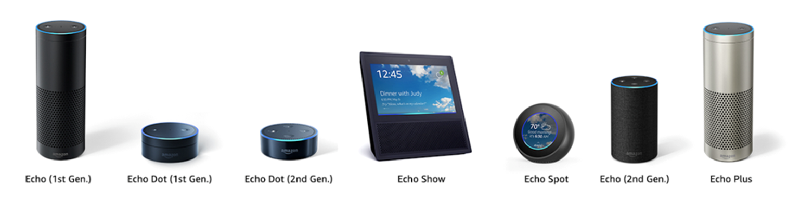
About Alexa

Slide 4
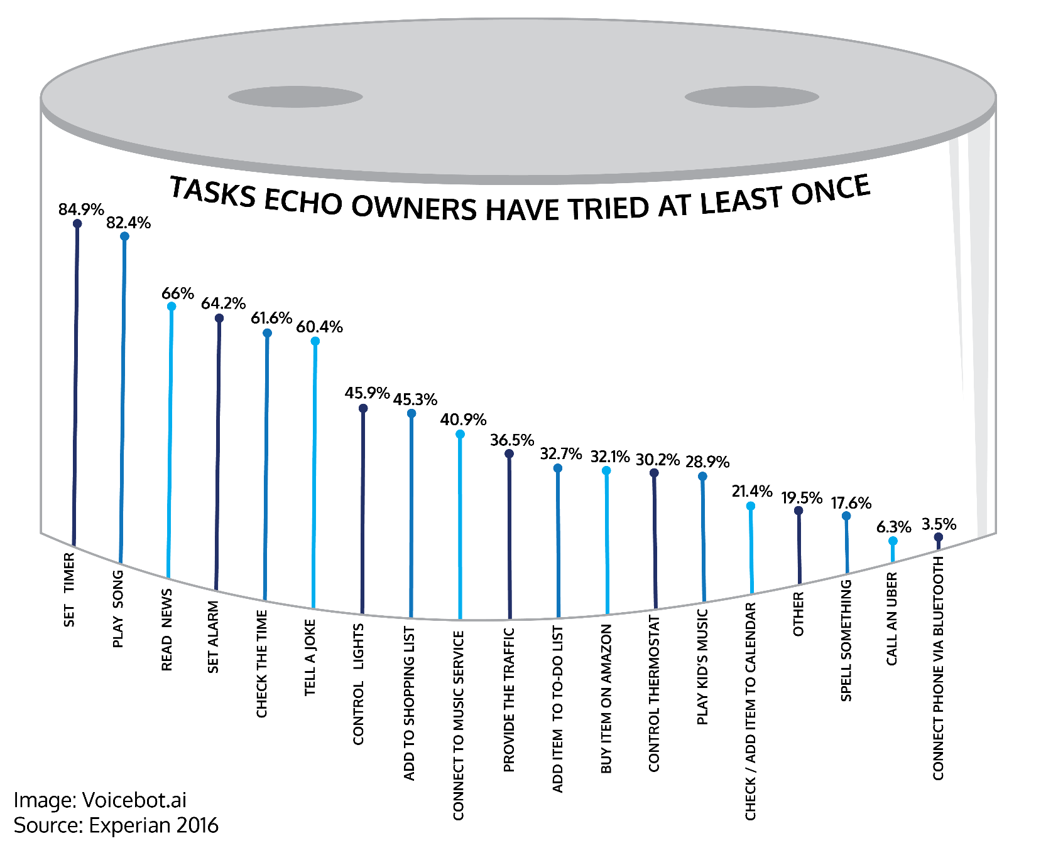
About Alexa

Slide 5
The Client: NoTone Ltd
Spoken to your contract team
Need help with an existing Alexa skill
You’re not a voice first team
Contract team said no problem!

Slide 6
“That would never happen!”
Tech are always consulted

Slide 7
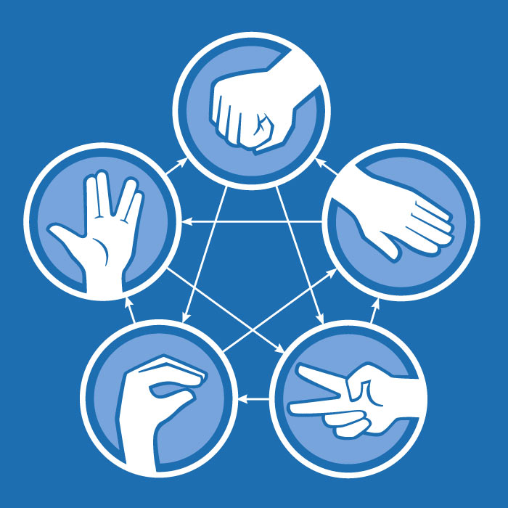
The Client: NoTone Ltd

Slide 8
Demo 1
Current Skill Overview

Slide 9

Request Lifecycle
{ request }

Slide 10
Request Lifecycle – Request JSON
{
"version": "1.0",
"session": {
"attributes": {
"key": "string value"
},
},
"context": {
"System": {
"device": {
"deviceId": "string", ….
},
"user": {
"userId": "amzn1.ask.account.[unique-value-here]",
"permissions": {
"consentToken": "ZZZZZZZ..."
}
},
Request:{} …..

Slide 11
Request Lifecycle
{ request }
🎉
🔊
{ response }

Slide 12
Request Lifecycle – Response JSON
{
"version": "1.0",
"sessionAttributes": {},
"response": {
"outputSpeech": {
"type": "PlainText",
"text": "Playing the requested song."
},
"directives": [
{
"type": "AudioPlayer.Play",
"playBehavior": "ENQUEUE",
}
}
}

Slide 13
AWS Lambda
Quicker to get working
Secure by Default
Free!

Slide 14
Alexa.NET
Open Source NuGet
Associated Packages
Active Support

Slide 15
Request Types
Launch Requested
End of Session
Intent

Slide 16
Intents
Utterance
What the user says
Slots (variables)
Names
Numbers
Cities
Custom

Slide 17
Demo 2
Intent – what are the moves?

Slide 18

New Intent – Fake Results
Alexa, ask Developer Wales
To fake some results
Okay. What are Player 1 moves?
Rock, Paper, Spock
Okay. And Player 2?
Lizard, Spock, Rock
Great. Here are the results….

Slide 19
Demo 3
Intent – Debug Results

Slide 20
Expressive Response
SSML – Speech Synthesis Markup Language
Change Speed, Pitch, Emphasis
Audio - Amazon Sound Library

Slide 21
Skill Messaging
Client details in developer console
Can be run from anywhere
Triggers “messageReceived” request against new user

Slide 22
Skill Messaging
Intent
Player 1
Challenge Set
MessageReceived
Token Client
Messaging
Token API
Skill Messaging

Slide 23
Push Notifications

Slide 24
Gadgets

Slide 25
Gadget Controller

Slide 26
Game Engine

Slide 27




Thank you!
Any Questions?
github.com/stoiveyp
twitter.com/stevenpears
linkedin.com/in/stevenpears
imacode.ninja

