Slide 1
Alexa Voice and more
Steven Pears
DDD Wales – 24th March 2018
Notes:
Do questions – who owns, who uses?

Slide 2
About Me
Day Job - AWS / .NET Core
Alexa & Me – 9 Months?
Notes:
Not exactly known for being cutting edge but…
AWS Partners
9 Months ago – sister’s fault

Slide 3
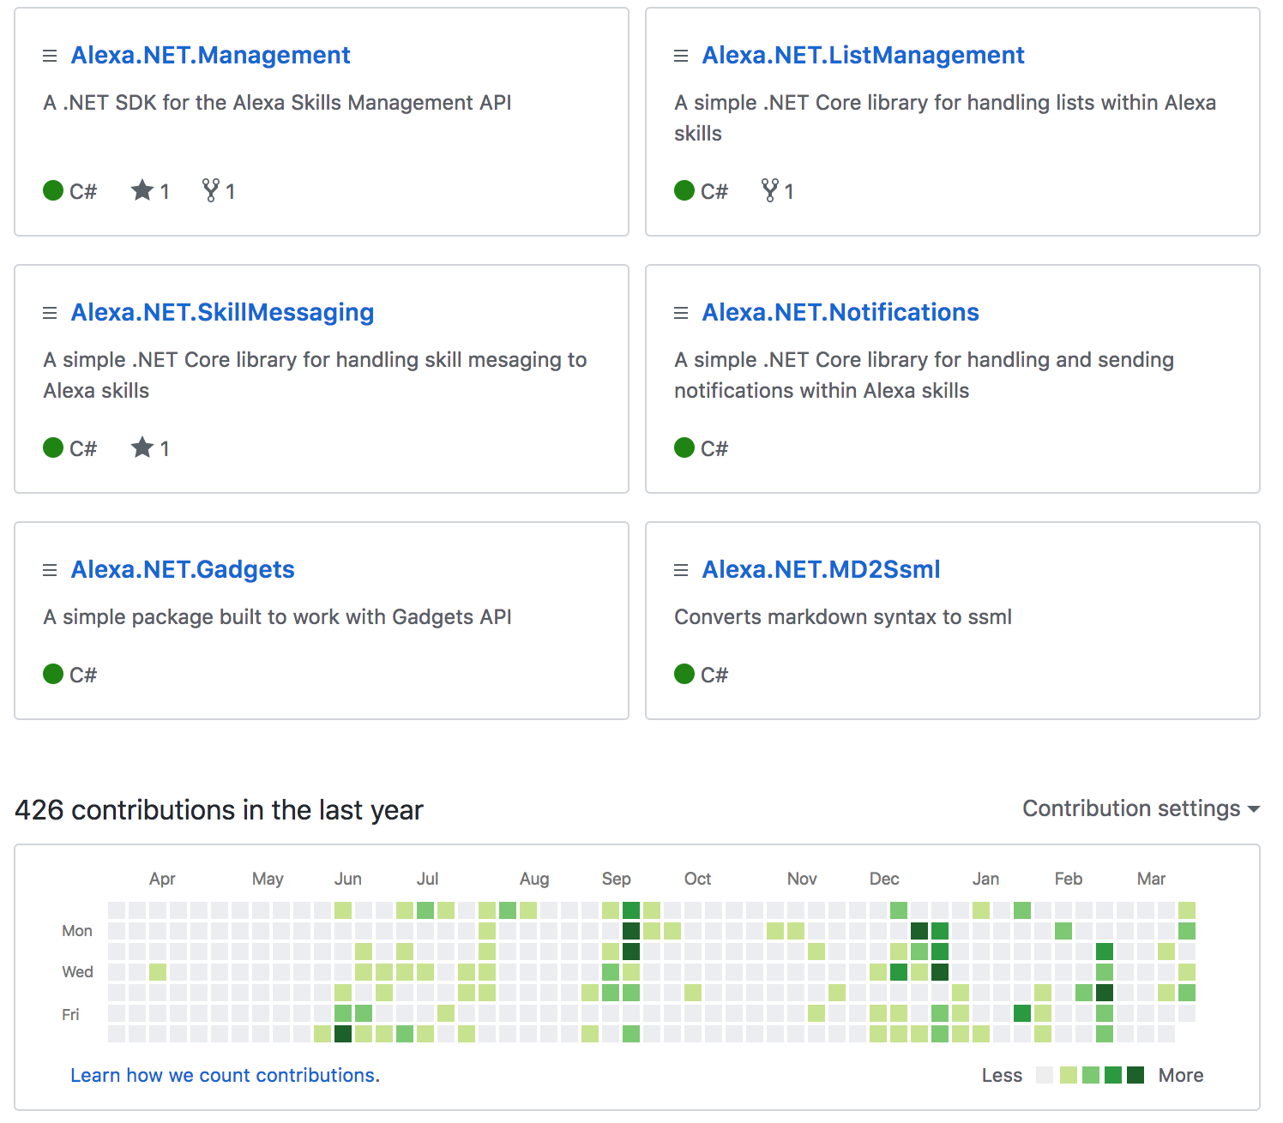
About Me

Slide 4
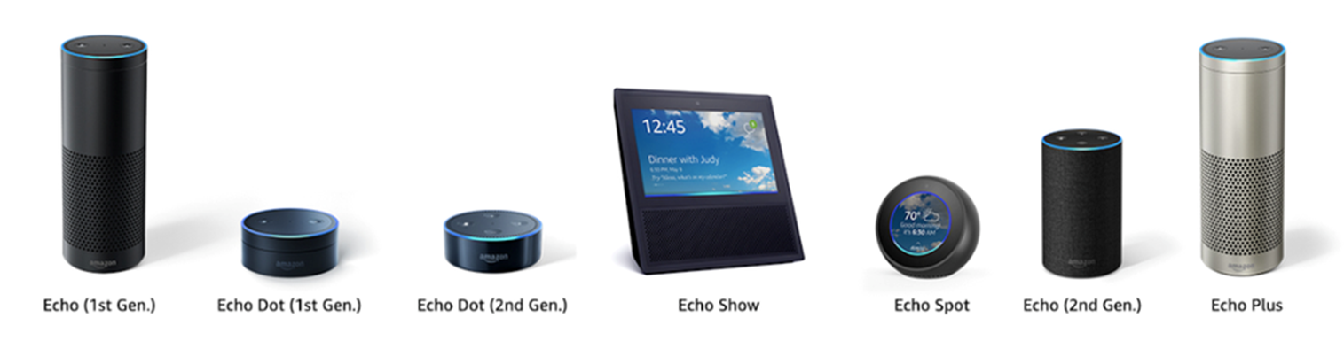
About Alexa

Slide 5
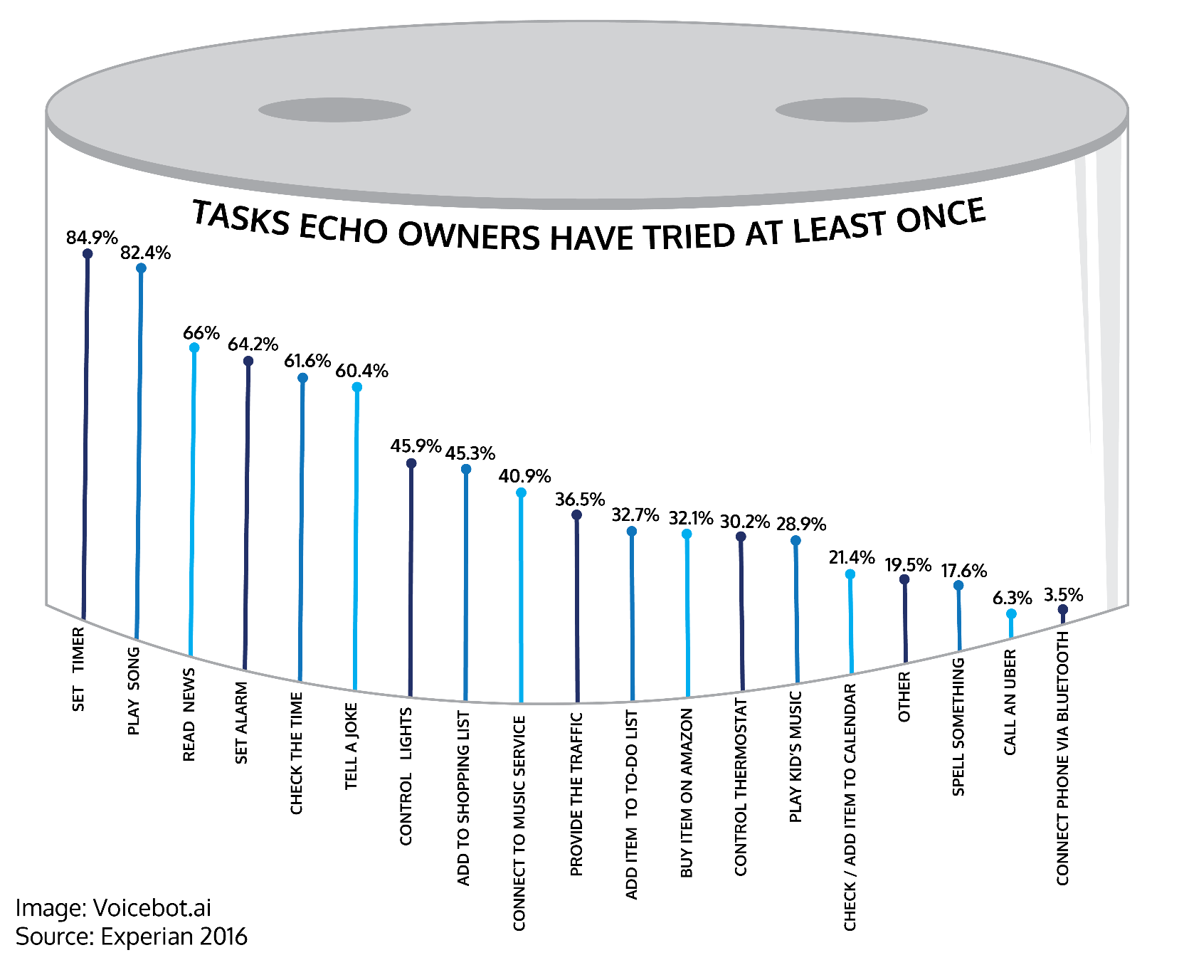
About Alexa

Slide 6
The Client: NoTone Ltd
Spoken to your contract team
Need help with an existing Alexa skill
You’re not a voice first team
Contract team said no problem!

Slide 7
“That would never happen!”
Tech are always consulted

Slide 8

The Client: NoTone Ltd
Big Bang Theory’s
Rock
Paper
Scissors
Lizard
Spock
Image from ThinkGeek.com

Slide 9
Demo 1
Current Skill Overview

Slide 10
AWS Lambda
Part of Amazon Serverless offering
Quicker to get working
More secure by default
Free!

Slide 11

Request Lifecycle
{ request }

Slide 12
Request Lifecycle
{
"version": "1.0",
"session": {
"attributes": {
"key": "string value"
},
},
"context": {
"System": {
"device": {
"deviceId": "string", ….
},
"user": {
"userId": "amzn1.ask.account.[unique-value-here]",
"permissions": {
"consentToken": "ZZZZZZZ..."
}
},
Request:{} …..

Slide 13
Request Lifecycle
{ request }
🎉
🔊
{ response }

Slide 14
Request Lifecycle
{
"version": "1.0",
"sessionAttributes": {},
"response": {
"outputSpeech": {
"type": "PlainText",
"text": "Playing the requested song."
},
"directives": [
{
"type": "AudioPlayer.Play",
"playBehavior": "ENQUEUE",
}
}
}
Response JSON

Slide 15
Alexa.NET
Open Source NuGet
Associated Packages
Active Support

Slide 16
Request Types
Launch Requested
End of Session
Intent

Slide 17
Intents
Utterance
What the user says
Slots (variables)
Names
Numbers
Cities
Custom

Slide 18
Demo 2
Intent – what are the moves?

Slide 19

New Intent – Fake Results
Alexa, ask Developer Wales
To fake some results
Okay. What are Player 1 moves?
{….}
Rock, Paper, Spock
Okay. And Player 2?
{….}
Lizard, Spock, Rock
{….}
Great. Here are the results….

Slide 20
Demo 3
Intent – Debug Results

Slide 21
Expressive Response - SSML
Speech Synthesis Markup Language
Change Speed, Pitch, Emphasis
Audio – MP3
Alexa Sound Library
<speak> I want to tell you a secret. <amazon:effect name="whispered">I am not a real human.</amazon:effect>. Can you believe it? </speak>

Slide 22
Demo 4
SSML
Alexa Sound Library

Slide 23
Push Notification - Messages
Every skill has unique credentials to send messages
Can be run from anywhere
Triggers “messageReceived” request against new user

Slide 24
Push Notifications
Messaging
Player 1
Player 2
Intent
MessageReceived
Challenge Set
Send Notification
Token API
Token Client
Notification
Skill Messaging

Slide 25
Demo 5
Skill Messaging
Push Notifications

Slide 26
Gadgets

Slide 27
Gadget Controller
SetLight Directive
Each color change is a step in an animation
Can be triggered or starts straight away

Slide 28
Game Engine
StartInputHandler
Recognisers – What to monitor
Events – When to tell you about it

Slide 29
Game Engine
0s
10s
timeout

Slide 30
Demo 6
Code for Gadget Controller
Code for Game Engine

Slide 31




Thank you!
Any Questions?
github.com/stoiveyp
twitter.com/stevenpears
linkedin.com/in/stevenpears
imacode.ninja

