Slide 1
Alexa Voice and more
Steven Pears
DDD Wales – 24th March 2018

Slide 2
About Me
Work for Experian
AWS / .NET core
Alexa & Me – 9 Months on

Slide 3
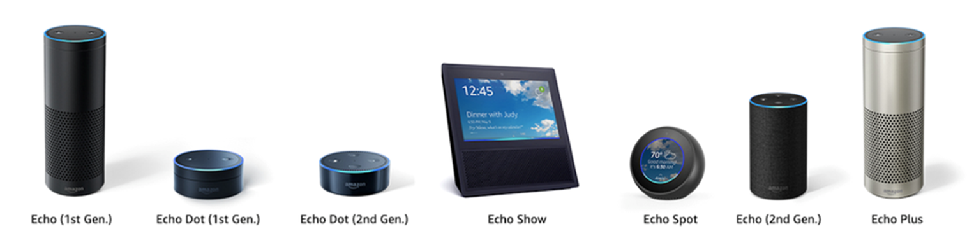
About Alexa

Slide 4
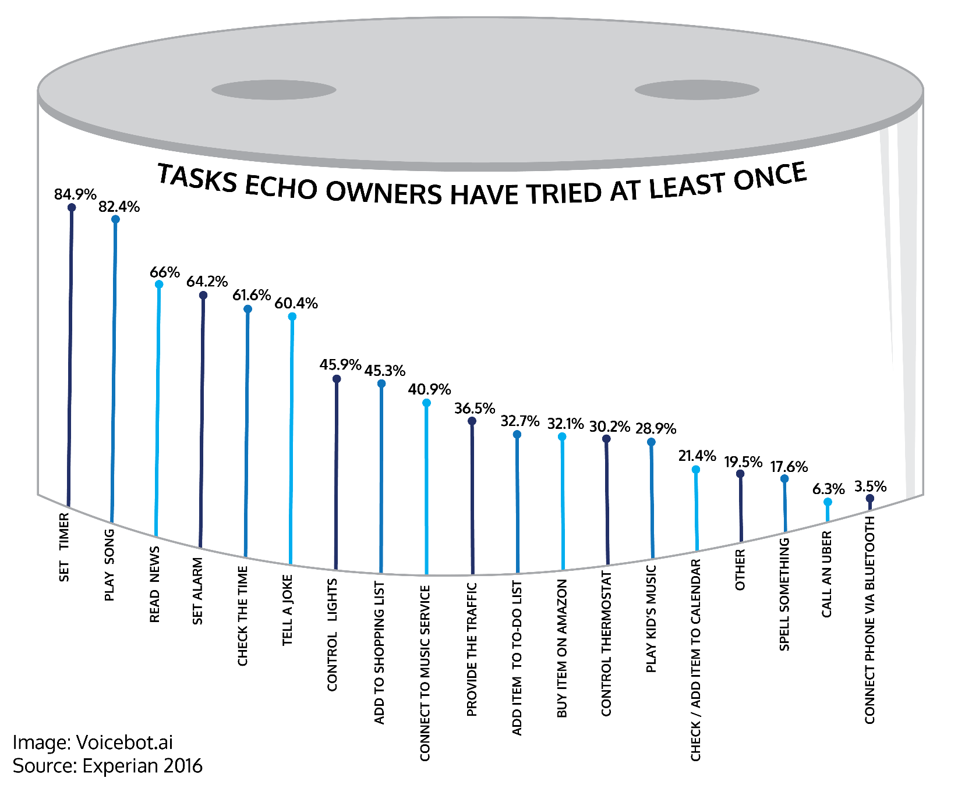
About Alexa

Slide 5

Request Lifecycle
{ request }
🎉
🔊
{ response }

Slide 6
The Contract: NoTone Ltd

Slide 7
Expressive Response

Slide 8
Push Notifications

Slide 9
Skill Messaging

Slide 10
Gadgets

Slide 11
Gadget Controller

Slide 12
Game Engine

Slide 13




Thank you!
Any Questions?
github.com/stoiveyp
twitter.com/stevenpears
linkedin.com/in/stevenpears
imacode.ninja

