Slide 1
Welcome
To code along -you will need
Visual Studio (community edition at https://www.visualstudio.com )
AWS Toolkit ( VS -> https://aws.amazon.com/visualstudio/ )
Accounts with:
AWS : https://aws.amazon.com
Amazon Dev: https://developer.amazon.com

Slide 2


Conversations with Alexa
stevenpears
linkedin.com/in/stevenpears/

Slide 3
Agenda
Introduction
Simple Functionality
Conversation
Advanced / Tips

Slide 4
About Me
.NET Developer
Regular Expression Enthusiast
Alexa is not my day job

Slide 5
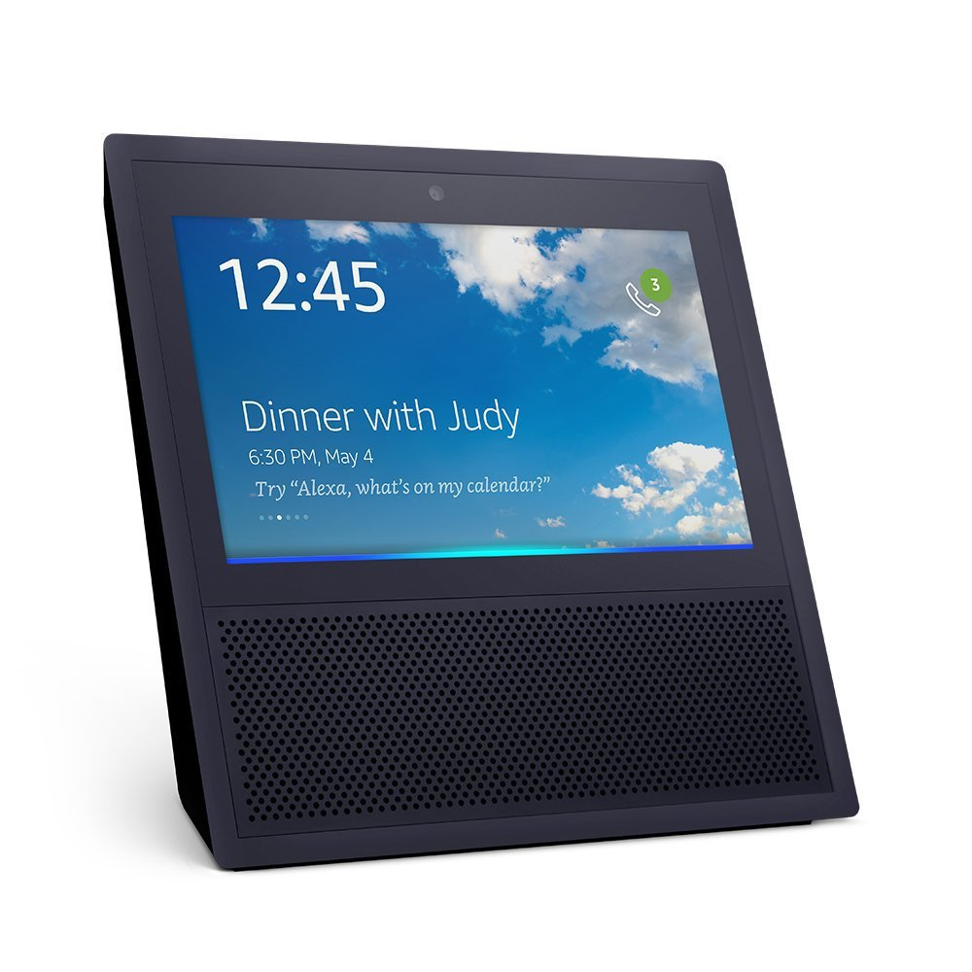
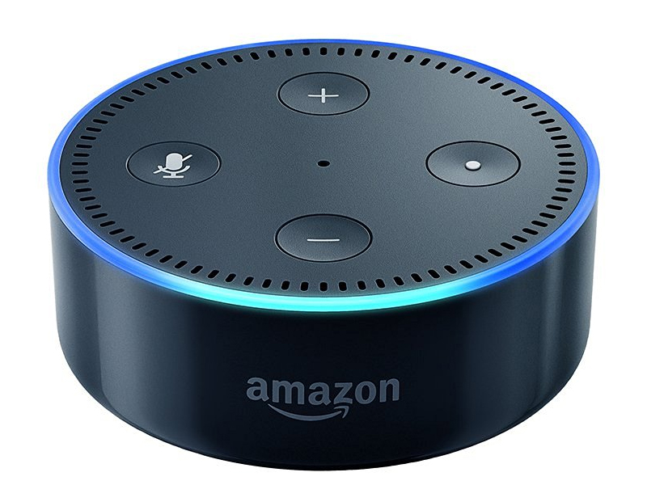


Who is Alexa?

Slide 6
What does she do?

Slide 7
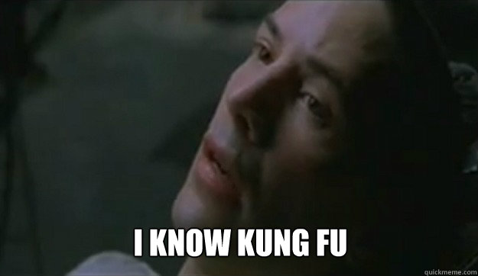
Skills

Slide 8
Skills - How do they work?
🗣
{ request }
🎉
🔈
{ response }

Slide 9
Skills - Options
Web API
Can use existing infrastructure
Verify signed requests
AWS Lambda
Less infrastructure to manage
Restricted Access

Slide 10
Flip a Coin - Stage #1
Goals
Empty working Lambda
Add Alexa Request/Response
Notes:
First skill – flip a coin

Slide 11
Skills – Requests
Request Types
Launch
SessionEnded
Intent
Notes:
How do we know what the user is trying to do?
Request object is used for that reason and is strongly typed
Launch – User runs your skill.
SessionEnded – sent when the user session is completed, allows you to clean up if needed
What happens when you ask a skill to do something?
Intent – the user asked your skill to perform a specific action.

Slide 12
Skills - Intents
Not what the user said, but what they want.
Built in Intents
Help
Stop / Cancel
Notes:
Doesn’t give you the words, they’re kept in the config
Means you can change the language without changing the code!

Slide 13
Flip a Coin - Stage #2
Goals
Skill Setup
Launch Request
Custom Intent

Slide 14
Slots
Variables within utterances
Shown as name in braces “{name}”

Slide 15
Slot Types
Built-In Types, including
Number
City
First Name
Custom Types

Slide 16
Session State
Dictionary of objects
Attached to each request
Sent back in every response

Slide 17
Higher or Lower – Stage #1
Goals
Skill with a single intent
Custom slot – higher/lower
Store previous value in session
Store total correct in session

Slide 18
Voice - SSML
Synthesized Speech Markup Language
Only a dictated subset
Use Speech object

Slide 19
Cards
Allows a skill to push data to a user device
Pre-determined format
Title & Text
Title, Text & Image

Slide 20
Higher or Lower – Stage #2
Goals
Make Alexa sound more excited
Put each correct answer in a card
Put the total in a card

Slide 21
Identity
UserId
Unique per installation
AccessToken
OAuth 2 Access Token (if available)
Can prompt using LinkAccountCard

Slide 22
Tips
If in doubt, leave it out
Rely on the user asking for help
Validate Input
Slot types are not guaranteed input
Use the docs!
https://developer.amazon.com/alexa

Slide 23
Thank you!
For more information go to imacode.ninja/github

