Slide 1

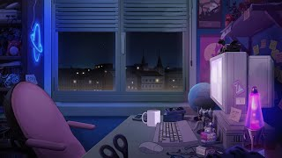
Intro to
Programming
With python
Fundamentals:
Programming IRl
Friday, February 7 2024 TOH210
Notes:
Layout objects pulled from: https://slidesgo.com/
All icons are from: https://thenounproject.com/

Slide 2
Colab workbook
Overview + how to fill out workbook
Link: click for access
These are our class notes. They allow us to run code chunks and type in text (sort of like a Word doc that lets you also code)
These are NEVER due. They help to solidify your learning, so make sure to complete them outside of class if we don’t finish them during.

Slide 3





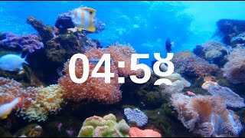
Once you’ve discussed, have some folks add answers to the board for concerning vs improving
Warm up
Well at least it won’t scare off all our customers
Ummm yeah is no one else concerned about this?
Noble bean cafe
>>pls i can help!
Grumpy barista
Terminal
Duke of decaf
Notes:
Warmup: Nestled amidst downtown's skyscrapers and bustling streets, Noble Bean Cafe was renowned citywide for its exquisite espresso drinks, each cup a carefully curated masterpiece. However, behind the counter, a group of baristas with personalities as bold as the espresso they served awaited patrons, greeting them not with smiles but with raised eyebrows and barely concealed sighs of impatience, immersing customers in their cantankerous drama. Frustrated by this, the shop's owner, the Duke of Decaf, resolved to effect change. A new automated order terminal has been on the market for a bit and the Duke is keen to see it used in Noble Beans Cafe. What aspects could be concerning when replacing a barista with an ordering terminal? Besides avoiding the death glares of the baristas, what are some ways that this terminal could improve the cafe?
Goal: show which things programs are good at, what they could improve upon. Show students the importance of brainstorming and prioritizing solutions. Should have a takeaway similar to “before we can add all the improvements, we need to make sure it works for our initial goal which was to allow the customers to not interact with the baristas”

Slide 4
Discuss with your group, taking notes as you go. Once you’ve discussed, have some folks add answers to the board for what you can do with CS, and one person answer what CS is.
Discussion
Yeah! And what can you do with it?
Sooo what is computer science then?
Noble bean cafe
>>lemme tell ya
Grumpy barista
Terminal
Duke of decaf
Notes:
Discussion:
What is computer science?
What does a computer scientist do?

Slide 5

>>computer science involves working with people to use computers to solve problems
Notes:
Definition of CS

Slide 6


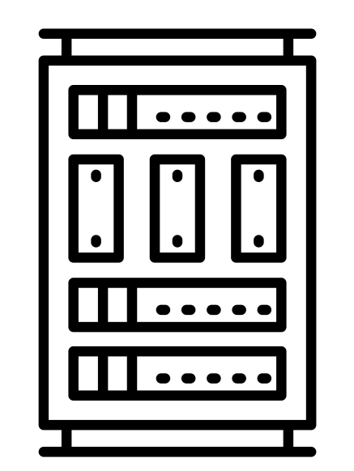






Graphics
game design +
GIS
= virtual reality
Operating system
connected +
parallel
= cloud computing
architecture
supercomputers + parallel computing
= weather forecasting
Human-Computer interaction
NLP+
voice recognition
= virtual assistant
>>computer science involves working with people to use computers to solve problems
Computational science
simulation+
scientific method
= molecular
structure
Web design
website +
software
= social media
Information storage
optimization +
large datasets
= big data
Artificial intelligence
image classification +
EMR
= disease diagnosis
Security
encryption +
data
= cryptography
Notes:
Programming IRL
Computer security (protection against threats): encryption(scramble) + data → cryptography
Computer architecture (optimize hardware): supercomputers + parallel computing → weather forecasting
Computational science (numerical solutions to scientific questions): simulation + modeling → protein folding
Computer graphics (generating and animating images): game design + real world maps → virtual reality
Web design: website + software → social media
Operating system (manages hardware and interacts with apps): interconnected computers + OS →cloud computing
AI (programs that can perform human tasks): image classification + electronic medical records → disease diagnosis
Information storage (databases): optimization + lots of data → big data
Human-Computer interaction (designing with humans in mind): natural language processing + voice recognition → virtual assistant

Slide 7
Discussion
What makes up
a computer?
What are some of the various components of a computer? If you were to build a computer, what would you need to source to do so?

Slide 8






Main components of computer hardware
Hardware is the physical parts of a computer and all work in tandem to run your machine. As computers grow smaller and smaller, hardware components have to scale appropriately by decreasing their size, generating less heat, and using less power.
Output devices show results of processor’s alterations, similar to how you speak/act after deciding what to do
memory stores data
Input devices gather data, similar to your eyes/ears
processors examine/alter data, similar to your brain

Slide 9



A computer’s system is broken down into two categories: hardware and software
Hardware are the visible components, and software are the sets of instructions which manage and/or allow the hardware to perform tasks. In other words, software are where algorithms live.
Output devices
memory
user
processors
uses
Input devices
hardware
uses
uses
applications
Operating system
last summer’s airport fiasco was due to bug at this stage, some place only a technician could fix
software

Slide 10
Discuss with your group, taking notes as you go. Once you’ve discussed, have two people add at least two answers to the board.
Discussion
How do we get better at things?
Think of something you’re good at. How did you to where you are at now?

Slide 11






Code a lot
practice makes perfect
(or at least proficient)
Have fun!
be patient with yourself
and enjoy the journey
Break your code
throw in weird values and see
what happens, or try rewriting
Be inquisitive
read up on current events in the CS
space, or watch some live coding
How to master programming
ask others
check in with peers to see how they approach a task. seeing how different people problem solve is a great way to boost your own knowledge base!
Notes:
More details in later slide (hidden)

Slide 12

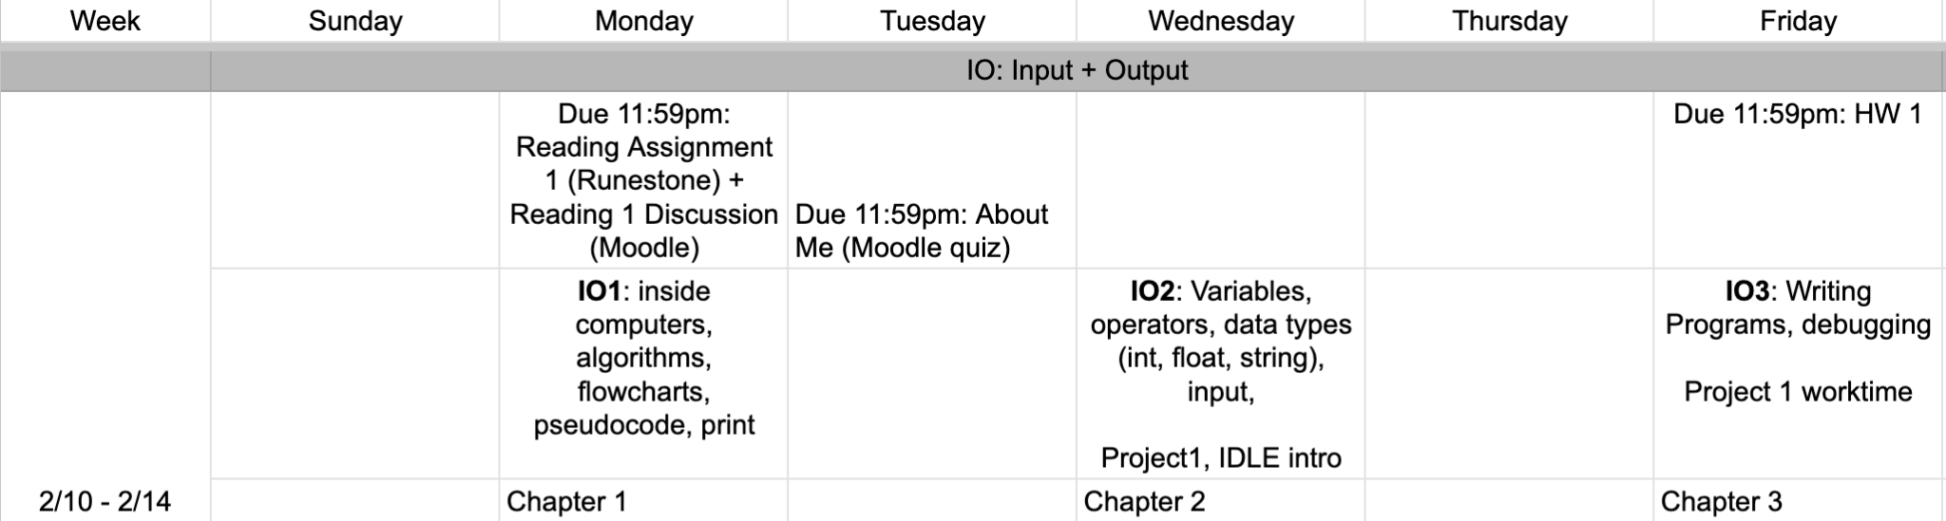
upcoming schedule
google sheet link

Slide 13

before next time
Finish workbook (not graded)
Reading + Reflection 1 due Monday at midnight
About Me due Tuesday at midnight
workbook Time!
Notes:
There is another definition of the learning zone that is related to what we have been talking about. In this amazing TED talk: How to get better at the things you care about, Eduardo Briceño talks about the “performance zone” versus the “learning zone.” Please watch it.
The big takeaway for you is that as a student in a classroom using this text, you are in the learning zone as Briceño defines it. You are not being judged or graded for how quickly you arrive at an answer or not. The classroom for this course is a time for you to practice old skills, try new skills, and to fail without repercussions; that is how we learn! You will spend a huge amount of the rest of your life in the performance zone, so take advantage of this opportunity and enjoy the chance to be in the learning zone.
If you find yourself in the panic zone, please seek help from your instructor and/or classmates. None of the activities in the book or examples are intended to stump you. As you understand how to solve some simpler problems, you will develop the ability to join these solutions together to solve increasingly challenging problems with real-world applications.

