Slide 1


Intro to
Programming
With python
iteration:
accumulator patterN
Monday, Mar 3 2025 TOH210
Quiz 1 rewrites due! Hand in at the front
Notes:
Layout objects pulled from: https://slidesgo.com/
All icons are from: https://thenounproject.com/

Slide 2
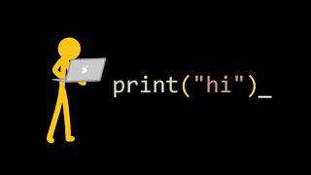
watch the whole video here

Slide 3
accumulator
colab workbook
click for access
found on Moodle under this week

Slide 4


Slide 5

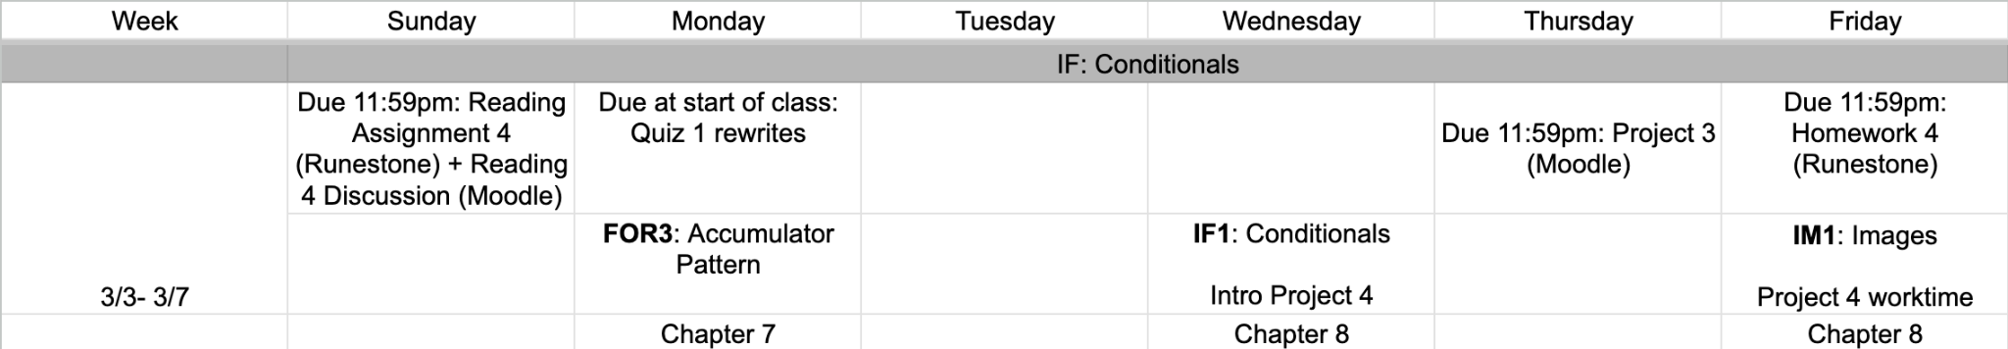
upcoming week
google sheet link

Slide 6
Working in a group
Plan meetings: meet up at least twice this week. I’d recommend once today and once Wednesday.
Task Delegation: decide if working together on each task (recommended), or if splitting up tasks.
Submission: plan who is submitting the work ahead of time.
Collaboration: share any work via Google Drive or email or colab (whichever is easiest)
Project 3
sign up due tonight!
see project overview for links

Slide 7
Takeaways from last time
Things you should know:
iterator variable either index and item
which iterates on either lists or strings
range offers multiple options to iterate through these sequences

Slide 8
recap
numbers_list = [1, 1, 2, 3, 5, 8, 13]
Product of numbers
total_product = 1
for number in numbers_list:
total_product = total_product * number
print(total_product)
sum of Even indices
total_sum = 0
for index in range(0, len(numbers_list), 2):
total_sum = total_sum + numbers_list[index]
print(total_sum)

Slide 9
recap
Reverse strings
accumulator Pattern
color_string = "pink orange green brown"
length = len(color_string)
reversed_string = “”
for index in range(length-1, -1, -1):
reversed_string = reversed_string + color_string[index]
print(reversed_string)
We can also accumulate to a string, using concatenation

Slide 10
our empty list
squared numbers
accumulator Pattern
square_list = []
for number in range(1,101):
square_list.append(number**2)
print(square_list)
number grabs values starting at 1 up to 100 (does not include 101)
We can also create new lists with this pattern by using the list method append
for each number 1 - 100, append its square to our list
[1, 4, 9, 25, 36, …, 10000]
Can also be done this way, but less efficient:
square_list = square_list + [number **2]

Slide 11


Practice
This is helpful for Project 3!
Name score
For any word, we can compute its "word score". Each letter has a point value : a -0pts b- I pt c- 2 pts d- 3 pts e- 4 pts . . .
The "word score " of a word is the sum of the point values of each of its letters.
Write a program that asks the user to enter their name, and computes and prints the score.
An example of executing this program is given below
Enter your name: kim
Your name score is 30
alphabet = “abcdefghijklmnopqrstuvwxyz”

Slide 12

bring a coat
Write a program that asks the user to enter the temperature.
If it’s below 65, the program prints “Bring a coat with you!”.
Otherwise, the program prints “Enjoy the sunshine”
We often want to write programs that behave differently depending on the situation
We can do this by using Conditionals
temp = int(input('What’s the temperature outside? '))
if temp < 65:
print('Bring a coat with you!')
else:
print('Enjoy the sunshine')
No
print “Enjoy the sunshine”
get value from user
is temp < 65?
Yes
print “Bring a coat with you!”

Slide 13
Practice
olympic age
qualification
Write a program that prompts the user to enter their age.
If they’re under 13, print “You’re too young to be on the US Olympic team”
If they’re 13 or older, print “You’re old enough to be on the US Olympic team”

Slide 14
Any time we do a comparison in an if-statement, we will be returning a boolean value
temp = int(input('What’s the temperature outside? '))
if temp < 65:
print('Bring a coat with you!')
else:
print('Enjoy the sunshine')
this expression is a comparison, so will return a boolean
Boolean is a type (like int, float, str) that has two possible values
True or False
0 < 1
25 < 15

Slide 15
comparison operators
a < b
a <= b
a > b
a >= b
a == b
a != b
returns True if a is less than b, otherwise returns False
returns True if a is less than or equal to b, otherwise returns False
returns True if a is greater than b, otherwise returns False
returns True if a is greater than or equal to b, otherwise returns False
returns True if a equals b, otherwise returns False
returns True if a is not equal to b, otherwise returns False

Slide 16

before next time
Finish workbook
Start HW 4
Sign up for Project 3 group
Finish task 1 on Project 3
Work on exercises in workbook until the end of class.
Let me know if you have any questions!

Slide 17
Name score
#ask user for input
name = input("Enter your name: ")
alphabet = "abcdefghijklmnopqrstuvwxyz"
#create accumulator variable
score = 0
#iteration by item in user input: add score of character to accumulator variable
for letter in name:
letter_point = alphabet.find(letter)
score = score + letter_point
#display score
print(score)

