Slide 1


Intro to
Programming
With python
Iteration:
Images
Friday, March 7 2025 TOH210
BWB: grab name cards, handing back rewrites. Also come grab a handout and a few markers
Notes:
Layout objects pulled from: https://slidesgo.com/
All icons are from: https://thenounproject.com/

Slide 2
Images
worksheet
click for access
found on Moodle under this week
Grab from back table
color by numbers
0 = white 1 = yellow 2 = orange
3 = brown 4 = red 5 = black
5
5
5
5
3
5
3
5
5
5
5
5
3
3
2
2
3
3
3
2
2
2
2
2
1
2
1
3
3
3
5
5
5
5
5
5
5
5
3
5
5
3
3
5
5
5
5
5
3
3
3
3
3
5
5
5
5
5
3
3
2
2
3
3
2
2
2
0
0
1
1
0
0
3
3
3
3
5
5
5
5
5
3
4
3
4
4
5
5
5
5
5
3
3
4
4
3
3
3
5
5
5
5
3
3
3
2
3
3
2
2
0
5
0
0
0
5
0
0
3
2
3
5
3
5
5
3
4
4
4
4
4
5
3
5
5
5
3
3
4
4
4
4
3
5
3
5
5
5
3
3
2
2
2
1
0
0
0
0
2
2
0
0
0
0
2
3
3
3
3
3
3
3
4
4
4
4
3
3
5
5
3
3
4
4
4
4
4
3
3
3
3
5
3
3
2
2
5
1
4
4
0
0
2
2
2
2
0
0
4
4
2
3
3
3
3
2
2
4
4
4
3
3
5
5
5
5
3
3
4
4
4
4
3
3
3
3
3
3
3
2
2
1
4
4
4
4
4
4
2
2
4
4
4
4
4
4
2
3
3
3
2
2
4
4
4
3
5
5
5
5
5
3
3
3
3
4
4
4
3
3
2
3
3
2
2
1
4
4
4
5
5
5
5
5
5
5
5
4
4
4
4
4
4
2
2
2
4
4
4
3
3
5
5
5
5
5
5
5
3
3
3
4
4
4
3
3
3
3
2
4
4
4
4
4
5
5
4
4
5
5
4
5
5
5
4
4
4
4
1
2
4
4
4
3
3
5
5
5
5
5
5
5
5
3
3
3
3
4
4
4
2
2
2
2
4
4
4
4
4
4
4
4
4
4
4
4
4
4
4
4
4
4
4
1
4
4
4
2
3
5
5
5
5
5
5
5
5
5
5
3
3
3
2
4
4
4
1
1
1
1
4
4
4
4
4
4
4
4
4
4
4
4
4
4
4
4
4
1
4
4
4
2
3
3
5
5
5
5
5
5
5
5
5
5
5
3
3
2
2
4
4
4
1
1
1
4
4
4
4
4
4
4
4
4
4
4
4
4
4
4
4
4
4
4
4
2
2
3
3
5
3
5
5
5
5
5
5
5
5
3
3
3
2
2
2
4
4
4
1
1
1
4
4
4
4
4
4
4
4
4
4
4
4
4
4
4
4
4
4
4
2
3
3
3
3
3
3
5
5
You may have to get creative with coloring. Color in 4 with red and 5 with black. Then do 1, 2, 3 in whatever colors you can find.

Slide 3
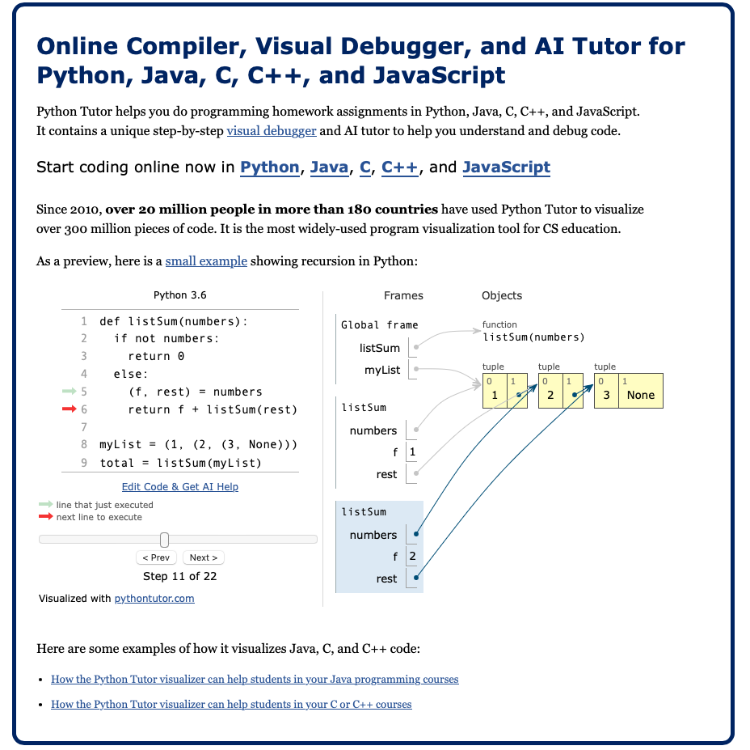
CS 121 + 125
Introduction to Programming (Python)
CS 221
Data Structures and Algorithms (C++)
highly recommended by TAs to help visualize iteration
https://pythontutor.com/

Slide 4

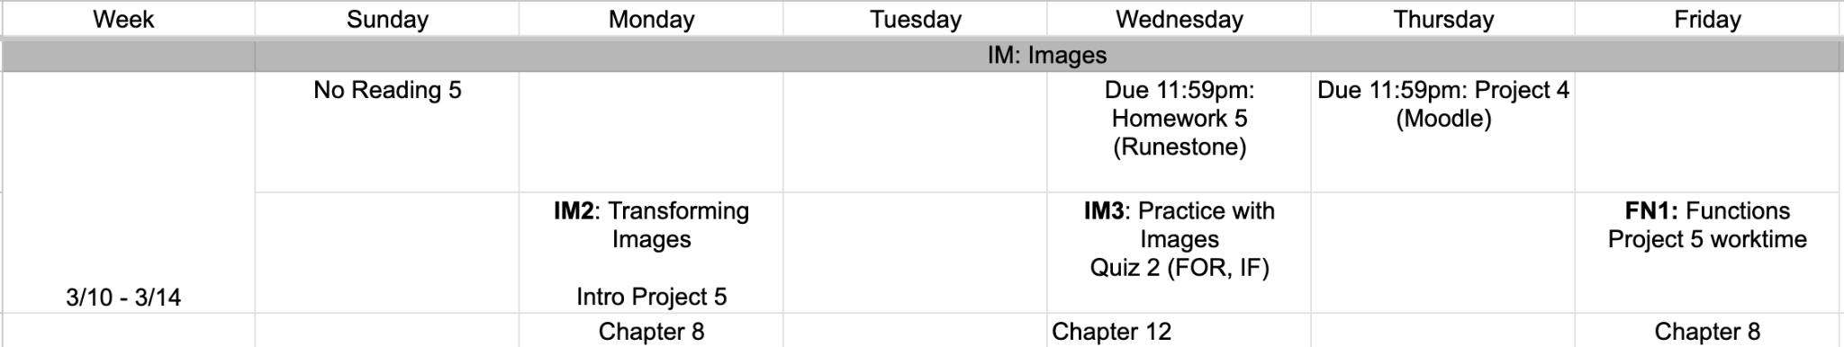
upcoming week
google sheet link

Slide 5
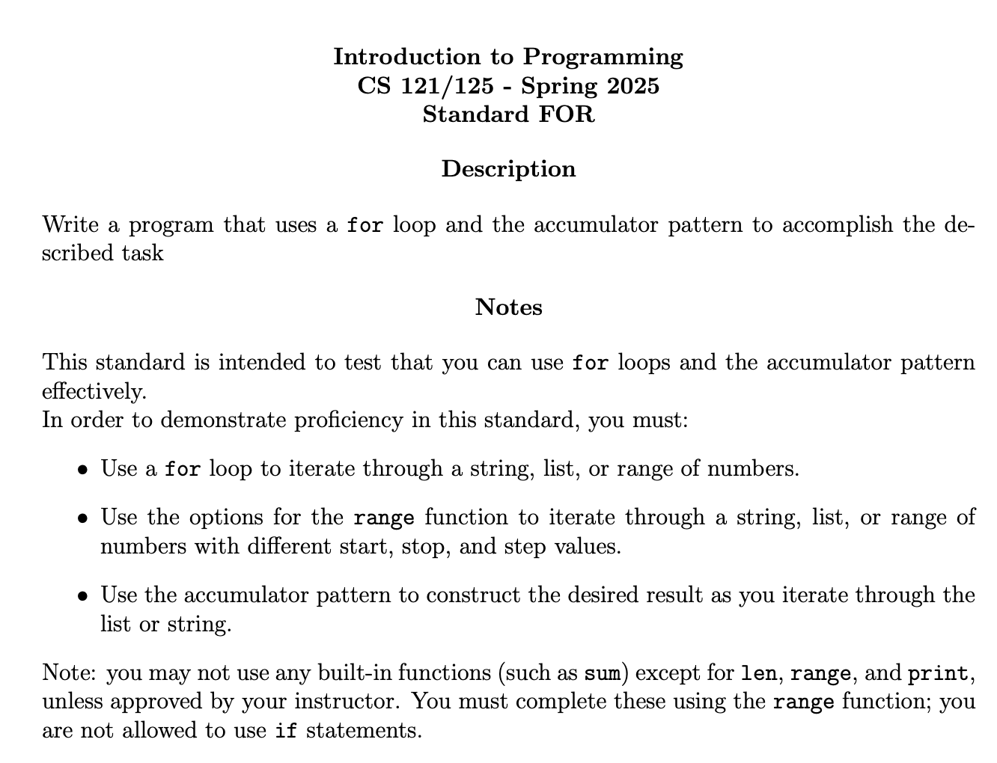
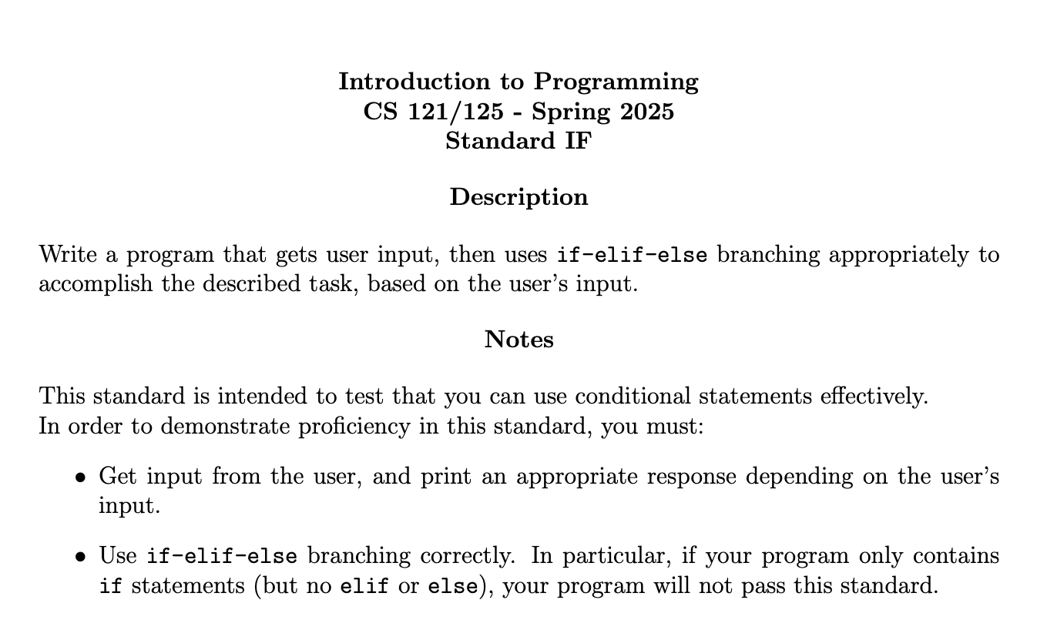
pdfs with practice exercises are up on Moodle.

Slide 6
Takeaways from last time
Things you should know:
practicing conditionals
elif
boolean operators: and, or, not
accumulator pattern with conditionals

Slide 7
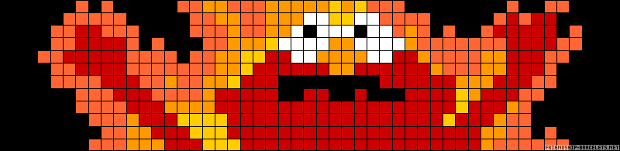
color by numbers
0 = white 1 = yellow 2 = orange
3 = brown 4 = red 5 = black
5
5
5
5
3
5
3
5
5
5
5
5
3
3
2
2
3
3
3
2
2
2
2
2
1
2
1
3
3
3
5
5
5
5
5
5
5
5
3
5
5
3
3
5
5
5
5
5
3
3
3
3
3
5
5
5
5
5
3
3
2
2
3
3
2
2
2
0
0
1
1
0
0
3
3
3
3
5
5
5
5
5
3
4
3
4
4
5
5
5
5
5
3
3
4
4
3
3
3
5
5
5
5
3
3
3
2
3
3
2
2
0
5
0
0
0
5
0
0
3
2
3
5
3
5
5
3
4
4
4
4
4
5
3
5
5
5
3
3
4
4
4
4
3
5
3
5
5
5
3
3
2
2
2
1
0
0
0
0
2
2
0
0
0
0
2
3
3
3
3
3
3
3
4
4
4
4
3
3
5
5
3
3
4
4
4
4
4
3
3
3
3
5
3
3
2
2
5
1
4
4
0
0
2
2
2
2
0
0
4
4
2
3
3
3
3
2
2
4
4
4
3
3
5
5
5
5
3
3
4
4
4
4
3
3
3
3
3
3
3
2
2
1
4
4
4
4
4
4
2
2
4
4
4
4
4
4
2
3
3
3
2
2
4
4
4
3
5
5
5
5
5
3
3
3
3
4
4
4
3
3
2
3
3
2
2
1
4
4
4
5
5
5
5
5
5
5
5
4
4
4
4
4
4
2
2
2
4
4
4
3
3
5
5
5
5
5
5
5
3
3
3
4
4
4
3
3
3
3
2
4
4
4
4
4
5
5
4
4
5
5
4
5
5
5
4
4
4
4
1
2
4
4
4
3
3
5
5
5
5
5
5
5
5
3
3
3
3
4
4
4
2
2
2
2
4
4
4
4
4
4
4
4
4
4
4
4
4
4
4
4
4
4
4
1
4
4
4
2
3
5
5
5
5
5
5
5
5
5
5
3
3
3
2
4
4
4
1
1
1
1
4
4
4
4
4
4
4
4
4
4
4
4
4
4
4
4
4
1
4
4
4
2
3
3
5
5
5
5
5
5
5
5
5
5
5
3
3
2
2
4
4
4
1
1
1
4
4
4
4
4
4
4
4
4
4
4
4
4
4
4
4
4
4
4
4
2
2
3
3
5
3
5
5
5
5
5
5
5
5
3
3
3
2
2
2
4
4
4
1
1
1
4
4
4
4
4
4
4
4
4
4
4
4
4
4
4
4
4
4
4
2
3
3
3
3
3
3
5
5

Slide 8
Computer Images
Big Idea: break image up into tiny pieces, store color for each piece.
Programming question: Cool, but how do we encode colors as numbers?
hardware question: And how do we get images to display?
answer to both: roughly images are displayed using a lot of tiny lights, and we control the intensity of these lights
Each pixel has three lights: red, green and blue.
By adjusting their intensity, we can make any color

Slide 9
you should know
Color values
color | red | green | blue
black | 0 | 0 | 0
white | 255 | 255 | 255
red | 255 | 0 | 0
green | 0 | 255 | 0
blue | 0 | 0 | 255
yellow | 255 | 255 | 0
orange | 255 | 150 | 50
purple | 100 | 0 | 200
brown | 100 | 50 | 0
Each pixel has three lights: red, green and blue.
By adjusting their intensity, we can make any color
Intensity ranges from 0 to 255, where 0 means that the light is off

Slide 10
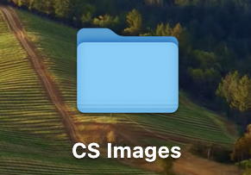
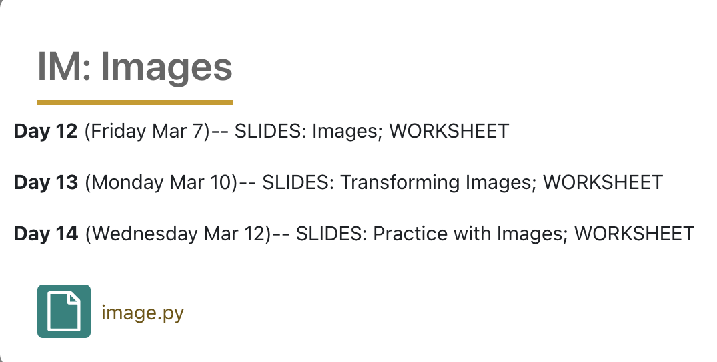
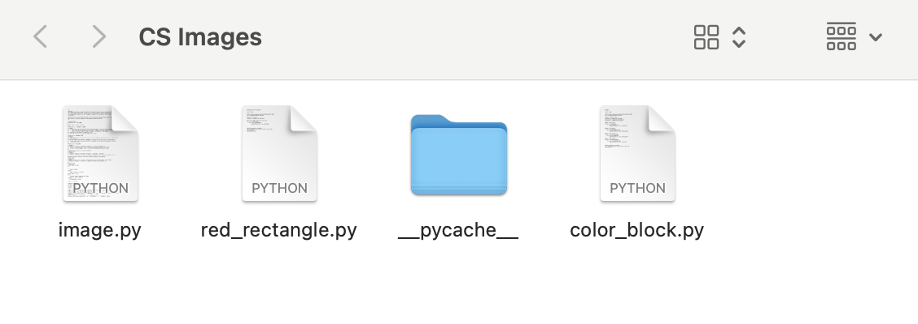
image.py
The image.py module does not come with the standard Python distribution.
You’ll need to download it from Moodle (found under this week) and save it in the same location as your Python file
Using the module image.py, we can manipulate images in Python
create a folder on your Desktop or Documents
ignore __pycache__
make sure image.py is in there and any Python file you create that does images is in there as well

Slide 11
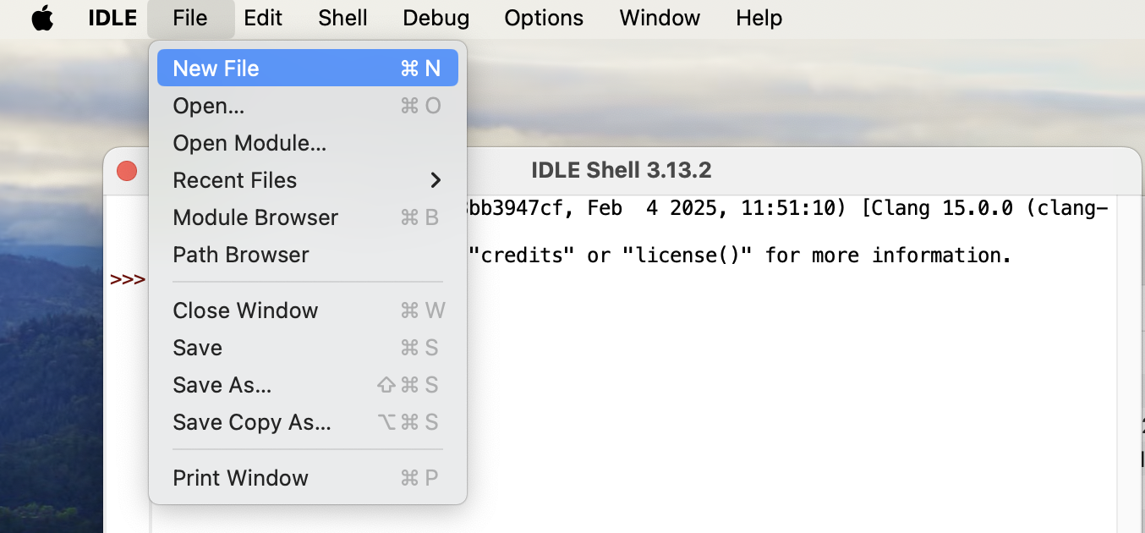
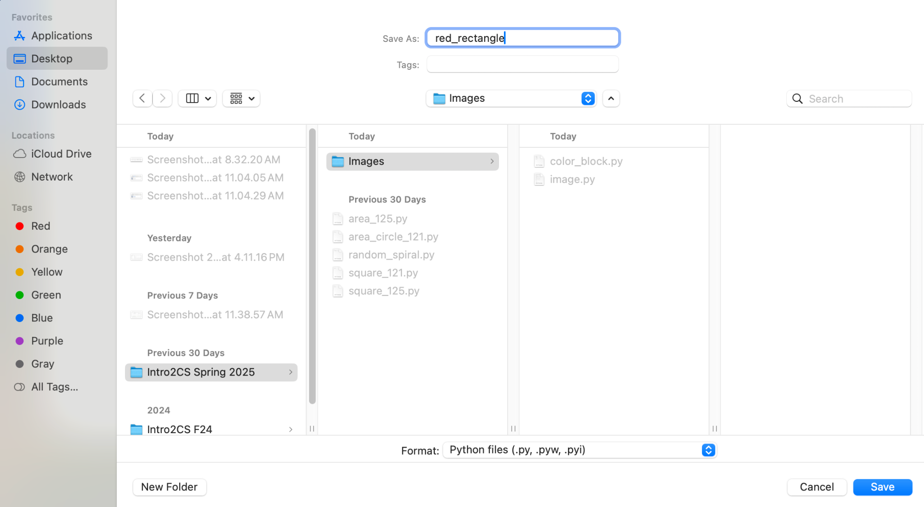
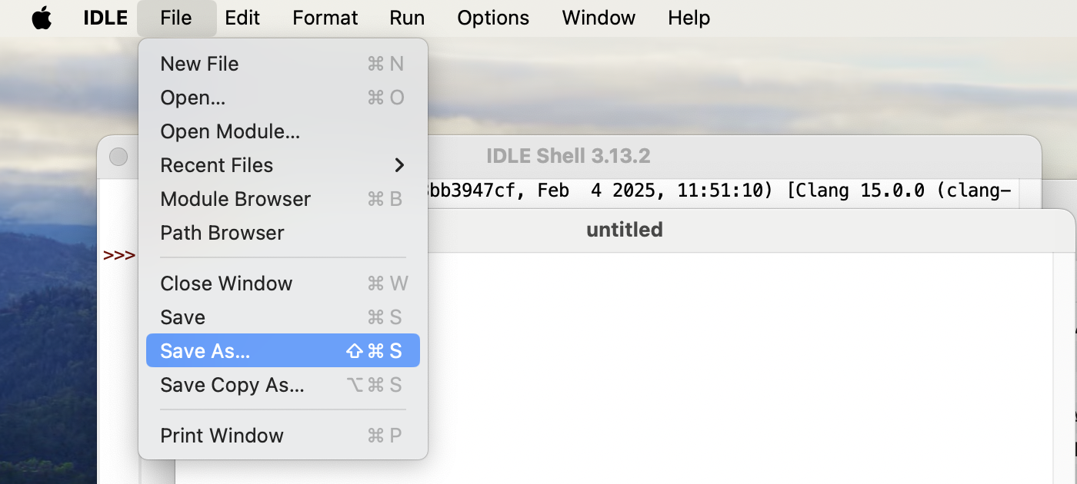
Let’s make our first file called red_rectangle.
Open IDLE and create new file by File > New File
Now pick a good name and where to save it to. Name this file red_rectangle AND pick where to save it
Note: you should see the image.py file in the save place you’re saving it!
Before adding code, save it by File > Save As

Slide 12
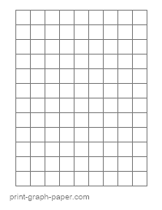

creating an image
#creating a red rectangle
import image
#create empty image with width 100 and height 200
img = image.EmptyImage(100,200)
#display image in a window
win = image.ImageWin("Red Rectangle", 100, 200)
img.draw(win)
outer for loop grabs columns you want, and inner for loop grabs rows
col
0 1 2 3 4 … 99
#create a red pixel
red_pixel = image.Pixel(255,0,0)
#fill the image in with the red pixel
for col in range(100):
for row in range(200):
img.setPixel(col, row, red_pixel)
row
199 … 4 3 2 1 0

Slide 13
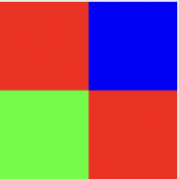
col
0 50 99
cols: 0-49
rows: 0-49
cols: 50-99
rows: 0-49
what columns and rows will the upper left square use?
what about upper right?
row
99 50 0
cols: 0-49
rows: 50-99
cols: 50-99
rows: 50-99
what about lower left?
what about lower right?
width 100 and height 100

Slide 14
#creating a color block
import image
#create empty image with width 100 and height 100
img = image.EmptyImage( , )
#create all color pixels you want
red_pixel = image.Pixel(255,0,0)
green_pixel = image.Pixel( , , )
blue_pixel = image.Pixel( , , )
#fill in upper left corner with red
for col in range(0,50):
for row in range(0,50):
img.setPixel(col, row, red_pixel)
#fill in upper right corner with blue
for col in range(50,100):
for row in range(0,50):
img.setPixel(col, row, blue_pixel)
#fill in lower left corner with green
##
#fill in lower right corner with red
##
#display image in a window
win = image.ImageWin("Color Block", , )
img.draw(win)
creating an image
Fill in blue highlighted parts to create the image below. The starter file is up on Moodle called color_block.py
Make sure to save this file in the same location as image.py!

Slide 15

before next time
Finish color_block.py
Read over Project 4
Look at standards FOR + IF

Slide 16
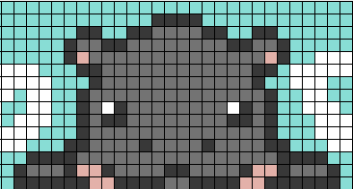
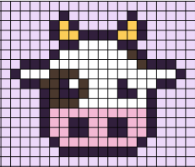
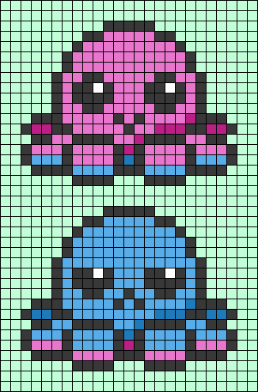

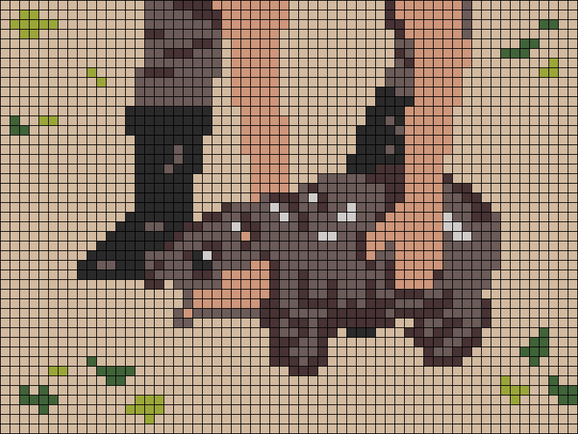
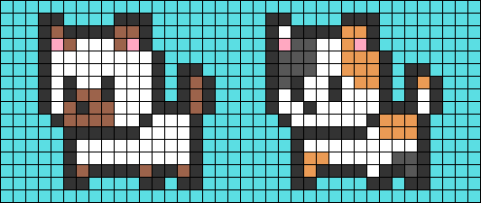
you can find these by searching alpha pattern + whatever you want

