Slide 1


Intro to
Programming
With python
Fundamentals:
Becoming a computer
Monday, February 10 2025 TOH210
Notes:
Layout objects pulled from: https://slidesgo.com/
All icons are from: https://thenounproject.com/

Slide 2

Announcements
Discord provides a space for students to ask questions and connect with one another. All TAs have already joined and are ready to assist students with any questions they may have
Use the QR code to the right or click the link here: https://discord.com/invite/F8wsBCEsM4

Slide 3
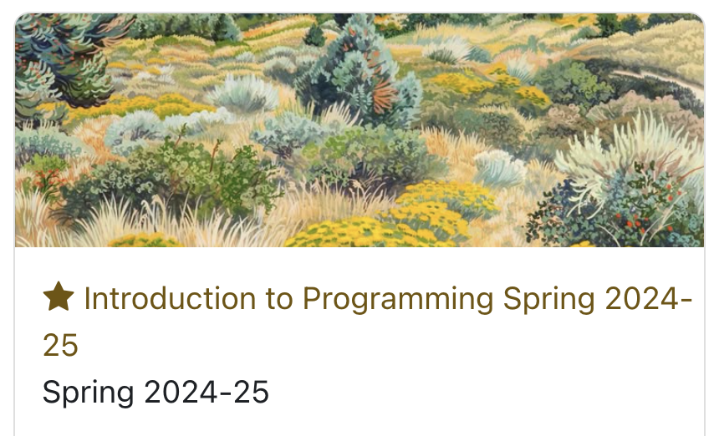
Takeaways from last time
Things you should know:
everything in the syllabus
how to access + use Runestone
how to copy colab workbooks
Moodle course

Slide 4

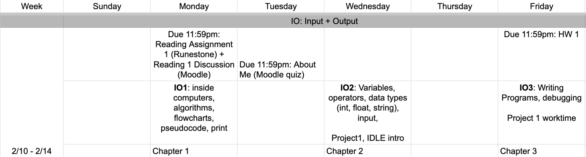
upcoming schedule
google sheet link
Remember, this includes ALL material for the week so it can take a while to complete
LOTS of new vocabulary which means you may want to revisit to help solidify your understanding

Slide 5
Colab workbook
Link: click for access
class notes

Slide 6

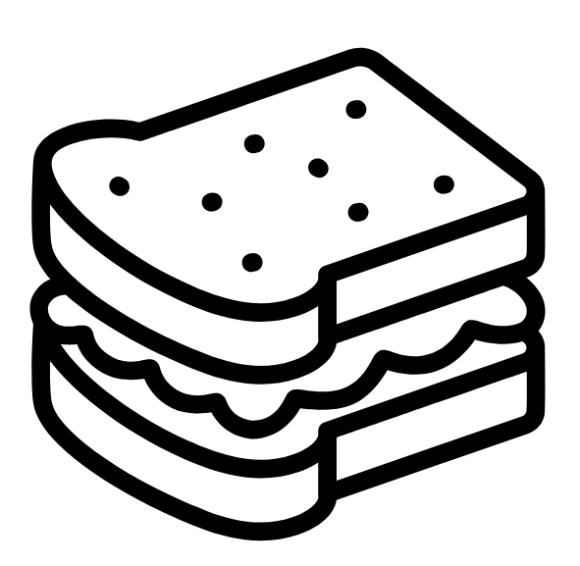

Warm up
Think about the process of making a peanut butter and jelly sandwich. How would you describe the sequential steps involved in making the sandwich? Why does the word sequential matter here?
Let’s say both you and a friend both wrote down the process for creating your own versions of pb+j, but have a different number of steps (you have 10 while they have 5). How can this be?

Slide 7
The fundamental skill in computer science is
problem solving
Break a problem into steps
Use math and logic to develop a solution
Test and validate

Slide 8


An algorithm is a step-by-step list of instructions for solving a problem
>>computer science involves working with people to use computers to solve problems
Learning the nuances of a computer language is only one part of coding. The other, usually more difficult, part is to understand what instructions to give to solve a given problem.
Notes:
Definition of CS

Slide 9
cool, but how can you visualize this rather than just thinking about it?
Thinking algorithmically
To create an algorithm to solve a problem we need to break the problem into a sequence of steps where each step is relatively simple and the order (usually) matters
By doing this, we can create instructions that a computer can follow. This skill is super useful beyond CS!
Notes:
Definition of CS

Slide 10
We can plan out our algorithm by using
flowcharts and pseudocode
Let’s see an example of this!
Flowcharts are a visual way of using boxes and arrows to show the order of instructions
Good for decision making or if there are a lot of user interactions
Pseudocode is an informal algorithm using simple English sentences and is organized by indentations (much like a computer program)
Good for mathematical processes

Slide 11

Cafe orders
We want to create a program that sends the drink a customer selects at the automated coffee shop to the barista. The program should prompt the user to select which drink they want, if it's hot or iced, and then send the drink to the barista.
Before we code anything, let's create some pseudocode to figure out what we’d like this program to do!
Noble bean cafe
1. ask user for drink choice
2. ask if drink is hot or iced
3. confirm drink is correct
4. send drink to barista

Slide 12
Discussion
1. ask user for drink choice
Select your drink (latte, coffee, chai):
chai
2. ask if drink is hot or iced
Select hot or iced (hot, iced):
iced
3. confirm drink is correct
You ordered a iced chai. Is that correct (yes, no):
yes
4. send drink to barista
Great! One iced chai coming your way :)
Once you have this, grab a partner and discuss where could you add improvements. What would you have to add so a customer can select multiple drinks? How about adding a flavoring? What happens when a user enters an invalid option?
Add any steps you think would be important to replicating the ordering process at a cafe.

Slide 13


Discussion
Remembering
Lighthouse codes
You are a part of a network of spies within a lighthouse organization. Your co-conspirators have left a clue for you. You see five lighthouses and want to remember which are lit (blue) and which are not.
Describe how you would remember this information if all you could share was a number or gesture. Think of multiple ways this could be done.

Slide 14

3
1 1 0 0 1
034
521
25
125
430

Slide 15
5 4 3 2 1
This tells me how many are lit, but not which ones
3
Algorithm
Count all blue lighthouses

Slide 16
5 4 3 2 1
4
This tells me how many and which position they are in
1
Algorithm
If lit, then put finger up.
Otherwise, keep finger down.
3 2
5
Maybe 541 or 145 could also work

Slide 17
4 3 2 1 0
Fun fact: in CS we often start counting at 0!
3
0
Algorithm
If lit, then put finger up.
Otherwise, keep finger down.
2 1
4
Maybe 430 or 034 could also work

Slide 18
4 3 2 1 0
This tells me how many and which position they are in
1 1 0 0 1
Algorithm
If lit, then 1.
Otherwise, 0.
This is called binary and it’s the language that computers speak

Slide 19
2
4 3 2 1 0
2
2
2
2
2 2 2 2 2
Algorithm
If lit, then add up corresponding power of 2.
Otherwise, add 0.
4 3 2 1 0
This is the decimal number we use to represent the binary number 11001
16 8 4 2 1
25
16 + 8 + 0 + 0 +1 =

Slide 20
How do we translate human language
to computer language?

Slide 21
Programming Languages
COBOL
Designed in 1959, still being used in banking.
BASIC
Designed in 1964 at Dartmouth College, very popular when home computers first became available.
Fortran
Designed in 1954 at IBM, very popular for calculations on large computers. Still used for weather forecasting at NASA.
Thousand of programming languages have been created. Which one you should use depends on a number of factors such as the type of program being written and which kind of computer it will run on.
Here are some popular ones, as well as some really old ones.
C
One of the most popular and used for programming hardware
C++
Based on C with some flair. Used in programs that need to be fast like console games
Objective-C
Based on C with some flair. Popular because of its use in Apple and iOS
MATLAB
Ideal for programs that carry out loads of calculations
Python
Very versatile. Used in backend of YouTube and Google, data science, among others.
Java
Very versatile. Often used for coding on Android OS
JavaScript
Used for programs that run in the browser, such as simple games
Ruby
Automatically turns lots of information into web pages
Ada
Used to control spacecraft, satellites, and airplanes
R
Used in statistical courses, biomedical research, data science.

Slide 22
Why python?
Most popular lots of existing programs are written in it
General purpose can program almost anything like web dev, scientific computing, data analysis, AI
Fun name it’s creator was a big fan of Monty Python (British sketch comedy group)
High level Syntax is designed to be relatively simple, so it is easier and faster to program in than other programs
Languages are designed for different types of programming, but they share a bit of the same basic structure

Slide 23
print function
displays information to users by taking in an argument (input)
arguments to print can be strings
or numbers
or variables
number = 42
print(number)
print(“hiya! :)”)
text = “hiya! :)”
print(text)
print(42)

Slide 24

before next time
Finish workbook
Reading 1 + discussion
About Me
Take a look at HW 1
workbook Time!

