Slide 1


Intro to
Programming
With python
iteration:
modules + turtles
Monday, February 17 2025 TOH210
Notes:
Layout objects pulled from: https://slidesgo.com/
All icons are from: https://thenounproject.com/

Slide 2

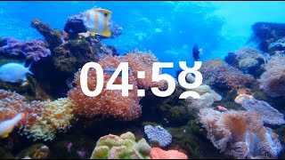
WARMUP
error spotting
Find the errors in the following blocks of code:
name = input(“What is your name?”)
print(“Hello” + Name)
age = input(“How old are you? ”)
print(“You are ” + age + “ years old”
color = inout(“What is your favorite color? ”)
print (color, “is my favorite color, too!”)
add space
add space
n
int( )
str( )
)
input
delete space

Slide 3

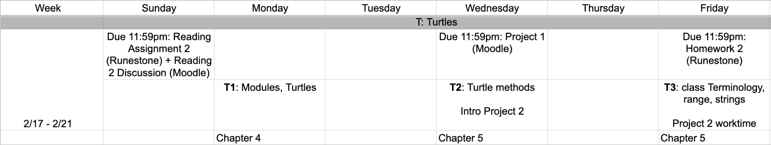
this week
google sheet link

Slide 4
Takeaways from last time
Things you should know:
comments help others understand your program
comments help you organize your program before and during coding
types of errors
error messages

Slide 5
use or
handout up on Moodle
runestone
code editor
python file with idle

Slide 6
A great thing about programming is that we don’t have to do everything ourselves! We can use code written by other people
We do this by importing a
module
which is a special type of Python file that is designed to be used in other programs.
The random module provides you with tools to write programs that exhibit (pseudo-)random behavior
import random
print(random.randint(1,5))
print(random.randrange(0,11))
print(random.randrange(0,11,2))
gives you access to everything in the random module
look inside random module
randint function from random module, returns a random integer between 1 and 5 (includes 1 and 5)
randrange function from random module, returns a random number between 0 and 11 (excludes 11)
When you installed Python, it automatically included some common modules (including the ones we are covering today!)
same as above, but skips every second number
this random number from the following list: 0, 2, 4, 6, 8, 10
How would you display a random number that is odd and between 15 and 29 (includes 15 and 29)?
print(random.randrange(15,30,2))

Slide 7
A great thing about programming is that we don’t have to do everything ourselves! We can use code written by other people
We do this by importing a
module
which is a special type of Python file that is designed to be used in other programs.
The math module contains useful constants and mathematical functions that go beyond the arithmetic operators
import math
print(math.pi)
print(math.sqrt(2))
gives you access to everything in the math module
look inside math module
variable pi from math module
square root function
When you installed Python, it automatically included some common modules (including the ones we are covering today!)

Slide 8

PRACTICE
workbook
radius of a circle
Write a program that prompts the user to enter the area of a circle. The program then computes and prints the radius.
An example of executing this program is given below.
Enter the area of a circle: 26.5
The radius is 2.904346408025913
Remember that A = pi * r² . For our problem, we want to return the radius r, so we’ll need to reorganize a bit to get r=sqrt(A/pi).
If it’s helpful, start outlining your program with comments, then add in input and print functions, then do calculation last. For each step, run your program and resolve errors

Slide 9
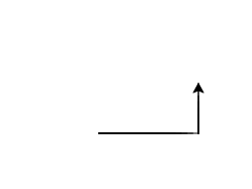
A great thing about programming is that we don’t have to do everything ourselves! We can use code written by other people
We do this by importing a
module
which is a special type of Python file that is designed to be used in other programs.
The turtle module allows you to draw things using Python
import turtle
myrtle = turtle.Turtle()
myrtle.forward(100)
myrtle.left(90)
myrtle.forward(50)
gives you access to everything in the turtle module
creates a Turtle object which we can use to draw things with
forward(100)
use myrtle’s forward function to move 100 ahead
left(90)
turn myrtle left 90 degrees
forward(50)
When you installed Python, it automatically included some common modules (including the ones we are covering today!)
always starts at (0,0)

Slide 10
practice
Squares
Use the turtle module to draw a square with side length 100
An example outline is below with a turtle named myrtle, but feel free to change it.
#create turtle named myrtle
import ____
____ = turtle._____
#draw square

Slide 11
Exercise
Triangles
Use the turtle module to draw an equilateral triangle with side length 200.
An example outline is below with a turtle named myrtle, but feel free to change it.
#create turtle named myrtle
import ____
____ = turtle._____
#draw triangle
Note: equilateral means all sides are the same length and all interior angles are 60. You may find it helpful to draw out a picture to get the degree myrtle must turn.

Slide 12
Exercise
random spirals
Use the math and turtle modules to create a turtle spiral with the following:
random side lengths between 50 and 200
random interior angles between 30 and 90
has six sides
#import math and random modules
#create spiral

Slide 13

before next time
Finish worksheet
Finish task 3 on Project 1

Slide 14
radius of a circle
Squares & Triangles
#import math
import math
#ask user for an area (float)
area = float(input("Enter the area of a circle: "))
#calculate radius = sqrt(area/pi)
radius = math.sqrt(area/math.pi)
#display radius to the user
print("The radius is", radius)
import turtle
myrtle = turtle.Turtle()
#square
for _ in range(4):
myrtle.forward(100)
myrtle.left(90)
#triangle
for _ in range(3):
myrtle.forward(100)
myrtle.left(360/3)

Slide 15
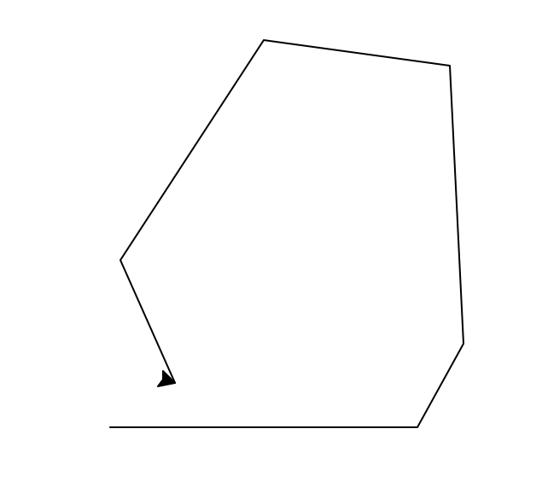
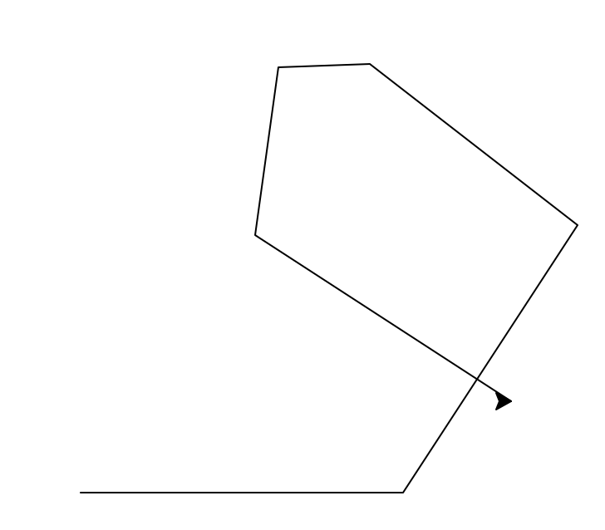
Random spirals
#imports
import math
import random
import turtle
#create turtle
myrtle = turtle.Turtle()
for _ in range(6): #six sides
random_length = random.randint(50,200) #random side lengths between 50 and 200
myrtle.forward(random_length)
random_angle = random.randint(30,90) #random interior angles between 30 and 90
myrtle.left(random_angle)

Slide 16
What is the maximum size for a module?
And other useful information
Modules are useful since they contain executable statements and functions that can live outside of the program we are working on.
Usually it is good practice to have a module under 400 lines of code. This seems like a lot, but when you are working on a project you may find it to be very limited. In this case, you can build what we call a package. A package is a way to have related modules (called submodules) all in one convenient place.
It is customary to place all import statements at the top of your script. You can shorthand a module name using the as command
import turtle as t
import math
import random as rd
wn = t.Screen()
pippin = t.Turtle()

Slide 17
How important are the
math and random modules?
Fairly important. We often write programs to simply a process and having prewritten code we can call on will save us a bunch of time.
The math module includes many ways to help us to perform complex calculations.
The random module may not seem important now, but when you want to add an element of chance to your program it will be very useful.
random.random() function will output a random probability (decimal from 0 to 1)
random.randrange(a,b) which outputs a random number from a to b-1 (**does not include b**)
The random module is called pseudo-random since there is a seed. Back in the day, random number books existed. To use one, you would turn to a page and it would contain a list of random numbers. The seed is used as the page number. Once you supply the seed, the program goes to that page number and then the first number off the page. Seeds are important because they make our programs reproducible.

Slide 18
Turtle module questions
This module is great for educational purposes because we can visualize loops! You can also create fairly intricate 2D games if you’re so inclined (Snake Game Part 1/7). Beyond that, turtle is limited in terms of real world applications.
The turtle will initialize East
The set-up for turtles is the same regardless of whether you want a simple straight line, or a random path on the screen.
Turtles can only do so much. If you ask it to do a task a few times it should be good. If you ask it to do a task hundreds of times you’ll either run into it repeatedly creating the same shape, or Runestone being unable to keep up with all the iterations.

Slide 19
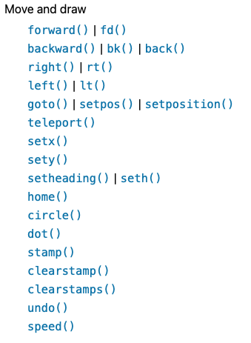
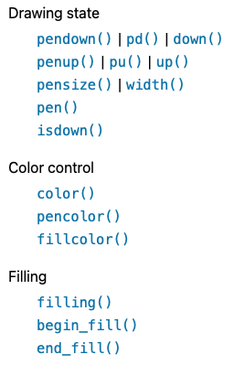
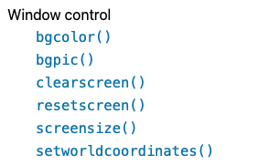
functions from the turtle module
teleport()
hideturtle()
Notes:
Garbage collection during execution.

