Slide 1


Intro to
Programming
With python
iteration:
turtle methods
Wednesday, February 19 2025 TOH210
create copy of worksheet from Moodle
& open up Runestone’s code editor
Notes:
Layout objects pulled from: https://slidesgo.com/
All icons are from: https://thenounproject.com/

Slide 2

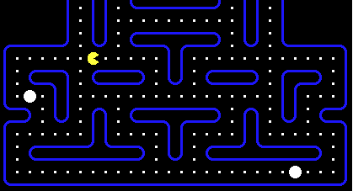
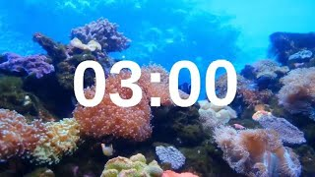
WARMUP
grab handout
Coin Collector
We want to write an algorithm to help Mabel the monster eat some snacks.
Use the algorithm below to figure out which snack Mabel is trying to eat first:
1. Mabel turn 180
2. Mabel forward 6
Next, add the rest of the steps to help Mabel find their delicious treat.
Challenge [time permitting]: write out your steps above with turtle methods forward, backward, left, and right.

Slide 3
Coin Collector
1. Mabel turn 180
2. Mabel forward 6
3. Mabel turn 90
4. Mabel forward 3
5. Mabel left 90
6. Mabel forward 1
import turtle
#create mabel
mabel = turtle.Turtle()
#move mabel to her snack
mabel.left(180)
mabel.forward(6)
mabel.left(90)
mabel.forward(3)
mabel.left(90)
mabel.forward(1)

Slide 4

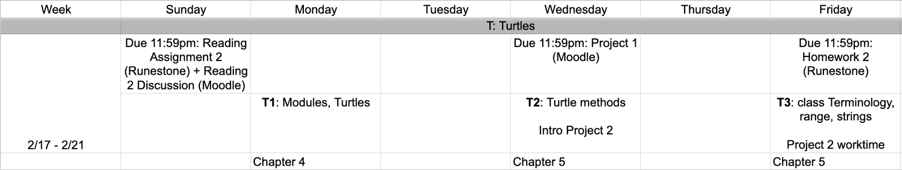
this week
google sheet link

Slide 5
Takeaways from last time
Things you should know:
modules allow us to use code created by other people
math + random + turtle modules
create a turtle + draw with it

Slide 6
use or
handout up on Moodle
runestone
code editor
python file with idle

Slide 7

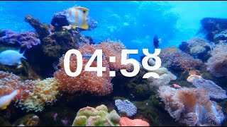
Exercise
Turtle Octagon
Use the turtle module to draw an octagon with side length 100.
Feel free to use your notes from Monday on how to draw a square and chat with your tablemates when you get stuck.
note: 8-sides which added end-to-end turn a total of 360 degrees

Slide 8
using loops we can repeat the same code without copying and pasting
_ is a variable, we can change this name to whatever we want! This variable is used as an index for each time the code repeats (i.e. it keeps track of where we are in the loop)
turtle octagon
import turtle
myrtle = turtle.Turtle()
for _ in range(8):
myrtle.forward(100)
myrtle.left(360/8)
this is called a for loop
another keyword is in, which is used to iterate _ through values
range(8) tells us how to iterate through values: starting at 0, we increase by 1 until we get to up to 8 (does not include 8)
for is a keyword in Python which indicates the start of a for loop
don’t forget to add a colon. This is to help the interpreter know you’re entering into your loop
indentation matters! anything indented is inside the loop so it’ll get repeated each time it repeats
note: 360/8 is the same as 45

Slide 9
turtle shapes
a few shapes we’ve seen so far
#create turtle
import turtle
myrtle = turtle.Turtle()
#draw triangle
for _ in range(3):
myrtle.forward(100)
myrtle.left(360/3)
#create turtle
import turtle
myrtle = turtle.Turtle()
#draw square
for _ in range(4):
myrtle.forward(100)
myrtle.left(360/4)
#create turtle
import turtle
myrtle = turtle.Turtle()
#draw octagon
for _ in range(8):
myrtle.forward(100)
myrtle.left(360/8)
let’s rewrite these to draw any general shape with n sides

Slide 10
turtle shapes
how to create multiple shapes with same for loop
#create turtle
import turtle
myrtle = turtle.Turtle()
n=3 #number of sides
#draw n-sided shape
for _ in range(n):
myrtle.forward(100)
myrtle.left(360/n)
#create turtle
import turtle
myrtle = turtle.Turtle()
n=4 #number of sides
#draw n-sided shape
for _ in range(n):
myrtle.forward(100)
myrtle.left(360/n)
#create turtle
import turtle
myrtle = turtle.Turtle()
n=8 #number of sides
#draw n-sided shape
for _ in range(n):
myrtle.forward(100)
myrtle.left(360/n)
be careful when using this method to draw several shapes in the same program

Slide 11
How to draw Turtle Shapes
Draw out what shape you hope to make on paper. Find any basic shapes you know how to create.
Plan out your code outline using comments
To create sections of a shape, put yourself in your turtle’s shoes to figure out forward, backward, left and right methods. Sometimes figuring out degrees for left and right is trial and error, so be patient
Do any sections of a shape repeat? If they do, use a for loop to make these!
Once you have an the outline of your shape the way you like it, add colors (fill or pen methods)

Slide 12
Exercise
Turtle stars
Use the turtle module and a for loop to draw a star

Slide 13
turtle stars
Use the turtle methods to draw a star
import turtle
myrtle = turtle.Turtle()
#create star
for _ in range(8):
myrtle.forward(50)
myrtle.left(180)
myrtle.forward(50)
myrtle.left(360/8)
myrtle.hideturtle()
import turtle
myrtle = turtle.Turtle()
#create star
for _ in range(5):
myrtle.forward(25)
myrtle.left(220)
myrtle.forward(25)
myrtle.left(70)
myrtle.hideturtle()
import turtle
myrtle = turtle.Turtle()
#create star
for _ in range(5):
myrtle.forward(50)
myrtle.left(360/5*2)

Slide 14
documentation
how can we know what functions and objects are available in a module?
check the documentation!
math module
https://docs.python.org/3/library/math.html
turtle module
https://docs.python.org/3/library/turtle.html
random module
https://docs.python.org/3/library/random.html

Slide 15
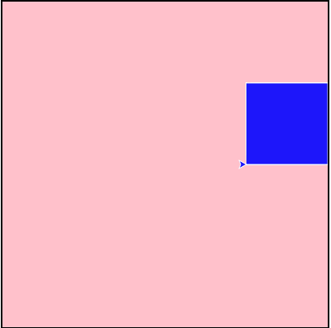
example
Turtle methods
import turtle
wn = turtle.Screen() #get window object
wn.bgcolor("pink") #change background color
myrtle = turtle.Turtle() #create myrtle
#move myrtle left without drawing anything
myrtle.up()
myrtle.setx(100)
myrtle.down()
#create square with white outline and blue fill
myrtle.pencolor("white")
myrtle.fillcolor("blue")
myrtle.begin_fill()
for _ in range(4):
myrtle.forward(100)
myrtle.left(90)
myrtle.end_fill()

Slide 16
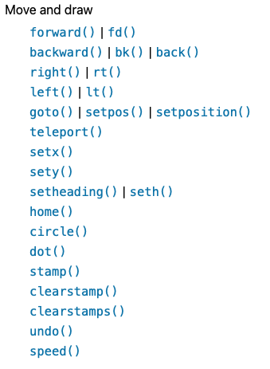
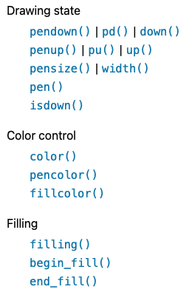
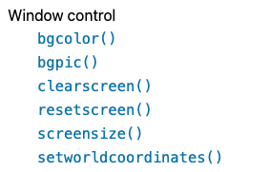
functions from the turtle module
teleport()
hideturtle()
Notes:
Garbage collection during execution.

Slide 17
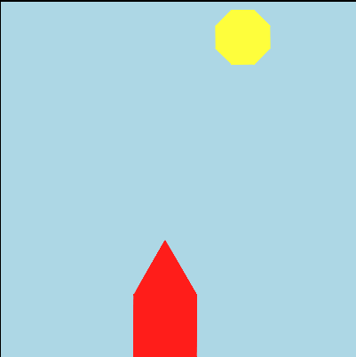
exercise
turtle house
Use the turtle methods to draw the picture below

Slide 18

before next time
Finish handout
Finish HW 1
Project 1 submitted if possible

Slide 19
turtle houses
Use the turtle methods to draw the picture
import turtle
#get window object
wn = turtle.Screen()
#change background color
wn.bgcolor("lightblue")
#create myrtle
myrtle = turtle.Turtle()
#move myrtle down and left
myrtle.up()
myrtle.setx(-50)
myrtle.sety(-130)
myrtle.down()
#make red house
myrtle.pencolor("red")
myrtle.fillcolor("red")
myrtle.begin_fill()
#create square
for _ in range(4):
myrtle.forward(70)
myrtle.right(90)
#create triangle roof
for _ in range(3):
myrtle.forward(70)
myrtle.left(360/3)
myrtle.end_fill()
#moves myrtle up and right myrtle.up()
myrtle.setx(60)
myrtle.sety(130)
myrtle.down()
#make yellow sun
myrtle.pencolor("yellow")
myrtle.fillcolor("yellow")
myrtle.begin_fill()
for _ in range(8):
myrtle.forward(25)
myrtle.left(360/8)
myrtle.end_fill()
myrtle.hideturtle()

