Slide 1
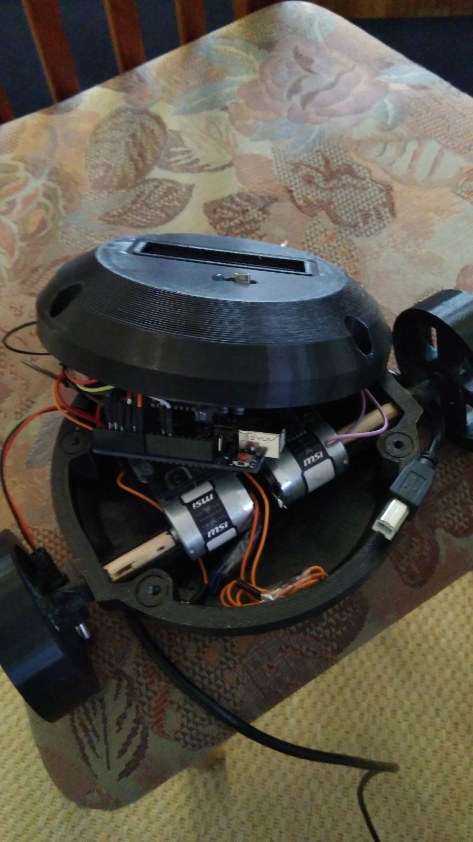
Alarm Clock
Anssi Uistola
Juho Valkama
Topias Syri

Slide 2
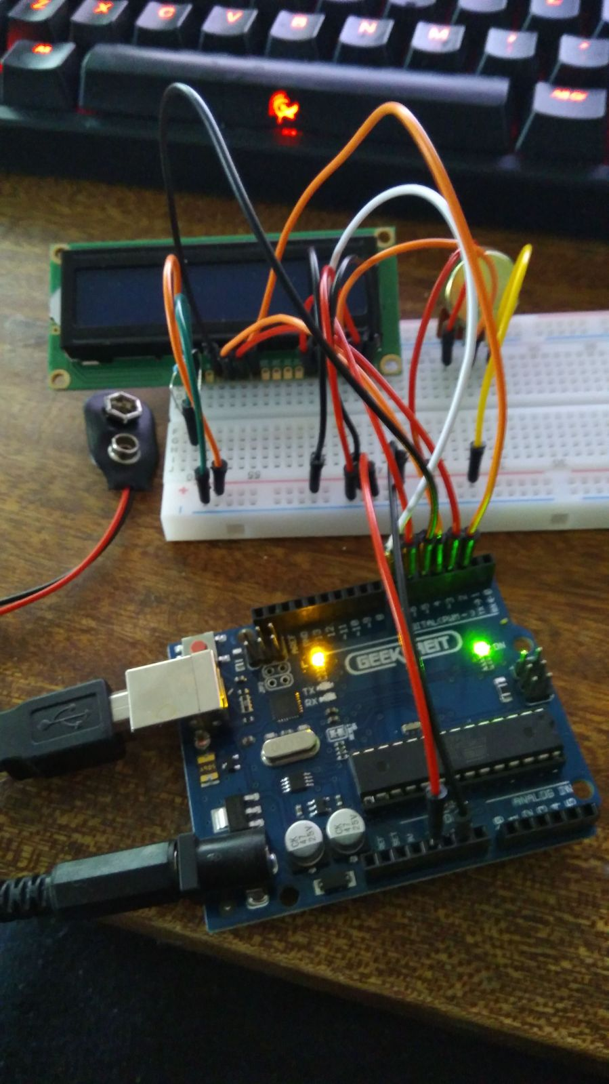
Parts used
Arduino UNO
16x2 LCD Screen
MPU 6050
2x DC motors
LED
IR Receiver and remote

Slide 3
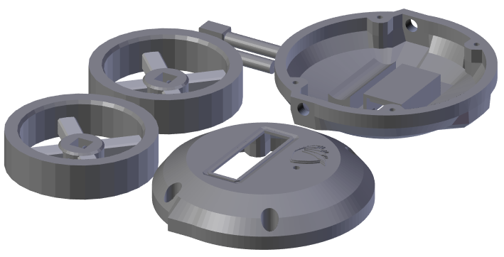
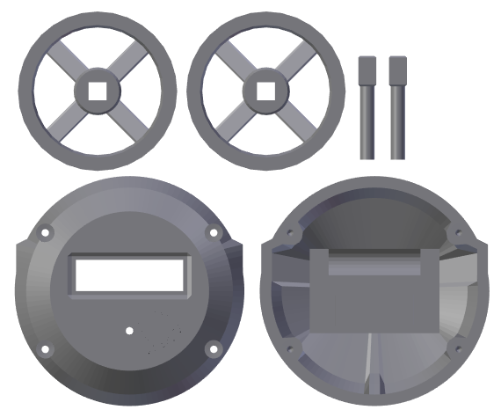
Sketches of the final design

Slide 4
Issues we had
3D-printing
Wiring
Assembly

