Slide 1


Game on
(Demo Time)
Mario Kart and coding challenges combined
Notes:
Jesse

Slide 2
Technical Challenges
Lightning Challenges
CodeOff offers the ability to compete with random people against coding challenges in real time.
Challengers accumulate power ups for passing test cases and can use these against their opponent.
An example of a powerup is the ability to see your opponents code for a limited duration

Slide 3
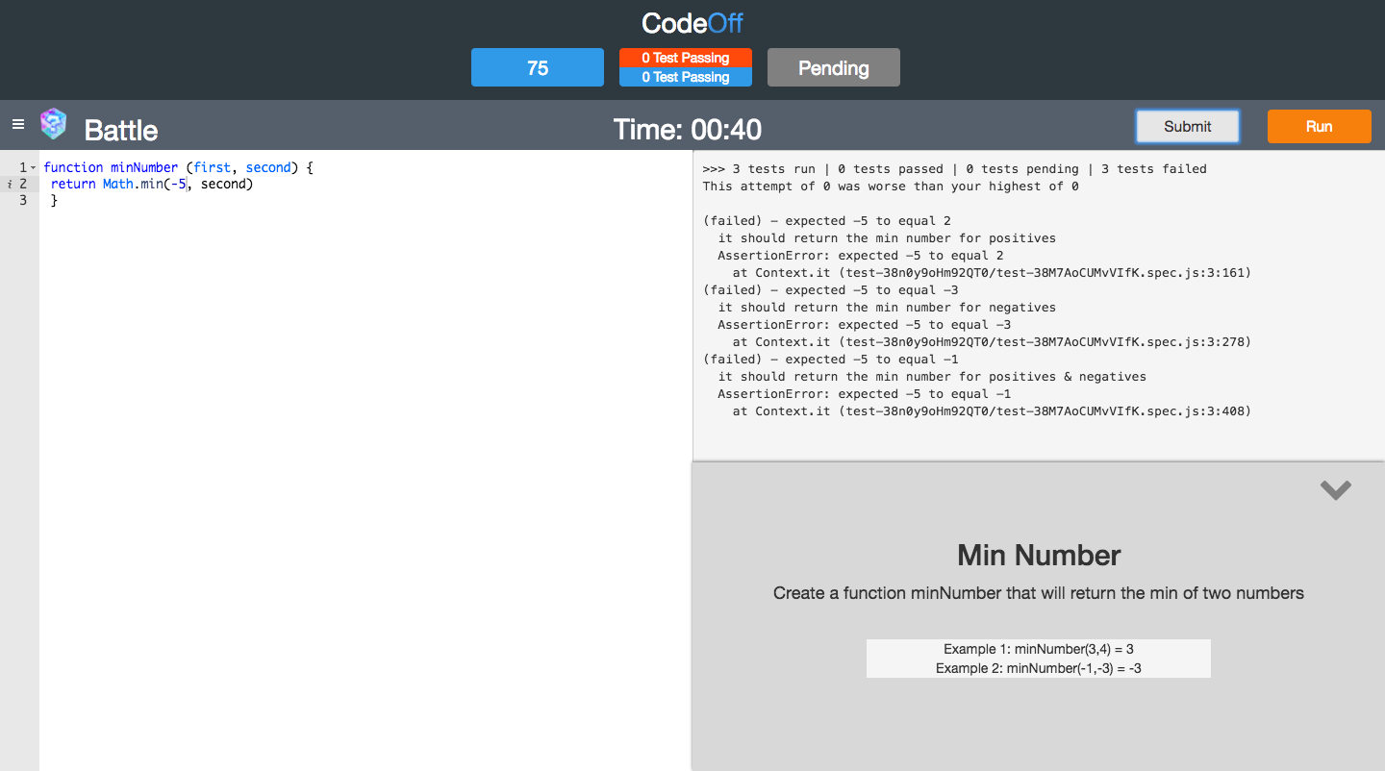
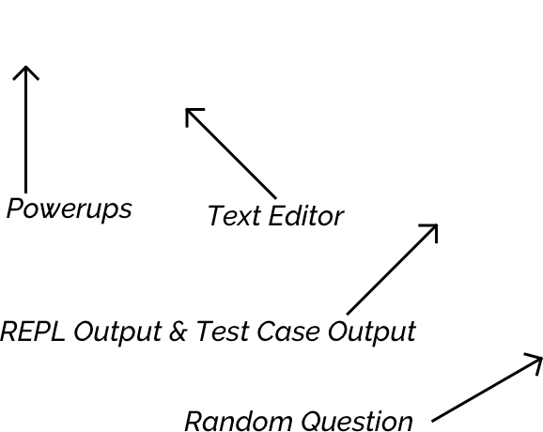
What makes us different
The User Interface
Notes:
Guy

Slide 4
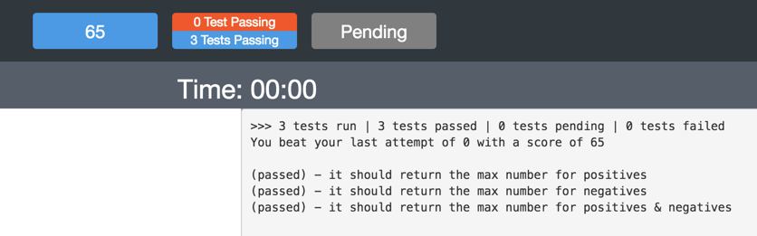
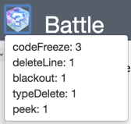
What makes us different
Differences between other coding platforms
Gamification / interactivity with powerups
Rewarding strong coding habits
Correct linting
Low time complexity
Spectate other people coding
Notes:
Guy

Slide 5
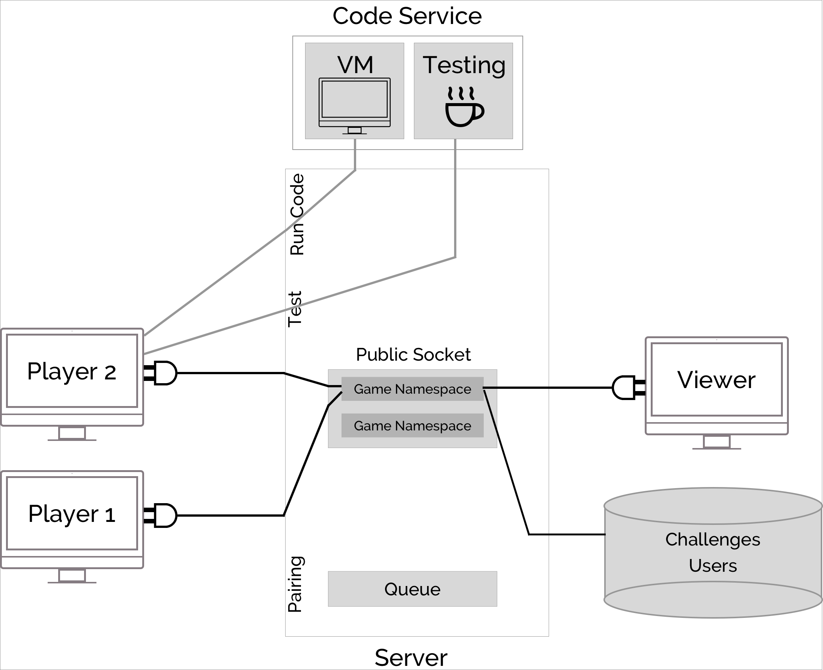




CodeOff Architecture
Diagram Raceway
Architecture Diagram
Code Service Diagram
attempt
> mocha
response
request
test
solution
child process
attempt
temp files
test
solution
Tech Stack
Notes:
Robbie
Client makes request to Server
Server makes request to Service
Service analyzes request(s), and sends back response(s)
Server receives, parses, then ultimately sends response to Client
Service is isolated

Slide 6
Technical Challenges
Challenges
Coding Service
Sandboxing
Provide desired output
Disable malicious code & infinite loops
Multiple websocket connections & using multiple identifiers for a client
OAuth
Deleting our repo (Github heros)

Slide 7
The Future
The Future
Enable users to specify challenge type before game
Create a leaderboard
Design tournament or bracket system
Add support for other programming languages
Provide users detailed performance analytics
Build out user features
Add more and varied challenges
Notes:
This will be our outro, it should explain the ambition behind the project, how the community can involve itself, and what we ultimately hope it will blossom into:
I.e. The core philosophy behind CodeOff is creating a friendly, competitive, and fun atmosphere for users to enjoy programming. We hope to expand upon this in a number of ways, such as adding additional challenges over time, creating an active leaderboard, profiling more detailed metrics, etc.
Not only can you code with or against others, but we are also an open-sourced project and welcome community involvement and contribution. If you have any ideas or thoughts we would love to hear them!
Coding, tackling tough problems and solving them are things that resonate within us as programmers/software engineers and building an active community like CodeOff ensures that everyone will have access to learning, laughing, and growing together.

Slide 8
Game on
(Demo Time)

