Slide 1

Image Segmentation with Ford-Fulkerson
Michael Crouse & Christopher Stull
Spring 2014

Slide 2
Graph Structure
Program requirements specified .pgm files and adjacency lists as input
.pgm files are represented as a series of vectors, each linked to other nearby nodes in all four cardinal directions, bidirectionally
Edge weights are considered as the difference between the z-values (greyscale value) of each vector
Adjacency list stored as a series of linked lists

Slide 3
Breadth First Search
Builds a tree of seen nodes, each branch has a link back to the parent. It marks each nearby node as visited, builds a branch for it, and puts it into a queue
Easy to backtrack, but 4 extra pointers per vector can use a lot of memory (31MB for 1080p if no path is found)
Once the shortest path is found, walk back up the tree and return the path as a linked list
Difficult to analyze due to short running time

Slide 4
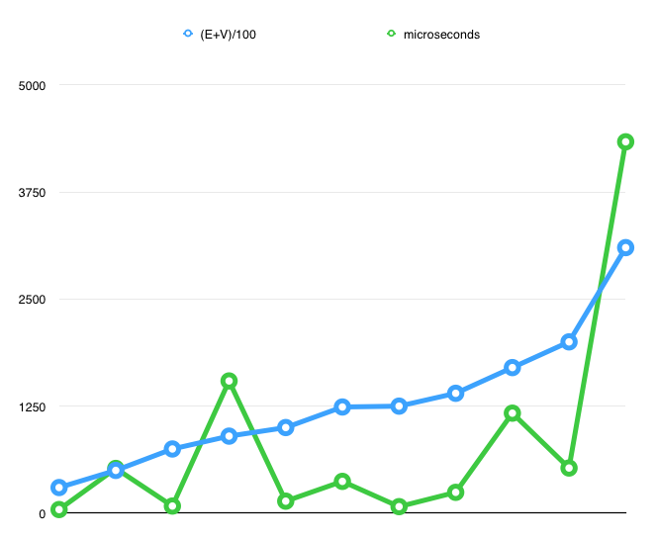
BFS Analysis
V | E | (E+V) /100 | Time (μs)
10000 | 20000 | 300 | 43
10000 | 40000 | 500 | 523
25000 | 50000 | 750 | 84
10000 | 80000 | 900 | 1544
30000 | 70000 | 1000 | 141
25000 | 100000 | 1250 | 77
40000 | 100000 | 1400 | 244
30000 | 140000 | 1700 | 1168
40000 | 160000 | 2000 | 528
30000 | 280000 | 3100 | 4335

Slide 5
Ford-Fulkerson
Uses original graph to store residual graph
Repeatedly calls BFS to get a flow, adds that flow in, and continues until BFS returns a null path
Expected efficiency of O(Ef) easier to test than BFS because making small graphs with large flow causes Ef to grow very quickly
With larger flows, efficiency actually increased, likely due to less system overhead

Slide 6
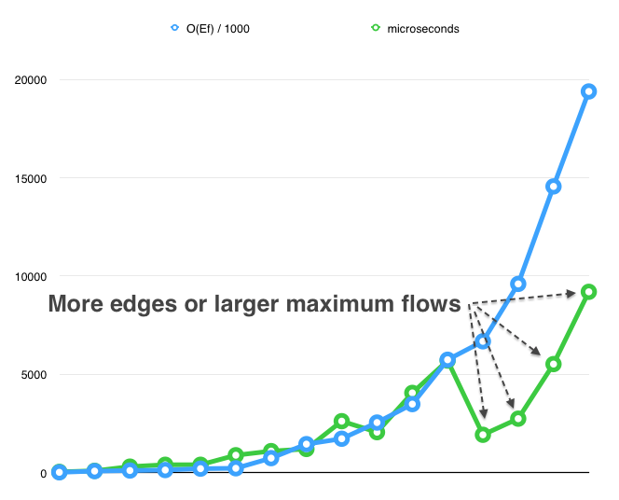
Ford-Fulkerson Analysis
V | E | flow | O(Ef) / 1000 | Time (μs)
1024 | 2048 | 8 | 16.384 | 39
2048 | 4096 | 19 | 77.824 | 92
1024 | 4096 | 26 | 106.49 | 306
256 | 1024 | 128 | 131.07 | 401
512 | 2048 | 99 | 202.75 | 401
2048 | 8192 | 27 | 221.18 | 886
256 | 2048 | 360 | 737.28 | 1096
512 | 4096 | 421 | 1724 | 724.416
1024 | 8192 | 311 | 2548 | 547.712
256 | 4096 | 851 | 3486 | 485.696
512 | 8192 | 701 | 5743 | 742.592
10000 | 40000 | 167 | 6680 | 1925
40000 | 160k | 60 | 9600 | 2745
30000 | 140k | 104 | 14560 | 5522
256 | 8192 | 2367 | 19390 | 390.464

Slide 7
Image Segmentation
Choose source and sink as extra vectors connected to nearest dark pixel and farthest light pixel, with flow highlighting an area with a lot of contrast – rapid changes from light to dark
Once maximum flow has been found, run a BFS finding all vectors that have remaining capacity, and choose that set of vectors as the foreground
May want to break image into multiple pieces in order to highlight several areas

Slide 8
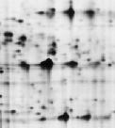
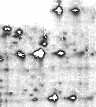
Result

Slide 9
Other Thoughts
Selecting a different place to attach source, sink will have vastly different outcomes – what information we are looking to glean from the image will inform how the graph is built
If multiple segments are desired, how to split up the file is not readily apparent
Edge weight calculation could be handled by other methods to change result

Slide 10
Questions

