Slide 1
5000
4000
3000
3000
Counts
2000
2000
1000
1000
0
0
100
200
300
400
500
100
200
300
400
500
Particle size (nm)
Particle size (nm)
(a)
(b)

Slide 2
5000
μ = 101
4000
Counts
3000
2000
σ = 44
1000
0
100
200
300
400
500
Particle size (nm)

Slide 3
3500
3000
2500
2000
Number of detected particles
1500
1000
500
0
0
50
100
150
200
250
Frame index

Slide 4
1200
2000
1000
Counts
1500
800
600
1000
400
500
200
0
0
100
200
300
400
500
100
200
300
400
500
Particle size (nm)
Particle size (nm)
(a)
(b)

Slide 5

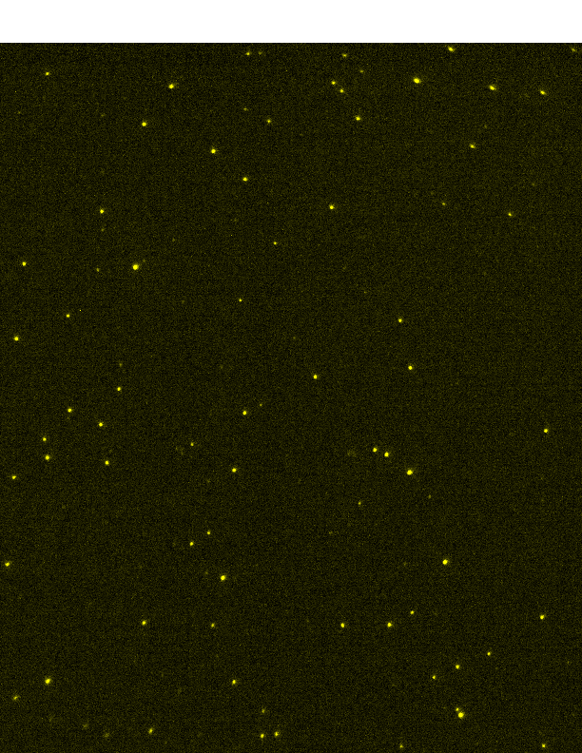
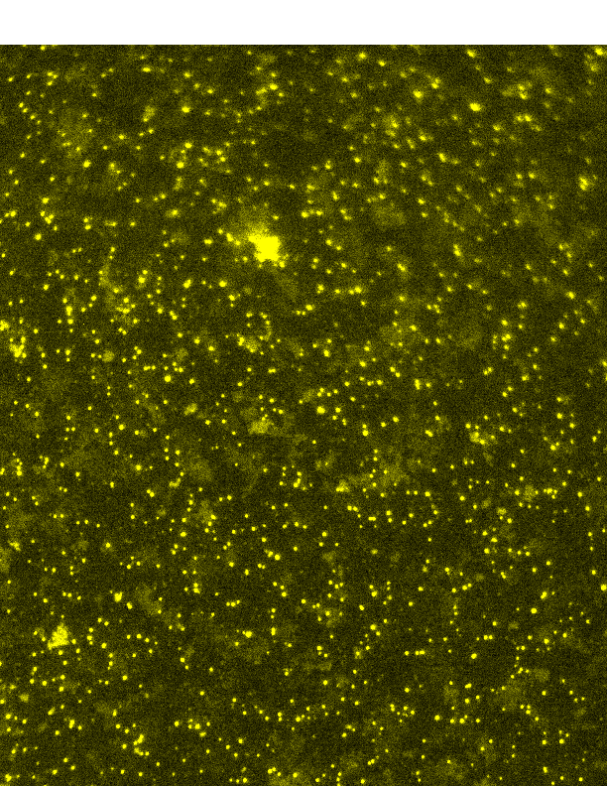
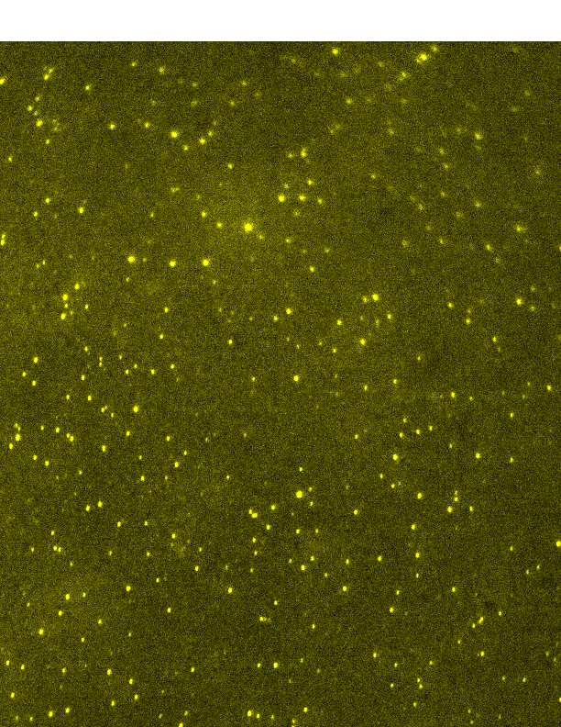
(a)
(b)
(c)
(d)

Slide 6
1200
1000
800
600
Number of detected particles
400
200
0
0
20
40
60
80
100
120
140
160
0
10
20
30
40
50
60
Frame index
Frame index
(a)
(b)

Slide 7
1200
2000
Counts
1000
μ = 155
μ = 142
1500
800
600
1000
400
σ = 71
σ = 68
500
200
0
0
100
200
300
400
500
100
200
300
400
500
Particle size (nm)
Particle size (nm)
(a)
(b)
5000
μ = 87
4000
Counts
3000
2000
σ = 33
1000
0
100
200
300
400
500
Particle size (nm)
(c)

Slide 8
2000
Counts
3000
μ = 142
μ = 88
1500
2000
1000
500
σ = 68
1000
σ = 42
0
0
100
200
300
400
500
100
200
300
400
500
Particle size (nm)
Particle size (nm)
(a)
(b)

Slide 9
2000
Counts
4000
μ = 101
μ = 142
1500
3000
1000
2000
σ = 44
500
σ = 68
1000
0
0
100
200
300
400
500
100
200
300
400
500
Particle size (nm)
Particle size (nm)
(a)
(b)

