Slide 1
eeg-toolkit
Managing, accessing and analyzing human EEG data
Motor-imagery demo on PhysioNet EEGBCI · github.com/stone-coding/eeg-toolkit
Notes:
This is a portfolio project I built to show how I would support a neuroscience lab with research software. It covers analysis, data management, access, privacy, real-time acquisition and a GUI. I will walk through it in about ten minutes, with real results from ten subjects of a public motor-imagery dataset.

Slide 2
Why labs need reusable data tools
■ One-off scripts per study: slow, unreproducible
■ Ad hoc file layouts, names and hidden identifiers
■ Results nobody can query months later
■ Live experiments: hardware drops, disconnects
Goal
Reusable, tested, documented
building blocks for the lab.
Principle
Correctness and reproducibility
before feature count.
eeg-toolkit
2
Notes:
In many labs each study re-implements loading, cleaning and QC in a one-off script, so results are hard to reproduce. Raw files also carry hidden identifiers and inconsistent naming. Experiments that run live add hardware and failure concerns. The toolkit packages these concerns once, with tests, so researchers spend time on science.

Slide 3
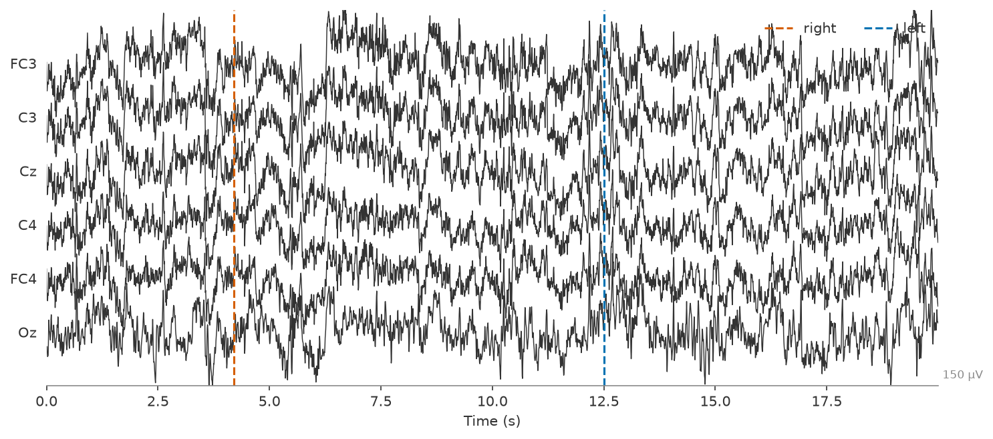
Dataset: EEGBCI motor imagery
■ PhysioNet EEGBCI, 109 subjects; 10 used
■ 64 channels, 160 Hz, 10-10 montage
■ Imagine left vs. right fist (~45 trials each)
■ Expected: contralateral mu/beta ERD
Subject 1, C3/Cz/C4 and neighbours; dashed lines = imagery cues
eeg-toolkit
3
Notes:
I used the public PhysioNet EEGBCI dataset: 64 channels at 160 hertz, with subjects imagining closing their left or right fist. I analysed subjects one to ten, three runs each, about 45 trials per person. The well-known effect to look for is a drop in mu and beta power over the opposite side of the motor cortex, called event-related desynchronization.

Slide 4
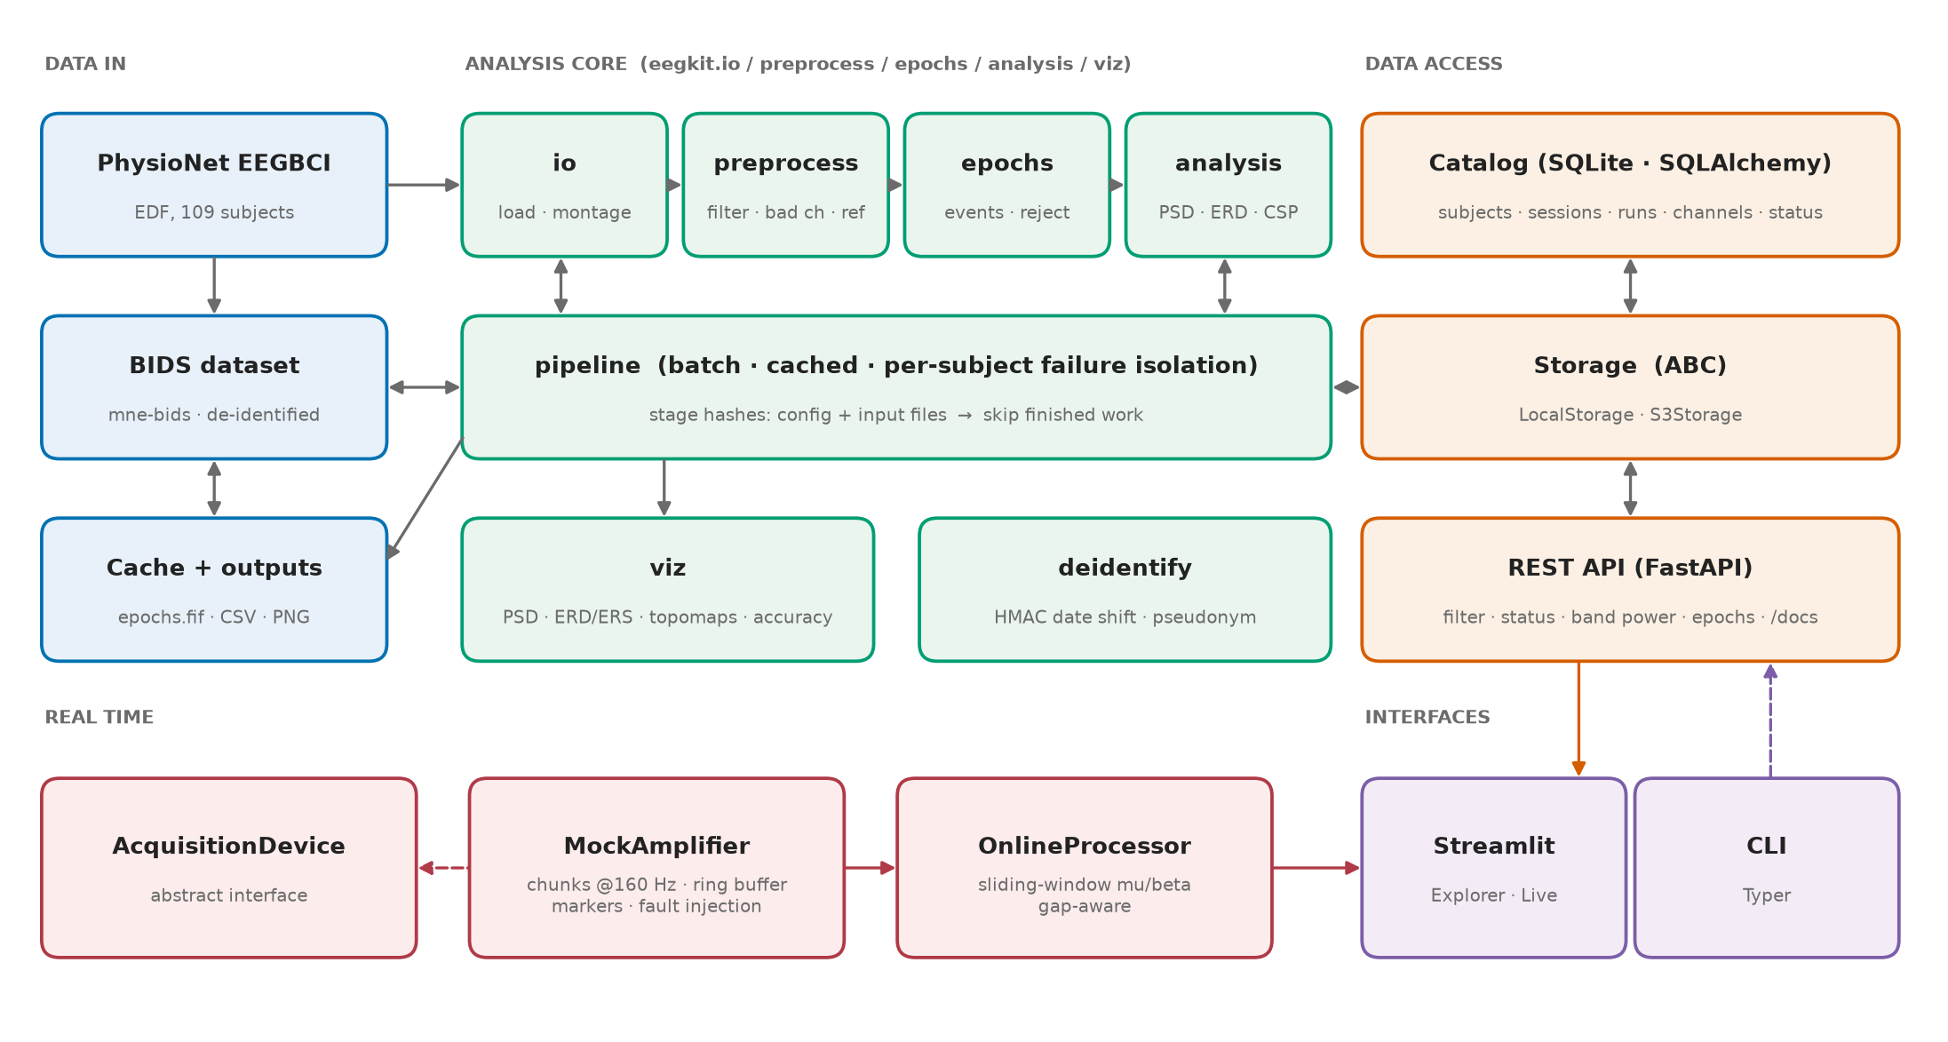
Architecture
eeg-toolkit
4
Notes:
The core analysis package has no dependency on the catalog, API or GUI, which keeps it easy to test and reuse. BIDS is the system of record, and the catalog can always be rebuilt from it. The real-time path sits behind an abstract device interface so a real amplifier driver can replace the simulator.

Slide 5
Data management: BIDS, batch, caching
BIDS dataset
Batch pipeline
Content-hash cache
mne-bids, EDF
events · channels · electrodes
de-identified on ingest
preprocess → epochs → analysis
per-subject + group CSV/figures
failures isolated per subject
config + input files → hash
change bands: only analysis reruns
second run: all stages skipped
eegkit download → to-bids → run → report --subject N
eeg-toolkit
5
Notes:
Raw downloads are converted to a BIDS dataset with mne-bids, with de-identification applied at that boundary. The batch pipeline processes every subject, isolates failures so one bad recording cannot stop the run, and writes per-subject and group outputs. Each stage stores a hash of its config and input files, so rerunning only recomputes what changed.

Slide 6
Data access: catalog + API
Catalog
Storage ABC
REST API
subjects → sessions
→ runs → channels
processing status
artifacts (results)
SQLite + SQLAlchemy
files addressed by key
LocalStorage
S3Storage (MinIO/AWS)
traversal-safe keys
GET /recordings?status=ok
&min_channels=64
GET /subjects/{id}/status
GET /subjects/{id}/bandpower
GET /subjects/{id}/epochs
/docs (OpenAPI)
eeg-toolkit
6
Notes:
A SQLite catalog, via SQLAlchemy, indexes subjects, sessions, runs, channels, sampling rate, file paths and processing status. Files are addressed by key through a storage interface with a local backend and an S3-compatible backend. A FastAPI service lets you filter recordings, read status and band power, and download the epochs file, with OpenAPI docs generated automatically.

Slide 7
Privacy: de-identify at the boundary
Strip
Shift
Verify
names, birthday, MRN
experimenter, device serial
free-text description
date offset 1–3 years
HMAC(salt, subject label)
within-subject intervals kept
identifier scanner
tests: object, FIF bytes,
every BIDS file
A demonstration of the approach — not a HIPAA certification. Docs: privacy.md
eeg-toolkit
7
Notes:
Recording headers can hold names, birthdays, record numbers, experimenter and device serials, and the measurement date. I strip those, replace the ID with a keyed pseudonym, and shift dates by a per-subject offset from an HMAC with a secret salt, so intervals within a subject are preserved. Tests plant identifiers and prove none remain in the object, in the saved file bytes, or in any file of the BIDS dataset. This is a demonstration, not a HIPAA certification.

Slide 8
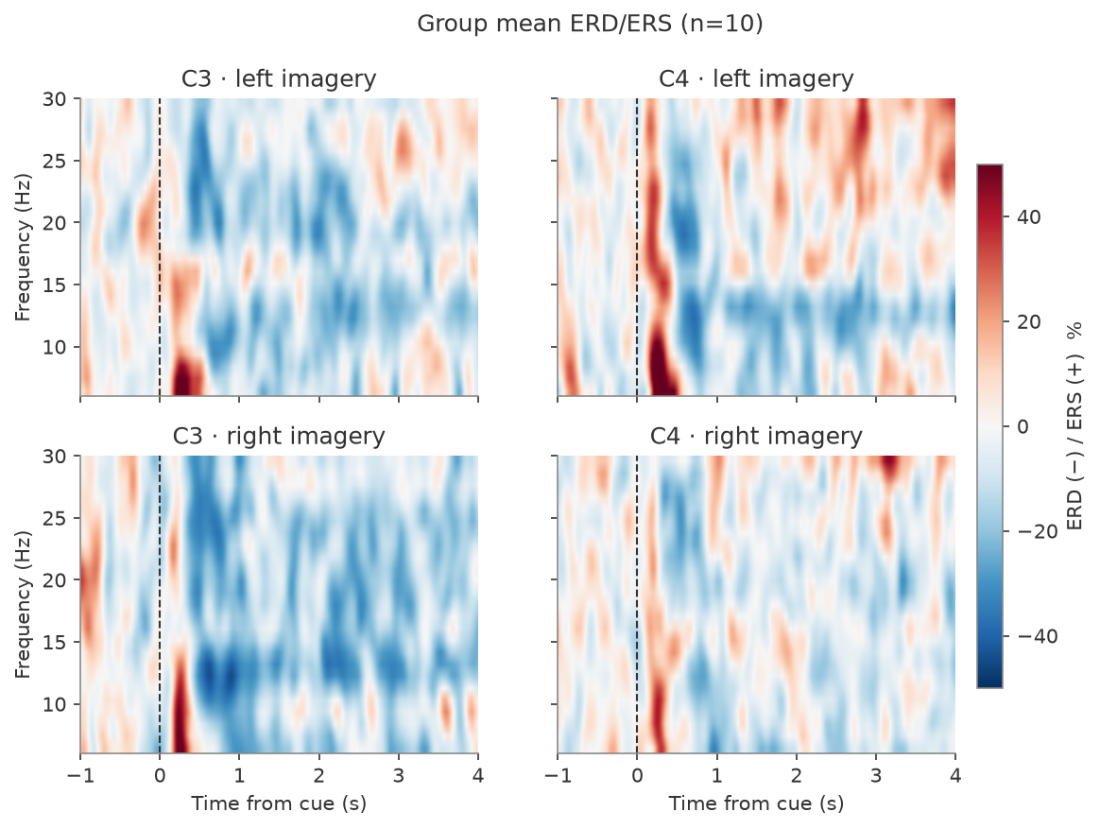
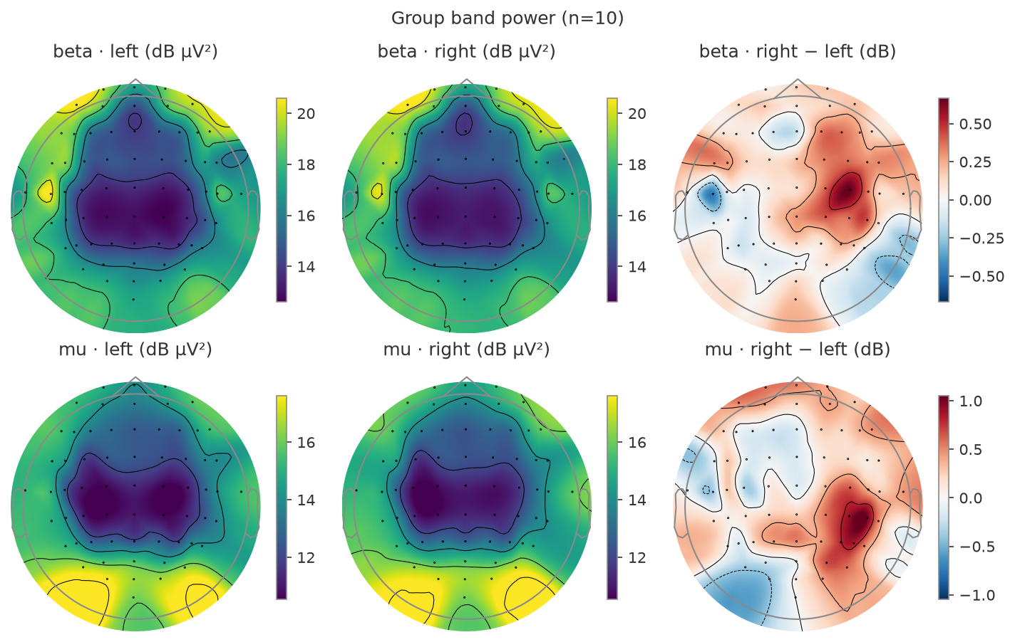
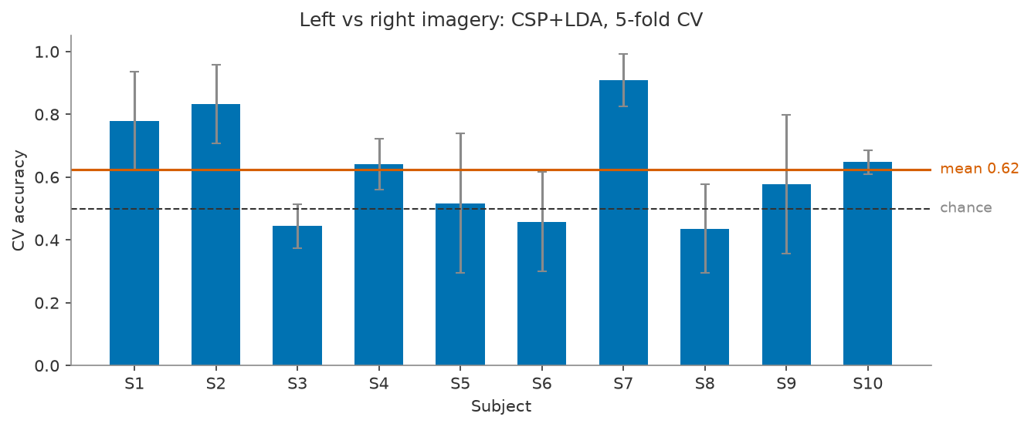
Analysis results
Right imagery: C3 mu -17.6% vs C4 -6.5% (group mean, n=10)
CSP+LDA, 5-fold CV: mean 0.62; 3 of 10 subjects ≥ 0.70
eeg-toolkit
8
Notes:
The time-frequency map shows percent power change after the cue. Imagining a right-hand movement suppresses mu power over C3, the left motor cortex, by about 18 percent, versus 7 percent at C4. The topographies show the same central suppression. Decoding left versus right with CSP and LDA gives 0.62 on average with a wide spread: three subjects reach 0.7 or better and several are at chance, which is typical for motor imagery and for about 45 trials per person.

Slide 9
Real-time acquisition simulation
AcquisitionDevice
(abstract)
MockAmplifier
chunks · markers
OnlineProcessor
mu/beta power
~2 ms
→
→
chunk → band power
Dropped chunk
seq gap detected → window reset
Device disconnect
buffered data delivered, clean stop
Consumer too slow
oldest chunk dropped and counted
eeg-toolkit
9
Notes:
A mock amplifier replays a recording in chunks at the real sampling rate, using absolute deadlines so timing does not drift, and writes into a ring buffer with event markers. An online processor computes sliding-window mu and beta power at C3 and C4; measured latency is about two milliseconds. Each failure mode is handled and tested: dropped chunks reset the window, a disconnect stops cleanly, and overflow drops the oldest data and counts it. A device interface lets a real driver replace the mock.

Slide 10
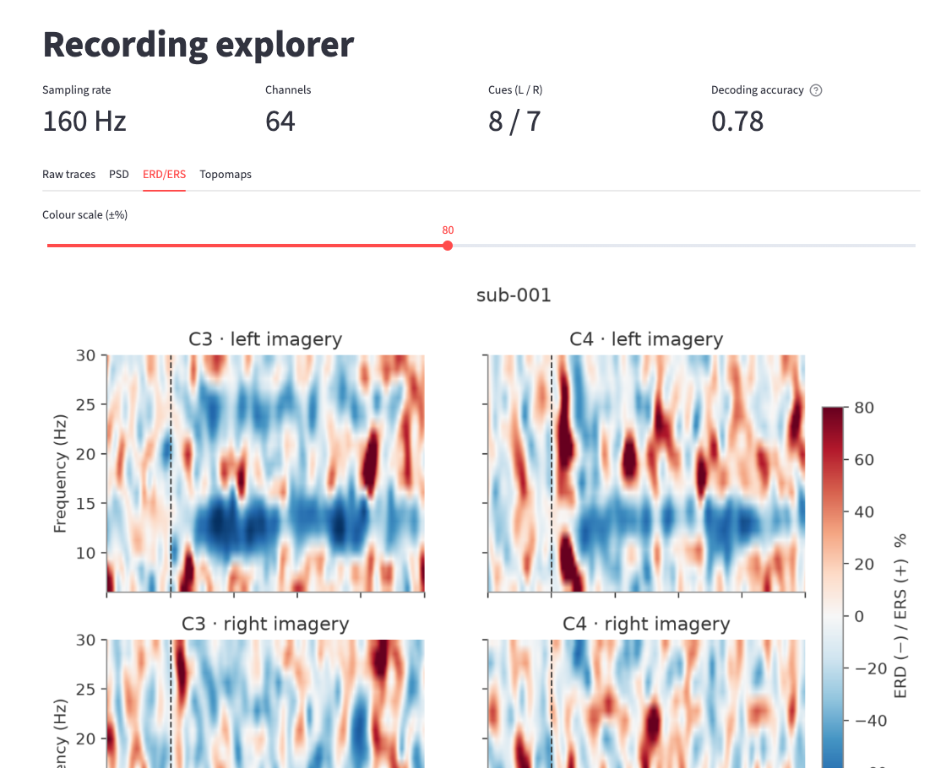
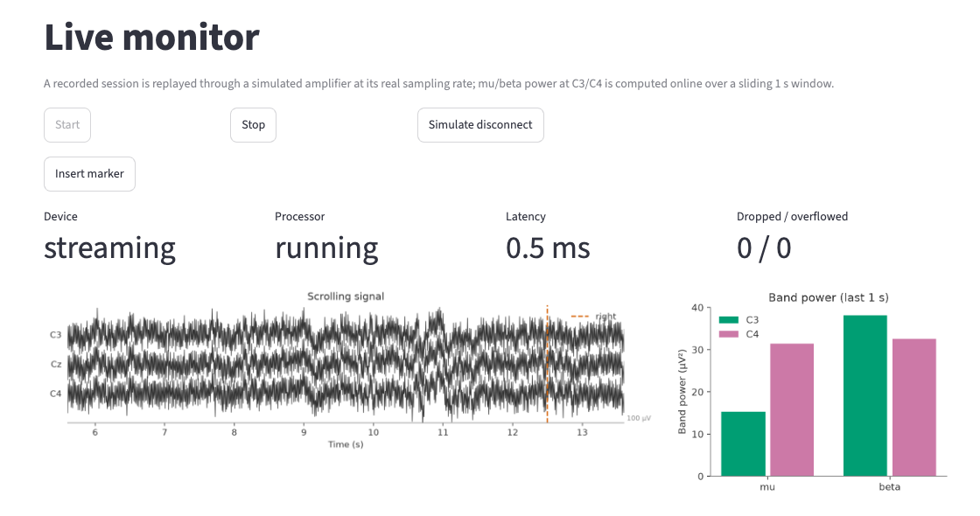
GUI: Explorer and Live monitor
Explorer: catalog-driven, 4 views
Live monitor: simulated amplifier, online power
eeg-toolkit
10
Notes:
The Streamlit app has two pages. The Explorer lets you pick a subject and run from the catalog and view raw traces, spectra, time-frequency maps and topographies. The Live monitor starts and stops the mock amplifier and shows the scrolling signal with cue markers and live band-power bars, plus latency and drop counters. There is also a button to simulate a disconnect, which is useful for demonstrating the failure handling.

Slide 11
Engineering quality
119
98%
ruff + mypy
Docker
tests
coverage
pre-commit, CI
+ MkDocs site
■ Synthetic signals: known sines, injected artifacts, fault injection
■ Real-data tests marked slow, skipped in CI
■ GitHub Actions: lint, type-check, tests on 3.10 + 3.12
eeg-toolkit
11
Notes:
The test suite is mostly synthetic signals built with RawArray, so it needs no downloads: known sines for band power, injected artifacts for rejection, and fault injection for the amplifier. A few tests that need the real dataset are marked slow and skipped in CI. CI runs lint, type-checking and the tests with coverage on Python 3.10 and 3.12, and the docs site and Docker images build from the same repo.

Slide 12
Next steps
Real device drivers
TMS-EEG artifacts
Lab storage
implement AcquisitionDevice
(SDK / Lab Streaming Layer)
timestamps, clock sync,
impedance
pulse + decay artifact removal
interpolation, ICA / SOUND
online gating around pulses
S3 / NAS via Storage ABC
auth + audit log
link to lab metadata system
eeg-toolkit
12
Notes:
First, a real device driver: implement the acquisition interface for an amplifier SDK or Lab Streaming Layer, handling timestamps and clock sync. Second, TMS-EEG: pulse and decay artifact handling, and gating the online processor around pulses. Third, lab storage integration: point the storage interface at the lab's object store or NAS, add authentication and audit logging, and link to the lab's metadata system.

