Slide 1
Email Triage Engine
A token-efficient, multi-stage pipeline that filters noise for free, classifies the rest with a cheap model, and reserves premium LLM calls for the handful of emails that actually matter.
Tiered triage pipeline · Reranker-based routing · Nightly quality audits

Slide 2
THE PROBLEM
You can't afford to run every email through a premium LLM
A naive pipeline sends every unread message's full body to a summarization model. Most inbox volume is noise — but the cost and latency scale with total volume, not with what's actually important.
Naive approach
1,000 unread emails → 1,000 full-body fetches → 1,000 premium LLM calls, every single sync.
Tiered approach
1,000 unread emails → most resolved for free or by a cheap model → only the truly important ones ever reach the premium summarizer.
Every processed message is cached by Message-ID — re-running the pipeline on mail it's already seen costs zero additional tokens.

Slide 3
THE SOLUTION
Escalating tiers — cheapest checks run first
Every unread email is evaluated in order until a level is decided. Each later stage costs more tokens and latency, so it only ever runs on whatever the cheaper stages couldn't confidently resolve.
Stage 0 Static filter
regex / blacklist — free
Stage 0.5 Reranker router
semantic score — cheap
Stage 1 LLM classify
ternary decision — cheap
Stage 2 Premium summary
full body — expensive
→
→
→
A VIP-sender bypass and a low-confidence escalation safety net sit alongside this main line.

Slide 4
STAGE 0
VIP bypass & the static noise filter
VIP bypass
If the sender matches whitelist_vip_senders, skip straight to Stage 2 — full body fetch and a premium summary. No triage decision needed for people who always matter.
Level 0 — static, free
Regex/substring match against blacklist_keywords / blacklist_senders, unless the sender's domain is whitelisted. A hit tags the message low / level 0 — no network call, no LLM call.
Example blacklist keywords
unsubscribe · newsletter · promotions · marketing · no-reply · noreply · digest · advertisement

Slide 5
STAGE 0.5 — DEEP DIVE
How the reranker router actually works
Not an LLM call — a semantic reranker (a Cohere/Jina-style /rerank endpoint) scores each email's relevance against two fixed “anchor” documents representing importance and noise.
“Important” anchor
“An urgent personal message from a specific person requiring your direct reply, decision, or action, such as a work request, deadline, bill, or critical account issue.”
“Noise” anchor
“An automated system notification, media download alert, promotional marketing email, newsletter, or subscription update that does not require any reply or action from you.”
Step | What happens
1. Build the query | From: {sender} | Subject: {subject} | Snippet: {snippet}
2. Call the reranker | POST /rerank {model, query, documents:[important, noise]} → {results:[{index, relevance_score}]}
3. Route on thresholds | importance ≥ 0.95 and ≥ noise → Level 2 · noise ≥ 0.999 and > importance → Level 0 · otherwise → Level 1

Slide 6
STAGE 1
Cheap LLM ternary classification
Sends only From / Subject / Snippet — never the full body — to a cheap model via an OpenAI-compatible /chat/completions proxy, expecting a strict JSON decision.
Field | Meaning
suggested_level | 0 (noise) · 1 (notification) · 2 (important)
reason | short natural-language justification
confidence_score | 0.0 – 1.0
tag | one-word classification, e.g. promotion, personal, vip
The same rerank-based classifier from Stage 0.5 can also stand in here (triage_type: "tei") instead of an LLM call.

Slide 7
SAFETY NET & STAGE 2
Ambiguity escalation, then the premium summary
Ambiguity escalation
If Stage 1's confidence_score falls below confidence_threshold (default 0.8), the full body is fetched and re-evaluated by the premium model — a rare safety net, not the normal path.
Level 2 — premium summarization
Only for messages that land here: full body → premium model → a bulleted executive summary, plus its own confidence score and tag.
SummaryResult schema
summary (string) · confidence_score (0.0–1.0) · tag (e.g. vip)

Slide 8
COST CONTROL
Cache everything — pay for a message exactly once
Every processed message is keyed by its RFC Message-ID in a SQLite email_cache table: triage level, tag, reason, score, summary, and per-stage token/duration metrics.
0
tokens spent re-processing an already-cached message
1
row per message, updated in place as it moves through stages
2
write phases — download (metadata/body) and triage (decision)
A row can exist before triage runs (metadata downloaded, not yet classified) — “processed” specifically means triage_level IS NOT NULL.

Slide 9
PRODUCTION QUALITY CHECK
How do you know accuracy holds — without reading every email?
Cheap models drift silently. A nightly “no-look” audit samples already-triaged mail, has a separate judge model independently re-decide, and compares the two — no human has to read anything.
Stratified sampling
Sampled per triage level (0/1/2), not as one flat draw — so a small sample rate can't miss an entire level by chance. Pooled across a user's accounts so a low-volume mailbox isn't rounded to zero.
Example — 10% sample rate
24h window: 20 level-0 + 50 level-1 + 30 level-2 emails → sampled: 2 + 5 + 3 — matching each level's share, minimum 1.

Slide 10
PRODUCTION QUALITY CHECK
Judge, compare, measure
Sample
stratified by level, pooled across accounts
Judge model
independent re-classification
Compare
judge vs. cached production result
Metrics
stored + trended nightly
→
→
→
Precision / Recall / F1
Macro-averaged over levels {0, 1, 2} — the judge's re-derived level is treated as ground truth, production's cached level as the prediction being evaluated.
Summary quality
For messages production actually summarized, the judge grades that summary 1–10 on accuracy, conciseness, and actionability.

Slide 11
ADMIN DASHBOARD
7-day quality trend, at a glance
Runs nightly (default 01:00 UTC), on-demand via Run now, or backfilled historically with a standalone script. Every run is logged so “nothing ran” is never confused with “it ran and failed”.

Slide 12
INTERFACES
Three ways to talk to the pipeline
The same tiered engine underneath — main.py and mcp_server.py share the same triage primitives — is exposed three different ways depending on who (or what) is asking.
CLI
main.py / email-triage.sh — silent JSON-array output by default, built for piping into other tooling. --human for a rich terminal UI, --level 2 --compact for a minified schema tuned for LLM agent consumption.
MCP server
mcp_server.py — Model Context Protocol server for AI agents/editors. stdio transport for local tools (e.g. Claude Desktop); SSE/HTTP transport for a long-running deployment with the background scheduler and dashboard.
Dashboard
A Vite + React SPA — login, per-account sync controls, token usage, integrations, admin settings, and the quality-check trend — talking to the same Starlette routes the MCP server exposes.
MCP access is per-user, token-based (issued at /api/me/mcp-tokens); the dashboard uses cookie sessions.

Slide 13
MCP SERVER
What an AI agent can actually call
Eight tools, split between reading cached state (free) and taking action (mutates a mailbox or triggers a live sync).
Read-only tool | What it does
fetch_and_process_unread | Cached triage/summaries for unread mail — zero token cost
search_emails | Live Gmail/IMAP search, enriched with cached triage data
get_last_download_time | Per-account sync freshness
Action tool | What it does
trigger_download | Forces an immediate sync + triage now
mark_emails_as_read | By triage level, a message, or all
create_new_draft | Creates a new draft (Gmail or IMAP)
create_draft_reply | Drafts a reply to an existing email
send_email_reply | Sends a reply directly, no draft step

Slide 14
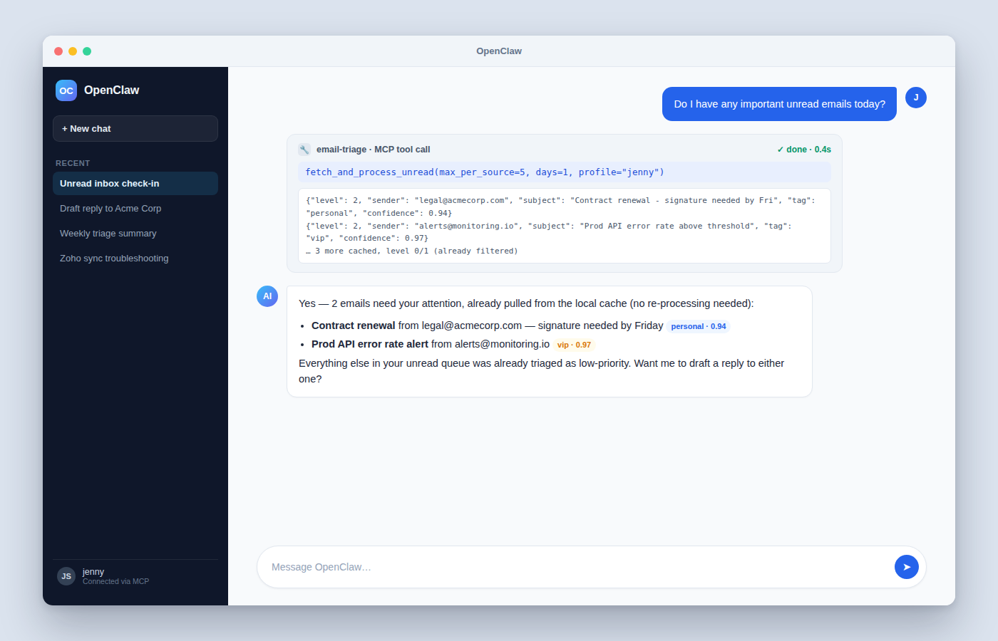
MCP IN THE WILD
Any MCP-compatible client can drive this
Point a client like OpenClaw at the SSE endpoint with a per-user token (issued from /api/me/mcp-tokens), and it gets the same 8 tools an editor or custom agent would — including cached, zero-token-cost reads like fetch_and_process_unread.
Illustrative mockup UI, not an actual OpenClaw screenshot — built to show the shape of a real tool-call exchange (request → cached result → synthesized answer).

Slide 15
UNDER THE HOOD
Architecture at a glance
Ingestion & pipeline
Gmail API + Zoho/IMAP (XOAUTH2), concurrent per account. CLI (main.py) and MCP server (mcp_server.py, FastMCP) share the same tiered pipeline primitives.
Storage
SQLite throughout — a per-user email_cache.db, plus a shared app.db for users, sessions, integrations, settings, and quality-check history.
Multi-tenant
DB-backed accounts with real login, per-user multi-account Gmail/Zoho/IMAP OAuth integrations, and per-user MCP tokens for agent access.
Dashboard
A Vite + React SPA — sync controls, token usage, and the quality-check trend — talking to the same Starlette routes the MCP server exposes.

Slide 16
Cheap checks first.
Premium only where it matters.
Quality measured continuously.
Questions?

