Slide 1
TiML: A Functional Language for Practical Complexity Analysis with Invariants
Peng Wang¹, Di Wang², Adam Chlipala¹
¹ MIT CSAIL, USA
² Peking University, China
OOPSLA 2017
Notes:
Timed ML
Previous work on type-based complexity analysis

Slide 2
Software Verification
Performance
Correctness
Notes:
Knowing the program produces correct answer is not enough.
We need to reason about their performance.
Time cost, memory usage, electricity consumption, etc.

Slide 3
Time-Complexity Verification
Asymptotic Performance Bugs¹
Algorithmic Complexity Attacks²
¹ Oswaldo Olivo, Isil Dillig, and Calvin Lin. Static Detection of Asymptotic Performance Bugs in Collection Traversals. PLDI’15.
² Scott A. Crosby and Dan S. Wallach. Denial of Service via Algorithmic Complexity Attacks. SSYM’03.
Notes:
Especially time-complexity draws a lot of attention.
Asymptotic performances bugs can influence user experience.
Suppose you are using an app on your phone, but it ‘dies’ when doing some actions, that’s annoying.

Slide 4
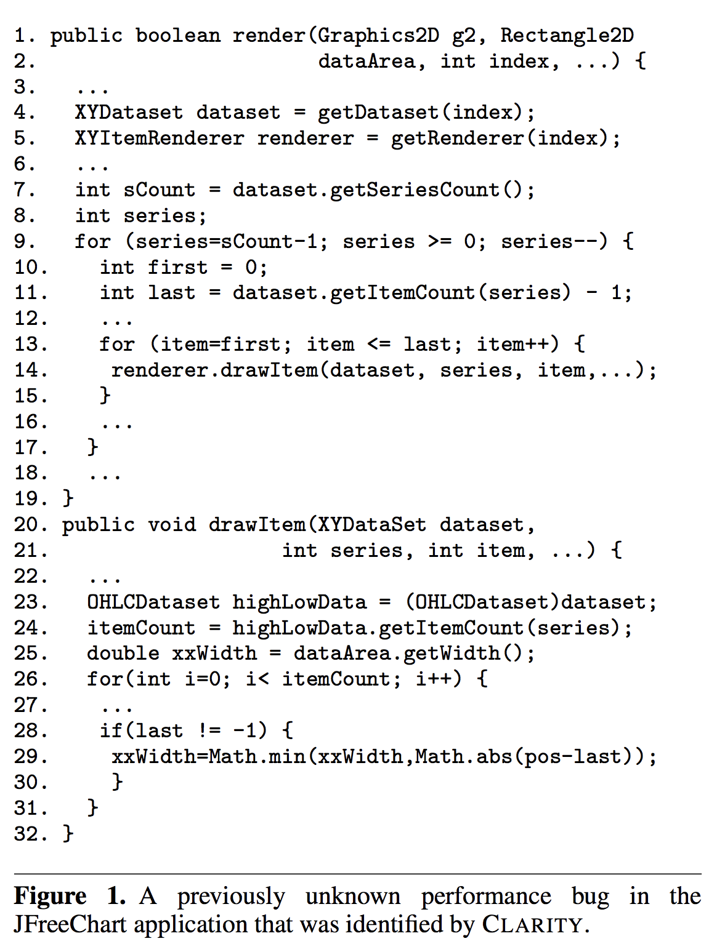
Notes:
A bug in previous JFreeChart implementation.
xxWidth is recomputed when it draws each item.
The complexity becomes quadratic.
But xxWidth can be pre-computed, then reduce to linear time.
It is helpful if some tool tells you the time complexity of render function is quadratic.

Slide 5
Time-Complexity Verification
Asymptotic Performance Bugs¹
Algorithmic Complexity Attacks²
¹ Oswaldo Olivo, Isil Dillig, and Calvin Lin. Static Detection of Asymptotic Performance Bugs in Collection Traversals. PLDI’15.
² Scott A. Crosby and Dan S. Wallach. Denial of Service via Algorithmic Complexity Attacks. SSYM’03.
Notes:
Another setting is algorithmic complexity attacks.
Most of time the program behaves normally, but there is a chance to construct input to make it slow.
If the slow is significant, then one can perform a Denial of Service attack.

Slide 6
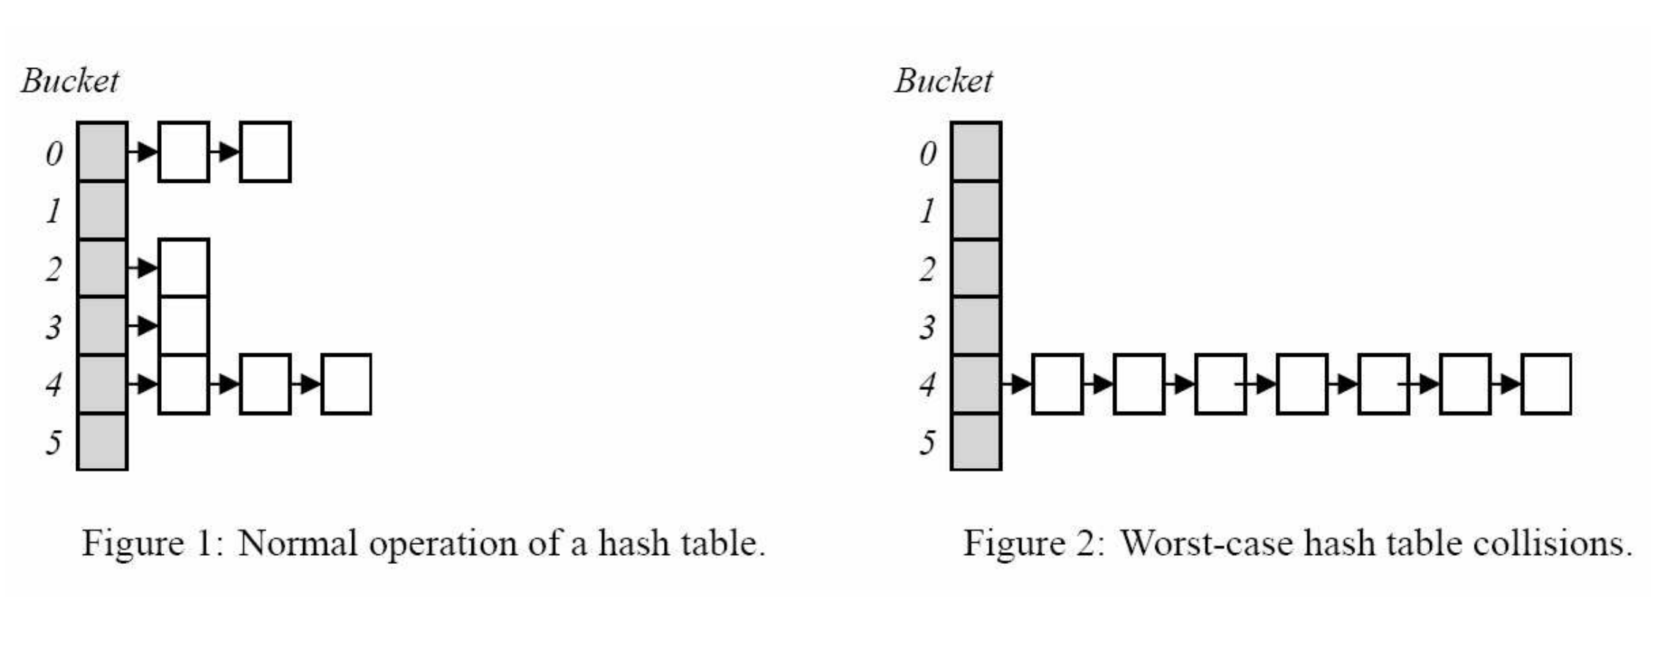
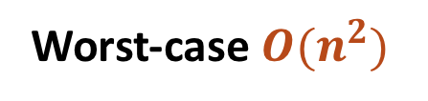
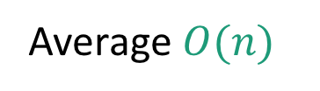
Denial of Service
Average $O(n)$
Worst-case $O(n^{2})$
Notes:
Example of hash tables.
In average each insertion takes constant time, and a list of insertions takes linear time.
If an attacker constructs a list of elements with the same hash key, then the whole time becomes quadratic.

Slide 7
Static Complexity Guarantee
Push-button Systems (RAML¹, SPEED², etc.)
Restricted domain
Disallow user-provided hints at failure
Full Proof Systems (Program Logics in Coq³, etc.)
Manual proof
¹ Jan Hoffmann, Ankush Das, and Shu-Chun Weng. Towards Automatic Resource Bound Analysis for OCaml. POPL’17.
² Sumit Gulwani, Krishna K. Mehra, and Trishul Chilimbi. SPEED: Precise and Efficient Static Estimation of Program Computational Complexity. POPL’09.
³ Robert Atkey. Amortised Resource Analysis with Separation Logic. ESOP’10.
Notes:
Different from correctness, time complexity is hard to test!
Need to run on a lot of inputs, even with large size.
Have nothing to do with worst-case.
Static methods come into the scene.
Automation & Human efforts

Slide 8
TiML’s Approach
Methodology
User-provided specs/hints/annotations
SMT-powered verification-condition discharging
Techniques
Indexed types – time and size
Refinement kinds – invariants
Big-O inference
Notes:
Middle-way approach
Human efforts – write type annotations as specs or hints
Automation – TiML generates verification conditions which are proved by SMT solvers

Slide 9
Outline
TiML Examples
Formal Definition and Soundness
Big-O Inference
Evaluation on 17 Example Programs

Slide 10
Outline
TiML Examples
Formal Definition and Soundness
Big-O Inference
Evaluation on 17 Example Programs

Slide 11
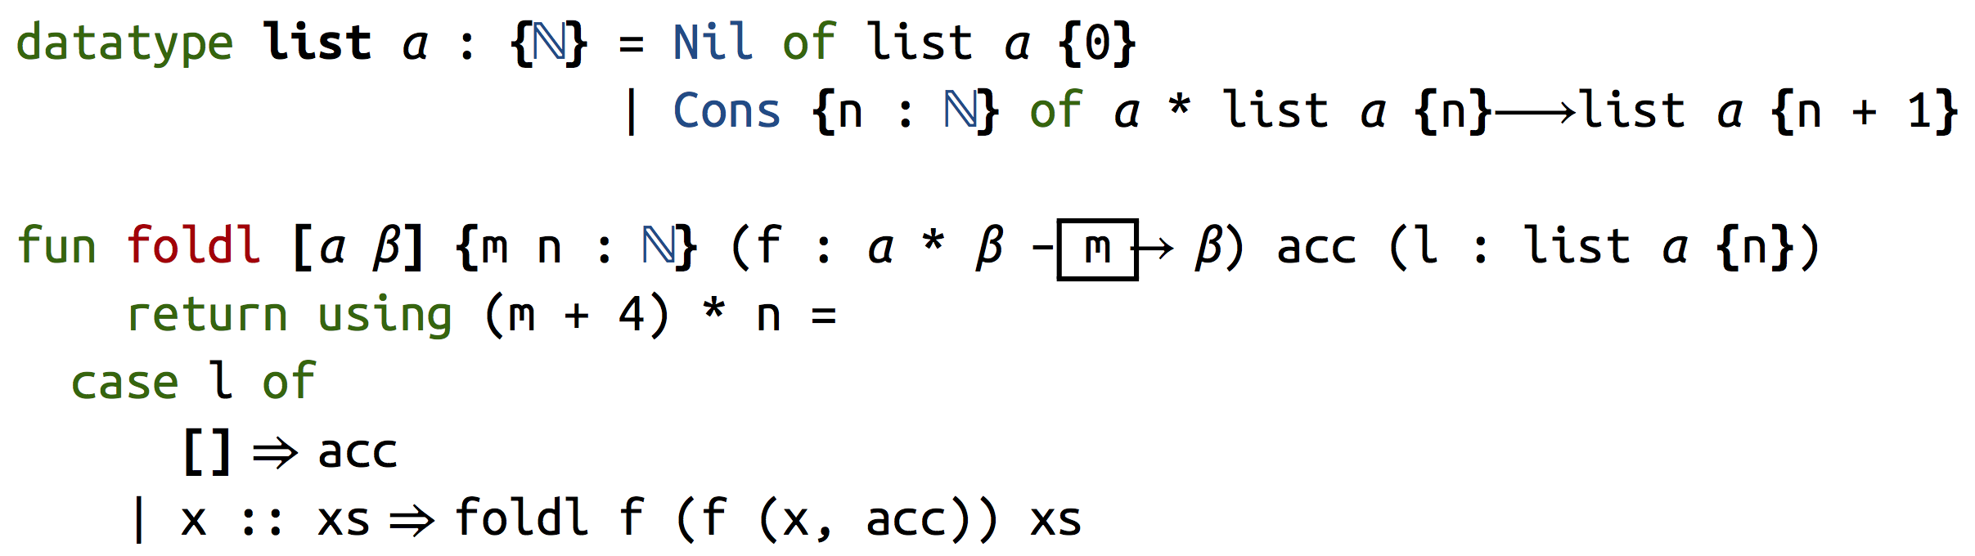
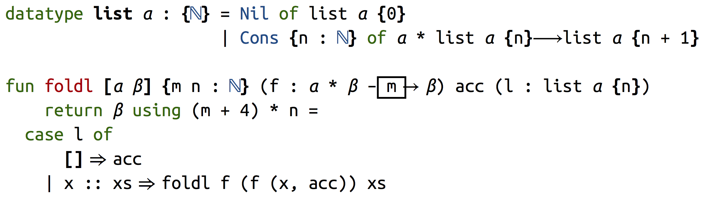
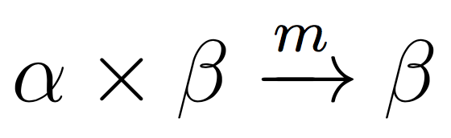
Eg 1 (foldl): Basic Syntax
Notes:
A standard fold-left function
3 arguments: a function to combine list element and result, a result, a list
Curried function
Count for #function calls
Lists are indexed by length
Verification condition

Slide 12
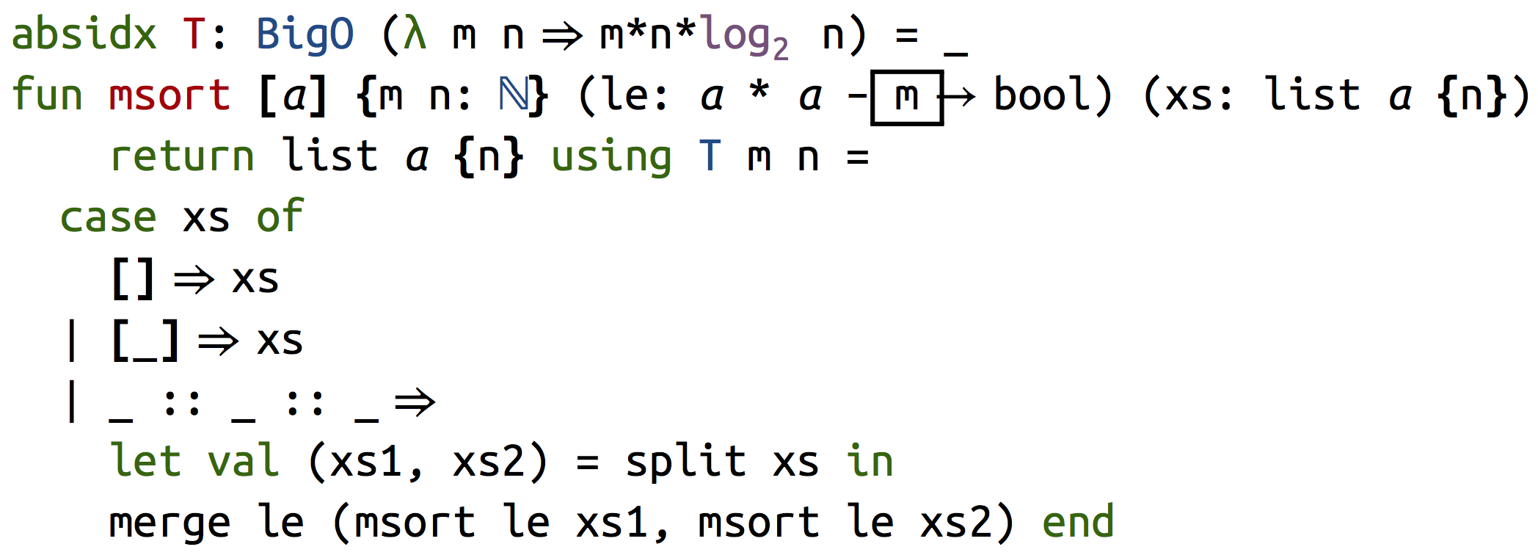


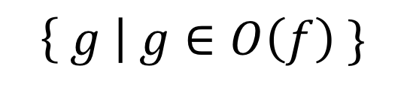
Eg 2 (msort): big-O complexity
$$\left\{ g \right| g∈O\left(f\right) \}$$
where
and
are known
Notes:
BigO is defined using other mechanisms, not ad-hoc
split and merge are defined elsewhere
split from 1 list to 2 lists with half length, linear time
merge from 2 lists to 1 list with sum length, linear time in sum
BigO is verified differently

Slide 13
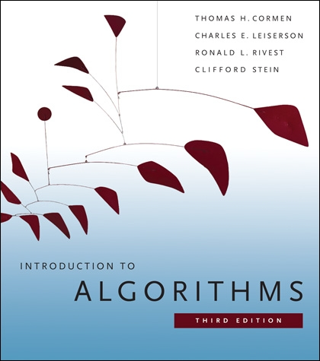
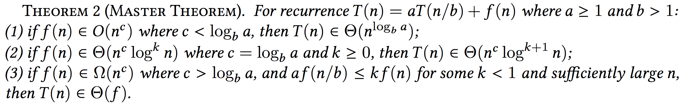

Slide 14
Eg 2 (msort): big-O complexity
where
and
are known
Notes:
Use Master’s Theorem to derive a BigO solution
Compare the solution to user’s specification
Syntactic rules

Slide 15
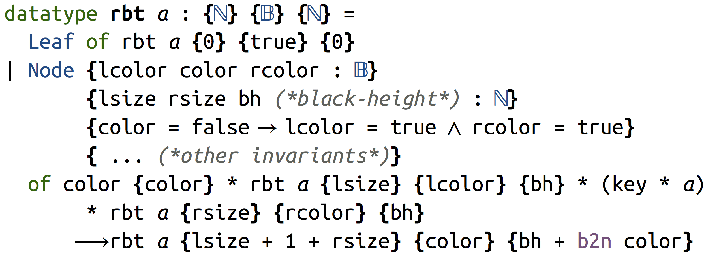
Eg 3 (rbt): custom size & invariant
Notes:
A red black tree is indexed by its size, the color of its root, and its black height
If root is red, then both children should be black
Complexity of operations on red black trees can be specified w.r.t. black height

Slide 16
Contributions
Novel use of refinement kinds for complexity analysis with invariants
A sizeable set of example programs
Formal soundness proof in Coq

Slide 17
Outline
TiML Examples
Formal Definition and Soundness
Big-O Inference
Evaluation on 17 Example Programs

Slide 18
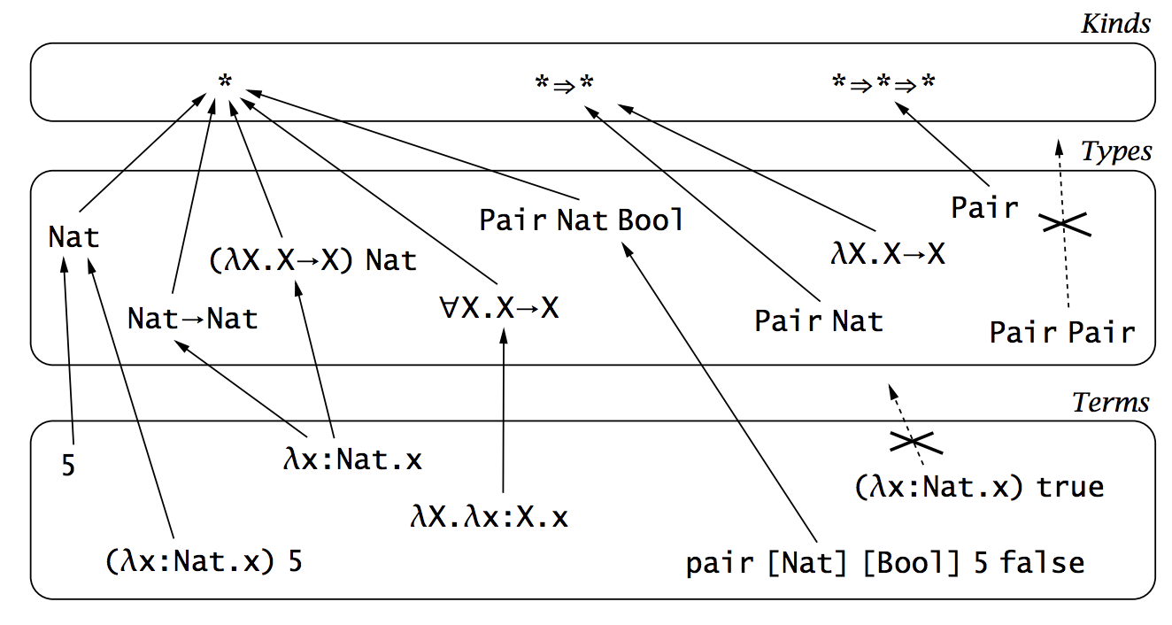

System $F_{ω}$: Kinding
[Picture from Benjamin C. Pierce. Types and Programming Languages. The MIT Press.]
Notes:
Types classify terms
How about type operators?
Type-level functions, treat them formally
Type abstraction & type application
Build classification over type constructors
Kinds classify types
Proper types

Slide 19
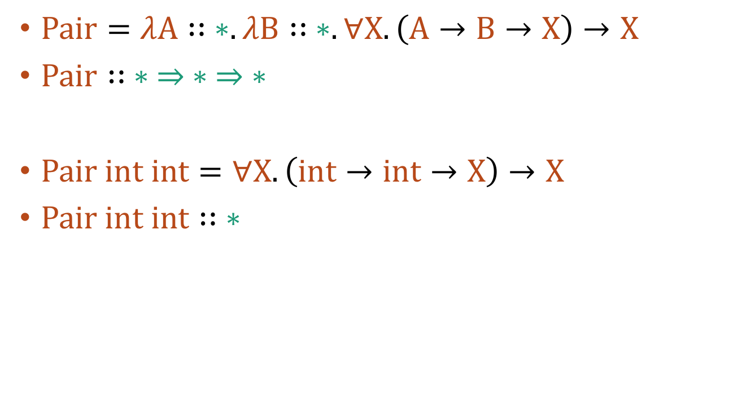
System $F_{ω}$: Kinding
$Pair=λA∷ ∗. λB∷ ∗. ∀X. \left(A→B→X\right)→X$
$Pair∷ ∗ ⇒ ∗ ⇒ ∗$
$Pair int int=∀X. \left(int→int→X\right)→X$
$Pair int int∷ ∗$
Notes:
Type-level lambdas
Church encoding of pairs

Slide 20











Indexed Types
Developed by Dependent ML¹
Kinds
$$∗$$
$$∗ ⇒ ∗$$
$$∗ ⇒ ∗ ⇒ ∗$$
$$ℕ⇒ ∗$$
$$ℕ$$
$$∗$$
?
X
Types
$$IntList$$
$$\underline{5}$$
$$∃n∷ℕ.IntList[n]$$
$$IntList[\underline{5}]$$
$$IntList[Foo]$$
$$∀n∷ℕ.int→IntList\left[n\right]→IntList[n+\underline{1}]$$
$$IntList=λn∷ℕ. if n=\underline{0} then Unit else int × IntList[n−\underline{1}]$$
¹ Hongwei Xi and Frank Pfenning. Dependent Types in Practical Programming. POPL’99.
Notes:
More fancy types
Reason about length of list on type level
Existential types – list of some length – user-input list
Universal types – type of cons
IntList can be defined as some type-level computation

Slide 21
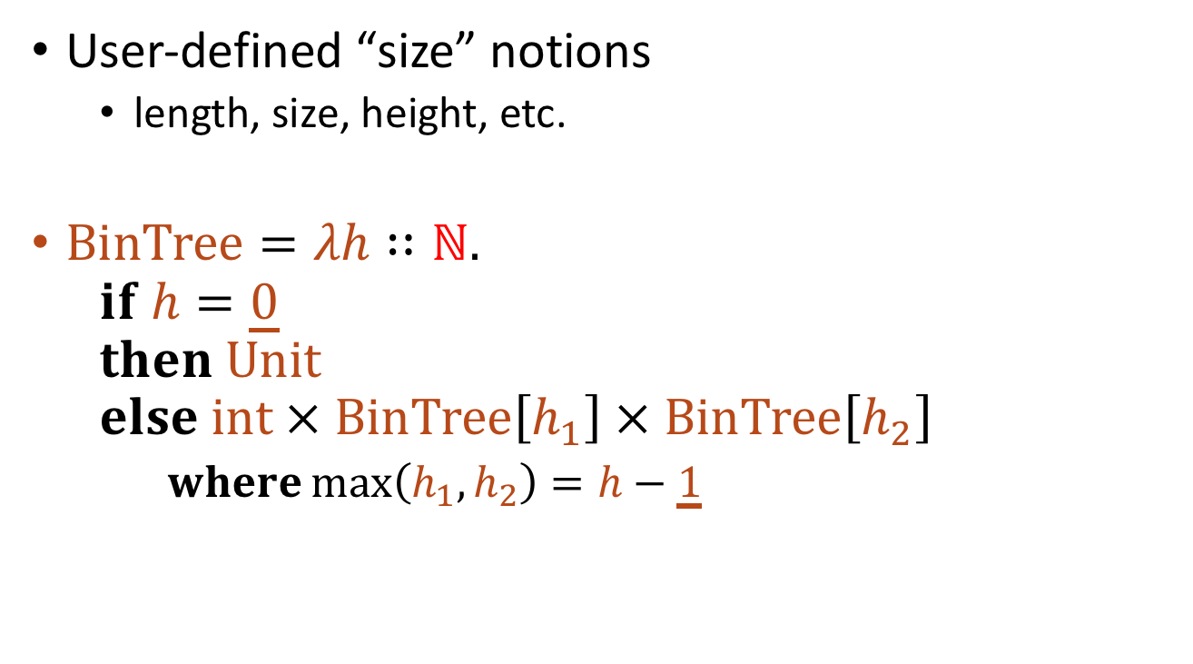
Index as Size
User-defined “size” notions
  length, size, height, etc.
$BinTree=λh∷ℕ.$
  $$if h=\underline{0}$$
  $$then Unit$$
  $$else int × BinTree\left[h_{1}\right] × BinTree\left[h_{2}\right]$$
  $where\max\left(h_{1},h_{2}\right)=h−\underline{1}$
Notes:
Data structures can be indexed using different measures
Binary tree indexed by height

Slide 22
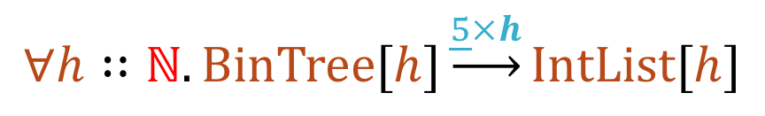
Arrows can be Indexed^{1,2}
Function types are indexed by an upper bound of number of function calls.
$$∀h∷ℕ.BinTree[h]\underset{→}{\underline{5}×h}IntList[h]$$
¹ Karl Crary and Stephanie Weirich. Resource Bound Certification. POPL’00.
² Brian Reistad and David K. Gifford. Static Dependent Costs for Estimating Execution Time. LFP’94.
Notes:
Use type-level indices to denote time complexity

Slide 23
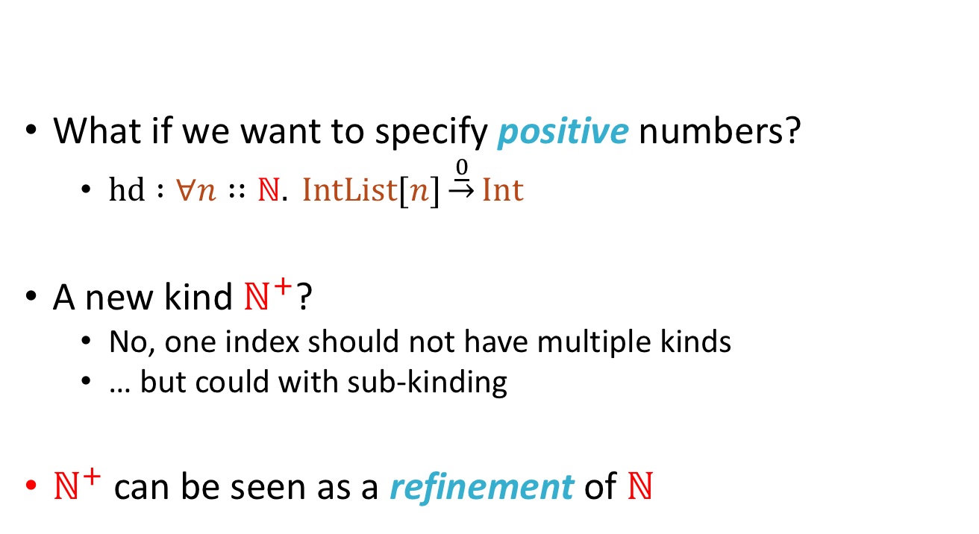





Refinement Kinds
Kinds
What if we want to specify positive numbers?
  $hd :∀n∷ℕ. IntList[n]\underset{→}{\underline{0}}Int$
A new kind $ℕ^{+}$?
  No, one index should not have multiple kinds
  … but could with sub-kinding
$ℕ^{+}$ can be seen as a refinement of $ℕ$
$$∗$$
$$∗ ⇒ ∗$$
$$∗ ⇒ ∗ ⇒ ∗$$
$$ℕ⇒ ∗$$
$$ℕ$$
Notes:
For a head function, we might require the length of list is positive
Instead of built-in sub-kinds, refinements are allowed

Slide 24
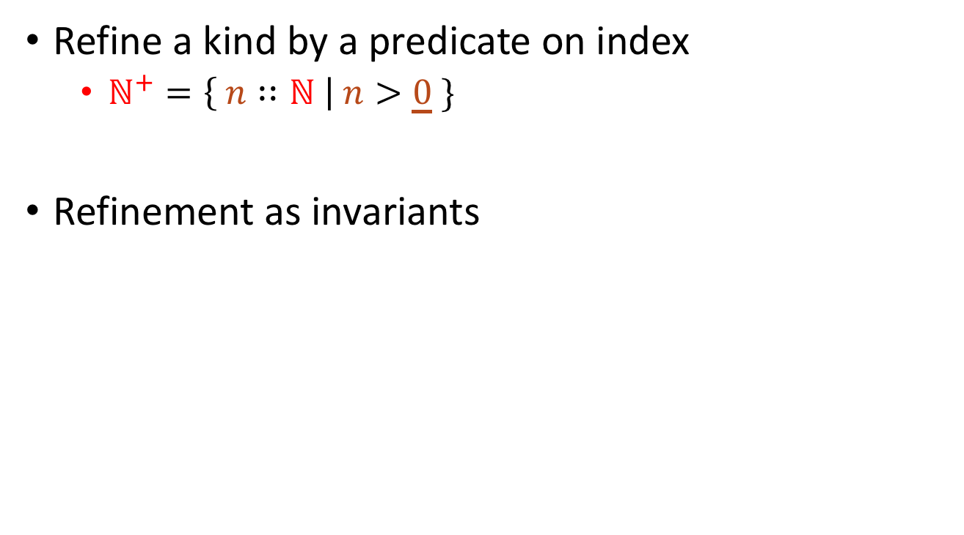

Refinement Kinds
Refine a kind by a predicate on index
  $ℕ^{+}=\left\{ n∷ℕ \right| n>\underline{0} \}$
Refinement as invariants
$$IntList=λn∷ℕ. if n=\underline{0} then Unit else int × IntList[n−\underline{1}]$$
$$IntList=λn∷ℕ. ∃_∷\left\{_∷1 \right| n=\underline{0}\}.Unit+$$
$∃n^{′}∷\left\{m∷ℕ \right| n=m+\underline{1}\}.int × IntList[n′]$
Notes:
IntList can be constructed using refinement kinds, existential types, and sum types

Slide 25


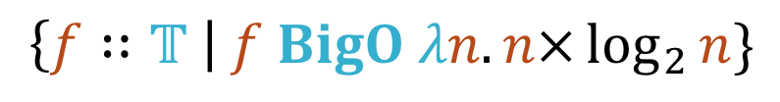

Big-O as Refinement
Kinds
$$∗$$
$$∗ ⇒ ∗$$
$$∗ ⇒ ∗ ⇒ ∗$$
$$ℕ⇒ ∗$$
$$ℕ$$
$$𝕋$$
$$λn.n×\log_{2}{n}$$
$$\left\{f∷𝕋 \right| f BigO λn.n×\log_{2}{n}\}$$
Notes:
Time functions are a separate kind
BigO defines a refinement

Slide 26
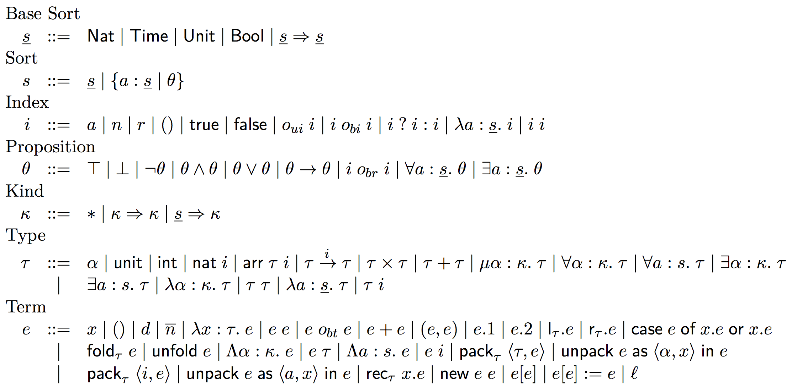
Formal Syntax
Notes:
Terms are classified by types
Types can be indexed by indices and are classified by kinds
Indices are classified by sorts
Types and indices are separated because they are treated differently in the metatheory
(dependent) indices are given a denotational semantics
Types are not
Also make least change to the base type system

Slide 27
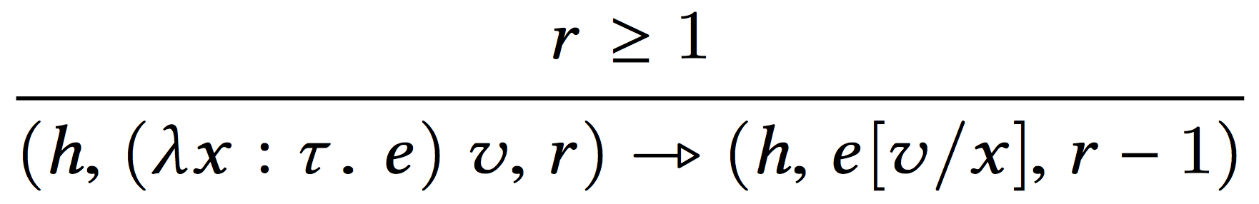
Fuel-augmented Semantics
Notes:
Standard small-step operational semantics
Beta reduction consumes the fuel

Slide 28

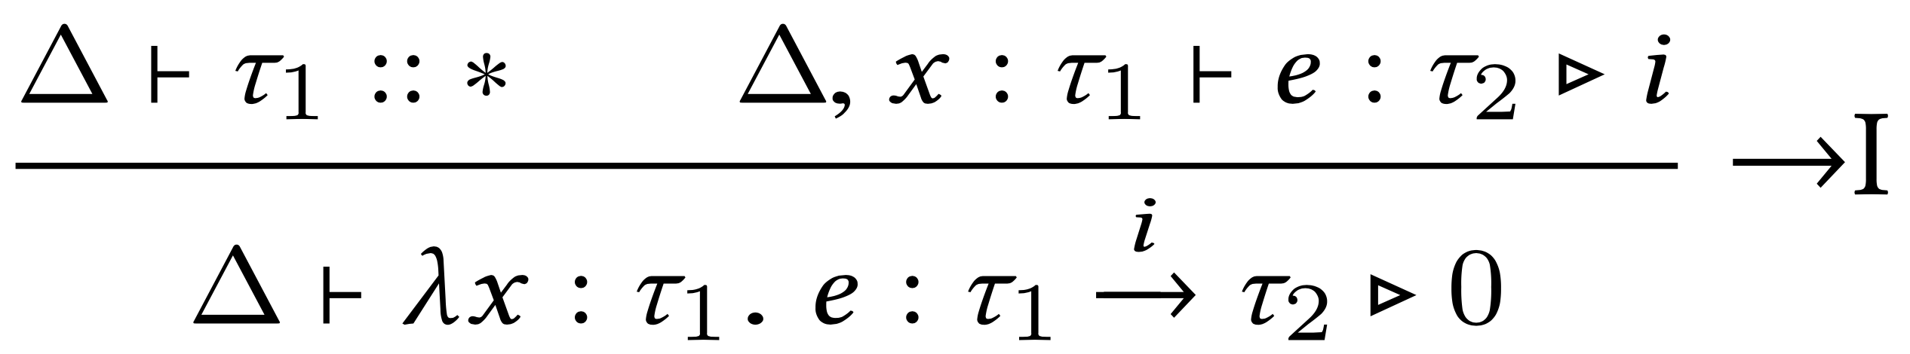
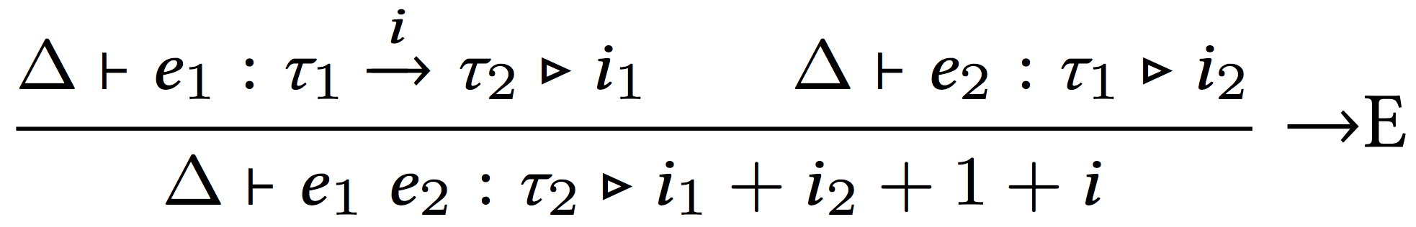
Type System: Typing Rules
Notes:
An upper bound on time needed to reduce e to a value
Can be an open index

Slide 29

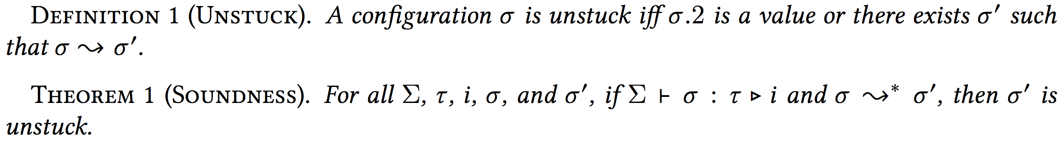
Soundness
“Given an amount of fuel no less than what is estimated by the type system, a well-typed program will never go wrong or run out of fuel.”
Notes:
Here i is a closed index
Closed terms behave well
Formalized in Coq

Slide 30
Outline
TiML Examples
Formal Definition and Soundness
Big-O Inference
Evaluation on 17 Example Programs

Slide 31
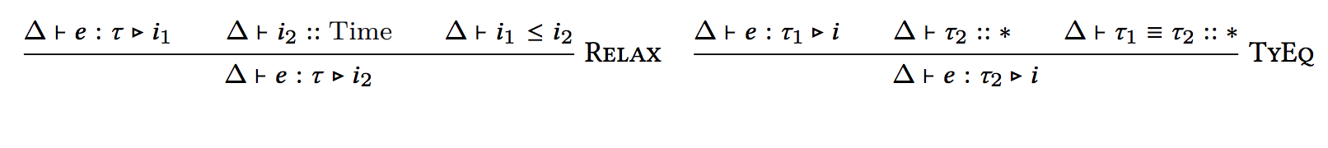
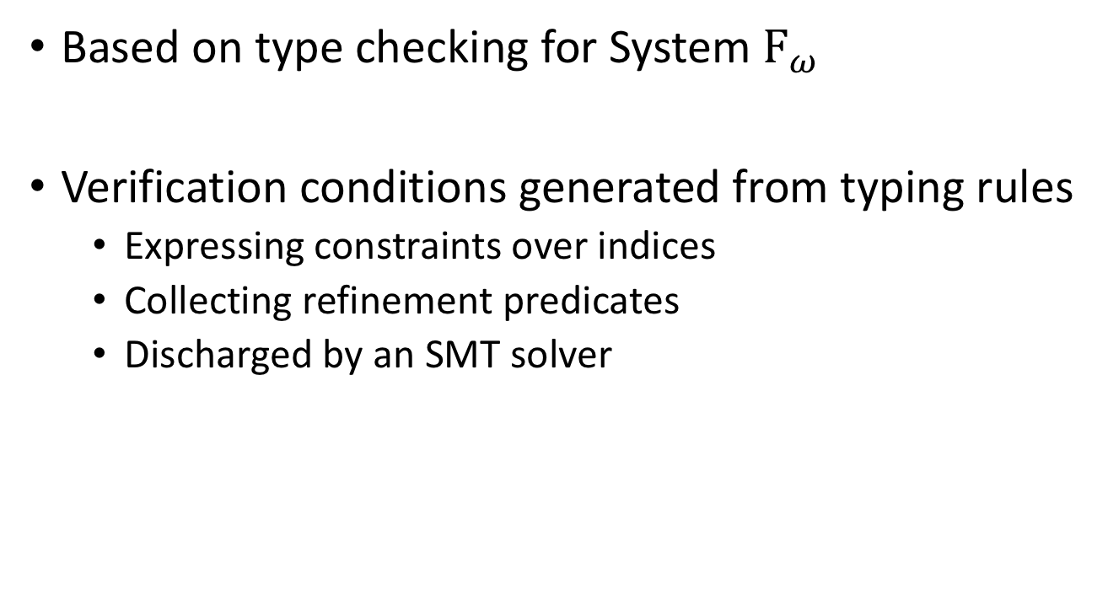
Type Checking
Based on type checking for System $F_{ω}$
Verification conditions generated from typing rules
  Expressing constraints over indices
  Collecting refinement predicates
  Discharged by an SMT solver
Notes:
Standard Hindley-Milner type inference
Some index inference
VC generation, SMT solving

Slide 32
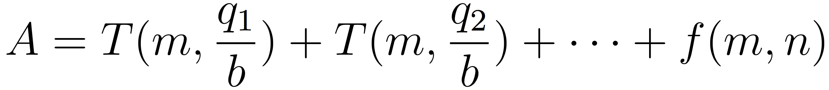
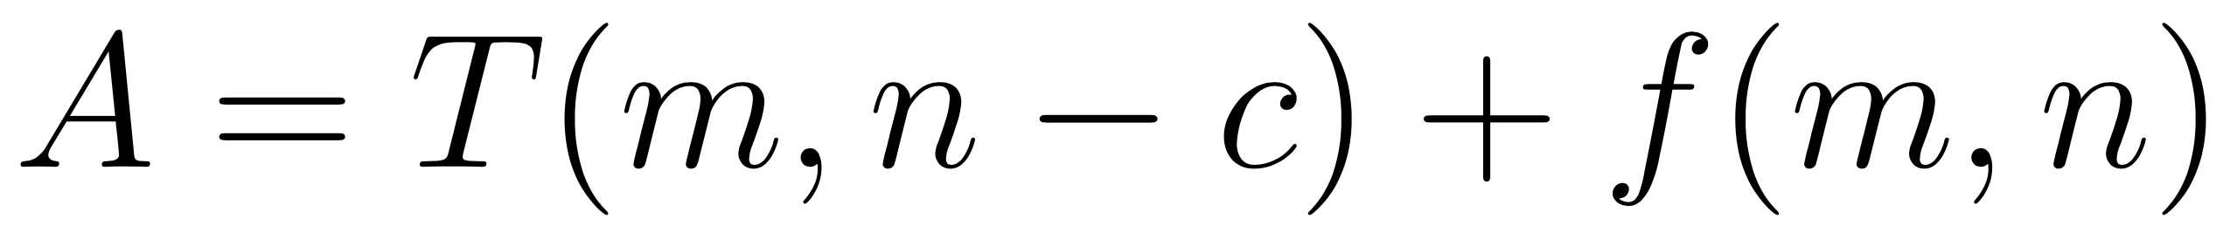
Pattern Match
or
Notes:
BigO solver
Massage the VCs and perform a pattern match w.r.t. Master’s theorem
Dividend/divisor

Slide 33
Outline
TiML Examples
Formal Definition and Soundness
Big-O Inference
Evaluation on 17 Example Programs

Slide 34
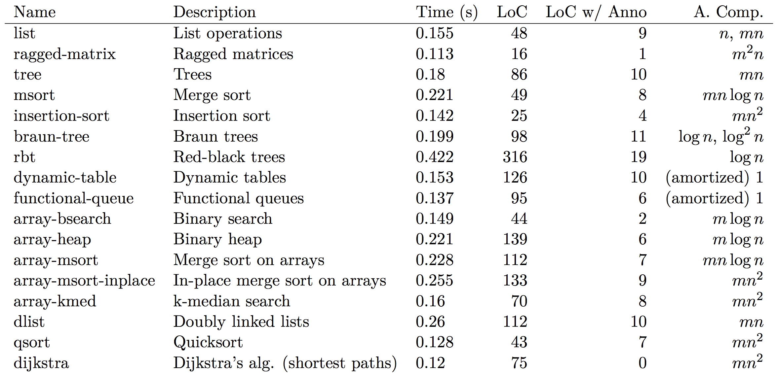
Notes:
Classic algorithms, including array-based ones
Can do amortized complexity
Amount of annotations are relatively reasonable

Slide 35
Future Work
Other Resources
Stack, memory, etc.
Type-preserving Compilation
Carry complexity guarantees to the assembly level

Slide 36
What’s more
Discussion of Coq formalization
Amortized Complexity
Annotation-burden Analysis
Check out the paper!

Slide 37
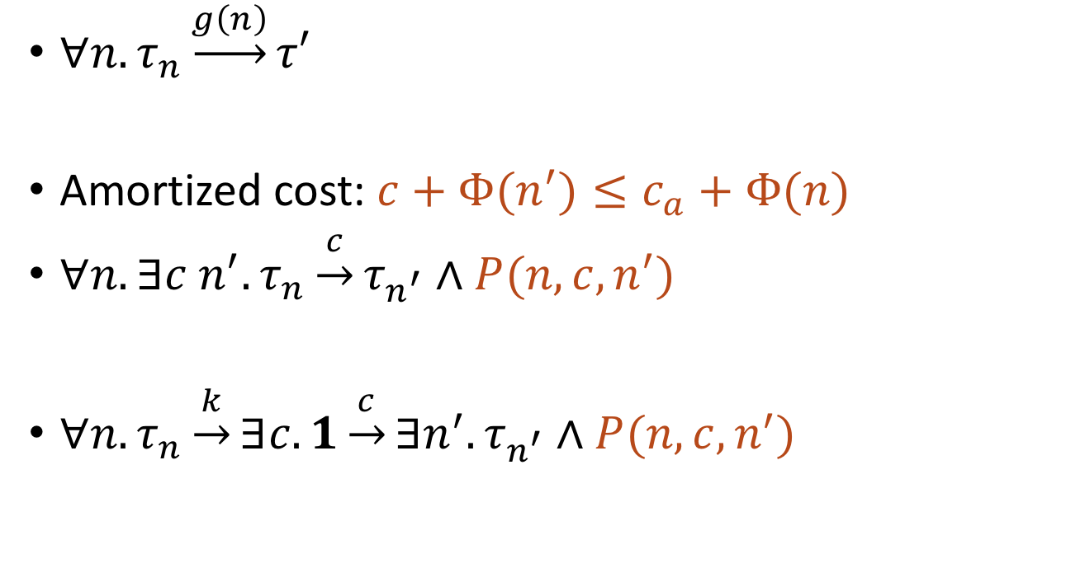
Amortized Complexity
$∀n. τ_{n}\underset{→}{g\left(n\right)}τ′$
Amortized cost: $c+Φ(n^{′})≤c_{a}+Φ(n)$
$∀n. ∃c n^{′}. τ_{n}\underset{→}{c}τ_{n^{′}}∧P(n,c,n^{′})$
$∀n. τ_{n}\underset{→}{k}∃c.1\underset{→}{c}∃n^{′}. τ_{n^{′}}∧P(n,c,n^{′})$

