Slide 1
The game of checkers!
Amadeus Java Academy
By Tatyana Borisova

Slide 2
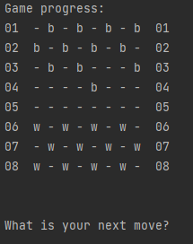
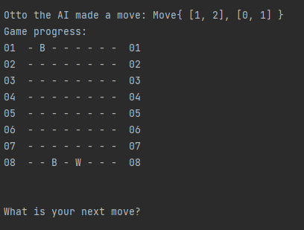
Graduation project
Checkers game for lonely fellas or competitive AI enthusiasts!
AI vs console player, implemented with the help of MINIMAX algorithm with alpha-beta pruning, a few difficulty levels
The game can start from a given state or we can start a new game with the initial board state

Slide 3
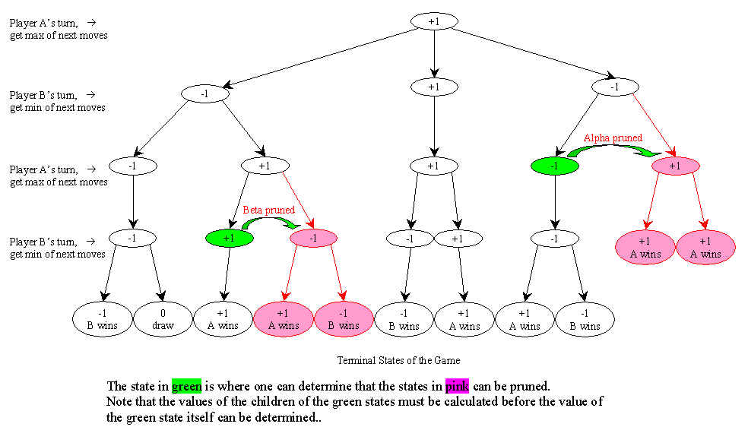

Slide 4
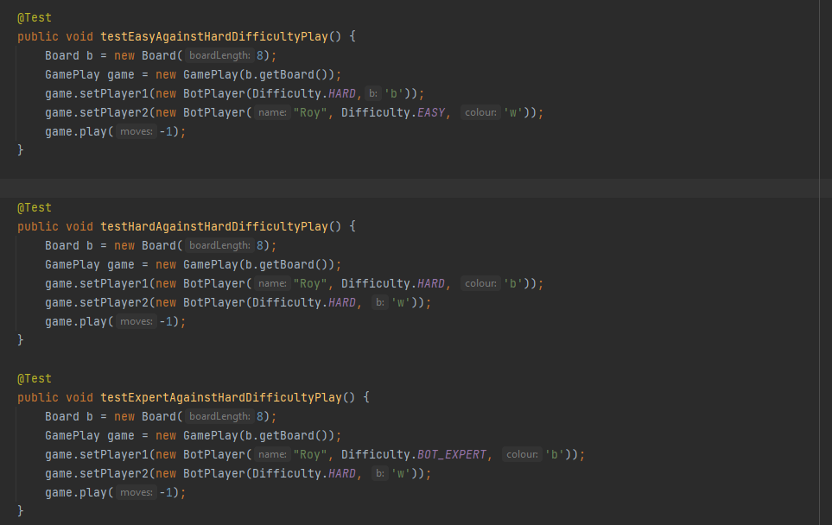
Showing functionality by evoking the play() tests

Slide 5
REST API
Currently available Controller logic:
Game creation via POST request
Access to all existing games and contestants
Ability to search for existing games(based on their initial id), contestants(by id) and the current state of a particular game.
Deletion of a game
Ability to make a move in a selected game

Slide 6
Architecture of the application
Client
The client in our case will be postman!
Controllers, Dtos
Services
Entities, Repos
Presentation (API)
Business Logic
Data Access
DB

Slide 7
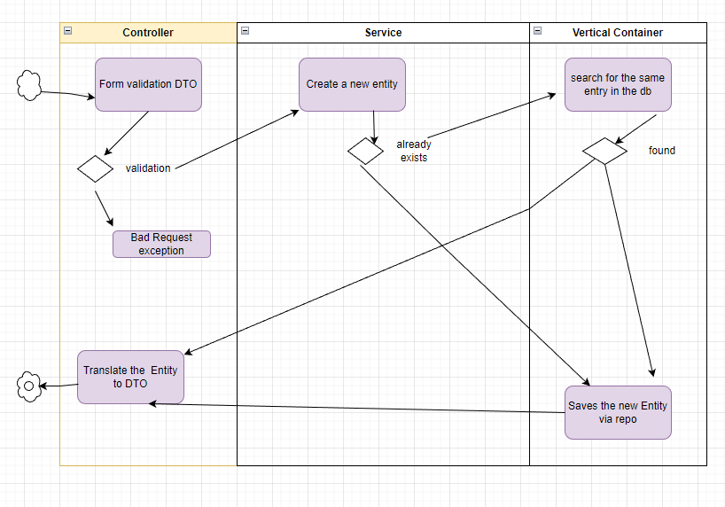

Slide 8
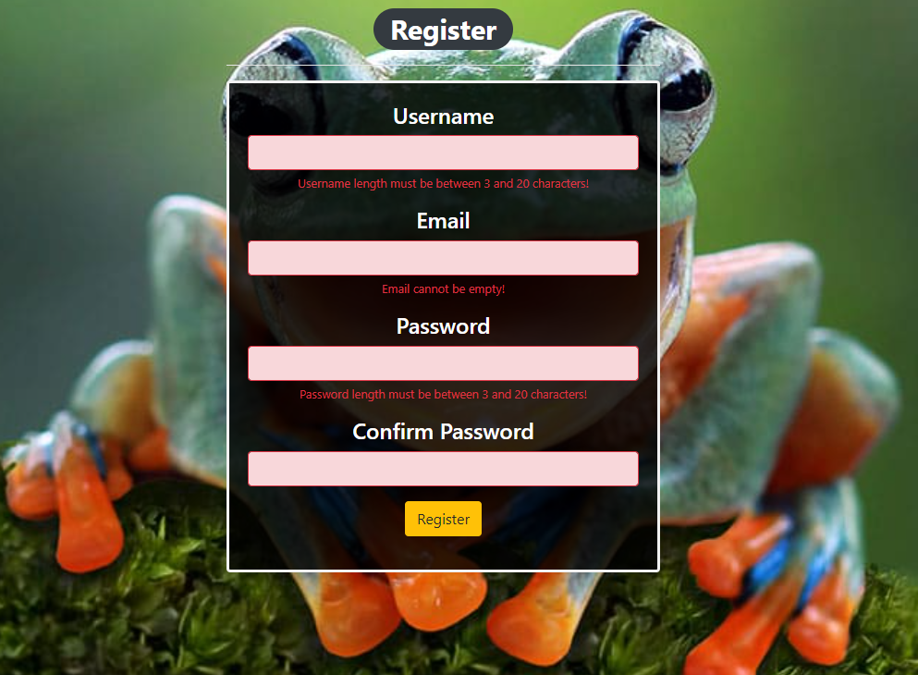
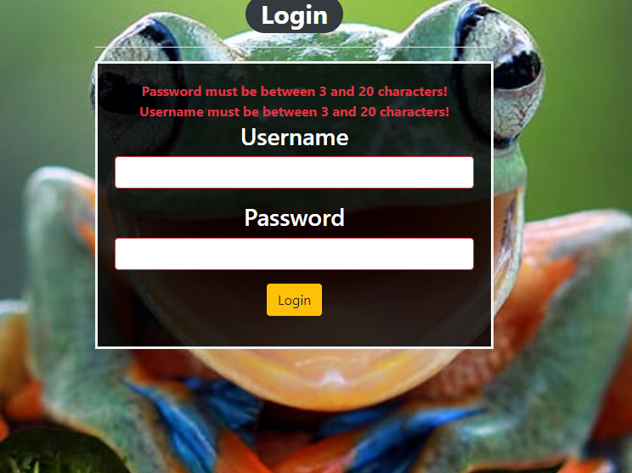
Registration and Login forms

Slide 9
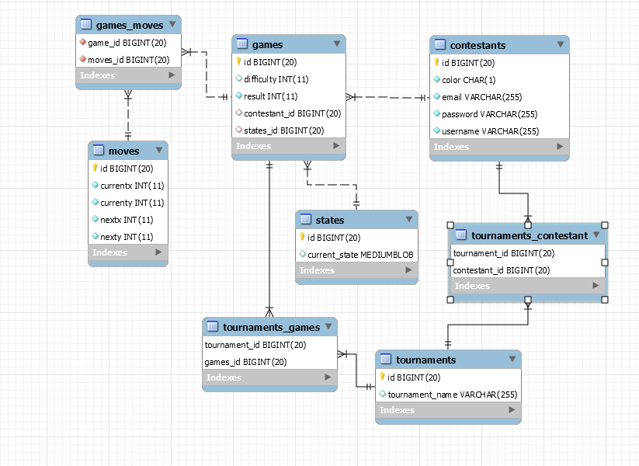
Database
MySQL db via Hibernate JPA
Every time the table is dropped:
“ALTER TABLE states MODIFY current_state LONGBLOB;”
since the data type of `current_state`
is a matrix of Piece (Piece[][]),
which is represented by blob and
It’s way too small for the input

