Slide 1

TDD
Test Driven Development

Slide 2
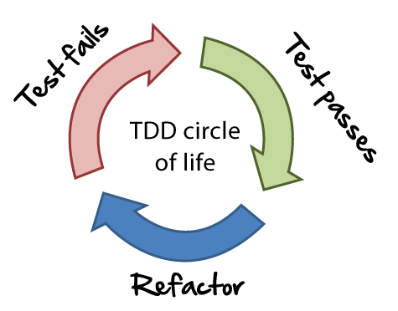
What is TDD

Slide 3
Why TDD?
Improve structure
Break down problems better
Keeps your code simple and clean
More reusable code
Improves debugging – error messages
Easy to understand for another dev

Slide 4

Fizzbuzz! Example
Click here for the example

Slide 5

Questions?

Slide 6
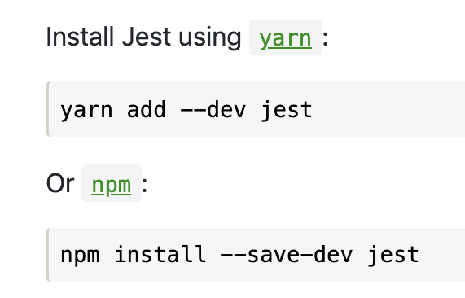
Exercise – try Fizzbuzz! yourselves

Slide 7
Retro and further knowledge
TDD allows for testing in isolation – Mocking, Stubbing, spying, dependency injection, encapsulation
XP principles
SOLID
TDD is part of BDD – multiple unit tests to pass a feature test

Slide 8
Extra challenge – A simple backend project to practice TDD
Click here for training project

