Slide 1
Green Fleet Dashboard Design

Slide 2
External Data Sources
Socrata
Fleet Data
EPA
Fuel Data
State Conroller
Data
Dept of Finance
Data
Flume Agent
Consume external data
Enriched
Data
Google like search capability
Kafka
Solr Search
Green Fleet Dashboard Portal
SQL Functionality
Spark
Impala
Data Parsing
Data enrichment
Data Monitoring
HDFS
HBase
Parquet
Long term big data storage
Greenfleet Dashboard Solution

Slide 3
Applicable Data Schemas
Fleet Data
Fuel used
Total miles
VIN
Agency
Report year
Postal code
EPA Data
Model
Cyl
Drive
Comb MPG
Air pollution Score
Greenhouse gas score
SmartWay
Comb Co2
Employee Headcount Data
Full Time Employees Count
Department

Slide 4
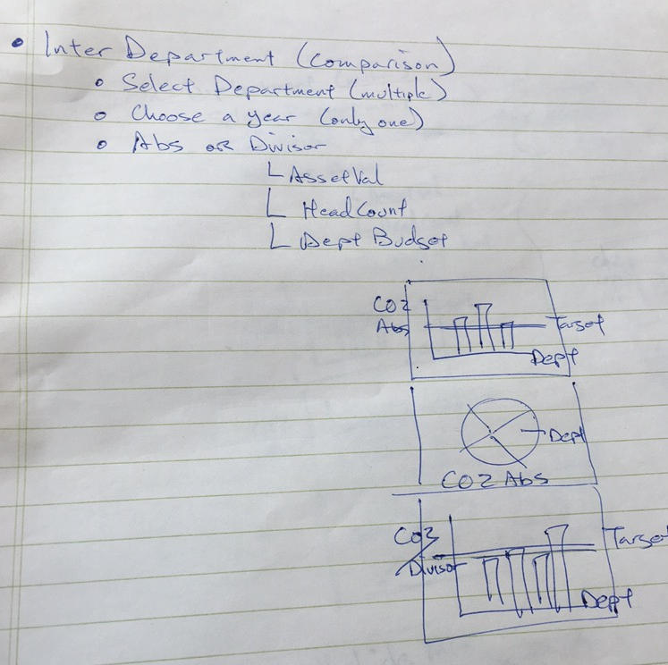
Inter-Department UI Sketches and Brain Storm

Slide 5
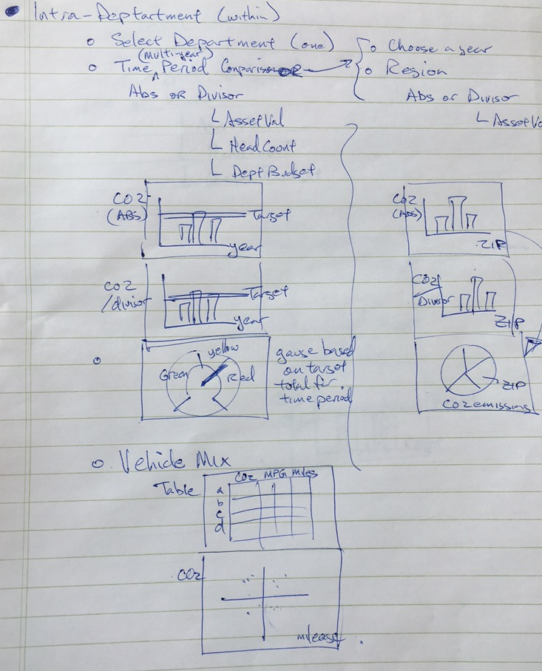
Intra-Department UI Sketches and Brain Storm

