Slide 1
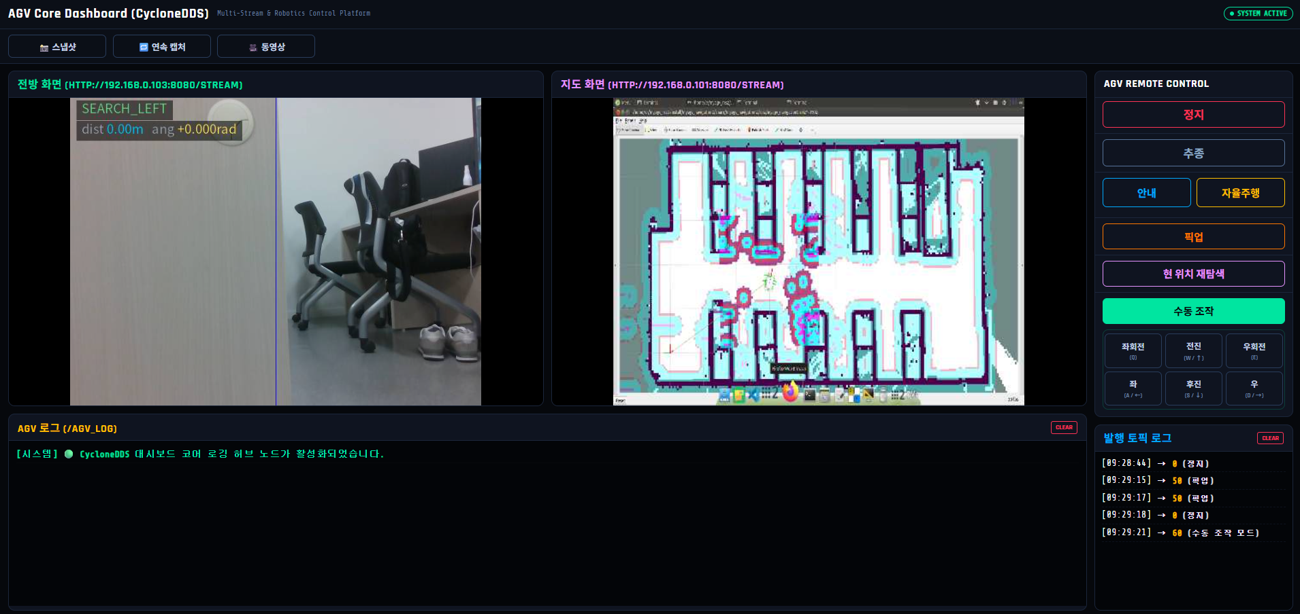
AGV Core Dashboard
CAMERA
MAP
Dashboard Overlay
Dashboard Overlay
LOG
REMOTE
Dashboard Overlay
Dashboard Overlay

